Slide 1
User Interface Components with Swing

Slide 2
The Model-View-Controller Design Pattern

Slide 3
Model-View-Controller Design Pattern
To better understand Swing UI components, it is a good idea to review how Swing works at an architectural level.
All Swing components (e.g. buttons, check boxes, text fields, etc) have three basic characteristics:
  Its contents
    such as the state of a button (pushed in or not), the text in a text field
  Its visual appearance
    color, size, etc.
  Its behavior
    reaction to events
To implement these characteristics, Swing uses a well-known design pattern - the Model-View-Controller patter.
  This pattern goes back to the principles of OO design - don’t make one object responsible for too much.

Slide 4
Model-View-Controller Design Pattern
The MVC design pattern:
  The model
    stores the contents
  The view
    displays the contents
  The controller
    handles user input
The advantage of this pattern is that a model can have multiple views, each showing a different aspect of the full contents
  For example, an html editor can offer two simultaneous views of the same contents. It can show the WYSIWYG view or the raw tag view depending on what the user wishes to see.

Slide 5
Model-View-Controller Design Pattern
The controller handles the user input events such as mouse clicks and keystrokes. It then decides whether to translate these events into changes in the model or the view.
  e.g. a keystroke in a text field causes the controller to call the “insert character” command in the model. The model then tells the view to update itself.
  e.g. likewise, if the user presses a cursor, the controller tells the view to scroll. The model is never affected.
The design of Swing components adopts the MVC architecture with wrapper classes such as JButton or JTextField that store the model and the view.

Slide 6
An introduction to layout managers

Slide 7
Layout managers
We have used the add() method to add a component to a container. (For example, adding a JButton to a JPanel.)
Exactly where the component is placed in the container is controlled by the container's layout manager.
You can set a container's layout manager with the setLayout(LayoutManager m) method.
Java includes a number of layout managers.
A layout manager recomputes its layout and repositions the components in a container whenever the container changes shape.

Slide 8
Layout Management
FlowLayout manager
  The default layout manager for a panel is the flow layout manager.
  The flow layout manager lines the components horizontally until there is no more room and then starts another row.
  You can choose how you want to arrange components in this row. The default is to center the components but you can align them to the left or right by specifying LEFT or RIGHT in the constructor:
    e.g. setLayout(new FlowLayout(FlowLayout.LEFT));
  The FlowLayout(int align, int hgap, int vgap) constructor allows you to specify the horizontal and vertical gaps (in pixels) which will be left between components.

Slide 9
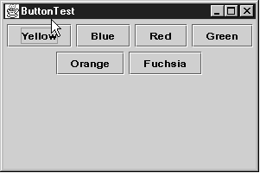
Flow layout
When you add six buttons to the panel, they are centered in a row, and when there isn't any more room, a new row is started.

Slide 10
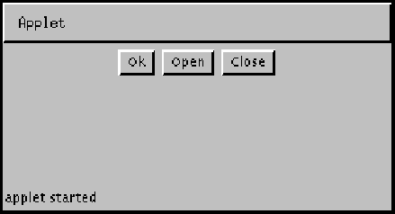
FlowLayout
Simplest
Arranges components
  Left to right
  Top to Bottom
Alignment options
  RIGHT
  LEFT
  CENTER
  LEADING
  TRAILING

Slide 11
BoxLayout
Aligns components in a line
  Horizontally or vertically
Can install a box layout into a JComponent
  comp.setLayout(new BoxLayout(comp, BoxLayout.Y_AXIS)
Or, create a “Box” Component
  Box.createVerticalBox()
  Box.createHorizontalBox()
  Box.createVerticalStruts to create spacers between boxes
See API documentation!

Slide 12
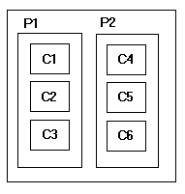
BoxLayout Example

Slide 13
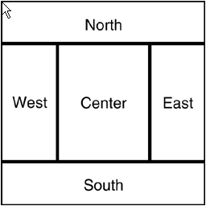
Border Layout
This is the default layout manager for the content pane.
It has 5 sections - North, South, East, West, and Center.
class MyPanel extends JPanel {
setLayout(new BorderLayout());
…
add (yellowButton, BorderLayout.SOUTH);
}
The edge components are laid out first and the remaining available space is occupied by the center.
If you don’t specify NORTH, SOUTH, EAST, WEST, or CENTER, CENTER is assumed.
When the container is resized, the thickness of the edge components is unchanged, but the center component changes its size

Slide 14
Border Layout
BorderLayout grows components to fill the available space. (This is why, when you add() a JPanel to a JFrame, it fills the frame.)

Slide 15
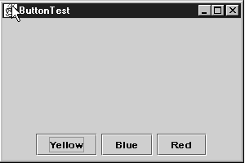
Using Panels with BorderLayout
The BorderLayout is not very useful by itself in the content pane.
It should be used with panels that act as small containers. You can have several panels in the content pane.
Container contentPane = getContentPane();
JPanel panel = new JPanel();
panel.add(yellowButton);
panel.add(blueButton);
panel.add(redButton);
contentPane.add(panel, BorderLayout.SOUTH);
All containers have a setLayout method to set the layout manager to something other than the default for the container.

Slide 16
Grid Layout
Arranges all components in rows and columns like a spreadsheet
Cells are always the same size
    sfdsfd
example
panel.setLayout(new GridLayout(5, 4));
You can also specify the veritical and horizontal gaps between the components in pixels
panel.setLayout(new GridLayout(5, 4, 3, 3)

Slide 17
Using panels for layout
None of the simple layout managers is completely satisfactory for positioning components in a container.
You can use nested panels, each with a different layout manager, to achieve some measure of control over layout.
More control is possible with the GridBagLayout (covered later).

Slide 18
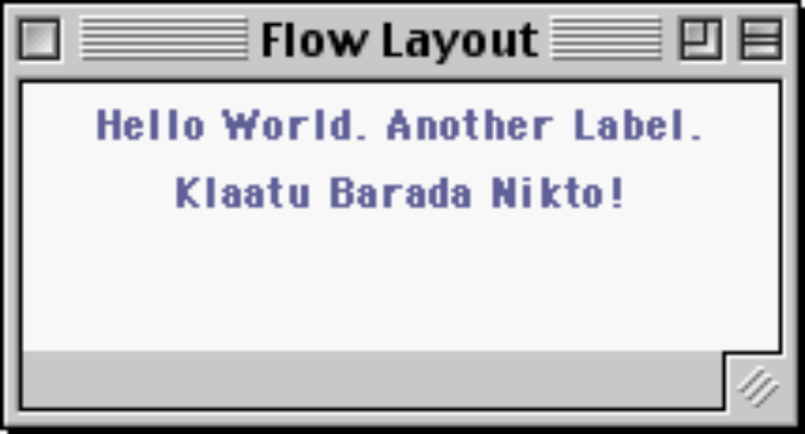
Layout Example

Slide 19
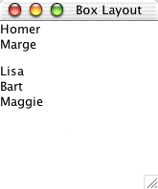
Layout Example

Slide 20
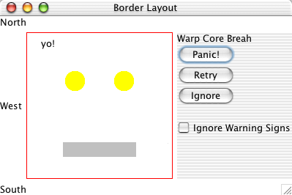
Layout Example

Slide 21

Layout Example
// Layouts.java
/* Demonstrates some basic layouts. */
import java.awt.*;
import javax.swing.*;
import java.util.*;
import java.awt.event.*;
public class Layouts
{
public static void main(String[] args)
{
// ----
// 1. Flow Layout
// Flow layout arranges Left-right top-bottom, like text
JFrame frame1 = new JFrame("Flow Layout");
JComponent content = (JComponent) frame1.getContentPane();
content.setLayout(new FlowLayout());
// Background color is a property of all components --
// here I it to white, so it looks better in the handouts
content.setBackground(Color.white);
// Use add() to install components
content.add(new JLabel("Hello World."));
content.add(new JLabel("Another Label."));
content.add(new JLabel("Klaatu Barada Nikto!"));
// Force the frame to size/layout its components
frame1.pack(); frame1.setVisible(true);
// ----
// 2. Box Layout
JFrame frame2 = new JFrame("Box Layout");
JComponent content2 = (JComponent)frame2.getContentPane();
content2.setBackground(Color.white);

Slide 22
// The Box layout make a vertical arrangement
content2.setLayout(new BoxLayout(content2, BoxLayout.Y_AXIS));
/*
// Could do it this way instead.
Box box = Box.createVerticalBox();
frame2.setContentPane(box);
// However, the setLayout() method above is preferred
// because Box is not a JComponent (as of Java 1.2)
*/
// add a few components
content2.add(new JLabel("Homer"));
content2.add(new JLabel("Marge"));
// add a little spacer
content2.add(Box.createVerticalStrut(12));
content2.add(new JLabel("Lisa"));
content2.add(new JLabel("Bart"));
content2.add(new JLabel("Maggie"));
frame2.pack();
frame2.setVisible(true);
// ----
// 3. Border Layout + nested box panel
JFrame frame3 = new JFrame("Border Layout");
JComponent content3 = (JComponent)frame3.getContentPane();
content3.setBackground(Color.white);
// Border layout
// (the 6's are for inter-component spacing)
content3.setLayout(new BorderLayout(6, 6));
// Add labels around the edge
content3.add(new JLabel("North"), BorderLayout.NORTH);
content3.add(new JLabel("West"), BorderLayout.WEST);
content3.add(new JLabel("South"), BorderLayout.SOUTH);

Slide 23
// Add a MyComponent in the center
content3.add(new MyComponent(200, 200), BorderLayout.CENTER);
// Create a little panel (box layout)
// with some labels. Nest it into the EAST
// (we'll use this strategy to arrange buttons
// around our main content)
JPanel panel = new JPanel();
panel.setLayout(new BoxLayout(panel, BoxLayout.Y_AXIS));
panel.add(new JLabel("Klaatu"));
panel.add(new JLabel("Barada"));
panel.add(new JLabel("Nikto"));
panel.add(new JButton("Retry"));
panel.add(new JButton("Ignore"));
content3.add(panel, BorderLayout.EAST);
frame3.pack();
frame3.setVisible(true);
}
}

Slide 24
Text input

Slide 25
Text input
Swing supplies several components for text input:
  JTextField
  JPasswordField
  JFormattedTextField
  JTextArea
All of Java's text fields are designed around the Model-View-Controller pattern:
  Text fields are based on an underlying Document object; the field is just a view of the Document.
  Use a text field's getDocument() method to retrieve the underlying Document object.

Slide 26
Text fields
Use JTextField to accept one line of text
Add a text field to a container just like a button; call the JTextField constructor, supplying the default contents of the field and its approximate width in characters:
  JPanel panel = new JPanel();
  JTextField tfield = new
  JTextField("default contents",20);
  panel.add(tfield);
The field width supplied in the constructor is just a hint to the layout manager:
  The field will be shorter if required by the layout.
  The length of text in the field isn't limited by its width.

Slide 27
Text fields (continued)
You can use the setText method to change the text later.
  textField.setText(“Hello”);
You can use the getText method to get the text from the field. Use the trim method to get rid of leading / trailing spaces.
  String text = textField.getText().trim()
Use setFont() to change a field's font.

Slide 28
Text fields (continued)
To perform some action when a text field changes, you must register a DocumentListener with the text field's underlying document:
  DocumentListener myListener = new
  MyTextListener();
  JTextField tfield = new JTextField(20);
  tfield.getDocument().
  addDocumentListener(myListener);
Instead of listening to document events, you can also add an action event listener to a text field.
  Remember, though, the action listener is notified only when the user hits enter

Slide 29
Text fields (continued)
Each change to the field calls one of the following methods of the document listener:
  void insertUpdate(DocumentEvent e)
  void removeUpdate(DocumentEvent e)
  void changedUpdate(DocumentEvent e)
Methods insertUpdate() and removeUpdate() are called whenever characters are added/removed.
Method changedUpdate() is never called for text fields or text areas, only for more complex field types.
There is no adapter class for DocumentListener; you must implement all three methods when you subclass it.

Slide 30
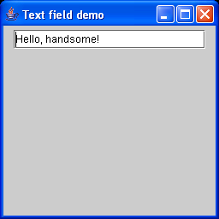
Demo of text field with document listener.
import java.awt.*;
import java.awt.event.*;
import javax.swing.*;
import javax.swing.event.*; // for DocumentListener
public class Text2 extends JFrame
{
public static void main(String[] argv)
{
Text2 t = new Text2();
t.setDefaultCloseOperation(JFrame.EXIT_ON_CLOSE);
t.show();
}
public Text2()
{
Toolkit kit = Toolkit.getDefaultToolkit();
Dimension ss = kit.getScreenSize();
setSize(ss.width/4,ss.height/3);
setLocation(ss.width/4,ss.height/4);
setTitle("Text field demo");
JPanel p = new JPanel();
Container cp = getContentPane();
cp.add(p);
JTextField f = new JTextField("Hello, handsome!",20);
p.add(f);
// Attach a simple document listener.
f.getDocument().addDocumentListener(new SillyListener());
}
}
class SillyListener implements DocumentListener
{
public void insertUpdate(DocumentEvent e)
{
System.out.println(e);
}
public void removeUpdate(DocumentEvent e)
{
System.out.println(e);
}
public void changedUpdate(DocumentEvent e)
{
// Shouldn't be called.
System.out.println(e);
}
}

Slide 31
Password fields
Java provides a special kind of text field, the password field.
  JPasswordField pfield = new JPasswordField(text,columns);
  pfield.setEchoChar('*');
  char[] pwd = pfield.getPassword();
For security reasons, the password is returned in a character array, not a String object.
  A String is immutable and will hang around until the JVM's next garbage collection sweep. You are encouraged to overwrite the elements of the array as soon as possible.

Slide 32
Formatted Input Fields
The JFormattedTextField class provides a rich (but complicated) mechanism for formatting and validating input fields:
  Use the JFormattedTextField
    JFormattedTextField intField = new
    JFormattedTextField(NumberFormat.getIntegerInstance());
  You can set the default value and the number of columns by using these methods:
    intField.setValue(new Integer(100));
    intField.setColumns(6);
  You can use the getValue method to read the value the user supplied. You need to cast the value to a Number object though.
  Number value = (Number)intField.getValue();
  int v = value.intValue();

Slide 33
Input validation
When a JFormattedTextField loses focus, its formatter inspects the text.
You can call the isEditValid() method to see whether a JFormattedTextField's text is valid.
  If the formatter knows how to convert the text string to an object, the text is valid. Otherwise it is invalid.
The 'value' of the field is determined from its text and is available via getValue(). It depends on the field's lost focus behavior (set with setLostFocusBehavior()).

Slide 34
Input validation (continued)
The possible lost focus behaviors are:
  COMMIT_OR_REVERT -- If the text is valid, change the field's value; otherwise, revert the value to the last good value. This is the default.
  COMMIT -- If the text is valid, change the value. If the text is invalid, leave it as is, but don't change the value. The programmer must fix one or the other.
  REVERT -- Ignore the edit, replace with the old value (not very useful).
  PERSIST -- Whether the text is valid or not, change neither the text nor the value. The programmer will call isEditValid() and then either call commitEdit() to commit the user's changes or setText() or setValue() to roll them back.

Slide 35
Text Input - Verifiers
If a verifier is used, the moment a text field loses focus, the verifier is queried.
  If he verifier reports the contents to be invalid, the text field immediately regains focus.
  The user is forced to fix the contents before supplying other inputs.
For example, if the formatter is checking for numerics and the user enters an alpha character, the verifier will force the user to enter only numerics before moving on.

Slide 36
Text Input - Verifiers
Here is an example of a verifier:
class FormattedTextFieldVerifier extends InputVerifier {
public boolean verify (JComponent component) {
JFormattedTextField field = (JFormattedTextField)component;
return field.isEditValid();
}
}
  Note, the verifier class must extend the InputVerifier class and override the verify method.
Then, you attach it to any JFormattedTextField:
intField.setInputVerifier(new FormattedTextFieldVerifier());

Slide 37
Other numeric formatters
The NumberFormat class provides other useful formatters:
  getNumberInstance()
  getCurrencyInstance()
  getPercentInstance()
  that provide formatters for floating-point numbers, currency values, and percentages
For example,
  JFormattedTextField currencyField = new JFormattedTextField(NumberFormat.getCurrencyInstance());

Slide 38
Date and time formatting
Dates and times can be formatted using the DateFormat class:
  getDateInstance()
  getTimeInstance()
  getDateTimeInstance()
Arguments to the constructors can control formatting, as in:
  JFormattedTextField dateField =
  new JFormattedTextField(
  DateFormat.getDateInstance(DateFormat.MEDIUM));
  This field edits a date in the default or "medium" format such as Feb 24, 2002
  You can choose a "short" format such as 2/24/02 by calling
DateFormat.getDateInstance(DateFormat.SHORT)
Call setLenient(false) to prevent a date/time formatter from trying too hard to fix bad inputs.

Slide 39
The default formatter
DefaultFormatter can format a field for any class with a String constructor and a toString() method:
  DefaultFormatter formatter =
  new DefaultFormatter();
  formatter.setOverwriteMode(false);
  JFormattedTextField url =
  new JFormattedTextField(formatter);
  url.setValue(new URL("http://ynu.edu.cn");
  use the DefaultFormatter to format URL objects.
  The formatter calls toString on the field value to initialize the field text.
  When the field loses focus, the formatter constructs a new object of the same class as the current value, using the constructor with a String parameter

Slide 40
Mask formatter
MaskFormatter allows fixed-size patterns with embedded characters (like a US telephone number):
  MaskFormatter formatter = new MaskFormatter("###-##-####");
  formatter.setPlaceholderCharacter('0');
  JFormattedTextField ssnField = new JFormattedTextField(formatter);
You can restrict the characters that can be typed into the field by calling setValidCharacters or setInvalidCharacters
  MaskFormatter formatter = new MaskFormatter("U*");
  formatter.setValidCharacters("ABCDF+- ");

Slide 41
MaskFormatter symbols
# - A digit
? - A letter
U - A letter, converted to uppercase
L - A letter, converted to lowercase
A - A letter or digit
H - A hexadecimal digit [0-9A-Fa-f]
* - Any character
‘ - Escape character to include a symbol in the pattern

Slide 42
Custom formatters
Writing a custom formatter is straightforward:
  Extend DefaultFormatter.
  Override two methods:
    String valueToString(Object value);
    Object stringToValue(String string);
  Throw ParseException if the text in the String isn't correct.

Slide 43
Example of using Custom formatters
Consider 4-byte IP addresses such as
  222.19.221.20
JFormattedTextField ipField = new JFormattedTextField(new IPAddressFormatter());
ipField.setValue(new byte[] { (byte)222, 19, 221, 20 });

Slide 44
JFormattedTextField ipField = new JFormattedTextField(new IPAddressFormatter());
ipField.setValue(new byte[] { (byte)222, 19, 221, 20 });
/**
A formatter for 4-byte IP addresses of the form a.b.c.d
*/
class IPAddressFormatter extends DefaultFormatter
{
public String valueToString(Object value)
throws ParseException
{
if (!(value instanceof byte[]))
throw new ParseException("Not a byte[]", 0);
byte[] a = (byte[])value;
if (a.length != 4)
throw new ParseException("Length != 4", 0);
StringBuffer buffer = new StringBuffer();
for (int i = 0; i < 4; i++)
{
int b = a[i];
if (b < 0) b += 256;
buffer.append(String.valueOf(b));
if (i < 3) buffer.append('.');
}
return buffer.toString();
}

Slide 45
public Object stringToValue(String text) throws ParseException
{
StringTokenizer tokenizer = new StringTokenizer(text, ".");
byte[] a = new byte[4];
for (int i = 0; i < 4; i++)
{
int b = 0;
try
{
b = Integer.parseInt(tokenizer.nextToken());
}
catch (NumberFormatException e)
{
throw new ParseException("Not an integer", 0);
}
if (b < 0 || b >= 256)
throw new ParseException("Byte out of range", 0);
a[i] = (byte)b;
}
return a;
}
}

Slide 46
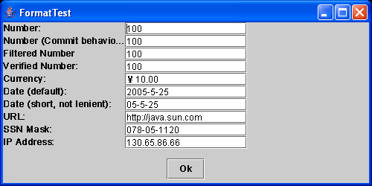
Example of using various formatted text fields
The program shows various formatted text fields in action. Click on the Ok button to retrieve the current values from the fields. (see page 356 for the code)

Slide 47
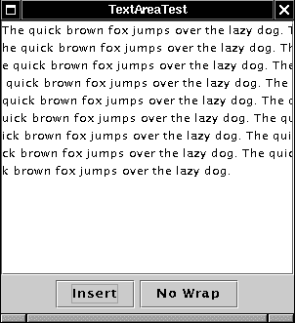
Text areas
Use the JTextArea class to create a text area where users can enter any number of lines of text, using ENTER to separate them.

Slide 48
Text areas
The JTextArea class provides for multiline input.
The constructor allows you to specify the number of rows and columns:
  JTextArea textArea = new JTextArea(8,40);
  contentPane.add(textArea);
The value of the text area is a String with embedded newline ('\n') characters.
The contents of the area can be larger than the visible area.
Turn line wrapping on or off with setLineWrap().
  textArea.setLineWrap(true); // wrap long lines
Line wrapping is "soft"; it doesn't add extra newlines to the field contents.

Slide 49
Text Areas
Example
JTextArea textArea = new JTextArea(8, 40); // 8 lines and 40 columns
textArea.setLineWrap(true); // wrap long lines
JScrollPane scrollPane = new JScrollPane(textArea); // add scroll bars
contentPane.add(scrollPane);
JTextArea only displays plain text. Use JEditorPane or JTextPane to display formatted text such as HTML or RTF.

Slide 50
Scrolling text areas
To create a scrolling text area, create a JScrollPane to hold it, then add the ScrollPane to the content pane:
  JTextArea textArea = new JTextArea(8,40);
  JScrollPane scrollPane = new JScrollPane(textArea);
  contentPane.add(scrollPane,BorderLayout.CENTER);
  textArea.append("Hello, handsome!\n");

Slide 51
Selecting and editing text
Java provides many ways to determine or change the selection in a text field or text area, including:
  JTextField f = new JTextField("bozo",20);
  JTextArea a = new JTextArea("bozo",8,40);
  f.selectAll();
  f.select(0,4);
  int n = f.getSelectionStart();
  n = f.getSelectionEnd();
  String s = f.getSelectText();
  a.replaceRange("new string",2,3);

Slide 52
Labels
Labels are components that hold text. They have no decorations (e.g. no boundries) and they do not react to user input.
You can use a label to identify components.
JLabel label = new JLabel(“Text”, JLabel.LEFT);

Slide 53
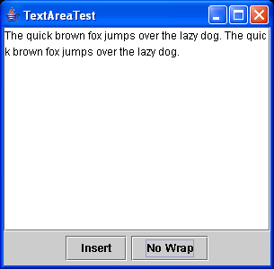
Example of using TextArea
This program simply lets you edit text in a text area.
Click on "Insert" to insert a sentence at the end of the text.
Click the second button to turn line-wrapping on and off.

Slide 54
TextAreaTest.java
import java.awt.*;
import java.awt.event.*;
import javax.swing.*;
public class TextAreaTest
{
public static void main(String[] args)
{
TextAreaFrame frame = new TextAreaFrame();
frame.setDefaultCloseOperation(JFrame.EXIT_ON_CLOSE);
frame.show();
}
}
/**
A frame with a text area and buttons for text editing
*/
class TextAreaFrame extends JFrame
{
public TextAreaFrame()
{
setTitle("TextAreaTest");
setSize(DEFAULT_WIDTH, DEFAULT_HEIGHT);
Container contentPane = getContentPane();
buttonPanel = new JPanel();
// add button to append text into the text area
JButton insertButton = new JButton("Insert");
buttonPanel.add(insertButton);
insertButton.addActionListener(new
ActionListener()
{
public void actionPerformed(ActionEvent event)
{

Slide 55
textArea.append("The quick brown fox "
+ "jumps over the lazy dog. ");
}
});
// add button to turn line wrapping on and off
wrapButton = new JButton("Wrap");
buttonPanel.add(wrapButton);
wrapButton.addActionListener(new
ActionListener()
{
public void actionPerformed(ActionEvent evt)
{
boolean wrap = !textArea.getLineWrap();
textArea.setLineWrap(wrap);
scrollPane.validate();
wrapButton.setText(wrap ? "No Wrap" : "Wrap");
}
});
contentPane.add(buttonPanel, BorderLayout.SOUTH);
// add a text area with scroll bars
textArea = new JTextArea(8, 40);
scrollPane = new JScrollPane(textArea);
contentPane.add(scrollPane, BorderLayout.CENTER);
}
public static final int DEFAULT_WIDTH = 300;
public static final int DEFAULT_HEIGHT = 300;
private JTextArea textArea;
private JScrollPane scrollPane;
private JPanel buttonPanel;
private JButton wrapButton;
}

Slide 56
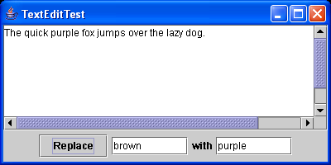
Example of Selecting and Editing Text

Slide 57
TextEditTest.java
import java.awt.*;
import java.awt.event.*;
import javax.swing.*;
public class TextEditTest
{
public static void main(String[] args)
{
TextEditFrame frame = new TextEditFrame();
frame.setDefaultCloseOperation(JFrame.EXIT_ON_CLOSE);
frame.show();
}
}
/**
A frame with a text area and components for search/replace.
*/
class TextEditFrame extends JFrame
{
public TextEditFrame()
{
setTitle("TextEditTest");
setSize(DEFAULT_WIDTH, DEFAULT_HEIGHT);
Container contentPane = getContentPane();
JPanel panel = new JPanel();
// add button, text fields and labels
JButton replaceButton = new JButton("Replace");
panel.add(replaceButton);
replaceButton.addActionListener(new ReplaceAction());
from = new JTextField("brown", 8);
panel.add(from);
panel.add(new JLabel("with"));

Slide 58
TextEditTest.java
to = new JTextField("purple", 8);
panel.add(to);
contentPane.add(panel, BorderLayout.SOUTH);
// add text area with scroll bars
textArea = new JTextArea(8, 40);
textArea.setText
("The quick brown fox jumps over the lazy dog.");
JScrollPane scrollPane = new JScrollPane(textArea);
contentPane.add(scrollPane, BorderLayout.CENTER);
}
public static final int DEFAULT_WIDTH = 400;
public static final int DEFAULT_HEIGHT = 200;
private JTextArea textArea;
private JTextField from;
private JTextField to;
/**
The action listener for the replace button.
*/
private class ReplaceAction implements ActionListener
{
public void actionPerformed(ActionEvent event)
{
String f = from.getText();
int n = textArea.getText().indexOf(f);
if (n >= 0 && f.length() > 0)
textArea.replaceRange(to.getText(), n,
n + f.length());
}
}
}

Slide 59
Menus

Slide 60
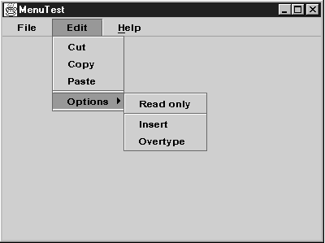
Menus
A menu bar on top of the window contains the names of the pull-down menus. Clicking on a name opens the menu containing menu items and submenus.

Slide 61
Menus
As you might expect, Swing supports pull-down and pop-up menus.
A menu bar can be added to a frame:
  JMenuBar mbar = new JMenuBar();
  myFrame.setJMenuBar(mbar);
Menus can be added to a menu bar:
  JMenu fileMenu = new JMenu("File");
  mbar.add(fileMenu);
Items and separators can be added to a menu:
  JMenuItem saveItem = new JMenuItem("Save");
  fileMenu.add(saveItem);
  fileMenu.addSeparator();

Slide 62
Menus (continued)
A submenu is just a menu that is added to another menu instead of to a menubar:
  JMenu optionsMenu = new JMenu("Options...");
  JMenuItem option2 = new JMenuItem("Option 1");
  JMenuItem option1 = new JMenuItem("Option 2");
  optionsMenu.add(option1);
  optionsMenu.add(option2);
  fileMenu.add(optionsMenu);
A convenient method JMenu.add(String s) that adds a menu item to the end of a menu
  editMenu.add("Paste");

Slide 63
Menus (continued)
When a menu item is selected, it triggers an action event.
Install an action listener for each menu item...
  ActionListener saveListener = …
  saveItem.addActionListener(saveListener);
...or create a menu item from an Action object:
  JMenuItem saveItem = new JMenuItem(saveAction);
  fileMenu.add(saveItem);

Slide 64
Menus (continued)
Action exitAction = new
AbstractAction("Exit") // menu item text goes here
{
public void actionPerformed(ActionEvent event)
{
// action code goes here
System.exit(0);
}
};
You can then add the action to the menu:
  JMenuItem exitItem = fileMenu.add(exitAction);
Or
  JMenuItem exitItem = new JMenuItem(exitAction);
fileMenu.add(exitItem);

Slide 65
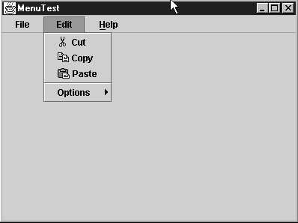
Icons in Menu Items
A menu item is a subclass of an abstract button, and can display both a text label and an icon.
Specify an icon in the menu item's constructor…
  JMenuItem cutItem = new JMenuItem(“Cut", new ImageIcon(“cut.gif"));
  cutItem.setHorizontalTextPosition(SwingConstants.LEFT); // this place the icon right to the text,
…or use the setIcon() method that JMenuItem inherits from AbstractButton.

Slide 66
Use icon in action
If you create a menu item from an Action, the menu will display the icon associated with the Action.
  cutAction.putValue(Action.SMALL_ICON, new ImageIcon("cut.gif"));
  the Action.NAME value is the text of the menu item,
  the Action.SMALL_ICON value is the icon.
Alternatively, you can set the icon in the AbstractAction constructor
  cutAction = new
  AbstractAction("Cut", new ImageIcon("cut.gif"))
  {
  public void actionPerformed(ActionEvent event)
  {
  // action code goes here
  }
  };

Slide 67
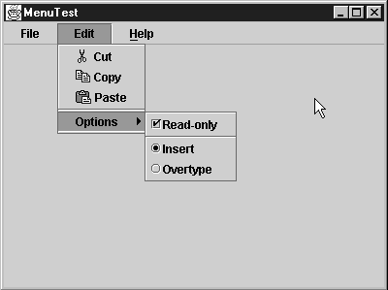
Check Box and Radio Button Menu Items
Check box and radio button menu items display a check box or radio button

Slide 68
Check Box and Radio Button Menu Items
Create a check box menu item
  JCheckBoxMenuItem readonlyItem = new JCheckBoxMenuItem("Read-only"); optionsMenu.add(readonlyItem);
Create radio menu items
  ButtonGroup group = new ButtonGroup();
  JRadioButtonMenuItem insertItem
  = new JRadioButtonMenuItem("Insert");
  insertItem.setSelected(true);
  JRadioButtonMenuItem overtypeItem
  = new JRadioButtonMenuItem("Overtype");
  group.add(insertItem);
  group.add(overtypeItem);
  optionsMenu.add(insertItem);
  optionsMenu.add(overtypeItem);

Slide 69
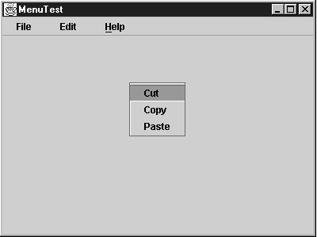
Popup menus
A pop-up menu is a menu that is not attached to a menu bar but that floats somewhere

Slide 70
Popup menus
Popup menus are created like regular menus, but with no title:
  JPopupMenu pop = new JPopupMenu();
  JMenuItem item1 = new JMenuItem("bozo");
  pop.add(item1);
  item1.addActionListener(new ClownListener());
To display a popup menu, call the show() method, giving a parent component and the coordinates for the menu:
  pop.show(bozoPanel,x,y);
Typically, you'll get the coordinates from a mouse event listener.

Slide 71
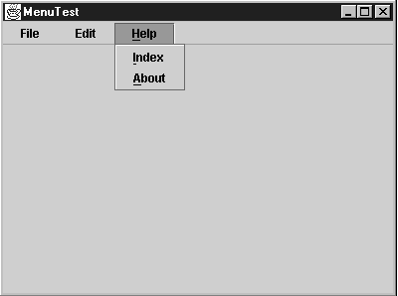
Keyboard Mnemonics
You can specify keyboard mnemonics for menu items by specifying a mnemonic letter in the menu item constructor
  JMenuItem cutItem = new JMenuItem("Cut", 'T');

Slide 72
Keyboard Mnemonics
Use an Action object, you can add the mnemonic as the value of the Action.MNEMONIC_KEY key
  cutAction.putValue(Action.MNEMONIC_KEY, new Integer('T'));
Attach a mnemonic to a menu, call the setMnemonic method:
  JMenu helpMenu = new JMenu("Help"); helpMenu.setMnemonic('H');

Slide 73
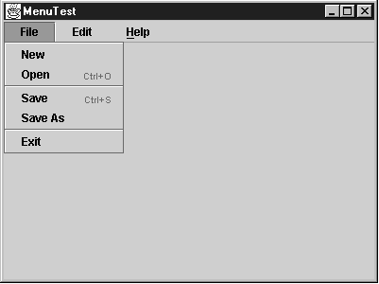
Keyboard Accelerators
Accelerators are keyboard shortcuts that let you select menu items without ever opening a menu.
  For example, CTRL+O and CTRL+S
You can use the setAccelerator method to attach an accelerator key to a menu item
  openItem.setAccelerator(KeyStroke.getKeyStroke(KeyEvent.VK_O, InputEvent.CTRL_MASK));

Slide 74
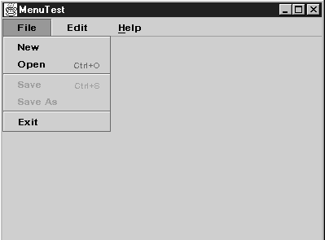
Enabling and Disabling Menu Items
It is better to deactivate the menu items that lead to temporarily inappropriate commands
To enable or disable a menu item, use the setEnabled method:
  saveItem.setEnabled(false);

Slide 75
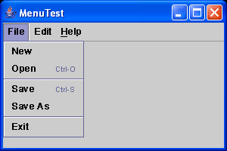
Example of menus
This example program generates a set of menus. It shows all the features that you saw in this section: nested menus, disabled menu items, check box and radio button menu items, a pop-up menu, and keyboard mnemonics and accelerators. (See page )

Slide 76
MenuTest.java
Page 408
import java.awt.*;
import java.awt.event.*;
import javax.swing.*;
import javax.swing.event.*;
public class MenuTest
{
public static void main(String[] args)
{
MenuFrame frame = new MenuFrame();
frame.setDefaultCloseOperation(JFrame.EXIT_ON_CLOSE);
frame.show();
}
}
/**
A frame with a sample menu bar.
*/
class MenuFrame extends JFrame
{
public MenuFrame()
{
setTitle("MenuTest");
setSize(DEFAULT_WIDTH, DEFAULT_HEIGHT);
JMenu fileMenu = new JMenu("File");
JMenuItem newItem = fileMenu.add(new TestAction("New"));
// demonstrate accelerators
JMenuItem openItem = fileMenu.add(new TestAction("Open"));
openItem.setAccelerator(KeyStroke.getKeyStroke(
KeyEvent.VK_O, InputEvent.CTRL_MASK));
fileMenu.addSeparator();
saveAction = new TestAction("Save");
JMenuItem saveItem = fileMenu.add(saveAction);
saveItem.setAccelerator(KeyStroke.getKeyStroke(
KeyEvent.VK_S, InputEvent.CTRL_MASK));
saveAsAction = new TestAction("Save As");
JMenuItem saveAsItem = fileMenu.add(saveAsAction);
fileMenu.addSeparator();

Slide 77
fileMenu.add(new
AbstractAction("Exit")
{
public void actionPerformed(ActionEvent event)
{
System.exit(0);
}
});
// demonstrate check box and radio button menus
readonlyItem = new JCheckBoxMenuItem("Read-only");
readonlyItem.addActionListener(new
ActionListener()
{
public void actionPerformed(ActionEvent event)
{
boolean saveOk = !readonlyItem.isSelected();
saveAction.setEnabled(saveOk);
saveAsAction.setEnabled(saveOk);
}
});
ButtonGroup group = new ButtonGroup();
JRadioButtonMenuItem insertItem
= new JRadioButtonMenuItem("Insert");
insertItem.setSelected(true);
JRadioButtonMenuItem overtypeItem
= new JRadioButtonMenuItem("Overtype");
group.add(insertItem);
group.add(overtypeItem);
// demonstrate icons
Action cutAction = new TestAction("Cut");
cutAction.putValue(Action.SMALL_ICON,
new ImageIcon("cut.gif"));
Action copyAction = new TestAction("Copy");
copyAction.putValue(Action.SMALL_ICON,
new ImageIcon("copy.gif"));
Action pasteAction = new TestAction("Paste");
pasteAction.putValue(Action.SMALL_ICON,
new ImageIcon("paste.gif"));

Slide 78
JMenu editMenu = new JMenu("Edit");
editMenu.add(cutAction);
editMenu.add(copyAction);
editMenu.add(pasteAction);
// demonstrate nested menus
JMenu optionMenu = new JMenu("Options");
optionMenu.add(readonlyItem);
optionMenu.addSeparator();
optionMenu.add(insertItem);
optionMenu.add(overtypeItem);
editMenu.addSeparator();
editMenu.add(optionMenu);
// demonstrate mnemonics
JMenu helpMenu = new JMenu("Help");
helpMenu.setMnemonic('H');
JMenuItem indexItem = new JMenuItem("Index");
indexItem.setMnemonic('I');
helpMenu.add(indexItem);
// you can also add the mnemonic key to an action
Action aboutAction = new TestAction("About");
aboutAction.putValue(Action.MNEMONIC_KEY,
new Integer('A'));
helpMenu.add(aboutAction);
// add all top-level menus to menu bar
JMenuBar menuBar = new JMenuBar();
setJMenuBar(menuBar);
menuBar.add(fileMenu);
menuBar.add(editMenu);
menuBar.add(helpMenu);
// demonstrate pop-ups
popup = new JPopupMenu();
popup.add(cutAction);
popup.add(copyAction);
popup.add(pasteAction);

Slide 79
getContentPane().addMouseListener(new
MouseAdapter()
{
public void mousePressed(MouseEvent event)
{
if (event.isPopupTrigger())
popup.show(event.getComponent(),
event.getX(), event.getY());
}
public void mouseReleased(MouseEvent event)
{
if (event.isPopupTrigger())
popup.show(event.getComponent(),
event.getX(), event.getY());
}
});
}
public static final int DEFAULT_WIDTH = 300;
public static final int DEFAULT_HEIGHT = 200;
private Action saveAction;
private Action saveAsAction;
private JCheckBoxMenuItem readonlyItem;
private JPopupMenu popup;
}
/**
A sample action that prints the action name to System.out
*/
class TestAction extends AbstractAction
{
public TestAction(String name) { super(name); }
public void actionPerformed(ActionEvent event)
{
System.out.println(getValue(Action.NAME)
+ " selected.");
}
}

Slide 80
Toolbars

Slide 81
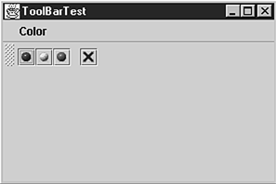
Toolbars
A tool bar is a button bar that gives quick access to the most commonly used commands

Slide 82
Toolbars
Java supports detachable toolbars.
You can add JButton or Action objects, or separators, to a toolbar:
  JToolBar bar = new JToolBar();
  bar.add(blueButton);
  bar.addSeparator();
  bar.add(blueAction);

Slide 83
Toolbars (continued)
Add a toolbar to a container just like any other component:
  contentPane.add(bar,BorderLayout.NORTH);
A toolbar can have a title (shown when it is detached):
  JToolBar bar = new JToolBar(“My tools");
You can add any kind of component, not just buttons, to a toolbar. (Combo boxes are popular.)

Slide 84
Toolbars (continued)
A toolbar can be "torn off" to make a floating palette window (unless its floatable property is set to false).
By default, toolbars are initially horizontal. To have a toolbar start out as vertical, use
  bar = new JToolBar(SwingConstants.VERTICAL) or
  bar = new JToolBar(titleString, SwingConstants.VERTICAL)
A window can have more than one toolbar, but the Java API docs recommend against it unless they are not floatable.

Slide 85
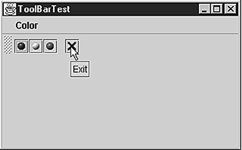
Tool tips
Any JComponent can display a tooltip when the cursor moves over it:
  exitButton.setToolTipText("Exit");
If you create a component from an Action object, the component will display the Action's SHORT_DESCRIPTION as its tooltip.
  exitAction.putValue(Action.SHORT_DESCRIPTION, "Exit");

Slide 86
Miscellaneous topics

Slide 87
Popup menus revisited
Different platforms have different methods of "popping up" a popup menu.
Swing supplies a platform-independent way to detect a request for a popup menu ---isPopupTrigger():
  public void MousePressed(MouseEvent e)
  {
  if (e.isPopupTrigger())
  myPopup.show(e.getComponent(),
  e.getX(),e.getY());
  }

Slide 88
repaint( ) and paintComponent( )
A JPanel subclass must override paintComponent().
You shouldn't call paintComponent() yourself.
paintComponent() is called whenever the GUI thread feels like redrawing, or sometime after a repaint().
Because the panel is completely redrawn whenever paintComponent() is called, your drawing code must save whatever is drawn there and redraw it.
You don't have to save and redraw Swing objects (like buttons) because you add() them to the panel, and the layout manager keeps track and redraws them.
You can repaint() any Swing object, not just a JPanel.

Slide 89
validate( )
If you add a component to a container (e.g., add a JButton to a JPanel), you must call validate() on the container.
validate() notifies the container that it should recompute its layout.

Slide 90
Ant
Ant is a Java-based build system:
  Similar to make.
  From the Apache Software Foundation (www.apache.org).
  XML syntax.
  Many predefined tasks, such as:
    javac
    jar
    ftp
    csc -- to compile C#!
    mkdir
  Users can create new Ant tasks.
  Instead of make's Makefile, Ant uses build.xml.

Slide 91
Simple build.xml file
<?xml version="1.0"?>
<project name="Units" default="compile">
<target name="init">
<mkdir dir="build/classes"/>
<mkdir dir="build/doc"/>
<mkdir dir="dist"/>
</target>
<target name="compile" depends="init">
<javac srcdir="src" destdir="build/classes"/>
</target>
<target name="doc" depends="init">
<javadoc destdir="build/doc"
sourcepath="src" packagename="com.bozoid.units"/>
</target>
<target name="deploy" depends="compile,doc">
</target>
</project>

Slide 92
JUnit
JUnit is a Java-based framework for unit testing.
Subclass junit.framework.TestCase or junit.framework.TestSuite to create a test.
Test suites can be composed (nested) arbitrarily deeply.
JUnit provides both text-based and GUI-based interfaces.

Slide 93
Other UI elements

Slide 94
Labels
Labels are static text or pictures.
Labels can be aligned (left, right, or center).
Labels can include (some) HTML formatting.
Label text is bold by default.
Examples:
  JLabel label1 = new JLabel("Bozo2",JLabel.LEFT);
  ImageIcon icon = new ImageIcon("marvel3.jpg");
  JLabel label2 = new JLabel(icon);
  JLabel label3 = new
  JLabel("<HTML><EM>Hello!</EM></HTML>");

Slide 95
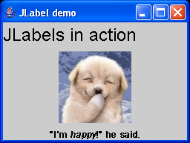
demonstrates JLabel's capabilities, including its ability to display images and HTML text
import java.awt.*;
import javax.swing.*;
public class Label1 extends JFrame
{
public static void main(String[] argv)
{
Label1 t = new Label1();
t.setDefaultCloseOperation(JFrame.EXIT_ON_CLOSE);
t.show();
}
public Label1()
{
Toolkit kit = Toolkit.getDefaultToolkit();
Dimension ss = kit.getScreenSize();
setSize(ss.width/4,ss.height/4);
setLocation(ss.width/4,ss.height/4);
setTitle("JLabel demo");
Container cp = getContentPane();
// Create a centered label with a large plain font.
JLabel label1 = new JLabel("JLabels in action");
Font f = label1.getFont();
label1.setFont(
new Font(f.getName(),Font.PLAIN,2*f.getSize()));
cp.add(label1,BorderLayout.NORTH);
// Create a static image label.
ImageIcon icon = new ImageIcon("try.jpg");
JLabel label2 = new JLabel(icon);
cp.add(label2,BorderLayout.CENTER);
// Create an HTML-formatted text label.
JLabel label3 =
new JLabel(
"<HTML>" +
"&quot;I'm <EM>happy</EM>!&quot; he said." +
"</HTML>",
JLabel.CENTER
);
cp.add(label3,BorderLayout.SOUTH);
}
}

Slide 96
Check boxes
Java's check box class is easy to use:
  JCheckBox cbox = new JCheckBox(“Demo");
To get or set the check box's state:
  cbox.isSelected()
  cbox.setSelected(true);
Check boxes use action listeners:
  cbox.addActionListener(…);

Slide 97
Radio buttons
Radio buttons are like check boxes…
  JRadioButton b1 = new JRadioButton("One",true);
…but must be part of a button group:
  ButtonGroup group = new ButtonGroup();
  JRadioButton b2 = new JRadioButton("Two",false);
  group.add(b1);
  group.add(b2);
You must also add the buttons to the container:
  contentPane.add(b1);
  contentPane.add(b2);
Add an action listener to each radio button. It will be invoked when the button is chosen.

Slide 98
Check box & radio button menu items
Menus items can have check boxes or radio buttons.
  JCheckBoxMenuItem cbm = new
  JCheckBoxMenuItem(“something1");
  JRadioButtonMenuItem rbm = new
  JRadioButtonMenuItem(“Something2");
  myMenu.add(cbm);
  myMenu.add(rbm);
JRadioButtonMenuItem items must be placed in a button group, just like normal check boxes, as well as added to a menu.

Slide 99
Combo boxes
Java provides combo boxes via the JComboBox class.
Create a combo box, then add items to it:
  JComboBox cb = new JComboBox();
  cb.addItem("One");
  cb.addItem("Two");
  cb.addItem("Three");
You can insert and remove items anywhere, not just at the end:
  cb.insertItemAt("Bozo",2);
  cb.removeItem("One");
  cb.removeItemAt(3);

Slide 100
Combo boxes (continued)
Use an action listener to handle events for a combo box.
When you detect an action event for a combo box:
  Call event.getSource() to get a reference to the combo box.
  Call getSelectedItem() on the combo box to get the chosen item.
  Cast the result to a String.

Slide 101
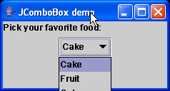
import java.awt.*;
import java.awt.event.*;
import javax.swing.*;
public class Combo1 extends JFrame
{
public static void main(String[] argv)
{
Combo1 c = new Combo1();
c.setDefaultCloseOperation(JFrame.EXIT_ON_CLOSE);
c.show();
}
public Combo1()
{
Toolkit kit = Toolkit.getDefaultToolkit();
Dimension ss = kit.getScreenSize();
setSize(ss.width/2,ss.height/6);
setLocation(ss.width/4,ss.height/4);
setTitle("JComboBox demo");
Container cp = getContentPane();
JPanel p = new JPanel();
cp.add(p);
JLabel label = new JLabel("Pick your favorite food:");
cp.add(label,BorderLayout.NORTH);
String[] labels = {
"Cake",
"Fruit",
"Coke",
"Biscuit",
"Rice",
"Meat",
"Nothing",
};
JComboBox box = new JComboBox();
for (int i=0; i<labels.length; i++)
box.addItem(labels[i]);
box.addActionListener(new Boxer(box));
p.add(box);
}
}

Slide 102
/**
An ActionListener to watch for changes in a JComboBox.
*/
class Boxer implements ActionListener
{
public Boxer(JComboBox box)
{ this.box = box; }
public void actionPerformed(ActionEvent e)
{
System.out.println("Selected " + box.getSelectedItem());
}
private JComboBox box;
}

Slide 103
Borders
To indicate functional groupings of components (e.g., a group of radio buttons), you can add a border to any component that extends JComponent.
Create a Border using one of the static methods of the BorderFactory class. For example:
  createLoweredBevelBorder()
  createRaisedBevelBorder()
  createEtchedBorder()
  createLineBorder(Color c)
  createMatteBorder(int top,int left,
  int bottom,int right,Color c)

Slide 104
Borders (continued)
If desired, add a title to a border by passing the border to createTitledBorder():
  Border b = BorderFactory.createEtchedBorder();
  Border b2 = BorderFactory.
  createTitledBorder(b,“My border type");
Add the border to a component with the component's setBorder() method.
If you want (you shouldn't), you can combine borders, or change border widths and colors.

Slide 105
File dialogs

Slide 106
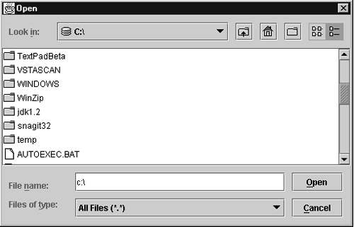
File dialogs
Swing provides a JFileChooser class that allows you to display a file dialog box

Slide 107
File dialogs
The JFileChooser allows the user to identify an existing file or directory, or to specify a new file. To use the file chooser:
  1) Create a JFileChooser object:
    JFileChooser chooser = new JFileChooser();
  2) Set the directory by calling the setCurrentDirectory() method.
    chooser.setCurrentDirectory(new File("."));
  3) If you know the default filename, set it:
    chooser.setSelectedFile("bozo.txt");
  4) Optionally allow the user to select multiple files:
    chooser.setMultiSelectionEnabled(true);

Slide 108
File dialogs (continued)
  5) To restrict the files by type or name, create a file filter (discussed later) and attach it by calling setFileFilter().
  6) Specify whether the user can select files, directories, or files and directories:
    chooser.setFileSelectionMode(
    JFileChooser.DIRECTORIES_ONLY);
    chooser.setFileSelectionMode(
    JFileChooser.FILES_ONLY);
    chooser.setFileSelectionMode(
    JFileChooser.FILES_AND_DIRECTORIES);

Slide 109
File dialogs (continued)
  7) Show the dialog box for opening a file or saving a file. The return is either JFileChooser.APPROVE_OPTION or JFileChooser.CANCEL_OPTION:
    chooser.showOpenDialog(parent);
    chooser.showSaveDialog(parent);
  8) Retrieve the file(s) specified as a File object or as an array of File objects:
    File[] files = chooser.getSelectedFiles();
    Or
    retrieve the name of the file object
    String filename = chooser.getSelectedFile().getPath();

Slide 110
File dialogs - FileFilter
The javax.swing.filechooser.FileFilter interface allows you to restrict the files which can be selected:
  public class GraphFilter extends FileFilter
  {
  public boolean accept(File f)
  {
  return f.getName().toLowerCase().endsWith(".gif")
  || f.isDirectory();
  }
  public String getDescription()
  {
  return "GIF image";
  }
  }
Once you have a file filter object, you use the setFileFilter method of the JFileChooser class to install it into the file chooser object:
  chooser.setFileFilter(new GifFilter());

Slide 111
File dialogs - FileFilter
By default, the "All files" filter is always present in the combo box. However, if you want to suppress the "All files" filter, call
  chooser.setAcceptAllFileFilterUsed(false)

Slide 112
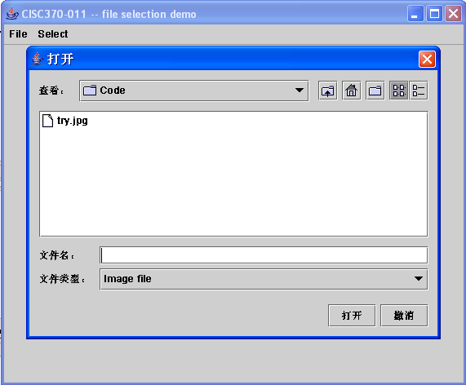
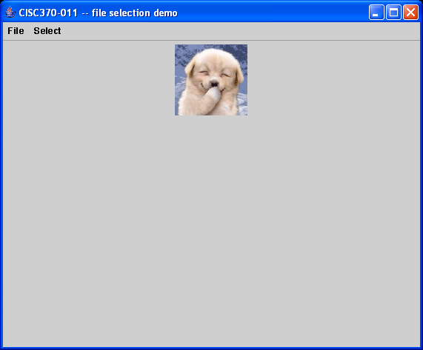
Example
This example demonstrate file selection dialog.

Slide 113
import java.awt.*;
import java.awt.event.*; // for ActionListener
import javax.swing.*;
import java.io.File;
public class FileSelect1 extends JFrame
{
public static void main(String[] argv)
{
FileSelect1 fs = new FileSelect1();
fs.setDefaultCloseOperation(JFrame.EXIT_ON_CLOSE);
fs.show();
}
public FileSelect1()
{
Toolkit kit = Toolkit.getDefaultToolkit();
Dimension ss = kit.getScreenSize();
setSize(3*ss.width/4,3*ss.height/4);
setLocation(ss.width/8,ss.height/8);
setTitle("CISC370-011 -- file selection demo");
Container cp = getContentPane();
JPanel p = new JPanel();
cp.add(p);
JLabel echo = new JLabel("No file yet.",JLabel.LEFT);
p.add(echo);
JMenuBar mbar = new JMenuBar();
setJMenuBar(mbar);
JMenu fileMenu = new JMenu("File");
mbar.add(fileMenu);
JMenuItem exitItem = new JMenuItem("Exit");
fileMenu.add(exitItem);
exitItem.addActionListener(new ActionListener() {
public void actionPerformed(ActionEvent e)
{ System.exit(0); }
});
JMenu selectMenu = new JMenu("Select");
mbar.add(selectMenu);
JMenuItem imageItem = new JMenuItem("Select image...");
selectMenu.add(imageItem);
imageItem.addActionListener(new FileLookerUpper(this,echo));
}
}

Slide 114
/**
Accept only image types known to work as JLabel image icons.
*/
class ImageFilter extends javax.swing.filechooser.FileFilter
{
static String[] extensions = {
".gif",
".jpg",
".png",
".jpeg",
};
public boolean accept(File f)
{
if (f.isDirectory())
return true;
for (int i=0; i<extensions.length; i++)
if (f.getName().toLowerCase().endsWith(extensions[i]))
return true;
return false;
}
public String getDescription()
{
return "Image file";
}
}
/**
Allow the user to select an image file, display it in the JLabel.
*/
class FileLookerUpper implements ActionListener
{
public FileLookerUpper(Component frame,JLabel label)
{
this.frame = frame;
this.label = label;
}
public void actionPerformed(ActionEvent e)
{
String s;

Slide 115
JFileChooser chooser = new JFileChooser();
chooser.setCurrentDirectory(new File("."));
chooser.setFileFilter(new ImageFilter());
chooser.setFileSelectionMode(JFileChooser.FILES_ONLY);
if (chooser.showOpenDialog(frame) ==
JFileChooser.APPROVE_OPTION) {
s = chooser.getSelectedFile().toString();
label.setIcon(new ImageIcon(s));
label.setText(null);
}
else {
label.setIcon(null);
label.setText("No image!");
}
label.repaint();
}
private Component frame;
private JLabel label;
}

Slide 116
Dialog Boxes - JOptionPane

Slide 117
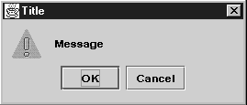
Option dialog
The dialog has the following components:
  An icon;
  A message;
  One or more option buttons.
The input dialog has an additional component for user input such as a text field or a combo box

Slide 118
JOptionPane
Swing provides a sophisticated built-in modal dialog, JOptionPane.
A JOptionPane object provides four methods:
  showMessageDialog() -- Display a message and wait for the user to click OK.
  showConfirmDialog() -- Show a message and wait for confirmation (e.g., Yes/No, OK/Cancel).
  showOptionDialog() -- Show a message and allow the user to select from a set of options.
  showInputDialog() -- Show a message and get one line of user input.

Slide 119
JOptionPane (continued)
The JOptionPane dialogs display an icon.
You can select the icon that will be displayed:
  ERROR_MESSAGE
  INFORMATION_MESSAGE
  WARNING_MESSAGE
  QUESTION_MESSAGE
  PLAIN_MESSAGE (no icon)

Slide 120
JOptionPane (continued)
The JOptionPane dialogs display a message.
The message can be any kind of object, and will be rendered as:
  String -- Displays the string
  Icon -- Draws the icon
  Component -- Shows the component
  Object[] -- Shows the elements of the array (vertically)
  Anything else -- Displays the string returned by toString()

Slide 121
JOptionPane (continued)
showConfirmDialog() allows you to specify the labels on its buttons:
  DEFAULT_OPTION
  YES_NO_OPTION
  YES_NO_CANCEL_OPTION
  OK_CANCEL_OPTION
showOptionDialog() allows an arbitrary set of options, specified as an array and rendered as:
  String -- A button with the string as label
  Icon -- A button with the icon as label
  Component -- Shows the component
  Anything else -- A button whose label is the object's toString() value

Slide 122
JOptionPane (continued)
The option pane functions return:
  showMessageDialog() -- nothing
  showConfirmDialog() -- An integer representing the chosen option
  showOptionDialog() -- An integer representing the chosen option
  showInputDialog() -- The string supplied or selected by the user

Slide 123
JOptionPane (continued)
The integer returned by showOptionDialog() is the index of the selected option, or CLOSED_OPTION if the user selected nothing.
The integer returned by showConfirmDialog() is one of:
  OK_OPTION
  CANCEL_OPTION
  YES_OPTION
  NO_OPTION
  CLOSED_OPTION

Slide 124
Example
int selection = JOptionPane.showConfirmDialog(parent,
"Message", "Title",
JOptionPane.OK_CANCEL_OPTION,
JOptionPane.WARNING_MESSAGE);
if (selection == JOptionPane.OK_OPTION) . . .

Slide 125
Steps of creating dialog box
Choose the dialog type (message, confirmation, option, or input).
Choose the icon (error, information, warning, question, none, or custom).
Choose the message (string, icon, custom component, or a stack of them).
For a confirmation dialog, choose the option type (default, Yes/No, Yes/No/Cancel, or OK/Cancel).
For an option dialog, choose the options (strings, icons, or custom components) and the default option.
For an input dialog, choose between a text field and a combo box.
Locate the appropriate method to call in the JOptionPane API.

