Slide 1
Design patterns

Slide 2
Design patterns
A Design Pattern:
  Is a solution to a problem in context
  Is a named problem/solution combination
  Has been applied repeatedly over time
  Can be applied in new contexts
  Includes advice on its application in novel situations
  Includes a discussion of its trade-offs

Slide 3
Why patterns?
Real engineering disciplines have handbooks that describe successful solutions to known problems.
Automotive engineers don't design cars using the laws of physics—they reuse designs with successful track records.
Until recently, there was no such body of knowledge for software engineering.

Slide 4
The Gang of Four
The Gang of Four (GOF) published the seminal work, "Design Patterns: Elements of Reusable Object-Oriented Software", in 1995.
  Gamma
  Helm
  Johnson
  Vlissides
Addressed shortcomings of C++.
Java had not yet been invented.
Java's APIs (for example, Collections) were designed by people with a strong knowledge of patterns.

Slide 5
The pattern metapattern
  IF you find yourself in CONTEXT
  for example EXAMPLES,
  with PROBLEM
  entailing FORCES
  THEN for some REASONS
  apply DESIGN FORM AND/OR RULE
  to construct SOLUTION
  leading to NEW CONTEXT and OTHER PATTERNS

Slide 6
Example GOF pattern
Name: Facade
Problem: A legacy subsystem is baroque and/or byzantine in its complexity.
Context: Legacy system provides vastly more features than are needed for the current application.
Forces: Understandability, maintainability.
Solution: Create a new class that provides only the necessary subset of functions from the legacy class.
Examples: Simplified interface to legacy SQL database
Resulting context: …
Rationale: …
Related patterns: Adapter
Known uses: …

Slide 7
Forces
A force is a generalized criterion that software engineers use to justify designs and implementations. Examples:
  Correctness (thread safety, fault tolerance)
  Resources
    space
    time
    policy dynamics (fairness, equilibrium, stability)
  Structure (modularity, extensibility, reusability, interoperability)
  Construction (understandability, maintainability, error-proneness)
  Usage (ethics, human factors, esthetics)

Slide 8
Where do patterns come from?
Patterns aren't invented—they're noticed.
If a solution isn't idiomatic, it isn't a pattern (yet).
Several hundred patterns have been cataloged, of which perhaps twenty or thirty are of general interest.
Catalogs of antipatterns are also popular.

Slide 9
Pattern catalog
We'll cover a few of the most popular and instructive GOF patterns:
  Adapter
  Facade
  Observer
  Factory Method
  Controller
  Strategy
  Template Method
  Composite
  Bridge

Slide 10
Adapter pattern
"Convert the interface of a class into another interface clients expect. Adapter lets classes work together that couldn't otherwise because of incompatible interfaces."
Consider credit card authorization.
  Each credit card company supplies a credit authorization API.
  The packages may have wildly different (or treacherously similar) APIs.
  All you really want is a method like authorizePayment().
  You don't want to use 'if' statements to call a different set of functions for each API.
Create an adapter interface, plus one concrete adapter class per credit card package…

Slide 11
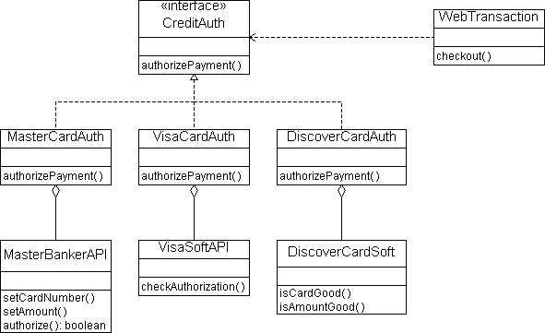
Adapter pattern (continued)

Slide 12
Facade pattern
"Provide a unified interface to a set of interfaces in a subsystem. Facade defines a higher-level interface that makes the subsystem easier to use."
Facade promotes weak coupling between the subsystem and its clients.
Facade doesn't prevent applications from using the full range of subsystem objects if they need to. Clients can choose between ease of use and generality.

Slide 13
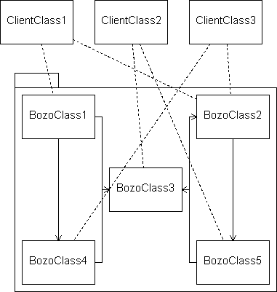
Facade pattern (continued)
Without a Facade, a system may look like this:

Slide 14
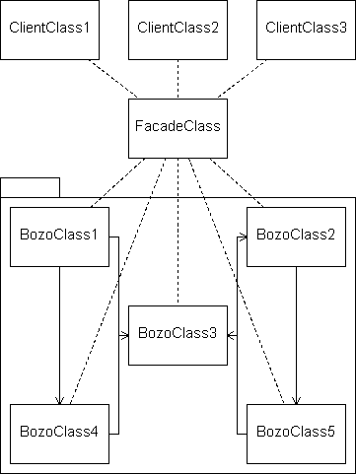
Facade pattern (continued)
With a Facade, the system will look like this:

Slide 15
Observer pattern
"Define a one-to-many dependency between objects so that when one object changes state, all its dependents are notified and updated automatically."
This pattern is used extensively in Java’s APIs—for example, 134 classes subclass EventListener, mostly in AWT and Swing.
Observer is also known as Publish–Subscribe. One publisher can have many subscribers.

Slide 16
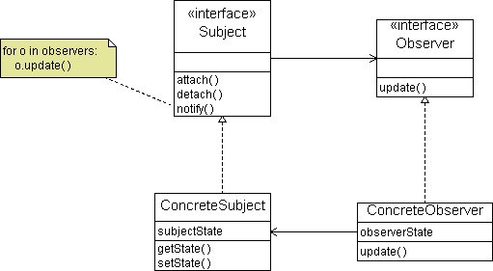
Observer pattern (continued)

Slide 17
Factory Method pattern
"Define an interface for creating an object, but let subclasses decide which class to instantiate. Factory Method lets a class defer instantiation to subclasses."
For example, an application framework might define an Application class and a Document class. An Application must be able to create a new Document, but the authors of the Application class didn't know about your subclass of Document so they can't call its constructor. Instead, the Document class should specify a Factory Method, createDocument().
Factory Methods are used extensively in Java's XML APIs (createParser(), createNode(), etc.).

Slide 18
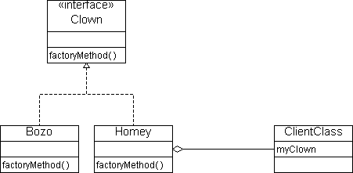
Factory Method pattern (continued)

Slide 19
Controller pattern
"A Controller is a non-user-interface object responsible for receiving or handling a system event."
Two flavors: (a) The controller represents the overall system, device, or subsystem. (b) The controller represents a Use Case scenario within which the system event occurs, with a name like -Coordinater, -Session, or -Handler.
A Controller shouldn't do a lot of the work itself; it may coordinate activities, but it should delegate the actual work to other classes.

Slide 20
Strategy pattern
"Define a family of algorithms, encapsulate each one, and make them interchangeable. Strategy lets the algorithm vary independently from clients that use it."
A strategy object is attached to a context object, so it can find the data to strategize from.
Use the Strategy pattern in preference to conditional statements.
The best way to create Strategy objects is with a Factory Method. The factory method can map class names to strategies, and look up the current strategy name in a configuration location (like the user’s Preferences).

Slide 21
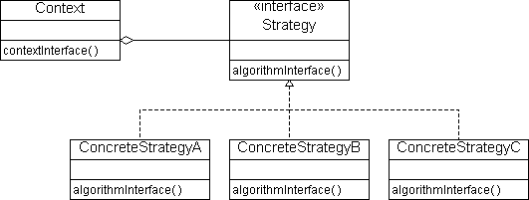
Strategy pattern (continued)

Slide 22
Template Method pattern
"Define the skeleton of an algorithm in an operation, deferring some steps to subclasses. Template Method lets subclasses redefine certain steps of an algorithm without changing the algorithm's structure."
Template methods are used extensively in class libraries and application frameworks. They employ the Hollywood Principle: "Don't call us, we’ll call you."
Some methods in a template class are abstract (which must be subclassed), some are hooks. "Hook" methods typically do nothing by default.

Slide 23
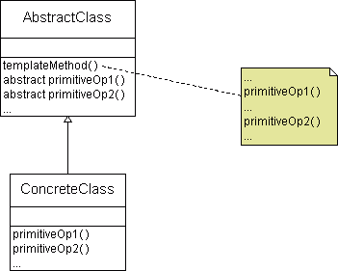
Template Method pattern (continued)

Slide 24
Composite pattern
"Compose objects into tree structures to represent part-whole hierarchies. Composite lets clients treat individual objects and compositions of objects uniformly."
Examples:
  In a graphics editor, users want to move, rotate, and resize objects. They also want to group objects together (recursively), and treat the groups as single objects.
  In a CAD system, users want aggregate results (mass, cost, etc.) for arbitrary groups of primitives.

Slide 25
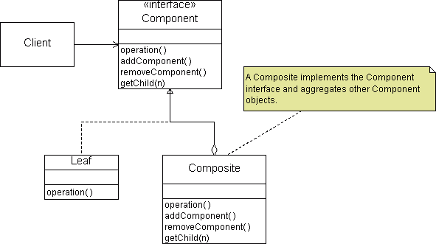
Composite pattern (continued)

Slide 26
Bridge pattern
"Decouples an abstraction from its implementation so that the two can vary independently."
Puts the use of an abstraction and its implementation in separate inheritance hierarchies.

Slide 27
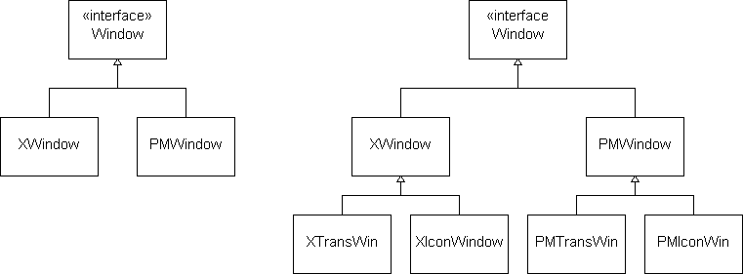
Bridge pattern (continued)
In this example, we'd like to add a new style of window (an "icon window") to a portable windowing system. The pure-inheritance design is ripe for a combinatorial explosion:

Slide 28
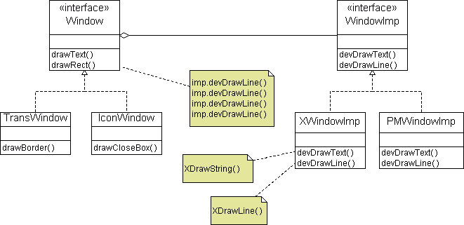
Bridge pattern (continued)
The Bridge pattern eliminates the combinatorial explosion by allowing any new window type to draw on any windowing system using portable primitives:

