Slide 1
Files & directories

Slide 2
Files
Java provides a single class, File, to encapsulate the filesystem.
File provides three constructors:
  File f = new File(name);
  File f = new File(String path, String name);
  File f = new File(File dir, String name);

Slide 3
Files (continued)
The file constructors create representations of possible files, rather than the files themselves:
  Use the exists() method to see if the file or directory represented by the File exists.
  Use createNewFile() to create the file corresponding to a File object.
  The FileOutputStream constructor accepts a File argument to create a file.
A File can represent either a file or a directory.
Call isFile() or isDirectory() to see which one it is.

Slide 4
Directories
If a directory does not exist, you can create it with the mkdir() method:
  File myDir = new File(“java");
  if (!myDir.exists())
  myDir.mkdir();
mkdir() does not create intermediate directories if they do not already exist; use the mkdirs() method instead.

Slide 5
Directories (continued)
You can retrieve the contents of a directory as an array of String or File objects:
  String[] nameList = myDir.list();
  File[] fileList = myDir.listFiles();

Slide 6
Directories (continued)
You can supply a FilenameFilter object to restrict the items returned by list() and listFiles():
  public class MyFileFilter implements FilenameFilter
  {
  public boolean accept(File dir, String name)
  {
  for (int i=0; i<names.length; i++)
  if (name.toLowerCase().startsWith(names[i]))
  return true;
  return false;
  }
  private String[] names = {“java",“j2ee",“j2me"};
  }
  File[] mylist =
  (new File("D:\")).listFiles(new MyFileFilter());

Slide 7

public class ExtensionFilter implements FilenameFilter
{
public ExtensionFilter(String ext)
{
extension = "." + ext;
}
public boolean accept(File dir, String name)
{
return name.endsWith(extension);
}
private String extension;
}

Slide 8
Portable file specification
The File class allows you (but doesn't force you) to specify files in a platform-independent way:
  Constructor File(File path,String name) joins path and name.
  File.separator gives the pathname separator ("/" on Unix).
  File.pathSeparator gives the separator for lists of files (e.g., ":" on Unix).
  listRoots() returns an array of File objects representing the roots of all directory trees in the system ("A:\", "C:\", etc on Windows).
  getCanonicalFile() returns a File object with the path and name cleaned up.
  getCanonicalPath() returns a String representing the cleaned-up version of a File's path and name.

Slide 9
Files
Other useful File methods:
  boolean canRead()
  boolean canWrite()
  boolean delete() // true if successful
  void deleteOnExit()
  long length()
  File getParentFile() // parent directory
  boolean renameTo(File dest) // true if changed
  URI toURI()
  URL toURL() (but use toURI().toURL() class instead)

Slide 10
import java.io.*;
public class FindDirectories
{
public static void main(String[] args)
{
// if no arguments provided, start at the parent directory
if (args.length == 0) args = new String[] { ".." };
try
{
File pathName = new File(args[0]);
String[] fileNames = pathName.list();
// enumerate all files in the directory
for (int i = 0; i < fileNames.length; i++)
{
File f = new File(pathName.getPath(),
fileNames[i]);
// if the file is again a directory, call
// the main method recursively
if (f.isDirectory())
{
System.out.println(f.getCanonicalPath());
main(new String [] { f.getPath() });
}
}
}
catch(IOException e)
{
e.printStackTrace();
}
}
}

Slide 11
Streams

Slide 12
Streams
Water analogy
  Think of streams as pipes for water
  It has a source and destination
Idea:
  You abstract away what the stream is connected to and perform all your I/O operations on the stream
  The stream may be connected to a file on a floppy, a file on a hard disk, a network connection or may even just be in memory!
Streams
  Way to deal with input and output
  A useful abstraction…

Slide 13
Streams
Java's I/O is based on streams of bytes or Unicode characters.
The stream library is built on top of four abstract classes:
  InputStream and OutputStream for byte-by-byte i/o
  Reader and Writer for Unicode character i/o

Slide 14
Types of Streams
InputStream / OutputStream
  Base class streams with few features
  read() and write()
FileInputStream / FileOutputStream
  Specifically for connecting to files
ByteArrayInputStream / ByteArrayOutputStream
  Use an in-memory array of bytes for storage!
BufferedInputStream / BufferedOutputStream
  Improve performance by adding buffers
  Should almost always use buffers
BufferedReader / BufferedWriter
  Convert bytes to unicode Char and String data
  Probably most useful for what we need

Slide 15
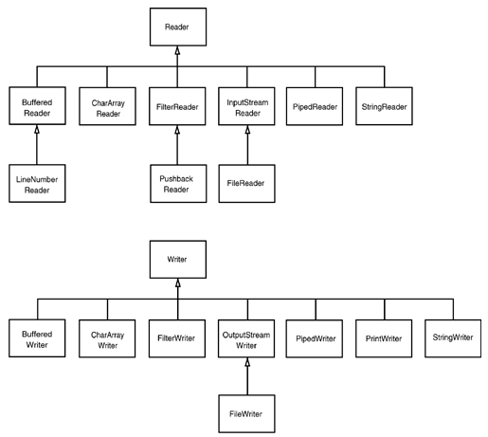

Slide 16
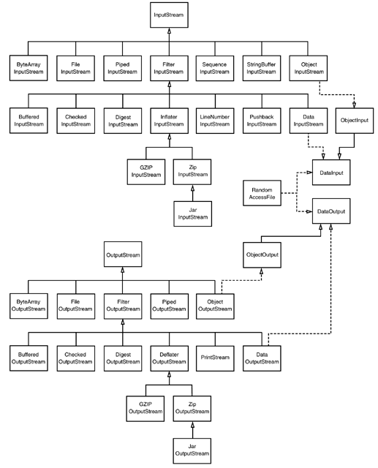

Slide 17
Stream composition
By themselves, InputStream can't even read from files.
The stream model's power comes from the ability to compose streams.
Constructors of advanced stream types take other streams as arguments.
Java has over 60 stream types, such as:
  Data streams
  Buffered streams
  ZIP streams
Composable streams inherit from FilterInputStream and FilterOutputStream classes.

Slide 18
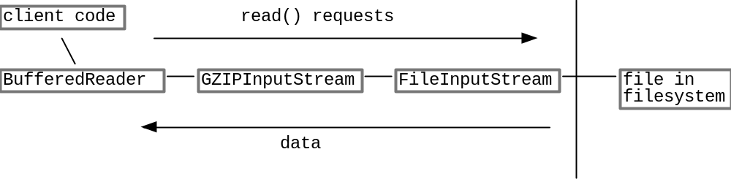
Stream composition
Java provides a hierarchy of streams
  Think of this as different “filters” you can add on to your water pipe
    Some may compress/decompress data
    Some may provide buffers
Common Use Scenario
  Streams are used by layering them together to form the type of “pipe” we eventually want

Slide 19
Stream composition
FileInputStream fin = new FileInputStream("employee.dat");
DataInputStream din = new DataInputStream(fin);
double s = din.readDouble();
  FileInputStream – read the file
  DataInputStream “wraps” FileInputStream, then it has more capabilities (methods), ie. read data in the double type
DataInputStream din = new DataInputStream
(new BufferedInputStream
(new FileInputStream("employee.dat")));
What about this?

Slide 20
Stream composition
PushbackInputStream provides facility to “push back” data
PushbackInputStream pbin = new PushbackInputStream
(new BufferedInputStream
(new FileInputStream("employee.dat")));
int b = pbin.read(); // read the next byte
if (b != '<') pbin.unread(b); // throw it back if it isn't what you wanted

Slide 21
Stream composition
But reading and unreading are the only methods in the pushback input stream. If you also want to read numbers, then:
DataInputStream din = new DataInputStream (pbin = new PushbackInputStream (new BufferedInputStream (new FileInputStream("employee.dat"))));

Slide 22
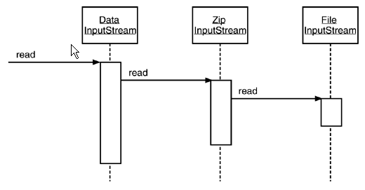
Stream composition
Reading zip files
ZipInputStream zin = new ZipInputStream(new FileInputStream("employee.zip"));
DataInputStream din = new DataInputStream(zin);

Slide 23
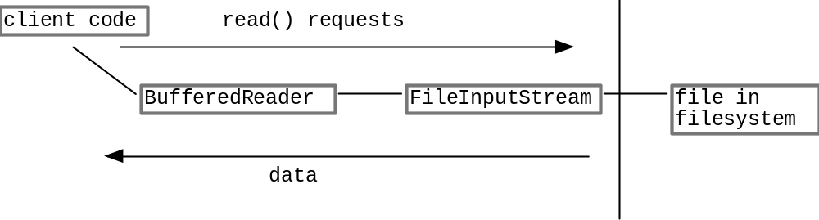
Common Use Scenario
Using a BufferedReader to read data from a file…

Slide 24
Streams and Threads
When a thread sends a read() to a stream,
  if the data is not ready, the thread blocks in the call to read().
  When the data is there, the thread unblocks and the call to read() returns
The reading/writing code does not need to do anything special
Read 10 things at once – create 10 threads!

Slide 25
Reading Text Input
To read a line of text, you need to combine a buffered reader with an input source.
  BufferedReader in = new BufferedReader(new FileReader("employee.txt"));
  The FileReader class converts bytes to Unicode characters
For other input sources, use the InputStreamReader

Slide 26
Reading Text Input (Con.)
To read from the standard input
  BufferedReader in2 = new BufferedReader(new
  InputStreamReader(System.in));
To read from the Web source
  BufferedReader in3 = new BufferedReader(new
  InputStreamReader(url.openStream()));
To read numbers from text input
  String s = in.readLine();
  double x = Double.parseDouble(s);

Slide 27
Reading Example
public void readLines(String fname) {
try {
// Build a reader on the fname, (also works with File object)
BufferedReader in = new BufferedReader(new FileReader(fname));
String line;
while ((line = in.readLine()) != null) {
// do something with 'line'
System.out.println(line);
}
in.close(); // polite
}
catch (IOException e) {
e.printStackTrace();
}
}

Slide 28
Writing Text Output
To write data in binary format, use a DataOutputStream.
To write in text format, use a PrintWriter.
  PrintWriter out = new PrintWriter(new FileWriter("employee.txt"));
  PrintWriter out = new PrintWriter(new FileOutputStream("employee.txt"));
  PrintWriter out = new PrintWriter(new FileWriter("employee.txt"), true); // autoflush

Slide 29
Writing Example
public void writeLines(String fname) {
try {
// Build a writer on the fname (also works on File objects)
BufferedWriter out = new BufferedWriter(new FileWriter(fname));
// Send out.print(), out.println() to write chars
for (int i=0; i<data.size(); i++) {
out.println( ... ith data string ... );
}
out.close(); // polite
}
catch (IOException e) {
e.printStackTrace();
}
}

Slide 30
InputStream
The InputStream class provides an abstract read() method that returns one byte from the stream, or -1 at the end of file.
Note that read() is similar to the C read() function; its return type is int and must be coerced to byte.
The read() method will block if there are no bytes to read.
The available() method returns the number of bytes available to read.

Slide 31
InputStream (continued)
Other InputStream methods:
  int read(byte[] b) (returns # of bytes read)
  int read(byte[] b,int offset, int len)
  long skip(long n)
  int available()
  void close()
  void reset()
  void mark(int readlimit)
  boolean markSupported()
mark() and reset() are not supported for all streams.

Slide 32
OutputStream
The OutputStream class provides an abstract void write(int b) which writes one byte.
The write() method will block until the byte can be written.
Other OutputStream methods:
  void write(byte[] b)
  void write(byte[] b,int offset,int len)
  void close()
  void flush()

Slide 33
File streams
The FileInputStream and FileOutputStream classes allow byte-by-byte reading or writing of disk files.
Constructors for these classes accept either pathnames or File objects:
  File f = new File(“test.dat");
  FileInputStream inStream = new FileInputStream(f);
  String name = “demo.dat";
  FileOutputStream outStream = new FileOutputStream(name);

Slide 34
String/byte streams
Two classes allow you to read/write characters to a String:
  StringReader
  StringWriter
Two classes allow you to read/write bytes to a byte array:
  ByteArrayInputStream
  ByteArrayOutputStream

Slide 35
Data streams
The DataInput and DataOutput interfaces define byte-level i/o for all of Java's primitive types:
  readBoolean() / writeBoolean()
  readByte() / writeByte()
  readInt() / writeInt()
  readShort() / writeShort()
  readLong() / writeLong()
  readFloat() / writeFloat()
  readDouble() / writeDouble()
  readChar() / writeChar()
  readUTF() / writeUTF()

Slide 36
Data streams (continued)
Some other useful methods of DataInput are:
  void readFully(byte[] b)
  void readFully(byte [] b, int offset, int len)
  String readLine()
  int skipBytes(int n)
Values are always read and written in byte, so data files are portable between platforms.

Slide 37
Buffered input & output
Reading or writing a byte at a time is very inefficient.
The standard C library includes buffering for all file descriptors, which the programmer can turn on or off.
In Java, buffering is just one more composable (layered) stream type. To add a 4k buffer to an input stream:
  DataInputStream dis =
  new DataInputStream(
  new BufferedInputStream(
  new FileInputStream(
  new File(“test.dat")),
  4096));

Slide 38
Pushback input
PushbackInputStream allows bytes to be read, then 'pushed back' for later reading.
Useful for lookahead, e.g., in parsing input.
Pushback methods are:
  void unread(int b);
  void unread(byte[] buf);
  void unread(byte[] buf,int offset,int len);

Slide 39
Sequenced input streams
A SequenceInputStream represents a concatenation of two or more InputStreams.
Constructors:
  SequenceInputStream(InputStream one,
  InputStream two);
  SequenceInputStream(Enumeration e);
Only returns EOF at the end of the last input stream.

Slide 40
ZIP streams
Java provides a stream interface to compressed ZIP files.
  ZipInputStream z = new ZipInputStream(
  new FileInputStream(zfile));
Given a ZIP input stream, use the getNextEntry() method to find the start of the next file:
  ZipEntry zentry = z.getNextEntry();
  System.out.println(zentry.getName());
Once an entry is located, open it as a stream:
  BufferedReader br =
  new BufferedReader(
  new InputStreamReader(z));

Slide 41
ZIP streams example
How it works
  ZipInputStream zin = new ZipInputStream
  (new FileInputStream(zipname));
  ZipEntry entry;
  while ((entry = zin.getNextEntry()) != null)
  {
  analyze entry;
  read the contents of zin;
  zin.closeEntry();
  }
  zin.close();
To read the contents of a ZIP entry
  BufferedReader in = new BufferedReader
  (new InputStreamReader(zin));
  String s;
  while ((s = in.readLine()) != null) //do someting with s;

Slide 42
ZIP streams example
Write a zip file
  FileOutputStream fout = new FileOutputStream("test.zip");
  ZipOutputStream zout = new ZipOutputStream(fout);
  for all files
  {
  ZipEntry ze = new ZipEntry(file name);
  zout.putNextEntry(ze);
  // send data to zout;
  zout.closeEntry();
  }
  zout.close();

Slide 43
Random-access files/streams
RandomAccessFile implements both the DataInput and DataOutput interfaces.
Reading and writing happen at the file pointer:
  seek() moves the file pointer to an arbitrary byte position in the file.
  getFilePointer() returns the current location of the file pointer.

Slide 44
Random-access files (continued)
Open a RandomAccessFile in read-only or read/write mode:
  RandomAccessFile a =
  new RandomAccessFile(name,"r");
  RandomAccessFile b =
  new RandomAccessFile(name,"rw");
Two other read/write modes, "rws" and "rwd", ensure completion of i/o to the physical medium (for high-reliability applications like databases).

Slide 45
RandomFileTest.java
import java.io.*;
import java.util.*;
public class RandomFileTest
{
public static void main(String[] args)
{
Employee[] staff = new Employee[3];
staff[0] = new Employee("Carl Cracker", 75000,
1987, 12, 15);
staff[1] = new Employee("Harry Hacker", 50000,
1989, 10, 1);
staff[2] = new Employee("Tony Tester", 40000,
1990, 3, 15);
try
{
// save all employee records to the file employee.dat
DataOutputStream out = new DataOutputStream(new
FileOutputStream("employee.dat"));
for (int i = 0; i < staff.length; i++)
staff[i].writeData(out);
out.close();
// retrieve all records into a new array
RandomAccessFile in
= new RandomAccessFile("employee.dat", "r");
// compute the array size
int n = (int)(in.length() / Employee.RECORD_SIZE);
Employee[] newStaff = new Employee[n];
// read employees in reverse order
for (int i = n - 1; i >= 0; i--)
{
newStaff[i] = new Employee();
in.seek(i * Employee.RECORD_SIZE);
newStaff[i].readData(in);
}

Slide 46
in.close();
// print the newly read employee records
for (int i = 0; i < newStaff.length; i++)
System.out.println(newStaff[i]);
}
catch(IOException e)
{
e.printStackTrace();
}
}
}
class Employee
{
public Employee() {}
public Employee(String n, double s,
int year, int month, int day)
{
name = n;
salary = s;
GregorianCalendar calendar
= new GregorianCalendar(year, month - 1, day);
// GregorianCalendar uses 0 for January
hireDay = calendar.getTime();
}
public String getName()
{
return name;
}
public double getSalary()
{
return salary;
}

Slide 47
public Date getHireDay()
{
return hireDay;
}
public void raiseSalary(double byPercent)
{
double raise = salary * byPercent / 100;
salary += raise;
}
public String toString()
{
return getClass().getName()
+ "[name=" + name
+ ",salary=" + salary
+ ",hireDay=" + hireDay
+ "]";
}
/**
Writes employee data to a data output
@param out the data output
*/
public void raiseSalary(double byPercent)
{
double raise = salary * byPercent / 100;
salary += raise;
}
public String toString()
{
return getClass().getName()
+ "[name=" + name
+ ",salary=" + salary
+ ",hireDay=" + hireDay
+ "]";
}

Slide 48
/**
Writes employee data to a data output
@param out the data output
*/
public void writeData(DataOutput out) throws IOException
{
DataIO.writeFixedString(name, NAME_SIZE, out);
out.writeDouble(salary);
GregorianCalendar calendar = new GregorianCalendar();
calendar.setTime(hireDay);
out.writeInt(calendar.get(Calendar.YEAR));
out.writeInt(calendar.get(Calendar.MONTH) + 1);
out.writeInt(calendar.get(Calendar.DAY_OF_MONTH));
}
/**
Reads employee data from a data input
@param in the data input
*/
public void readData(DataInput in) throws IOException
{
name = DataIO.readFixedString(NAME_SIZE, in);
salary = in.readDouble();
int y = in.readInt();
int m = in.readInt();
int d = in.readInt();
GregorianCalendar calendar
= new GregorianCalendar(y, m - 1, d);
// GregorianCalendar uses 0 = January
hireDay = calendar.getTime();
}
public static final int NAME_SIZE = 40;
public static final int RECORD_SIZE
= 2 * NAME_SIZE + 8 + 4 + 4 + 4;

Slide 49
private String name;
private double salary;
private Date hireDay;
}
class DataIO
{
public static String readFixedString(int size,
DataInput in) throws IOException
{
StringBuffer b = new StringBuffer(size);
int i = 0;
boolean more = true;
while (more && i < size)
{
char ch = in.readChar();
i++;
if (ch == 0) more = false;
else b.append(ch);
}
in.skipBytes(2 * (size - i));
return b.toString();
}
public static void writeFixedString(String s, int size,
DataOutput out) throws IOException
{
int i;
for (i = 0; i < size; i++)
{
char ch = 0;
if (i < s.length()) ch = s.charAt(i);
out.writeChar(ch);
}
}
}

Slide 50
Text i/o

Slide 51
Text streams
Character i/o in Java is done in Unicode rather than ASCII.
Different systems use different encodings of host characters to Unicode.
Byte-oriented i/o is not suitable for Unicode, but the host computer probably does not store files in Unicode.
Java provides additional classes for Unicode i/o for text files:
  InputStreamReader translates an input byte stream in a given host encoding into a Unicode input stream.
  OutputStreamWriter translates a Unicode output stream into a given host encoding.

Slide 52
Text streams (continued)
If necessary, supply the desired encoding name or character set CharSet in the stream constructor:
  InputStreamReader in =
  new InputStreamReader(
  new FileInputStream(“in.txt"),
  "8859_1");
  OutputStreamReader out =
  new OutputStreamReader(
  new FileOutputStream(“out.txt"),
  "8859_5");

Slide 53
Text output
For text output in the host character set, use the PrintWriter class:
  PrintWriter out = new PrintWriter(
  new FileOutputStream("happy.txt"));
  out.print(x);
  out.println(y);
PrintWriter's println() method adds the correct newline character for the host operating system.
The print() and println() methods do not throw exceptions. Call checkError() to see if the stream has generated an error.

Slide 54
Text input
There is no input class equivalent to the PrintWriter class.
Use the readLine() method of the BufferedReader class to read lines of text:
  BufferedReader in1 = new BufferedReader(
  new FileReader(“in.txt"));
  String line;
  while ((line = in.readLine()) != null)
  // process the line
  BufferedReader in2 = new BufferedReader(
  new InputStreamReader(System.in));
  BufferedReader in3 = new BufferedReader(
  new InputStreamReader(url.openStream()));

Slide 55
String tokenizers
Use the StringTokenizer class to parse delimited input.
  StringTokenizer t =
  new StringTokenizer(string,delimiterChars);
The StringTokenizer's nextToken() and hasMoreTokens() methods can be used to extract tokens:
  StringTokenizer t = new StringTokenizer("This is a test"," \r\n\t");
  while (t.hasMoreTokens())
  System.out.println(t.nextToken());

Slide 56
Serialization

Slide 57
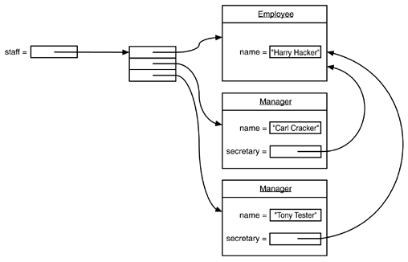
Why Serialization
Now, suppose we write the employee data to disk.
  Save employee data;
  Save secretary data.

Slide 58
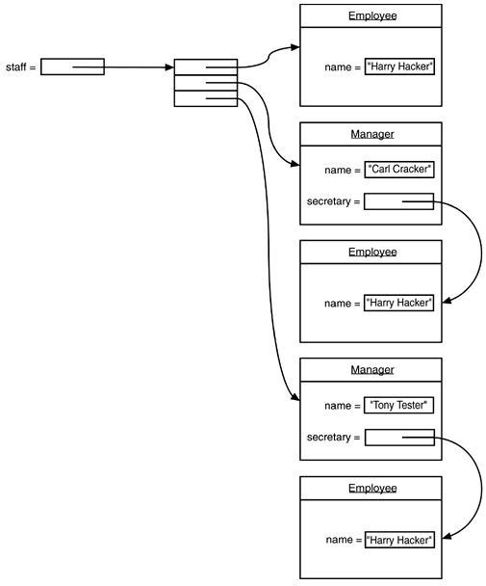
Why Serialization

Slide 59
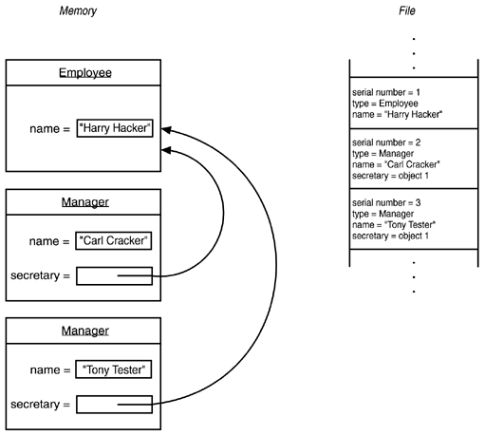
How Serialization Works in Java
All objects saved to disk are given a serial number
When saving, check if the same object has already been stored.
  If stored previously, just write "same as previously saved object with serial number x." If not, store all its data

Slide 60
Serialization
Motivation
  A lot of code involves boring conversion from a file to memory
  This is a common problem!
Java’s answer:
  Serialization
    Object know how to write themselves out to disk and to read themselves back from disk into memory!

Slide 61
Serialization / Archiving
Objects have state in memory
Serialization is the process of converting objects into a streamed state (Network, Disk)
  No notion of an address space
  No pointers
Serialization is also called
  Flattening, Streaming, Dehydrate (rehydrate = read), Archiving

Slide 62
How it works?
To write out an object
  ObjectOutputStream out;
  out.writeObject(obj)
To read that object back in
  ObjectInputStream in;
  obj = in.readObject();
Must be of the same type
  class and version

Slide 63
Java: Automatic Serialization
Serializable Interface
  By implementing this interface a class declares that is it willing to be read/written by automatic serialization machinery
Automatic Writing
  System knows how to recursively write out the state of an object
  Recursively follows pointers and writes out those objects too!
  Can handle most built in types
    int, array, Point etc.
  Can detect version changes

Slide 64
Java: Automatic Serialization
“transient” keyword to mark a field that should not be serialized
  Transient fields are returned as null on reading
Override readObject() and writeObject() for customizations
Versioning

Slide 65
Circularity: not an issue
Serialization machinery will take circular references into account and do the right thing!

Slide 66
Object streams

Slide 67
Object streams
In many applications, you have to read and write objects, e.g.:
  Network transmission
  Storage in database
The naive approach involves a giant multi-way 'if' statement with each branch calling a different class's input or output method.
Java provides a more powerful approach -- object serialization.
Two stream classes are provided for object serialization:
  ObjectOutputStream
  ObjectInputStream

Slide 68
Object streams (continued)
Classes which want to allow their objects to be streamed must implement the Serializable interface (which has no methods).
The object stream classes provide methods to read and write objects:
  Object readObject(ObjectInputStream in)
  throws IOException, ClassNotFoundException;
  void writeObject(Object out) throws IOException;

Slide 69
Object streams (continued)
Writing an object may involve writing out references to its subobjects.
An object streams saves and restores a set of objects.
You may write out a number of objects, each of which refers to the same subobject.
The object stream classes deal with this situation automatically:
  Each object is written out with a unique serial number.
  The stream will only write out each object once.
  Object references refer to the serial number, not the memory address of the object.
  As an object stream is read, serial numbers are replaced with memory references.

Slide 70
Object streams (continued)
Some fields shouldn't be written out (e.g., window handles, file handles).
To have the object serialization code ignore these fields, mark them as transient.

Slide 71
Storing Objects of Variable Type
Step 1: Open an ObjectOutputStream object:
  ObjectOutputStream out = new ObjectOutputStream(new
  FileOutputStream("employee.dat"));
Step 2: Use the writeObject method of ObjectOutputStream to save an object
  Employee harry = new Employee("Harry Hacker", 50000,
  1989, 10, 1);
  Manager boss = new Manager("Carl Cracker", 80000,
  1987, 12, 15);
  out.writeObject(harry);
  out.writeObject(boss);

Slide 72
Reading Objects
Step 1: Open an ObjectInputStream object:
  ObjectInputStream in = new ObjectInputStream(new
  FileInputStream("employee.dat"));
Step 2: Use the readObject method of ObjectInputStream to save an object:
  Employee a = (Employee)in.readObject();

Slide 73
Object Streams Example

Slide 74
import java.io.*;
import java.util.*;
class ObjectFileTest
{
public static void main(String[] args)
{
Manager boss = new Manager("Carl Cracker", 80000, 1987, 12, 15);
boss.setBonus(5000);
Employee[] staff = new Employee[3];
staff[0] = boss;
staff[1] = new Employee("Harry Hacker", 50000, 1989, 10, 1);
staff[2] = new Employee("Tony Tester", 40000, 1990, 3, 15);
try
{
// save all employee records to the file employee.dat
ObjectOutputStream out = new ObjectOutputStream(new FileOutputStream("employee.dat"));
out.writeObject(staff);
out.close();
// retrieve all records into a new array
ObjectInputStream in = new ObjectInputStream(new FileInputStream("employee.dat"));
Employee[] newStaff = (Employee[])in.readObject();
in.close();
// print the newly read employee records
for (int i = 0; i < newStaff.length; i++)
System.out.println(newStaff[i]);
}
catch (Exception e)
{
e.printStackTrace();
}
}
}

Slide 75
class Employee implements Serializable
{
public Employee() {}
public Employee(String n, double s,
int year, int month, int day)
{
name = n;
salary = s;
GregorianCalendar calendar = new GregorianCalendar(year, month - 1, day);
// GregorianCalendar uses 0 for January
hireDay = calendar.getTime();
}
public String getName()
{
return name;
}
public double getSalary()
{
return salary;
}
public Date getHireDay()
{
return hireDay;
}
public void raiseSalary(double byPercent)
{
double raise = salary * byPercent / 100;
salary += raise;
}
public String toString()
{
return getClass().getName()
+ "[name=" + name
+ ",salary=" + salary
+ ",hireDay=" + hireDay
+ "]";
}

Slide 76
private String name;
private double salary;
private Date hireDay;
}
class Manager extends Employee
{
/**
@param n the employee's name
@param s the salary
@param year the hire year
@param month the hire month
@param day the hire day
*/
public Manager(String n, double s,
int year, int month, int day)
{
super(n, s, year, month, day);
bonus = 0;
}
public double getSalary()
{
double baseSalary = super.getSalary();
return baseSalary + bonus;
}
public void setBonus(double b)
{
bonus = b;
}
public String toString()
{
return super.toString()
+ "[bonus=" + bonus
+ "]";
}
private double bonus;
}

Slide 77
The 'typesafe enumeration'
Some classes are intended to take on only a fixed set of values, and have private constructors.
  public class Orientation
  {
  public static final Orientation HORIZONTAL =
  new Orientation(1);
  public static final Orientation VERTICAL =
  new Orientation(2);
  private Orientation(int v) { value = v; }
  private int value;
  }
Such classes are hard to serialize.

Slide 78
Serializing enumerations
When reading a serialized typesafe enumeration, the serialization mechanism will call its private constructor, violating object identity constraints.
To make sure that the right value gets filled in by readObject(), you must provide a special method:
  protected Object readResolve()
  throws ObjectStreamException;
This method will be called by readObject() after the object is deserialized.

Slide 79
Serializing enumerations
protected Object readResolve() throws ObjectStreamException
{
if (value == 1) return Orientation.HORIZONTAL;
if (value == 2) return Orientation.VERTICAL; return null; // this shouldn't happen
}

Slide 80
Versioning
Object serialization can be used to implement long-term persistence.
Unfortunately, software can change.
Changing a class definition makes its serialVersionUID (its serialization 'fingerprint') change.
Objects can be marked as compatible with previous serialized versions.
See the book for details.

Slide 81
Cloning around
Serialization is a simple way to clone an object. Simply write the serialized object to a stream, then read it back in to another object.
However, serialization is inefficient. It is not a general replacement for a clone() method.

Slide 82
Memory-mapped i/o

Slide 83
Memory-mapped files
A memory-mapped file takes advantage of virtual memory hardware to bypass much of the overhead of regular file i/o.
The 'new i/o' package (java.nio), which provides a number of advanced i/o features, includes memory-mapped files.
A program can map a region of a file, then read and write bytes within the region.

Slide 84
Memory-mapped files (continued)
To map a file, create a channel for a stream using the stream's getChannel() method.
Next, call the channel's map() method to create a MappedByteBuffer on a region of the file. The program has three options regarding changes to the file:
  FileChannel.MapMode.READ_ONLY -- the contents of the file cannot be changed
  FileChannel.MapMode.READ_WRITE -- changes to the file are propagated back to the copy on disk
  FileChannel.MapMode.PRIVATE -- changes to the file are not propagated back to the copy on disk

Slide 85
Memory-mapped files (continued)
Use the byte buffer's get() and put() methods (like getInt(), putDouble(), etc.) to read and write.
The hasRemaining() function returns true if it is possible to read another byte from the mapped region of the file.
Use the get(int byteNumber) method to read a byte from a particular location in the file.
Binary values (e.g., with putLong()) are transferred in big-endian order. Change the order with the buffer's order() method:
  buf.order(ByteOrder.LITTLE_ENDIAN);

Slide 86
Memory-mapped files (example)
try {
FileInputStream in = new FileInputStream("MM.java");
FileChannel channel = in.getChannel();
MappedByteBuffer buf = channel.map(
FileChannel.MapMode.READ_ONLY,
0, (int)channel.size());
while (buf.hasRemaining())
System.out.print(
(char)(buf.get()));
in.close();
}
catch(IOException e)
{ System.err.println("I/O error: " + e); }

Slide 87
Regular expressions

Slide 88
Regular expressions
Just like Perl, Python, and other languages, Java has a regular expression package.
The package is based on two classes, Pattern and Matcher.
  Pattern p = Pattern.compile(pattern,flags);
  Matcher m = p.matcher(teststring);
  if (matcher.matches()) . . .
The flags argument can be a combination of:
  CASE_INSENSITIVE
  UNICODE_CASE
  MULTILINE
  UNIX_LINES
  DOTALL
  CANON_EQ

Slide 89
Regular expressions (continued)
Given a Matcher object, invoke its match() method to test for a match or repeatedly invoke its find() method to return successive matches.
If the pattern included tagged subexpressions, the match for each group can be retrieved by its group number.
  Group 0 is the entire expression.
  Groups 1…n are the matched subexpressions.
  start(groupNumber) returns the index of the first character in the pattern.
  end(groupNumber) returns the index of the last character in the pattern.
  group(groupNumber) returns the matched subexpression as a String.

Slide 90
Design patterns (again)

Slide 91
Design patterns (continued)
There are other patterns besides those enshrined in the GOF book.
The following four "patterns" are from the CISC475 book:
  Protected Variations
  Information Expert
  Low Coupling
  High Cohesion
(They're really design principles, not design patterns.)

Slide 92
Protected Variations pattern
Identify points of predicted variation or instability; assign responsibilities to create a stable interface around them.
Example applications:
  Data-driven designs -- Parameterize a system by reading configuration data, style sheets, etc. from external storage.
  Service lookup -- The JDBC driver manager protects client code from having to know the locations of drivers.
  Reflective design -- As with JavaBeans, where code can examine and use a new class that conforms to the Bean meta-conventions.

Slide 93
Information Expert pattern
An object should be responsible for something that is done to it, or something it does, in the real world.
  Who should be responsible for knowing the grand total of a sale?
  Who should be able to tell when the lander touches the lunar surface?
Responsibilities don't map 1:1 to method calls, but methods are typically used to fulfill responsibilities.

Slide 94
Low Coupling pattern
Coupling is a measure of how strongly one element is connected to, has knowledge of, or relies on other elements.
Classes with strong coupling have a number of problems:
  More likely to change; changes in related classes force local changes.
  Harder to understand in isolation.
  Harder to reuse -- must reuse a whole group of classes rather than just one.
  Harder to test -- the 'scaffolding' for testing one class may include most of the rest of the system.

Slide 95
Low Coupling pattern (continued)
Types of coupling between types X and Y include:
  X has an attribute that refers to an object of type Y or to the type Y.
  X calls on services of Y as part of its basic operation.
  X has a method that references an instance of Y or the type Y.
  X is a subclass of Y.
  Y is an interface implemented by X.

Slide 96
The Law of Demeter
The Law of Demeter is related to the Low Coupling and Protected Variations patterns.
Any method of an object should call only methods belonging to
  itself,
  any parameters that were passed to the method,
  any objects it created, or
  any component objects directly held by this object.
This is the "Don't talk to strangers" rule.

Slide 97
The Law of Demeter (example)
If you're writing a simple "data recording" app, this is bad:
  public void plotData(Date aDate, Selection aSelection)
  {
  TimeZone tz =
  aSelection.getRecorder().getLocation().getTimeZone();
  ...
  }
And this is good:
  public void plotData(Date aDate, TimeZone aTz)
  {
  ...
  }
  plotDate(someData, someSelection.getTimeZone());

Slide 98
High Cohesion pattern
Cohesion is a measure of how strongly related and focused the responsibilities of an element are. A class with low cohesion does many unrelated things, and has a number of problems:
  Hard to understand.
  Hard to reuse.
  Hard to test.
  Hard to maintain.
  Constantly affected by change.
Design each class to do one thing well.

Slide 99
High Cohesion pattern (example)
Which of the following classes has higher cohesion?
  class Split1 {
  public Split1(InputStreamReader rdr) {...}
  public void readNextLine( ) throws IOException {...}
  public int numFields( ) {...}
  public String getField(int fieldNo) {...}
  }
  class Split2 {
  public Split2(String line) {...}
  public int numFields( ) {...}
  public String getField(int fieldNo) {...}
  }

Slide 100
High Cohesion pattern (continued)
High cohesion is correlated with orthogonality.
A set of things is orthogonal if a change to one results in no change to any of the others.
Orthogonality is highly desirable everywhere, from programming language design to project documentation.

