Slide 1
Threads

Slide 2
Threads
Real operating systems (not DOS) run multiple processes simultaneously:
  Unix, Windows, MacOS X, etc. use preemptive multitasking.
  Older versions of MacOS used cooperative multitasking.
Threads allow a single program to have multiple threads of control and do multiple tasks at the same time.
Threads are like cooperative multitasking programs, but even harder to write correctly.

Slide 3
Threads (continued)
Threads are "lightweight" compared to processes.
  Quicker to start.
  Use less memory.
  Can't escape from their parent process.
Multitasking with threads is useful in many situations:
  Web server or other server application.
  GUI apps (e-mail clients, Web browsers, etc.)
  Programming language runtimes.

Slide 4
Threads (continued)
To create a thread, subclass Thread and create an object.
Code the thread's actual work in its run() method.
To start the Thread object, call its start() method.
Don't call the run() method of a thread directly! If you do, you don't get a new thread of control; the code in run() runs in the current thread.
If the run() method will run for a long time, have it yield control occasionally with yield() or sleep().

Slide 5
Thread example
public class SimpleThread extends Thread {
public SimpleThread(String str) {
super(str);
}
public void run() {
for (int i = 0; i < 10; i++) {
System.out.println(i + " " + getName());
try {
sleep((long)(Math.random() * 1000));
} catch (InterruptedException e) {}
}
System.out.println("DONE! " + getName());
}
}

Slide 6
Continue
public class TwoThreadsDemo {
public static void main (String[] args) {
new SimpleThread("Jamaica").start();
new SimpleThread("Fiji").start();
}
}

Slide 7

Sample output of the example
0 Jamaica
0 Fiji
1 Fiji
1 Jamaica
2 Jamaica
2 Fiji
3 Fiji
3 Jamaica
4 Jamaica
4 Fiji
5 Jamaica
5 Fiji
6 Fiji
6 Jamaica
7 Jamaica
7 Fiji
8 Fiji
9 Fiji
8 Jamaica
DONE! Fiji
9 Jamaica
DONE! Jamaica

Slide 8
The Runnable interface
Java doesn't support multiple inheritance.
Sometimes you want to make a Thread out of a class that's already inheriting from some other superclass.
You can make any class run like a thread by implementing the Runnable interface and asking the Thread class to run it for you.
This is generally a good idea anyway, because most of the time the class you're implementing fails the "is-a" test for subclassing.

Slide 9
Runnable example
class SillyRunnable implements Runnable
{
public void run()
{
try {
while (!interrupted()) {
// do something useful
Thread.sleep(10); // milliseconds
}
}
catch (InterruptedException e) {
System.out.println("Interrupted: "+e);
}
}
}

Slide 10
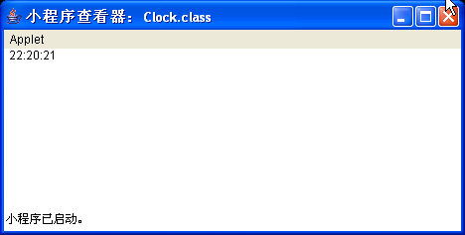
import java.awt.Graphics;
import java.util.*;
import java.text.DateFormat;
import java.applet.Applet;
public class Clock extends Applet implements Runnable {
private Thread clockThread = null;
public void start() {
if (clockThread == null) {
clockThread = new Thread(this, "Clock");
clockThread.start();
}
}
public void run() {
Thread myThread = Thread.currentThread();
while (clockThread == myThread) {
repaint();
try {
Thread.sleep(1000);
} catch (InterruptedException e){
// the VM doesn't want us to sleep anymore,
// so get back to work
}
}
}
public void paint(Graphics g) {
// get the time and convert it to a date
Calendar cal = Calendar.getInstance();
Date date = cal.getTime();
// format it and display it
DateFormat dateFormatter = DateFormat.getTimeInstance();
g.drawString(dateFormatter.format(date), 5, 10);
}
// overrides Applet's stop method, not Thread's
public void stop() {
clockThread = null;
}
}

Slide 11
Thread names
A thread can be given a name, either in its constructor or by calling its setName() method.
You can retrieve the name of a thread by calling its getName() method.
Thread names are a convenience for debugging, but not used by the JVM.

Slide 12
Interrupting threads
InterruptedException -- generated by another thread calling interrupt() only while blocked
interrupt() -- sets interrupt flag for a thread
isInterrupted() -- has interrupt() been called for a thread?
interrupted() -- clears the interrupt flag, returns old value (in current thread)
The interrupt() method doesn't generate an InterruptedException if it occurs while the thread is running.

Slide 13
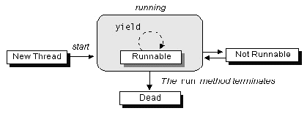
The Life Cycle of a Thread

Slide 14
Thread states
A thread can be in one of four states:
  New -- created, but start() has not been called
  Runnable -- start() has been called, thread is not blocked or dead
  Blocked -- sleep() or wait() called, or waiting on i/o or lock
  Dead -- run() has exited or been terminated by an uncaught exception

Slide 15
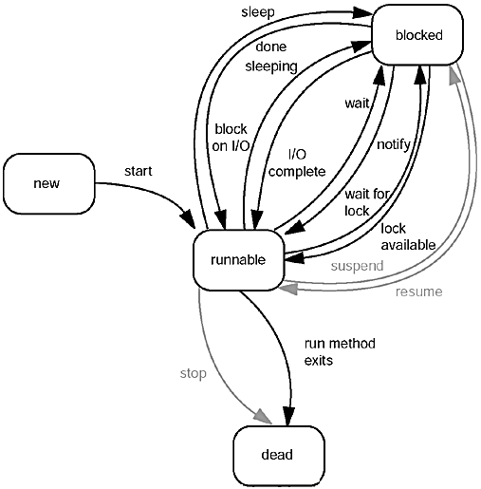
Thread states

Slide 16
Blocked threads
A thread blocks when:
  Someone calls its sleep() method.
  The thread is blocked for i/o.
  The thread has called wait().
  The thread is waiting for an object lock.
A thread unblocks when:
  The sleep() call has completed.
  An i/o operation has completed.
  Another thread calls notify() or notifyAll() to terminate a wait().
  An object lock is released by another object.

Slide 17
Dead threads
A thread dies because:
  Its run() method exits normally.
  It dies because of an uncaught exception.
Call isAlive() to find out if a thread object is alive (runnable or blocked).

Slide 18
Daemon threads
A thread can be marked as a daemon thread:
  someThread.setDaemon(true);
A Java application will terminate if only daemon threads remain.
A thread that isn't a daemon thread is called a user thread.

Slide 19
Thread groups
In a massively threaded program (like a threaded Web server), it is convenient to refer to groups of threads.
A thread group allows you to refer to a number of threads at once.
  ThreadGroup g = new ThreadGroup(groupName);
The Thread constructor allows you to specify the group the new thread will belong to:
  Thread t = new Thread(g,threadName);
The activeCount() method counts the runnable members of a thread group:
  if (g.activeCount() > 0) { ...

Slide 20
Thread groups (continued)
You can interrupt all members of a thread group using the group's interrupt() method:
  g.interrupt();
Thread groups can have subgroups:
  A new thread group is a child of the current group.
  activeCount() and interrupt() refer to all children recursively.
By subclassing ThreadGroup and overriding uncaughtException(), you can be notified when any thread in the group dies because of an uncaught exception.

Slide 21
Thread groups (continued)
The getParent() method returns the parent group of a thread group.
The enumerate() method fills an array with the active threads in a group (but ignores any that won't fit in the array!).

Slide 22
Thread priorities
You can assign priorities to threads. The JVM chooses the highest-priority thread to run when the running thread blocks.
Priority values run from 1 to 10:
  Not all systems support that many levels.
  Some systems have no priority levels.
setPriority() allows a thread to set its priority.
yield() allows a thread to give up control to another thread.
Thread priorities are highly non-portable. Don't depend on them to make your application run.

Slide 23
Synchronization
A thread can be interrupted in the middle of a method, or in the middle of a statement.
Such interruptions can cause data corruption in objects shared between threads.
You can tag any method which should not be interrupted as synchronized.
A synchronized method is guaranteed to finish before another thread can execute any synchronized method of the same object.
Synchronization adds overhead, so you shouldn't apply it indiscriminately to all methods.

Slide 24
Synchronized blocks
Rather than synchronizing an entire method, you can lock an object for the duration of a single block of statements:
  public void whatever()
  {
  ...
  synchronized(myObject) {
  // Several statements that
  // shouldn't be interrupted.
  ...
  }
  ...
  }

Slide 25
Object locks
When control enters a synchronized method or block, the method's object is locked.
Leaving a synchronized method releases the lock, even if an exception is thrown.
An object's lock can only be owned by one thread at a time.
A thread can own multiple locks at one time.
It is possible for a system to deadlock.
Example deadlock: Thread 1 has locked object A and is waiting for object B, while thread 2 has locked object B and is waiting for object A.

Slide 26
wait(), notify(), and notifyAll()
A thread may enter a synchronized object, then discover that it cannot do what it wants.
The thread can call wait() to relinquish its lock and block.
A thread which has called wait() must be unblocked by another thread calling notify() or notifyAll().
notify() notifies one randomly-chosen thread from the set of threads waiting on the object.
notifyAll() notifies all threads waiting on the object.

Slide 27
wait()/notifyAll() --- example
public synchronized void transfer(
int from, int to, int amount)
throws InterruptedException
{
while (accounts[from] < amount)
wait();
accounts[from] -= amount;
accounts[to] += amount;
ntransacts++;
notifyAll();
}

Slide 28
Synchronized static methods
Static methods can also be marked synchronized.
A static method's lock is held on the class, rather than on an object of the class.
Synchronized static methods are used, e.g., for singleton objects.

Slide 29
The Producer/Consumer Example
The Producer generates an integer between 0 and 9 (inclusive), stores it in a CubbyHole object, and prints the generated number
The Consumer consumes all integers from the CubbyHole as quickly as they become available
The Producer and Consumer share data through a common CubbyHole object.

Slide 30
synchronization
The activities of the Producer and Consumer must be synchronized in two ways.
  First, the two threads must not simultaneously access the CubbyHole.
  And second, the two threads must do some simple coordination.
    the Producer must have some way to indicate to the Consumer that the value is ready
    the Consumer must have some way to indicate that the value has been retrieved.
    wait, notify, and notifyAll

Slide 31
Producer
public class Producer extends Thread {
private CubbyHole cubbyhole;
private int number;
public Producer(CubbyHole c, int number) {
cubbyhole = c;
this.number = number;
}
public void run() {
for (int i = 0; i < 10; i++) {
cubbyhole.put(i);
System.out.println("Producer #" + this.number + " put: " + i);
try {
sleep((int)(Math.random() * 100));
} catch (InterruptedException e) { }
}
}
}

Slide 32
public class Consumer extends Thread {
private CubbyHole cubbyhole;
private int number;
public Consumer(CubbyHole c, int number) {
cubbyhole = c;
this.number = number;
}
public void run() {
int value = 0;
for (int i = 0; i < 10; i++) {
value = cubbyhole.get();
System.out.println("Consumer #" + this.number + " got: " + value);
}
}
}

Slide 33
public class CubbyHole {
private int contents;
private boolean available = false;
public synchronized int get() {
while (available == false) {
try {
wait();
} catch (InterruptedException e) { }
}
available = false;
notifyAll();
return contents;
}
public synchronized void put(int value) {
while (available == true) {
try {
wait();
} catch (InterruptedException e) { }
}
contents = value;
available = true;
notifyAll();
}
}

Slide 34
Main program
public class ProducerConsumerTest {
public static void main(String[] args) {
CubbyHole c = new CubbyHole();
Producer p1 = new Producer(c, 1);
Consumer c1 = new Consumer(c, 1);
p1.start();
c1.start();
}
}

Slide 35
Timeouts
A waiting thread is at the mercy of the external world (i/o timeouts, other threads), and might never regain control.
To limit this risk, call the wait() method with a timeout.
When wait() returns, either the timeout expired or some other thread called notify() or notifyAll() on the object.
Check the system time to decide how the wait() terminated.
  long before = System.currentTimeMillis();
  wait(delay);
  long after = System.currentTimeMillis();
  if (after-before > delay)
  // probably was a timeout

Slide 36
Timeouts (continued)
A thread can also block indefinitely when calling an I/O operation that doesn't have a timeout
  Solution: force a timeout by putting the blocking operation into a second thread, and then use join()
The t.join(ms) call blocks the current thread until thread t has completed or ms milliseconds have expired.
  Thread t = new Thread() {
  public void run() {
  // blocking operation
  }
  };
  t.start();
  t.join(msTimeout);
  // may want to interrupt 't' if timeout occurred

Slide 37
Swing threads
Most Swing methods are not synchronized.
Swing is not thread safe!
Don't call methods of Swing objects from any thread other than the GUI thread.
There are some exceptions, including:
  JTextComponent.setText()
  JTextArea.insert()
  JTextArea.append()
  JTextArea.replaceRange()
  Any thread may call repaint() or revalidate() for a JComponent.
  Any thread may call validate() for a JFrame.

Slide 38
Swing threads (continued)
To affect Swing objects from a non-GUI thread, you must use the EventQueue class:
  Create a subclass of Runnable.
  Place the Swing code to be executed in the class's run() method.
  Create an object of the class.
  Pass the object to EventQueue's invokeLater() or invokeAndWait() method.

Slide 39
Swing threads (continued)
  public class LabelUpdater implements Runnable
  {
  public LabelUpdater(JLabel aLabel, int aPercent)
  { label = aLabel; percent = aPercent; }
  public void run()
  { label.setText(percent + "% complete"); }
  private JLabel label;
  private int percent;
  }
  Runnable updater =
  new LabelUpdater(label33, currentPct);
  EventQueue.invokeLater(updater);

Slide 40
Swing threads (continued)
An idiomatic shortcut for the above code:
  EventQueue.invokeLater(
  new Runnable() {
  public void run() {
  label33.setText(currentPct+"% complete");
  }
  }
  );

Slide 41
Animation
We have seen how to use a Timer to perform animation.
You can also use threads for animation.
A timer is a simpler solution for a single animation.
Threads allow asynchronous image loading and multiple interleaved animations.

Slide 42
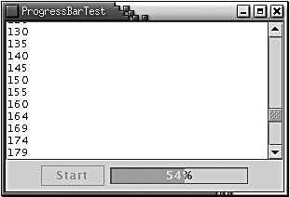
Progress
Swing provides some prebuilt components to keep the user informed of the progress of a task:
  JProgressBar
  ProgressMonitor
  ProgressMonitorInputStream
See the book for details.

Slide 43
Pipes between threads
Communication between threads frequently follows a producer/consumer model.
Java includes pipe classes for byte i/o (PipedInputStream and PipedOutputStream) and character i/o (PipedReader and PipedWriter).
PipedInputStream has two constructors:
  PipedInputStream();
  PipedInputStream(PipedOutputStream source);
PipedOutputStream has two constructors:
  PipedOutputStream();
  PipedOutputStream(PipedInputStream sink);

Slide 44
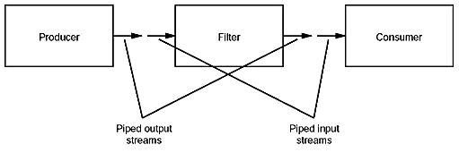
Example

Slide 45
Refactoring

Slide 46
Refactoring
Refactoring: Making small, primarily behavior-neutral changes to a system to improve its design, performance, or future maintainability.

Slide 47
Refactoring (continued)
"Our design patterns capture many of the structures that result from refactoring. … Design patterns thus provide targets for your refactorings." (GoF)
"There is a natural relation between patterns and refactorings. Patterns are where you want to be; refactorings are ways to get there from somewhere else." (Fowler, Refactoring: Improving the Design of Existing Code, Addison-Wesley, 1999.)

Slide 48
Refactoring
We'll look at six example refactorings:
  Extract Method
  Encapsulate Field
  Chain Constructors
  Split Loop
  Parameterize Method
  Split Temporary Variable
There are many more.

Slide 49
Refactoring -- Extract Method
Observation: "You have a code fragment that can be grouped together (i.e. it is a cohesive 'lump' of code)."
Refactoring:
  (1) Turn the fragment into a method whose name explains the purpose of the fragment.
  (2) Replace all occurrences of the fragment with calls to the method.

Slide 50
Extract Method (example)
Before:
  void printOwing()
  {
  printBanner();
  System.out.println("name: " + name);
  System.out.println("amount: " + getOutstanding());
  }
After:
  void printOwing()
  {
  printBanner();
  printDetails(getOutstanding());
  }
  void printDetails (double outstanding)
  {
  System.out.println("name: " + name);
  System.out.println("amount: " + outstanding);
  }

Slide 51
Refactoring -- Encapsulate Field
Observation: "There is a public field."
Refactoring:
  (1) Make the field private.
  (2) Create accessor and mutator methods. (Provide mutator only if needed.)
  (3) Revise all references to the field to call accessors and mutators.

Slide 52
Refactoring -- Chain Constructors
Observation: "There is a class with multiple constructors, each of which does non-trivial and partially overlapping work."
Refactoring:
  (1) Identify and write the 'least common denominator' constructor.
  (2) Recode all other constructors to call this one to do the shared work.

Slide 53
Refactoring -- Split Loop
Observation: "There is a loop that is doing two things." (For example, accumulating both average age and total salary for all employees.)
Refactoring: Split it into two loops.
  Makes each thing easier to understand.
  Opens the door to further refactoring/optimization (e.g., one loop may be replaced by a Collection aggregate function).

Slide 54
Split Loop example -- before
void printValues()
{
double averageAge = 0;
double totalSalary = 0;
for (int i=0; i<people.length; i++) {
averageAge += people[i].age;
totalSalary += people[i].salary;
}
averageAge = averageAge / people.length;
System.out.println(averageAge);
System.out.println(totalSalary);
}

Slide 55
Split Loop example -- after
void printValues()
{
double totalSalary = 0;
for (int i=0; i<people.length; i++)
totalSalary += people[i].salary;
double averageAge = 0;
for (int i=0; i<people.length; i++)
averageAge += people[i].age;
averageAge = averageAge / people.length;
System.out.println(averageAge);
System.out.println(totalSalary);
}

Slide 56
Refactoring -- Parameterize Method
Observation: "Several methods do similar things, but with different values in the method body."
Refactoring:
  (1) Create a parameterized method that can substitute for each repetitive method;
  (2) Compile;
  (3) Replace the body of one method with a call to the new method;
  (4) Compile and test;
  (5) Replace all calls to old method with parameterized calls to new method;
  (6) Repeat 2--6 for all replaced methods.

Slide 57
Refactoring -- Split Temporary Variable
Observation: "You have a temporary variable assigned to more than once, but is not a loop variable nor a collecting temporary variable."
Refactoring: Make a separate temporary variable for each assignment.

Slide 58
Split Temporary Variable example
Before:
  double temp = 2 * (height + width);
  System.out.println(temp);
  temp = height * width;
  System.out.println(temp);
After:
  final double perimeter = 2 * (height + width);
  System.out.println(perimeter);
  final double area = height * width;
  System.out.println(area);

Slide 59
Refactoring browsers
Refactoring by hand is tedious and error-prone.
There are a number of refactoring browsers for Java and other languages.
See, e.g., JRefactory, which integrates into JEdit, Visual Age, and other IDEs (and has a standalone mode as well).

