Slide 1
XML basics

Slide 2
XML
XML == eXtensible Markup Language.
XML is a text-based, hierarchical markup language for structured information.
XML tags describe data's meaning rather than how to display it.
Sun's Java Web site has an excellent, highly-detailed tutorial on XML and Java.

Slide 3
XML in a nutshell
XML is sort of like HTML, except…
An XML document must be well-formed.
XML tags are case-sensitive.
Tag attributes must be quoted.
Empty elements must end with a slash (e.g., <br/>).
A well-formed XML document has elements nested correctly.
A valid XML document is well-formed and conforms to a document type definition (DTD).

Slide 4
XML documents
An XML document starts with a prolog (only the 'version' attribute is required):
  <?xml version="1.0"
  encoding="ISO-8859-1"
  standalone="yes"?>
An XML document consists of elements, some of which may have attributes:
  <BOZO>
  <TURKEY name="tom" weight="26.4">
  <HORSE name="fred" weight="800">
  </BOZO>
Attribute values must be quoted.

Slide 5
XML documents (continued)
An XML document consists of a single root element, which can (and usually does) contain other elements.
An XML document may contain processing instructions for applications which process it:
  <?target-application instruction text?>
Character data must use entities (like the "&amp;" in HTML) to represent special characters, or may use a CDATA section:
  <![CDATA[...many lines of weird stuff here...]]>
The principal decision to be made when designing an XML format is: Should a given item be an element or an attribute of an element?

Slide 6
Namespaces
XML schemas may contain duplicate element names (e.g., common words like TITLE, SUBJECT, and COMMENT).
The XML spec provides for namespaces for names.
Any element can define namespaces for use by itself and its childrens. For example:
  <idiot:head xmlns:idiot="http://www.bozoid.com/idiot">
  <idiot:number>3</idiot:number>
  <idiot:name>Executive Summary</idiot:name>
  </idiot:head>

Slide 7
DTD
An XML document may specify a Document Type Definition (DTD):
  <!DOCTYPE PLAY SYSTEM "play.dtd">
A DTD specifies the allowable elements, attributes, entities, and structure of an XML document.
A DTD is not written in XML!
  This is bad.
  XML Schema and other languages have been proposed to supersede DTDs.
A DTD can be internal or external to the XML document:
  External -- <!DOCTYPE clown SYSTEM "clown.dtd">
  Internal -- <!DOCTYPE clown [ ... ]>
A DTD can define custom entities and attributes.

Slide 8
DTD example
<!-- DTD for a Shakespeare play -->
<!ENTITY amp "&#38;#38;">
<!ELEMENT PLAY (TITLE, FM, PERSONAE, SCNDESCR, PLAYSUBT, INDUCT?, PROLOGUE?, ACT+, EPILOGUE?)>
<!ELEMENT TITLE (#PCDATA)>
<!ELEMENT FM (P+)>
<!ELEMENT P (#PCDATA)>
<!ELEMENT PERSONAE (TITLE, (PERSONA | PGROUP)+)>
<!ELEMENT PGROUP (PERSONA+, GRPDESCR)>
<!ELEMENT PERSONA (#PCDATA)>
<!ELEMENT GRPDESCR (#PCDATA)>
<!ELEMENT SCNDESCR (#PCDATA)>
<!ELEMENT PLAYSUBT (#PCDATA)>
<!ELEMENT INDUCT (TITLE, SUBTITLE*, (SCENE+|(SPEECH|STAGEDIR|SUBHEAD)+))>
<!ELEMENT ACT (TITLE, SUBTITLE*, PROLOGUE?, SCENE+, EPILOGUE?)>
<!ELEMENT SCENE (TITLE, SUBTITLE*, (SPEECH | STAGEDIR | SUBHEAD)+)>
<!ELEMENT PROLOGUE (TITLE, SUBTITLE*, (STAGEDIR | SPEECH)+)>
<!ELEMENT EPILOGUE (TITLE, SUBTITLE*, (STAGEDIR | SPEECH)+)>
<!ELEMENT SPEECH (SPEAKER+, (LINE | STAGEDIR | SUBHEAD)+)>
<!ELEMENT SPEAKER (#PCDATA)>
<!ELEMENT LINE (#PCDATA | STAGEDIR)*>
<!ELEMENT STAGEDIR (#PCDATA)>
<!ELEMENT SUBTITLE (#PCDATA)>
<!ELEMENT SUBHEAD (#PCDATA)>

Slide 9
XHTML
XML-based successor to HTML.
Enforces correct organization of page elements.
Can use RDF (Resource Description Framework) to describe contents of a page.

Slide 10
XML dialects
Besides XHTML, there are many XML dialects for specialized purposes, including:
  SVG -- Scalable Vector Graphics
  MathML -- Mathematical Markup Language
  CBL -- Common Business Library
  SMIL -- Synchronized Multimedia Integration Language
  ICE -- Information and Content Exchange

Slide 11
XML parsing

Slide 12
Parsing XML
Fortunately, you don't have to parse XML yourself -- XML parsers are widely available.
There are two main classes of XML parser:
  SAX (Simple API for XML)
  DOM (Document Object Model)

Slide 13
XML parsers
There are a number of XML parsers, each with its own strengths and weaknesses (speed, memory, error reporting, etc).
Parsers fall into two broad categories:
  Non-validating
  Validating
Validating parsers validate against a DTD, and generate errors if the input is invalid.
XML class libraries allow you to specify the parser you want to use.

Slide 14
XML APIs
JAXP -- Java API for XML Processing
JAXB -- Java API for XML Binding
JDOM -- Java Document Object Model
DOM4J -- an alternate DOM
JAXM -- Java API for XML Messaging
JAX-RPC -- Java API for XML-based Remote Process Communications
JAXR -- Java API for XML Registries

Slide 15
XML APIs (continued)
JAXP has four main packages:
  javax.xml.parsers
  org.w3c.dom
  org.w3c.sax
  javax.xml.transform
DOM4J is a Java2 Collections-based version of DOM.
  Lightweight, Java-only, and can be used standalone.
  See http://www.dom4j.org/.
JDOM is similar in concept.

Slide 16
Using DOM
The DOM, SAX, and XSLT are interfaces:
  Extensive use of factory methods to create parsers.
  Parsers can be exchanged without changing code.
DOM == Document Object Model
Represents an entire XML document in a tree in memory.
Uses three packages:
  org.w3c.dom.*
  org.xml.sax.*
  javax.xml.parsers.*
Faster than SAX, but less efficient for many uses.

Slide 17
Using SAX
SAX == Simple API for XML
Event-driven, serial access for element-by-element processing.
Higher efficiency than DOM.
Uses four packages:
  javax.xml.sax
  org.xml.sax.ext
  org.xml.sax.helpers
  javax.xml.parsers

Slide 18
Using SAX (continued)
Subclass org.xml.sax.helpers.DefaultHandler
DefaultHandler implements four interfaces:
  ContentHandler
  DTDHandler
  EntityResolver
  ErrorHandler
'Callback' methods will be called in order as the SAX parser processes XML input:
  startDocument( )
  startElement( )
  endElement( )
  characters( )
  ...and others as needed...

Slide 19
XSLT
eXtensible Stylesheet Language for Transformations.
Uses XPath to specify sections of an XML document to process.
Includes general programming constructs (variables, conditionals, etc.)
Xalan-Java is an XSLT processor developed by the Apache group.
XSLT includes four main packages:
  javax.xml.transform
  javax.xml.transform.sax
  javax.xml.transform.dom
  javax.xml.transform.stream

Slide 20
RMI

Slide 21
RMI
RMI == Remote Method Invocation
RMI allows code on one computer (the client) to call methods of objects on another computer (the server).
Server object methods are typically computationally intensive or require special resources.
Java RMI only works if both client and server code are written in Java; other standards (CORBA, SOAP, XML-RPC) must be used if multi-language compatibility is required.

Slide 22
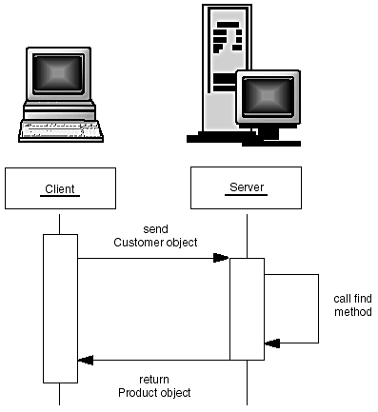
Invoking a remote method on a server object

Slide 23
Stubs and Parameter Marshalling
Stub
  When client invokes a remote method on a remote object, it actually calls an Java method that is encapsulated in a surrogate object called a stub
  The stub resides on the client machine
the stub method builds an information block including:
  An identifier of the remote object to be used;
  A description of the method to be called;
  The marshalled parameters

Slide 24
Stubs and Parameter Marshalling
On the server side, a receiver object performs the following actions for every remote method call:
  It unmarshals the parameters.
  It locates the object to be called.
  It calls the desired method.
  It captures and marshals the return value or exception of the call.
  It sends a package consisting of the marshalled return data back to the stub on the client.

Slide 25
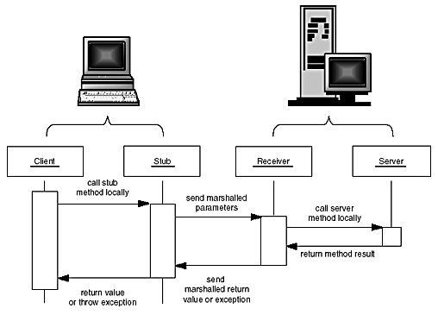
Parameter marshalling

Slide 26
What are needed for a RMI Application
A remote interface
  So, client knows what it can do with remote objects.
  It is shared between the client and server
    resides simultaneously on both client and server machines
Server side
  A server class implementing that interface
  A server program that creates server objects
  A skeleton class
    that is automatically generated by the rmic program; needed for SDK 1.1
  A stub class
    that is automatically generated by the rmic program
    For example, rmic -v1.2 ProductImpl

Slide 27
What are needed for a RMI Application (Con.)
Client side
  A client program that calls remote methods

Slide 28
RMI (continued)
Objects which will be invoked remotely must implement the Remote interface.
Server-side objects extend abstract class java.rmi.server.RemoteServer or its concrete default implementation, UnicastRemoteObject.
  implement the class that actually carries out the methods advertised in the remote interface.
Server-side objects must be 'alive' when they are invoked by a client (i.e., a server must be running, must be listening on the correct port, and must be able to load the object class invoked).
RMI invocations can be synchronous or asynchronous.

Slide 29
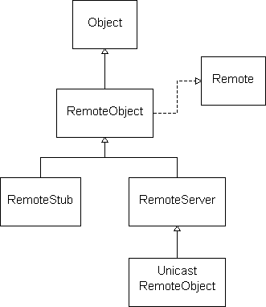
RMI (continued)

Slide 30
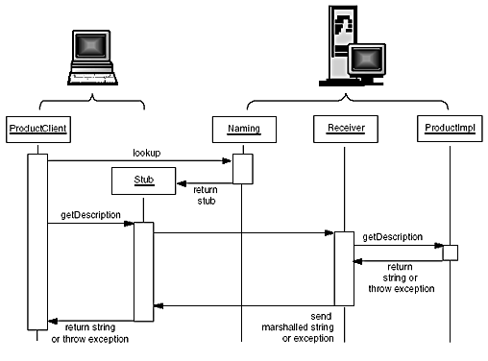
Example - RMI

Slide 31
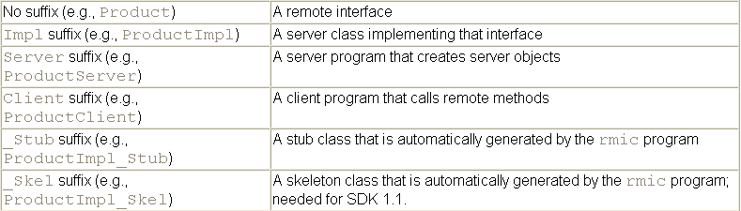
Naming conventions for RMI classes

Slide 32
Locating Server Objects
Server
  Need to register a server object by giving the registry service a reference to the object and a name
  ProductImpl p1 = new ProductImpl("Blackwell Toaster");
  Naming.bind("toaster", p1);
Client
  Need to get a stub to access that server object by specifying the server name and the object name
  Product p = (Product)Naming.lookup("rmi://yourserver.com/toaster");
  // rmi://localhost:99/central_warehouse
  // By default, the port number is 1099.

Slide 33

Server Code - ProductServer.java
1. import java.rmi.*;
2. import java.rmi.server.*;
3.
4. /**
5. This server program instantiates two remote objects,
6. registers them with the naming service, and waits for
7. clients to invoke methods on the remote objects.
8. */
9. public class ProductServer
10. {
11. public static void main(String args[])
12. {
13. try
14. {
15. System.out.println
16. ("Constructing server implementations...");
17.
18. ProductImpl p1
19. = new ProductImpl("Blackwell Toaster");
20. ProductImpl p2
21. = new ProductImpl("ZapXpress Microwave Oven");
22.
23. System.out.println
24. ("Binding server implementations to registry...");
25.
26. Naming.rebind("toaster", p1);
27. Naming.rebind("microwave", p2);
28.
29. System.out.println
30. ("Waiting for invocations from clients...");
31. }
32. catch(Exception e)
33. {
34. e.printStackTrace();
35. }
36. }
37. }

Slide 34
Server Code - ProductImpl.java
1. import java.rmi.*;
2. import java.rmi.server.*;
3.
4. /**
5. This is the implementation class for the remote product
6. objects.
7. */
8. public class ProductImpl
9. extends UnicastRemoteObject
10. implements Product
11. {
12. /**
13. Constructs a product implementation
14. @param n the product name
15. */
16. public ProductImpl(String n) throws RemoteException
17. {
18. name = n;
19. }
20.
21. public String getDescription() throws RemoteException
22. {
23. return "I am a " + name + ". Buy me!";
24. }
25.
26. private String name;
27. }

Slide 35
Server/Client Code - Product.java
1. import java.rmi.*;
2.
3. /**
4. The interface for remote product objects.
5. */
6. public interface Product extends Remote
7. {
8. /**
9. Gets the description of this product.
10. @return the product description
11. */
12. String getDescription() throws RemoteException;
13. }

Slide 36
Starting the server
First, start the RMI registry:
  > start rmiregistry
Then, start the server
  > start java ProductServer

Slide 37
This program verifies that we succeeded in registering the remote objects. The Naming class has a method list that returns a list of all currently registered names.
1. import java.rmi.*;
2. import java.rmi.server.*;
3.
4. /**
5. This programs shows all bindings in the naming service.
6. */
7. public class ShowBindings
8. {
9. public static void main(String[] args)
10. {
11. try
12. {
13. String[] bindings = Naming.list("");
14. for (int i = 0; i < bindings.length; i++)
15. System.out.println(bindings[i]);
16. }
17. catch(Exception e)
18. {
19. e.printStackTrace();
20. }
21. }
22. }
Output should be:
rmi:/toaster
rmi:/microwave

Slide 38
The Client Side
Client programs that use RMI should install a security manager to control the activities of the dynamically loaded stubs.
  use security manager RMISecurityManager.
  System.setSecurityManager(new RMISecurityManager());

Slide 39
1. import java.rmi.*;
2. import java.rmi.server.*;
3.
4. /**
5. This program demonstrates how to call a remote method
6. on two objects that are located through the naming service.
7. */
8. public class ProductClient
9. {
10. public static void main(String[] args)
11. {
12. System.setProperty("java.security.policy", "client.policy");
13. System.setSecurityManager(new RMISecurityManager());
14. String url = "rmi://localhost/";
15. // change to "rmi://yourserver.com/"
16. // when server runs on remote machine
17. // yourserver.com
18. try
19. {
20. Product c1 = (Product)Naming.lookup(url + "toaster");
21. Product c2 = (Product)Naming.lookup(url + "microwave");
22. System.out.println(c1.getDescription());
23. System.out.println(c2.getDescription());
24. }
25. catch(Exception e)
26. {
27. e.printStackTrace();
28. }
29. }
30. }

Slide 40
Gain network permission at the client side
By default, the RMISecurityManager restricts programs from establishing network connections
To allow the client to connect to the RMI registry and the server object, you need to supply a policy file:
  grant
  {
  permission java.net.SocketPermission
  "*:1024-65535", "connect";
  };

Slide 41
Gain network permission at the client side (Con.)
System.setProperty("java.security.policy", "client.policy");
Alternatively, you can specify the system property setting on the command line:
java -Djava.security.policy=client.policy ProductClient

Slide 42
Running the client
Compile the source files for the interface, implementation, client, and server classes.
  javac Product*.java
Run rmic on the implementation class.
  rmic -v1.2 ProductImpl
Start the RMI registry:
  start rmiregistry
Start the server:
  start java ProductServer
Run the client:
  java ProductClient
  (Make sure the client.policy file is in the current directory.)

Slide 43
Other RMI concepts
CORBA == Common Object Request Broker Architecture
CORBA is a language-neutral architecture for large-scale remote method invocation.
Objects on each client communicate through an ORB (Object Request Broker).
Language-independent interface descriptions are written in IDL (Interface Definition Language).
IIOP ==Internet Inter-ORB Protocol

Slide 44
SOAP

Slide 45
SOAP
SOAP (Simple Object Access Protocol) is a language-neutral remote procedure call protocol that works over HTTP.
SOAP is used to implement Web services.
SOAP is language- and platform-neutral.
HTTP tunneling allows SOAP to work through proxies and firewalls.

Slide 46
SOAP (continued)
SOAP's payload can contain integers, floats, strings, dates, and complex, nested structures and records.
SOAP is a lightweight, efficient alternative to RMI and CORBA.
See the "Busy Developer's Guide to SOAP 1.1" at http://www.soapware.org/bdg for a tutorial on a portable SOAP subset.

Slide 47
SOAP example request
POST /examples HTTP/1.1
User-Agent: Radio UserLand/7.0 (WinNT)
Host: localhost:81
Content-Type: text/xml; charset=utf-8
Content-length: 505
SOAPAction: "/examples"
<?xml version="1.0"?>
<SOAP-ENV:Envelope
SOAP-ENV:encodingStyle="http://schemas.xmlsoap.org/soap/encoding/"
xmlns:SOAP-ENC="http://schemas.xmlsoap.org/soap/encoding/"
xmlns:SOAP-ENV="http://schemas.xmlsoap.org/soap/envelope/"
xmlns:xsd="http://www.w3.org/1999/XMLSchema"
xmlns:xsi="http://www.w3.org/1999/XMLSchema-instance">
<SOAP-ENV:Body>
<m:getStateName xmlns:m="http://www.soapware.org/">
<statenum xsi:type="xsd:int">41</statenum>
</m:getStateName>
</SOAP-ENV:Body>
</SOAP-ENV:Envelope>

Slide 48
SOAP example response
HTTP/1.1 200 OK
Connection: close
Content-Length: 521
Content-Type: text/xml; charset=utf-8
Date: Wed, 28 Mar 2001 05:05:04 GMT
Server: UserLand Frontier/7.0-WinNT
<?xml version="1.0"?>
<SOAP-ENV:Envelope
SOAP-ENV:encodingStyle="http://schemas.xmlsoap.org/soap/encoding/"
xmlns:SOAP-ENC="http://schemas.xmlsoap.org/soap/encoding/"
xmlns:SOAP-ENV="http://schemas.xmlsoap.org/soap/envelope/"
xmlns:xsd="http://www.w3.org/1999/XMLSchema"
xmlns:xsi="http://www.w3.org/1999/XMLSchema-instance">
<SOAP-ENV:Body>
<m:getStateNameResponse xmlns:m="http://www.soapware.org/">
<Result xsi:type="xsd:string">South Dakota</Result>
</m:getStateNameResponse>
</SOAP-ENV:Body>
</SOAP-ENV:Envelope>

Slide 49
SOAP -- Amazon Web services request
<?xml version="1.0" encoding="UTF-8"?>
<SOAP-ENV:Envelope
xmlns:SOAP-ENV="http://schemas.xmlsoap.org/soap/envelope/"
xmlns:SOAP-ENC="http://schemas.xmlsoap.org/soap/encoding/"
xmlns:xsi="http://www.w3.org/2001/XMLSchema-instance"
xmlns:xsd="http://www.w3.org/2001/XMLSchema"
SOAP-ENV:encodingStyle=
"http://schemas.xmlsoap.org/soap/encoding/">
<SOAP-ENV:Body>
<namesp1:AuthorSearchRequest
xmlns:namesp1="urn:PI/DevCentral/SoapService">
<AuthorSearchRequest xsi:type="m:AuthorRequest">
<author>king</author>
<page>1</page>
<mode>books</mode>
<tag>webservices-20</tag>
<type>lite</type>
<dev-tag >your-dev-tag</dev-tag>
<format>xml</format>
<version>1.0</version>
</AuthorSearchRequest>
</namesp1:AuthorSearchRequest>
</SOAP-ENV:Body>
</SOAP-ENV:Envelope>

Slide 50
XML-RPC

Slide 51
XML-RPC
XML-RPC == XML-based Remote Procedure Call
When Microsoft became involved in the SOAP standardization effort, the protocol immediately got heavier and less standard.
Dave Winer (UserLand) and others decided to create an even simpler version of SOAP -- XML-RPC.
Like SOAP, XML-RPC tunnels over HTTP.
Unlike SOAP, XML-RPC has a small, fixed set of datatypes.
See http://www.xmlrpc.org/ for more details.

Slide 52
XML-RPC (continued)
There are XML-RPC implementations for most languages, including Java, Perl, Python, Rexx, Tcl, C, C++, Lisp, and PHP. (Frequently there are several implementations for each langauge.)
The Apache Project provides a good Java XML-RPC implementation:
  Built-in Web server for standalone XML-RPC implementations.
  Asynchronous calls.
  Multiple message handlers per Web server.

Slide 53
XML-RPC (continued)
In languages like Python, an XML-RPC client request is trivial:
  import xmlrpclib
  s = xmlrpclib.Server("http://localhost:9010")
  s.reverse("This is a test!")
In Java, a client is only slightly more difficult to implement.

Slide 54
XML-RPC -- Server example
import org.apache.xmlrpc.*;
import java.util.*; // for Vector
public class Bserver
{
public static void main(String[] argv)
{
HashMap m = new HashMap(); // Storage shared by clients.
try {
WebServer ws = new WebServer(9090);
ws.addHandler("$default",new RHandler());
ws.start();
}
catch (Exception e) {
e.printStackTrace();
}
}
}

Slide 55
XML-RPC -- Server example (cont'd)
/**
Handler with a reverse() function.
*/
class RHandler implements XmlRpcHandler
{
public Object execute(String method,Vector params)
throws Exception
{
if (method.endsWith("reverse")) {
return (new StringBuffer((String)(params.get(0)))).
reverse().toString();
}
return "Unknown method name: " + method;
}
}

Slide 56
XML-RPC -- Java client example
import org.apache.xmlrpc.*;
import java.util.*; // for Vector
public class Bclient
{
public static void main(String[] argv)
{
try {
XmlRpcClient c =
new XmlRpcClient("http://localhost:9010/");
Vector params = new Vector();
params.addElement("This is a test!");
String answer =
(String)c.execute("other.reverse",params);
System.out.println("Answer: " + answer);
}
catch (Exception e) {
e.printStackTrace();
}
}
}

