Slide 1

Optimization

Slide 2

Optimization Quotes
Rules of Optimization
  Rule 1: Don’t do it.
  Rule 2 (for experts only): Don’t do it yet.
    M.A. Jackson
“More computing sins are commited in the name of efficiency (without necessariy achieving it) that for any other reason – including blind stupidity.” – W.A. Wulf
  Y2K bug! – saving 2 bytes!
We should forget about small efficiencies, say about 97% of the time: premature optimization is the root of all evil.” – Donald Knuth

Slide 3
Optimization 101
Reality
  Hard to predict where the bottlenecks are
  Easier to use tools to measure the bottlenecks once the code is written
    Write the code you want to be correct and finished first, then worry about optimization
“Premature Optimization” = evil
  Classic advice from Don Knuth
  Write the code to be straightforward and correct first
  May already be fast enough!
    If not, measure the bottleneck
    Focus optimization on bottleneck using Algorithms and Language optimizations

Slide 4
Optimization 101
Data Structures
  Have a profound influence on performance
    Early design helps once
  Choice of datastructure can constrain what algorithms you can use
Proportionality to Caller
  Foo() takes 1 ms. Bar() calls foo.
    If Bar() takes 20 ms, it’s not worth looking at Foo()
    If Bar() takes 2ms, then we should look at Foo()

Slide 5
Optimization 101
1-1 User Event Rule
  If something happened a fixed number of times (1-3) for each user event, then it’s not worth looking at
  If something happens 100s of times for each user even then it is worth looking at
  User events are very slow from the CPU’s perspective

Slide 6
Java Optimization Tip #1
1-10-100 Rule
  Assignment – 1 unit of time
  Method call – 10 units of time
  New Object or Array – 100 units of time
    Rule of thumb only. Not scientific.
    Hard to determine the actual cost
Also sometimes known as the 1-10-1000 rule, but modern GC is much more efficient
  Bad idea to try and maintain your own free list. The GC knows best.

Slide 7
Java Optimization Tip #2
int getWidth() vs. Dimension getSize()
  getSize() requires a heap allocated object
  getWidth() and getHeight() may just be inlined to move the two ints right into the local variables of the caller code
With Hotspot, shortlived object (like Dimension) are less of a concern…

Slide 8
Java Optimization Tip #3
Locals are faster than Instance variables
  Local (stack) variables faster than any member variables of objects
    Easier for the optimizer to work with
Inside loops, pull needed values into local variables
  1. Slow: message send
    … i < piece.getWidth()
  2. Medium: instance variable
    … i < piece.width
  3. Fast: local variable
    … final int width = piece.getWidth
    … i < width
      This is faster since the JIT can put the value in a native register

Slide 9
Java Optimization Tip #4
Avoid Synchronized (Vector)
  Synchronized methods have a cost associated with them
    This is significantly improved in Java 1.3
  Can have synchronized and unsynchronized methods and switch based on some flag
  Use “immutable” objects to finesse synchronization problems
  Vector class is sychronized for everything
    Use ArrayList instead!
    If you can use a regular array, even better

Slide 10
Java Optimization Tip #5
StringBuffer
  Use StringBuffer for multiple append operations
  Convert to String only when done
Automatic case
  Compiler optimizes the case of several string +’d together on one line
  String s = “a string” + foo.toString() + “more”
No:
  String record; // ivar
  void transaction(String id) {
  record = record + " " + id; // NO, chews through memory
  }
Yes:
  StringBuffer record;
  void transaction(String id) {
  record.append(" ");
  record.append(id); + id;
  }

Slide 11
Java Optimization Tip #6
Don’t Parse
  Obvious but slow strategy – read in XML, ASCII, etc.
  Build a big data structure
Faster approach
  Read into memory, but keep as characters
  Search/Parse when needed
  Or Parse only subparts

Slide 12
Java Optimization Tip #7
Avoid weird code
  JVM will optimize most stadard coding styles
    So write code in the most obvious, common way
  Weird code is often the result of an attempt at optimization!
Let the JIT/Hotspot do it’s thing!

Slide 13
Java Optimization Tip #8
Threading / GUI Threading
  Use separate thread to ensure the GUI is snappy
Pros
  Makes best use of parallel hardware
Cons
  Software is harder to write
  Bugs can be subtle
  Locking/Unlocking costs

Slide 14
Java Optimization Tip #9
Inlining Methods/Classes
  JVM optimizers and HotSpot use aggressive inlining
    Pasting called code into the caller code
  final keyword
    for a class means it will not be subclassed
    for a method means it will not be overridden
  Use final keyword to help the optimizer do more inlining

Slide 15
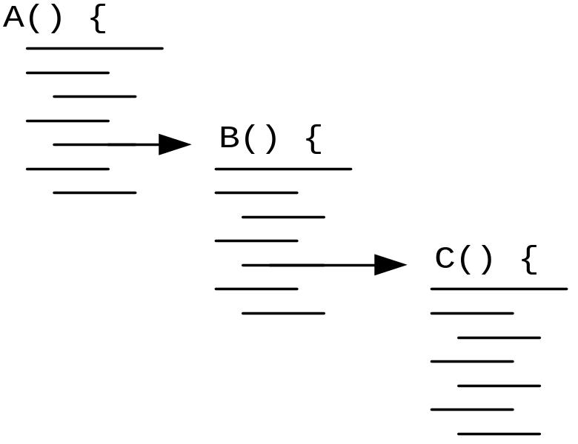
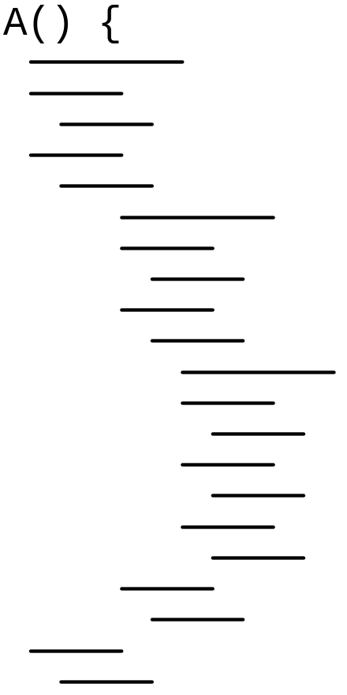
Java Optimization Tip #9 cont.
Non-Inlined
Inlined

Slide 16
Java Optimization Tip #9 cont.
Advantages of inlining
  Values are passed from A() to B() to C()
    After inlining, the values can just stay in registers
    Reduced number of load/saves
  Propogation of analysis
    Having code inlined can often lead to better optimizations since the compiler can see values from start to finish

Slide 17
Java Optimization Tip #10
Think about memory traffic
  Old: CPU bound
  New: Memory bound
    CPU operations are cheaper and faster
    Once data is in the cache it is cheaper to work with
      Reduce the roundtrips to memory, disk, network
  Linked List vs. Chunked List
    Linked List: Read a node, then fetch the next node
    Chunked List: Each element contains a small array of elements
      Makes better use of cache lines/memory pages
      … some of this is very low level! ☺

