Slide 1
Fundamental Programming Structures in Java

Slide 2
Your first program
Package edu.ynu.java.lession1
/*
The simplest Java program
*/
public class FirstJavaProg
{
public static void main(String[] args)
{
// System.out is the standard output stream.
System.out.println("Hello!");
}
}

Slide 3
Items to notice
Everything in a Java program must be inside a class.
The name of the .java file is the same as the name of its public class.
Case is significant!
Class names should start with an upper-case letter.
A source file may have only one public class.
System.out is the standard output stream object. One of its methods is println().

Slide 4
Compile and run
Save the program as FirstJavaProg.java.
Compile with javac, and run with java.
$ javac FirstJavaProg.java
$ java FirstJavaProg
Hello!
$
Easy, no?

Slide 5
More items to notice:
The argument to the javac compiler includes the .java extension.
The argument to the java runtime is the class name without the .class extension
  the JVM looks in all directories (and archive files) in CLASSPATH for classes.
The java interpreter looks for a public static void method named main in the public class. (We’ll cover the meanings of those attributes later.)

Slide 6
Comments
Comments ignored during program execution
Document and describe code
Provides code readability
  Single-line comments start with // and extend to the end of the line.
  Multiline comments are bracketed with /* … */.
  javadoc comments are bracketed with /** … */.
  Note: line numbers not part of program, added for reference
// This is my first Java program

Slide 7
System.out
System class
  Out represents the screen
System.out.println()
  Prints the string followed by an end of line
  Forces a flush
System.out.print()
  Does not print the end of line
  Does not force a flush
System.out.flush()
  Force a flush

Slide 8

Graphical Applications
A graphical application – ImageViewer.java, It simply loads and displays a GIF file
  javac ImageViewer.java
  java ImageViewer

Slide 9

import java.awt.*;
import java.awt.event.*;
import java.io.*;
import javax.swing.*;
/**
A program for viewing images.
*/
public class ImageViewer
{
public static void main(String[] args)
{
JFrame frame = new ImageViewerFrame();
frame.setDefaultCloseOperation(JFrame.EXIT_ON_CLOSE);
frame.show();
}
}
/**
A frame with a label to show an image.
*/
class ImageViewerFrame extends JFrame
{
public ImageViewerFrame()
{
setTitle("ImageViewer");
setSize(DEFAULT_WIDTH, DEFAULT_HEIGHT);
// use a label to display the images
label = new JLabel();
Container contentPane = getContentPane();
contentPane.add(label);
// set up the file chooser
chooser = new JFileChooser();
chooser.setCurrentDirectory(new File("."));

Slide 10
// set up the menu bar
JMenuBar menuBar = new JMenuBar();
setJMenuBar(menuBar);
JMenu menu = new JMenu("File");
menuBar.add(menu);
JMenuItem openItem = new JMenuItem("Open");
menu.add(openItem);
openItem.addActionListener(new
ActionListener()
{
public void actionPerformed(ActionEvent evt)
{
// show file chooser dialog
int r = chooser.showOpenDialog(null);
// if file selected, set it as icon of the label
if(r == JFileChooser.APPROVE_OPTION)
{
String name
= chooser.getSelectedFile().getPath();
label.setIcon(new ImageIcon(name));
}
}
});
JMenuItem exitItem = new JMenuItem("Exit");
menu.add(exitItem);
exitItem.addActionListener(new
ActionListener()
{
public void actionPerformed(ActionEvent event)
{
System.exit(0);
}
});
}

Slide 11
private JLabel label;
private JFileChooser chooser;
private static final int DEFAULT_WIDTH = 300;
private static final int DEFAULT_HEIGHT = 400;
}

Slide 12
Datatypes

Slide 13
Java datatypes
Unlike C, C++, and other languages, Java’s primitive datatypes are fully specified in the language design.
Numeric types behave identically (almost) on all platforms.
Arrays and strings are objects, not primitives.
Numeric types include standard type promotion behavior.
All integral types are signed.
Java supplies wrapper classes (such as Integer and Double) for the primitive types.

Slide 14
Integer datatypes
byte (1 bytes, -128 … 127)
short (2 bytes, -32,768 … 32,767)
int (4 bytes, -2,147,483,648 … 2,147,483,647)
long (8 bytes)
Integer literals can be specified in several bases:
  Decimal — -99 or 32174
  Octal — 012 or 07
  Hexadecimal — 0xff or 0XABCDEF01
long literals must be suffixed with ‘l’ or ‘L’.
Hexadecimal numbers have a prefix 0x
  For example, 0xCAFE
Octal numbers have a prefix 0.
  For example, 010 is 8

Slide 15
Integer datatypes (continued)
The Integer, Short, etc. classes supply utility functions (e.g., Integer.parseInt('12345')) for integral types.
For very large, very precise fixed-point data, use the java.math.BigInteger class.
For highly precise floating-point data, use the java.math.BigDecimal class.

Slide 16
Floating-point datatypes
float
  4 bytes
  6.5 significant digits
  ±3.4028E+38F
  denoted by ‘F’ or ‘f’ suffix
double
  8 bytes
  15 significant digits
  ±1.7977E+308
  denoted by ‘D’ or ‘d’ suffix (or no suffix)

Slide 17
Continue
Three special floating-point values:
  positive infinity - Double.POSITIVE_INFINITY
  negative infinity - Double.NEGATIVE_ INFINITY
  NaN (not a number) - Double.NaN
They are rarely used in practice. You cannot test
if (x == Double.NaN) // is never true to check whether a particular result equals Double.NaN.
However, you can use the Double.isNaN method:
if (Double.isNaN(x)) // check whether x is "not a number"

Slide 18
Boolean datatype
boolean
Only allowable values are true and false.
Not an integral type!

Slide 19
Character datatype
char
Literal is character enclosed in single quotes ('c')
16-bit Unicode values
  Literals can be encoded as '\u0000'
  E.g., '\u0009' is the ASCII TAB character
Includes some of the usual escape sequences:
  \n — newline
  \r — carriage return
  \t — tab
Utility methods (e.g., Character.isLetterOrDigit('c')) are provided by the Character built-in class.

Slide 20
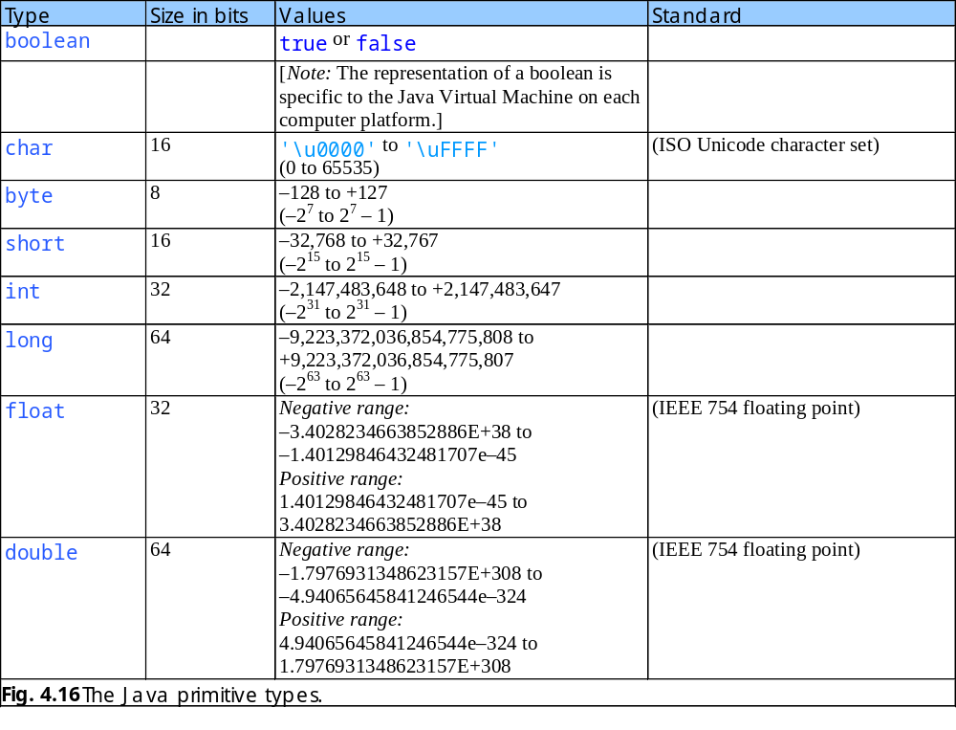

Slide 21
Syntax

Slide 22
Variables
Variables are declared as in C++:
  int a;
  double b, c, d;
Variable names:
  Must start with a letter.
  Can be of unlimited length.
  Can include Unicode characters.
Variable declaration can include initialization.
  boolean isSilly = true;
Variables can be declared in any block and have block scope.
Conventionally, variable names start with a lower-case letter.

Slide 23
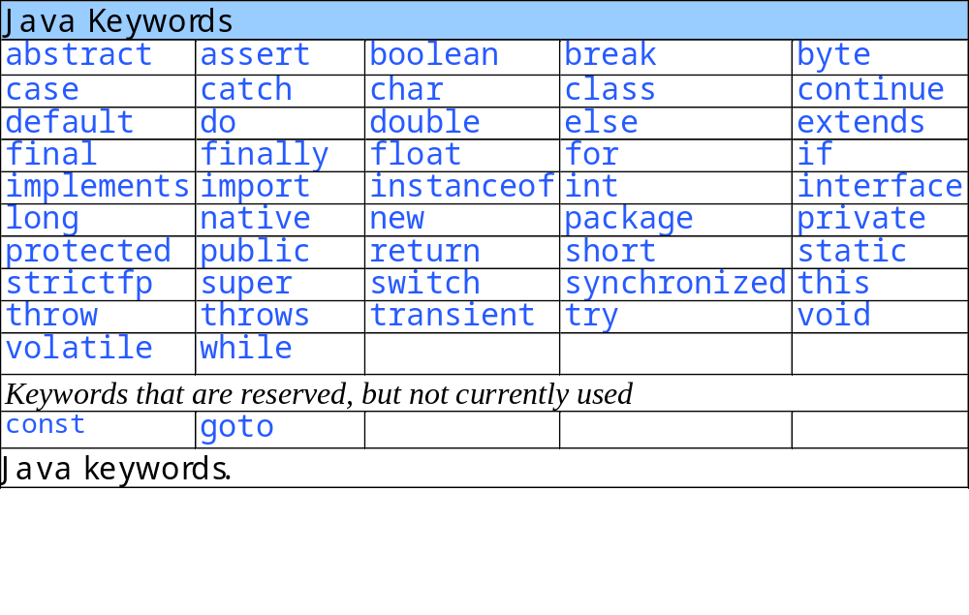
Variable name can not be a Java reserved word

Slide 24
Assignments and Initializations
int vacationDays; // this is a declaration
vacationDays = 12; // this is an assignment
You can declare and initialize a variable on the same line.
int vacationDays = 12; // this is an initialization
You can put declarations anywhere in your code.
double salary = 65000.0;
System.out.println(salary);
int vacationDays = 12; // ok to declare variable here

Slide 25
Constants
Look like variables…
…but are declared final.
  final int BOZO=32;
  final double PI=3.14159;
Conventionally, constant names are all upper case.
Constants can be made available to all methods in a class:
  Must be defined outside any method (but inside the class definition!).
  Must be marked static final.

Slide 26
Example of Constants
public class Constants
{
public static void main(String[] args)
{
final double CM_PER_INCH = 2.54;
double paperWidth = 8.5;
double paperHeight = 11;
System.out.println("Paper size in centimeter: "
+ paperWidth * CM_PER_INCH + " by "
+ paperHeight * CM_PER_INCH);
}
}

Slide 27
Operators
Arithmetic +, -, *, /, and %.
Prefix and postfix ++ and --.
Boolean ==, !=, <, <=, >, >=, &&, and ||.
Bitwise &, |, ^, and ~.
Arithmetic shift << and >>.
Logical shift >>>.

Slide 28
Logical Operators
Logical operators
  Allows for forming more complex conditions
  Combines simple conditions
Java logical operators
  && (conditional AND)
  & (boolean logical AND)
  || (conditional OR)
  | (boolean logical inclusive OR)
  ^ (boolean logical exclusive OR)
  ! (logical NOT)

Slide 29
Increment and Decrement Operators
Note the difference between prefix and postfix
int m = 7;
int n = 7;
int a = 2 * ++m; // now a is 16, m is 8
int b = 2 * n++; // now b is 14, n is 8

Slide 30
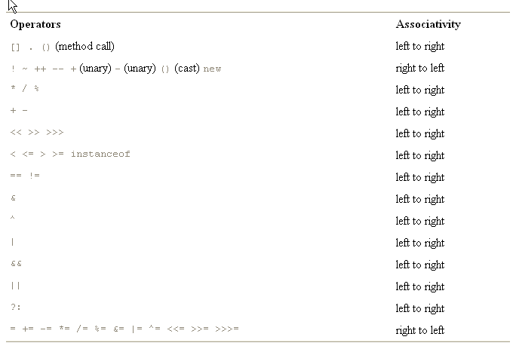
Precedence of Operators

Slide 31
Higher math functions
Available in the built-in Math class
Constants (e.g, Math.PI)
Functions (e.g., Math.sin())

Slide 32
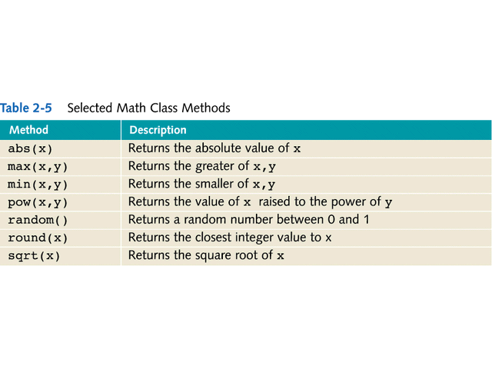

Slide 33
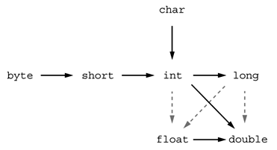
Conversions Between Numeric Types
The six solid arrows - conversions without information loss.
The three dotted arrows - conversions that may lose precision
int n = 123456789;
float f = n; // f is 1.23456792E8

Slide 34
Conversion Rules
When combining two values with a binary operator both operands are converted to a common type before the operation is carried out.
  If any of the operands is of type double, the other one will be converted to a double.
  Otherwise, if any of the operands is of type float, the other one will be converted to a float.
  Otherwise, if any of the operands is of type long, the other one will be converted to a long.
  Otherwise, both operands will be converted to an int.

Slide 35
Casts
Conversions can be done by means of casts.
  The syntax for casting is to give the target type in parentheses, followed by the variable name.
double x = 9.997;
int nx = (int)x; // nx has the value 9, as casting a floating-point value to an integer discards the fractional part.
Round a floating-point number to the nearest integer - use the Math.round method:
double x = 9.997;
int nx = (int)Math.round(x);

Slide 36
Strings
Java has great support for Strings
  String is an object, not a point to an array of chars
  Strings (and char) both use 2-byte characters to support Internationalization (Chinese, Kanji, Russian)
  Strings are “Immutable”
    String state doesn’t change
    No append() or reverse() that changes the state of the object
    To change a String, a new String is created!
    This is done to allow sharing of objects

Slide 37
Strings (cont)
String constants
  Use double quotes
    “Hello World!”
  Builds a string and returns a pointer to it
String concatenation
  Official way String.concat
  BUT for ease of use “This” + “That” will work!
    String a = "foo";
    String b = a + "bar"; // b is now "foobar“
toString()
  Most classes support a toString which will give a String representation of an Object!

Slide 38
Changing String Values
Strings have no methods to let you change an existing character in a string.
  To change a string you have to reassign the variable to a new string.
  example:
    String greeting = “Hello”;
    greeting = greeting.substr(0,4) + “!”;
    Result: greeting is now “Hell!”

Slide 39
String (Continued)
Initializing a String is painless
  s1 = “This is some java String”;
Memory is allocated dynamically.
Think of above method as shortcut for more standard way (assuming s1 has been declared):
s1 = new String(“This is some java String”);
new operator required to create memory for new String object.
StringBuffer class (covered later) provides mutable strings.

Slide 40
String Class methods
Extensive list of methods available in the API documentation!
  int length() -- number of chars
  char charAt(int index) -- char at given 0-based index
  int indexOf(char c) -- first occurrence of char, or -1
  int indexOf(String s)
  boolean equals(Object) -- test if two strings have the same characters
  boolean equalsIgnoreCase(Object) -- as above, but ignoring case
  String toLowerCase() -- return a new String, lowercase
  String substring(int begin, int end) -- return a new String made of the begin..end-1 substring from the original

Slide 41
String example
String a = "hello"; // allocate 2 String objects
String b = "there";
String c = a; // point to same String as a – fine
int len = a.length(); // 5
String d = a + " " + b; // "hello there"
int find = d.indexOf("there"); // find: 6
String sub = d.substring(6, 11); // extract: "there“
sub == b; // false (== compares pointers)
sub.equals(b); // true (a "deep" comparison)

Slide 42
String Methods
Substrings - extract a substring from a larger string
String greeting = "Hello";
String s = greeting.substring(0, 4); // “Hell”
public String substring(int beginIndex, int endIndex)
  beginIndex - the begin index, inclusive.
  endIndex - the end index, exclusive.
public String substring(int beginIndex)

Slide 43
String Methods (Continued)
Find out the length of a string - use the length method. String greeting = "Hello";
int n = greeting.length(); // is 5.
Get at individual characters of a string – charAt()
char last = greeting.charAt(4); // fourth is 'o'
public char charAt(int index)
  index - the index of the character.

Slide 44
Comparing String Values
Because String variables hold memory addresses, you cannot make a simple comparison
The String class provides a number of methods
  equals() method
  equalsIgnoreCase() method
  compareTo() method

Slide 45
Testing Strings for Equality
Use the equals method;
s.equals(t) // returns true if the strings s and t are equal, false otherwise.
s and t can be string variables or string constants. "Hello".equals(command) // OK
To test if two strings are identical except for the upper/lowercase letter distinction
"Hello".equalsIgnoreCase("hello")

Slide 46
Do not use == to test string equality
== operator only determines whether or not the strings are stored in the same location
String greeting = "Hello";
if (greeting == "Hello") . . . // probably true
if (greeting.substring(0, 4) == "Hell") . . . // probably false

Slide 47
Comparing String Values
compareTo() method- Used to compare two Strings
  Returns zero only if the two Strings hold the same value
  If there is any difference between the Strings, a negative number is returned if the calling object is “less than” the argument
  A positive number is returned if the calling object is “more than” the argument
  Strings are considered “less than” or “more than” each other based on their Unicode values

Slide 48
Using Other String Methods
indexOf() method determines whether a specific character occurs within a String
  If it does contain that character, the method returns the position of the character
  The first position of a String is zero, not one
  The return value is -1 if the character is not in the String

Slide 49
Parsings Strings
To convert a String to int, use the Integer.parseInt(String) function.
  Ex. String s1 = “32”;
  int j = Integer.parseInt(s1); // j now holds 32
Converting to double is analogous:
  Ex. String s1 = “32”;
  double j = Double.parseDouble(s1); // j now holds 32

Slide 50
Using Other Methods
charAt() method requires an integer argument which indicates the position of the character that the method returns
endsWith() method and the startsWith() method each take a String argument and return true or false if a string object does or does not end or start with the specified argument
replace() method allows you to replace all occurrences of some character within a String
toString() method converts any primitive type to a String

Slide 51
char charAt(int index) // returns the character at the specified location.
int compareTo(String other) // returns a negative value if the string comes before other in dictionary order, a positive value if the string comes after other in dictionary order, or 0 if the strings are equal.
boolean endsWith(String suffix) // returns true if the string ends with suffix.
boolean equals(Object other) // returns true if the string equals other.
boolean equalsIgnoreCase(String other) // returns true if the string equals other, except for upper/lowercase distinction.
int indexOf(String str)
int indexOf(String str, int fromIndex) // return the start of the first substring equal to str, starting at index 0 or at fromIndex.
int lastIndexOf(String str)
int lastIndexOf(String str, int fromIndex) // return the start of the last substring equal to str, starting at the end of the string or at fromIndex.
int length() // returns the length of the string.
String replace(char oldChar, char newChar) // returns a new string that is obtained by replacing all characters oldChar in the string with newChar.
boolean startsWith(String prefix) // returns true if the string begins with prefix.
String substring(int beginIndex)
String substring(int beginIndex, int endIndex) // return a new string consisting of all characters from beginIndex until the end of the string or until endIndex (exclusive).
String toLowerCase() // returns a new string in lower case.
String toUpperCase() // returns a new string in upper case.
String trim() // returns a new string by eliminating all leading and trailing spaces in the original string.

Slide 52
Learning about the StringBuffer Class
A String class limitation is that the value of a String is fixed after the string is created
Using StringBuffer objects provide more flexibility than String objects because you can insert or append new contents into a StringBuffer

Slide 53
StringBuffer
StringBuffer is an alternative to the String class
  Part of the java.lang package
Must use the keyword new and provide an initializing value between parentheses
A StringBuffer object contains a memory block called a buffer which might not contain a string

Slide 54
StringBuffer
The length of the String may not be the same as the length of the buffer
The length of the buffer is referred to as the capacity of the StringBuffer object
You can change the length of a String in a StringBuffer object with the setLength() method
When the StringBuffer object’s length is longer than the String it holds, the extra characters contain ‘\u0000’
If you use the setLength() method to specify a length shorter than its String, the string is truncated

Slide 55
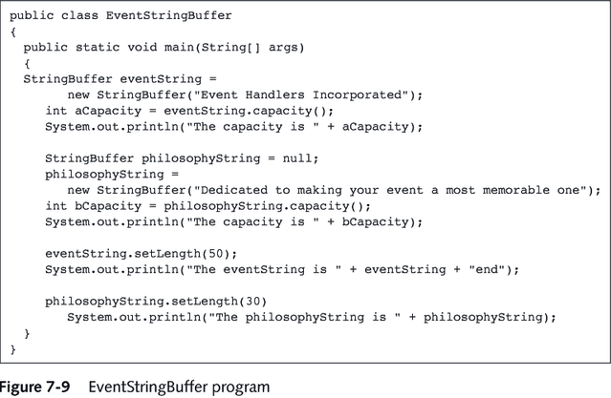

Slide 56
StringBuffer Constructors
The StringBuffer class provides 3 constructors
  public StringBuffer() constructs a StringBuffer with no characters and a default size of 16 characters
  public StringBuffer(int length) constructs a StringBuffer with no characters and a capacity specified by length
  public StringBuffer(String s) contains the same characters as those stored in the String object s

Slide 57
StringBuffer Methods
append() method- Lets you add characters to the end of a StringBuffer object
insert() method- Lets you add characters at a specified location within a StringBuffer object
setCharAt() method- Use to alter just one character in a StringBuffer

Slide 58
StringBuffer Methods
charAt() method extracts characters from a StringBuffer object
  Accepts an argument that is the offset of the character position from the beginning of a String

Slide 59
StringBuffer
StringBuffer Example
StringBuffer buff = new StringBuffer();
for (int i=0; i<100; i++) {
buff.append(<some thing>);
// efficient append
}
String result = buff.toString();
// make a String once done with appending

Slide 60
StringTokenizer
Used to break up a string based on a certain “token”
  e.g. take the string “Homer, Marge, Bart, Lisa, Maggie” You can use the StringTokenizer to break up the string based on the comma to get five separate strings “Homer” “Marge” “Bart” “Lisa” and “Maggie”
Example:
  String testString = “one-two-three”;
  StringTokenizer st = new StringTokenizer(testString,”-");
  while (st.hasMoreTokens()) {
  String nextName = st.nextToken();
  System.out.println(nextName);
  }
  Result:
  one
  two
  three

Slide 61
Miscellany

Slide 62
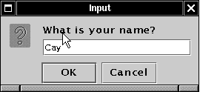
Reading Input
Use a dialog box for keyboard input in Java
  JOptionPane.showInputDialog(promptString)
Examples
  String name = JOptionPane.showInputDialog("What is your name?");
  String input = JOptionPane.showInputDialog("How old are you?");
  int age = Integer.parseInt(input);

Slide 63
import javax.swing.*;
public class InputTest
{
public static void main(String[] args)
{
// get first input
String name = JOptionPane.showInputDialog
("What is your name?");
// get second input
String input = JOptionPane.showInputDialog
("How old are you?");
// convert string to integer value
int age = Integer.parseInt(input);
// display output on console
System.out.println("Hello, " + name +
". Next year, you'll be " + (age + 1));
System.exit(0);
}
}

Slide 64
Command-line arguments
Available as an array of Strings passed to main.
Element zero of the argument array is the first argument, not the program name or class name.
Example:
  class ArgTest
  {
  public static void main(String[] args)
  {
  for (int i=0; i<args.length; i++)
  System.out.println(args[i]);
  }
  }

Slide 65
Code conventions
Source code formatting conventions are important for a number of reasons, such as:
  All members of a team project can understand each others’ code.
  Using common idioms can help you understand your own code (and examples in manual!).
  Future maintenance programmers can understand code which adheres to common conventions.
In this course, you must use Sun’s Java language formatting conventions

Slide 66
Code conventions (continued)
Some conventions you will follow:
  Tab stops are 4 characters wide.
  Source lines may be no longer than 72 characters.
  Indentation must be consistent.
  Do not use the "} else {" idiom.
We will return to this subject in future classes.

