Slide 1
Formatting

Slide 2
Number formatting
Sadly, Java lacks printf()-style formatting.
Simple printing with System.out.println() is insufficient for production use:
  Precision is not controlled
  Output is not sensitive to locale
Use the NumberFormat class to format numbers, currency, and percentages:
Obtain a formatter for the default locale
  NumberFormat.getNumberInstance()
  NumberFormat.getCurrencyInstance()
  NumberFormat.getPercentInstance()

Slide 3

Obtain number formats that are appropriate for different locales
Locale.GERMANY
Locale.US
double x = 10000.0 / 3.0;
NumberFormat formatter = NumberFormat.getNumberInstance();
// NumberFormat.getNumberInstance(Locale.GERMANY);
String s = formatter.format(x); // the string "3,333.33"
formatter.setMaximumFractionDigits(4);
formatter.setMinimumIntegerDigits(6);
String s = formatter.format(x); // the string "003,333.3333"

Slide 4
Number formatting (continued)
NumberFormat class provides factory methods to create formats for numbers, currency, and percentages.
A NumberFormat object provides methods to:
  Get and set number of fraction digits
  Get and set number of integer digits
  Parse strings to numbers
  Format numbers as strings

Slide 5
Formatting and locales
Formatting should follow the conventions of a locale.
A locale is an identifier for a set of formatting preferences.
Use java.util.Locale.getAvailableLocales() to list available locales.
Locale.getDefault() returns system's default locale.
Pass a Locale to a NumberFormat factory method (like getCurrencyInstance(Locale.US)) to get an appropriate formatter.

Slide 6
static NumberFormat getCurrencyInstance()
// returns a NumberFormat object to convert currency values to strings using the conventions of the current locale.
static NumberFormat getNumberInstance()
// returns a NumberFormat object to format numbers using the conventions of the current locale.
static NumberFormat getPercentInstance()
// returns a NumberFormat object to convert percentages to strings.
String format(double number)
// returns a string that contains the formatted number.
void setMaximumFractionDigits(int digits)
// Parameters:
// Digits: the number of digits to display
// sets the maximum number of digits after the decimal point for the format object. The last
// displayed digit is rounded.
void setMaximumIntegerDigits(int digits)
// Parameters:
// Digits: the number of digits to display
// sets the maximum number of digits before the decimal point for the format object. Use this method with extreme caution. If you specify too few digits, then the number is simply truncated, displaying a dramatically wrong result!
void setMinimumFractionDigits(int digits)
// Parameters:
// Digits: the number of digits to display
// sets the minimum number of digits after the decimal point for the format object. If the number has fewer fractional digits than the minimum, then trailing zeroes are supplied.
void setMinimumIntegerDigits(int digits)
// Parameters:
// Digits: the number of digits to display
// sets the minimum number of digits before the decimal point for the format object. If the number has fewer digits than the minimum, then leading zeroes are supplied.

Slide 7
Control flow

Slide 8
Control flow
if-else, for, while, switch — just like C++
break and continue — unlabelled or labelled
Compound statements grouped in braces ( { and } ).
Variables can be declared inside the initial clause of a for statement, e.g.:
  for (int i=0; i<10; i++)
  System.out.println(i);

Slide 9
Block Scope
A block is any number of Java statements that are surrounded by a pair of braces.
Blocks define the scope of your variables.
Blocks can be nested inside another

Slide 10
This program demo the scope in Java
class ScopeExample {
public static void main(String[] args) {
// aNumber comes into existence
int aNumber = 22;
System.out.println("Number is " + aNumber);
{
// anotherNumber comes into existence
int anotherNumber = 99;
System.out.println("aNumber is " + aNumber);
System.out.println("anothreNumber is " + anotherNumber);
} // End of block - anotherNumber ceases to exist
System.out.println("aNumber is " + aNumber);
System.out.println("anotherNumber is " + anotherNumber);
} // End of outer block - anumber ceases to exist
}

Slide 11
In Java, it is not possible to declare identically named variables in two nested blocks
public static void main(String[] args)
{
int n;
. . .
{
int k;
. . .
} // k is only defined up to here
}
public static void main(String[] args)
{
int n;
. . .
{
int k;
int n; // error--can't redefine n in inner block
. . .
}
}

Slide 12
Control Structures
Java provides three selection structures
  if
  If…else
  switch
Java provides three repetition structures
  while
  do…while
  do
Each of these words is a Java keyword

Slide 13
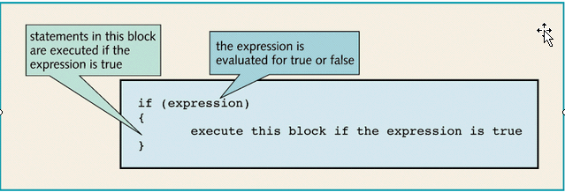
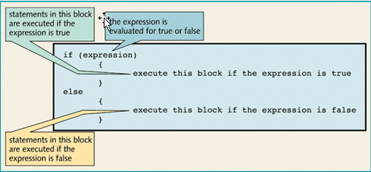
Conditional Statements
if . . . else if . . .

Slide 14
  if (yourSales >= 2 * target)
  {
  performance = "Excellent";
  bonus = 1000;
  }
  else if (yourSales >= 1.5 * target)
  {
  performance = "Fine";
  bonus = 500;
  }
  else if (yourSales >= target)
  {
  performance = "Satisfactory";
  bonus = 100;
  }
  else
  {
  System.out.println("You're fired");
  }

Slide 15
While Loop and Do While Loop
Use when you do not know how many times a loop should be processed
while (condition) statement
  while (balance < goal)
  {
  balance += payment;
  double interest = balance * interestRate / 100;
  balance += interest;
  years++;
  }

Slide 16
While Loop and Do While Loop (2)
do…while structure
  Similar to while structure
  Tests loop-continuation after performing body of loop
    i.e., loop body always executes at least once
do statement while (condition);
  do
  {
  balance += payment;
  double interest = balance * interestRate / 100;
  balance += interest;
  year++;
  // print current balance
  . . .
  // ask if ready to retire and get input
  . . .
  }
  while (input.equals("N"));

Slide 17
Example 3-3 Retirement.java
1. import javax.swing.*;
2.
3. public class Retirement
4. {
5. public static void main(String[] args)
6. {
7. // read inputs
8. String input = JOptionPane.showInputDialog
9. ("How much money do you need to retire?");
10. double goal = Double.parseDouble(input);
11.
12. input = JOptionPane.showInputDialog
13. ("How much money will you contribute every year?");
14. double payment = Double.parseDouble(input);
15.
16. input = JOptionPane.showInputDialog
17. ("Interest rate in %: ");
18. double interestRate = Double.parseDouble(input);
19.
20. double balance = 0;
21. int years = 0;
22.
23. // update account balance while goal isn't reached
24. while (balance < goal)
25. { // add this year's payment and interest
26.
27. balance += payment;
28. double interest = balance * interestRate / 100;
29. balance += interest;
30.
31. years++;
32. }
33.

Slide 18
34. System.out.println
35. ("You can retire in " + years + " years.");
36. System.exit(0);
37. }
38. }

Slide 19
Example 3-4 Retirement2.java
1. import java.text.*;
2. import javax.swing.*;
3.
4. public class Retirement2
5. {
6. public static void main(String[] args)
7. {
8. String input = JOptionPane.showInputDialog
9. ("How much money will you contribute every year?");
10. double payment = Double.parseDouble(input);
11.
12. input = JOptionPane.showInputDialog
13. ("Interest rate in %:");
14. double interestRate = Double.parseDouble(input);
15.
16. double balance = 0;
17. int year = 0;
18.
19. NumberFormat formatter
20. = NumberFormat.getCurrencyInstance();
21.
22. // update account balance while user isn't ready to retire
23. do
24. {
25. // add this year's payment and interest
26. balance += payment;
27. double interest = balance * interestRate / 100;
28. balance += interest;
29.
30. year++;
31.

Slide 20
32. // print current balance
33. System.out.println("After year " + year
34. + ", your balance is "
35. + formatter.format(balance));
36.
37. // ask if ready to retire and get input
38. input = JOptionPane.showInputDialog
39. ("Ready to retire? (Y/N)");
40. input = input.toUpperCase();
41. }
42. while (input.equals("N"));
43.
44. System.exit(0);
45. }
46. }

Slide 21
for Repetition Statement
Handles counter-controlled-repetition details
for
keyword
Control variable
Required semicolon separator
Final value of control variable for which the condition is true
Required semicolon separator
for ( int counter = 1; counter <= 10; counter++ )
Initial value of control variable
Loop-continuation condition
Increment of control variable

Slide 22
for Repetition Structure
for ( initialization; loopContinuationCondition; increment ) statement;
can usually be rewritten as:
initialization;
while ( loopContinuationCondition ){
statement;
increment;
}

Slide 23
Examples Using the for Statement
Varying control variable in for statement
  Vary control variable from 1 to 100 in increments of 1
    for ( int i = 1; i <= 100; i++ )
  Vary control variable from 100 to 1 in increments of –1
    for ( int i = 100; i >= 1; i-- )
  Vary control variable from 7 to 77 in increments of 7
    for ( int i = 7; i <= 77; i += 7 )

Slide 24
Demo Scope of Control Variable
for (int i = 1; i <= 10; i++)
{
. . .
}
// i no longer defined here
int i;
for (i = 1; i <= 10; i++)
{
. . .
}
// i still defined here
for (int i = 1; i <= 10; i++)
{
. . .
}
. . .
for (int i = 11; i <= 20; i++) // ok to redefine i
{
. . .
}

Slide 25
Example to demo the for loop
The program computes the odds on winning a lottery.
  For example, if you must pick 6 numbers from the numbers 1 to 50 to win, then there are (50 x 49 x 48 x 47 x 46 x 45)/(1 x 2 x 3 x 4 x 5 x 6) possible outcomes, so your chance is 1 in 15,890,700. Good luck!

Slide 26
Example 3-5
LotteryOdds.java
1. import javax.swing.*;
2.
3. public class LotteryOdds
4. {
5. public static void main(String[] args)
6. {
7. String input = JOptionPane.showInputDialog
8. ("How many numbers do you need to draw?");
9. int k = Integer.parseInt(input);
10.
11. input = JOptionPane.showInputDialog
12. ("What is the highest number you can draw?");
13. int n = Integer.parseInt(input);
14.
15. /*
16. compute binomial coefficient
17. n * (n - 1) * (n - 2) * . . . * (n - k + 1)
18. -------------------------------------------
19. 1 * 2 * 3 * . . . * k
20. */
21.
22. int lotteryOdds = 1;
23. for (int i = 1; i <= k; i++)
24. lotteryOdds = lotteryOdds * (n - i + 1) / i;
25.
26. System.out.println
27. ("Your odds are 1 in " + lotteryOdds + ". Good luck!");
28.
29. System.exit(0);
30. }
31. }

Slide 27
switch Multiple-Selection Statement
switch statement
  Used for multiple selections
For example, if you set up a menuing system with four alternatives, you could use code that looks like this:

Slide 28
String input = JOptionPane.showInputDialog
("Select an option (1, 2, 3, 4)");
int choice = Integer.parseInt(input);
switch (choice)
{
case 1:
. . .
break;
case 2:
. . .
break;
case 3:
. . .
break;
case 4:
. . .
break;
default:
// bad input
. . .
break;
}

Slide 29
Continue
Note that the case labels must be integers. You cannot test strings.
  For example, the following is an error:
  String input = . . .;
  switch (input) // ERROR
  {
  case "A": // ERROR
  . . .
  break;
  . . .
  }

Slide 30
break and continue Statements
break/continue
  Alter flow of control
break statement
  Causes immediate exit from control structure
    Used in while, for, do…while or switch statements
continue statement
  Skips remaining statements in loop body
  Proceeds to next iteration
    Used in while, for or do…while statements

Slide 31
Break
while (years <= 100)
{
balance += payment;
double interest = balance * interestRate / 100;
balance += interest;
if (balance >= goal)
break;
years++;
}

Slide 32
Labeled Break
int n;
read_data:
while (. . .) // this loop statement is tagged with the label
{
. . .
for (. . .) // this inner loop is not labeled
{
String input
= JOptionPane.showInputDialog("Enter a number >= 0");
n = Integer.parseInt(input);
if (n < 0) // should never happen—can't go on
break read_data;
// break out of read_data loop
. . .
}
}
// this statement is executed immediately after the break
if (n < 0) // check for bad situation
{
// deal with bad situation
}
else
{
// carry out normal processing
}

Slide 33
Continue
Curiously, you can apply a label to any statement, even an if statement or a block statement, like this:
  label:
  {
  . . .
  if (condition) break label; // exits block
  . . .
  }
  // jumps here when the break statement executes

Slide 34
If n < 0, then the continue statement jumps immediately to the loop header, skipping the remainder of the current iteration.
If the continue statement is used in a for loop, it jumps to the "update" part of the for loop. For example, consider this loop.
while (sum < goal)
{
String input = JOptionPane.showInputDialog("Enter a number");
n = Integer.parseInt(input);
if (n < 0) continue;
sum += n; // not executed if n < 0
}
for (count = 0; count < 100; count++)
{
String input = JOptionPane.showInputDialog("Enter a number");
n = Integer.parseInt(input);
if (n < 0) continue;
sum += n; // not executed if n < 0
}

Slide 35
Big Numbers
If the precision of the basic integer and floating-point types is not sufficient, use BigInteger and BigDecimal (in the java.math package)
For manipulating numbers with an arbitrarily long sequence of digits.
  The BigInteger class implements arbitrary precision integer arithmetic
  BigDecimal does the same for floating-point numbers.

Slide 36
Big Numbers (Cont)
Use the static valueOf method to turn an number into a big number:
BigInteger a = BigInteger.valueOf(100);
Adding and multiplying in the big number classes.
BigInteger c = a.add(b); // c = a + b
BigInteger d = c.multiply(b.add(BigInteger.valueOf(2)));
// d = c * (b + 2)

Slide 37
Example 3-6 BigIntegerTest.java
1. import javax.swing.*;
2. import java.math.*;
3.
4. public class BigIntegerTest
5. {
6. public static void main(String[] args)
7. {
8. String input = JOptionPane.showInputDialog
9. ("How many numbers do you need to draw?");
10. int k = Integer.parseInt(input);
11.
12. input = JOptionPane.showInputDialog
13. ("What is the highest number you can draw?");
14. int n = Integer.parseInt(input);
15.
16. /*
17. compute binomial coefficient
18. n * (n - 1) * (n - 2) * . . . * (n - k + 1)
19. -------------------------------------------
20. 1 * 2 * 3 * . . . * k
21. */
22.
23. BigInteger lotteryOdds = BigInteger.valueOf(1);
24.
25. for (int i = 1; i <= k; i++)
26. lotteryOdds = lotteryOdds
27. .multiply(BigInteger.valueOf(n - i + 1))
28. .divide(BigInteger.valueOf(i));
29.
30. System.out.println("Your odds are 1 in " + lotteryOdds +
31. ". Good luck!");
32.
33. System.exit(0);
34. }
35. }

Slide 38
java.math.BigInteger 1.1
BigInteger add(BigInteger other)
BigInteger subtract(BigInteger other)
BigInteger multiply(BigInteger other)
BigInteger divide(BigInteger other)
BigInteger mod(BigInteger other)
// Return the sum, difference, product, quotient, and remainder of this big integer and other.
int compareTo(BigInteger other)
// Returns 0 if this big integer equals other, a negative result if this big integer is less than other, and a positive result otherwise.
static BigInteger valueOf(long x)
// Returns a big integer whose value equals x.

Slide 39
java.math.BigDecimal 1.1
BigDecimal add(BigDecimal other)
BigDecimal subtract(BigDecimal other)
BigDecimal multiply(BigDecimal other)
BigDecimal divide(BigDecimal other, int roundingMode)
// Return the sum, difference, product, or quotient of this big decimal and other. To compute the quotient, you need to supply a rounding mode. The mode BigDecimal.ROUND_HALF_UP is the rounding mode that you learned in school (i.e. round down digits 0 . . . 4, round up digits 5 . . . 9). It is appropriate for routine calculations. See the API documentation for other rounding modes.
int compareTo(BigDecimal other)
// Returns 0 if this big Decimal equals other, a negative result if this big decimal is less than other, and a positive result otherwise.
static BigDecimal valueOf(long x)
static BigDecimal valueOf(long x, int scale)
// Return a big decimal whose value equals x or x / 10scale.

Slide 40
Arrays

Slide 41
Introduction
Array - a data structure that stores a collection of values of the same type
  Related data items of same type
  Length fixed when declared
  Reference type

Slide 42
Arrays
Length fixed when declared; indices checked on access
Length available via the .length field
Array objects are created with the new keyword, e.g.:
  int a[] = new int[20];
  for (int i=0; i<a.length; i++)
  a[i] = i;

Slide 43
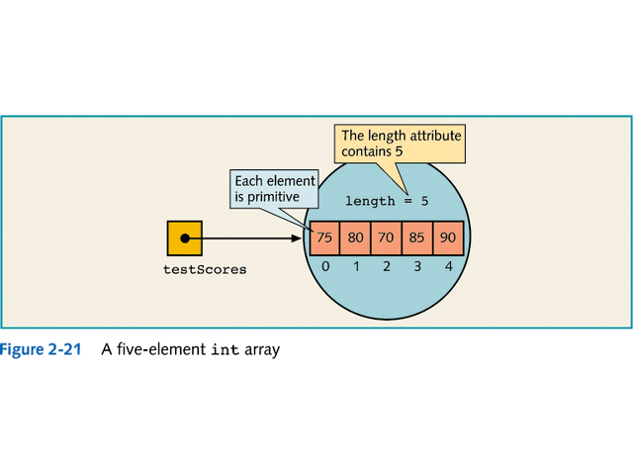

Slide 44
Arrays (cont.)
Index
  Position number in square brackets
  Must be positive integer or integer expression
  Indices start at zero
Note: Arrays in Java begin with 0 not 1
  a = 5;
  b = 6;
  c[ a + b ] += 2;
    // Adds 2 to c[ 11 ]

Slide 45
Declaring and Creating Arrays
Declaring and Creating arrays
  Arrays are objects that occupy memory
  Created dynamically with keyword new
    int c[] = new int[ 12 ];
    Equivalent to
    int c[]; // declare array variable
    c = new int[ 12 ]; // create array
    We can create arrays of objects too
      String b[] = new String[ 100 ];
You can declare an array variable either as
  int[] a; or as
  int a[];

Slide 46
Continue
Length available via the .length field
e.g.:
  for (int i = 0; i < a.length; i++)
  System.out.println(a[i]);

Slide 47
Arrays (continued)
Arrays can be initialized with list of literals:
  int smallInts[] = {1,2,3};
  String[] cardinals = {"one","two","three"};
  String[] ordinals = {"first","second","third"};
Anonymous array
  smallPrimes = new int[] { 17, 19, 23, 29, 31, 37 }
  is a shorthand for
  int[] anonymous = { 17, 19, 23, 29, 31, 37 };
  smallPrimes = anonymous;

Slide 48
Manipulate Arrays
Various array utilities are available in the java.lang.System and java.util.Arrays packages, e.g.:
Copy Array
  System.arraycopy(from, fromIndex, to, toIndex, count);
    The ‘to’ array must have sufficient space to hold the copied elements.
Sort Array
  Arrays.sort(a); // for arrays of primitive type

Slide 49
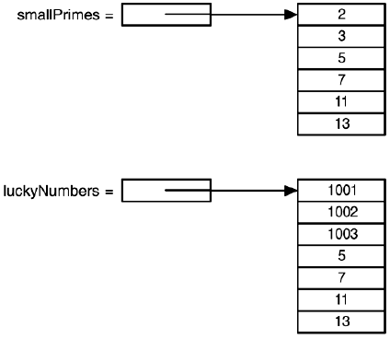
Example to demo array copy
This example sets up two arrays and then copy the last four entries of the first array to the second array.
The copy starts at position 2 in the source array and copies 4 entries, starting at position 3 of the target.

Slide 50
Demo – Copy Array
The copy starts at position 2 in the source array and copies 4 entries, starting at position 3 of the target.
int[] smallPrimes = {2, 3, 5, 7, 11, 13};
int[] luckyNumbers = {1001, 1002, 1003, 1004, 1005, 1006, 1007};
System.arraycopy(smallPrimes, 2, luckyNumbers, 3, 4);
for (int i = 0; i < luckyNumbers.length; i++)
System.out.println(i + ": " + luckyNumbers[i]);
The output is:
0: 1001
1: 1002
2: 1003
3: 5
4: 7
5: 11
6: 13

Slide 51
Example to demo array sort
This program draws a random combination of numbers for a lottery game.

Slide 52
1. import java.util.*;
2. import javax.swing.*;
3.
4. public class LotteryDrawing
5. {
6. public static void main(String[] args)
7. {
8. String input = JOptionPane.showInputDialog
9. ("How many numbers do you need to draw?");
10. int k = Integer.parseInt(input);
11.
12. input = JOptionPane.showInputDialog
13. ("What is the highest number you can draw?");
14. int n = Integer.parseInt(input);
15.
16. // fill an array with numbers 1 2 3 . . . n
17. int[] numbers = new int[n];
18. for (int i = 0; i < numbers.length; i++)
19. numbers[i] = i + 1;
20.
21. // draw k numbers and put them into a second array
22.
23. int[] result = new int[k];

Slide 53
24. for (int i = 0; i < result.length; i++)
25. {
26. // make a random index between 0 and n - 1
27. int r = (int)(Math.random() * n);
28.
29. // pick the element at the random location
30. result[i] = numbers[r];
31.
32. // move the last element into the random location
33. numbers[r] = numbers[n - 1];
34. n--;
35. }
36.
37. // print the sorted array
38.
39. Arrays.sort(result);
40. System.out.println
41. ("Bet the following combination. It'll make you rich!");
42. for (int i = 0; i < result.length; i++)
43. System.out.println(result[i]);
44.
45. System.exit(0);
46. }
47. }

Slide 54
Multidimensional Arrays
Multi-dimensional arrays are handled as arrays of arrays
  double[][] balance;
  balance = new double[NYEARS][NRATES]; // you cannot use the array until you new and initialize it
Shorthand for initializing
  int[][] magicSquare =
  {
  {16, 3, 2, 13, 23},
  {5, 10, 11, 8, 3},
  {9, 6, 7, 12, 67},
  {4, 15, 14, 1, 44}
  }; // note: no “new”

Slide 55
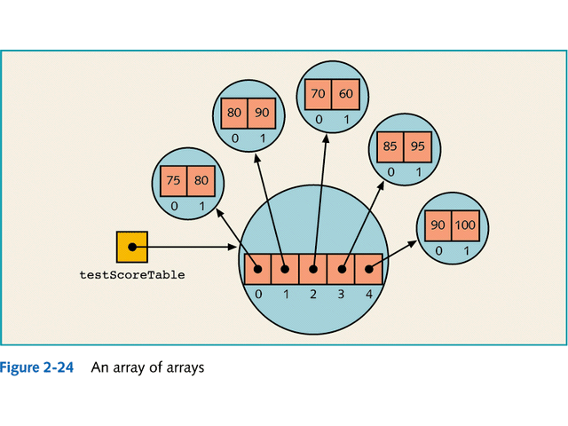

Slide 56
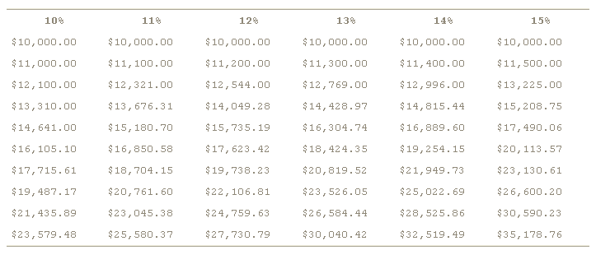
Interests Calculation Example
Calculate how much an investment of $10,000 will grow under different interest rate in which interest is paid annually and reinvested

Slide 57
Example 3-8 CompoundInterest.java
1. import java.text.*;
2. import javax.swing.*;
3.
4. public class CompoundInterest
5. {
6. public static void main(String[] args)
7. {
8. final int STARTRATE = 10;
9. final int NRATES = 6;
10. final int NYEARS = 10;
11.
12. // set interest rates to 10 . . . 15%
13. double[] interestRate = new double[NRATES];
14. for (int j = 0; j < interestRate.length; j++)
15. interestRate[j] = (STARTRATE + j) / 100.0;
16.
17. double[][] balance = new double[NYEARS][NRATES];
18.
19. // set initial balances to 10000
20. for (int j = 0; j < balance[0].length; j++)
21. balance[0][j] = 10000;
22.
23. // compute interest for future years
24.
25. for (int i = 1; i < balance.length; i++)
26. {
27. for (int j = 0; j < balance[i].length; j++)
28. {
29. // get last year's balance from previous row
30. double oldBalance = balance[i - 1][j];
31.
32. // compute interest
33. double interest = oldBalance * interestRate[j];
34.
35. // compute this year's balance
36. balance[i][j] = oldBalance + interest;
37. }
38. }

Slide 58
39.
40. // print one row of interest rates
41.
42. NumberFormat formatter = NumberFormat.getPercentInstance();
43.
44. for (int j = 0; j < interestRate.length; j++)
45. {
46. System.out.print(" ");
47. System.out.print(formatter.format(interestRate[j]));
48. }
49. System.out.println();
50.
51. // print balance table
52.
53. formatter = NumberFormat.getCurrencyInstance();
54.
55. for (int i = 0; i < balance.length; i++)
56. {
57. // print table row
58. for (int j = 0; j < balance[i].length; j++)
59. {
60. System.out.print(" ");
61. System.out.print(formatter.format(balance[i][j]));
62. }
63. System.out.println();
64. }
65. }
66. }

Slide 59
Vectors
Similar to arrays but do not need to declare size
Can contain a list of different object types
Structure
  Vector vec = new Vector();
Vector class has many helpful methods such as:
  isEmpty()
  indexOf(Object arg)
  contains(Object arg)
  See java docs for more info

Slide 60
Vectors
Use the Enumeration class to iterate through a vector
  Example:
  Vector vec = new Vector();
  vec.addElement(“one”);
  vec.addElement(“two”);
  vec.addElement(“three”);
  Enumeration e = vec.elements();
  while (e.hasMoreElements()) {
  System.out.println(“element = “ + e.nextElement());
  }
  Result:
  element = one
  element = two
  element = three

Slide 61
Another example
import java.util.*;
public class VectorDemo
{
public static void main(String[] args)
{
Vector a = new Vector();
a.addElement(new String("I"));
a.addElement(new String("am"));
a.addElement(new String("Michael"));
System.out.println(a.size());
for(int i = 0; i < a.size(); i++)
{
System.out.println(a.elementAt(i));
}
System.out.println("--------------");
Iterator it = a.iterator();
while(it.hasNext())
{
System.out.println(it.next());
}
System.out.println("--------------");
it = a.listIterator();
while(it.hasNext())
{
String temp = (String)it.next();
if(temp.equals("am"))
it.remove();
}
a.removeAll(Collections.singleton("I"));
it = a.listIterator();
while(it.hasNext())
{
System.out.println(it.next());
}
}
}

Slide 62
Collection

Slide 63
Collections
Built-in support for collections
  Similar to STL in C++
Collection type
  Sequence/Set
  Example ArrayList
Map type
  Hashtable
  Example HashMap
Collections store pointers to objects!
Use inheritance and interfaces
Read
  http://java.sun.com/docs/books/tutorial/collections

Slide 64
Collection Design
All classes implement a similar interface
  add(), size(), iterator()…
  Easy learning curve for using Collections
Implemented as pointer to Object
  Require a cast back to the actual type
  Example
    String element = (String)arraylist.get(i)
Java checks all casts at run-time

Slide 65
Collection Messages
Basic messages
  constructor()
    Creates a collection with no elements
  size()
    Number of elements in the collection
  boolean add()
    Add a new pointer/element at the end of the collection
    Returns true is the collection is modified.
  iterator()
    Returns an Iterator Object

Slide 66
Additional Collection Messages
Utilities
  Additional useful methods
  boolean isEmpty()
  boolean contains(Object o)
    Iterative search, uses equals()
  boolean remove(Object o)
    Iterative remove(), uses equals()
  Boolean addAll(Collection c)

Slide 67
Iterators
Used to iterate through a collection
  Abstracts away the underlying details of the implementation
    Iterating through an array is the same as a binary tree
Responds to
  hasNext() - Returns true if more elements
  next() - Returns the next element
  remove() - removes element returned by previous next() call.

Slide 68
Working with Iterators
Not valid to modify a collection directly while an iterator is being used!
  Should not call collection.add() or collection.remove()
OK to modify the collection using the iterator itself
  iterator.remove()

Slide 69
ArrayList
Most useful collection
Replaces the “Vector” class
Can grow over time
Methods
  add()
  int size()
  Object get(int index)
    Index is from 0 to size() -1
    Must cast to appropriate type when used.
  iterator()
    We’ll see an example!

Slide 70
ArrayList Demo: constructor
import java.util.*;
/*
The ArrayList is replaces the old Vector class.
ArrayList implements the Collection interface, and also
the more powerful List interface features as well.
Main methods:add(), size(), get(i), iterator()
See the "Collection" and "List" interfaces.
*/
public static void demoArrayList() {
ArrayList strings = new ArrayList();
…

Slide 71
ArrayList Demo: adding/size
// add things...
for (int i= 0; i<10; i++) {
// Make a String object out of the int
String numString = Integer.toString(i);
strings.add(numString); // add pointer to collection
}
// access the length
System.out.println("size:" + strings.size());

Slide 72
ArrayList Demo: looping
// ArrayList supports a for-loop access style...
// (the more general Collection does not support this)
for (int i=0; i<strings.size(); i++) {
String string = (String) strings.get(i);
// Note: cast the pointer to its actual class
System.out.println(string);
}

Slide 73
ArrayList: iterating
// ArrayList also supports the "iterator" style...
Iterator it = strings.iterator();
while (it.hasNext()) {
String string = (String) it.next(); // get and cast pointer
System.out.println(string);
}
// Calling toString()
System.out.println("to string:" + strings.toString());

Slide 74
ArrayList Demo: removing
// Iterate through and remove elements
// get a new iterator (at the beginning again)
it = strings.iterator();
while (it.hasNext()) {
it.next(); // get pointer to elem
it.remove(); // remove the above elem
}
System.out.println("size:" + strings.size());
}

Slide 75
ArrayList Demo: output
Output:
size:10
0
1
2
3
4
5
6
7
8
9
to string:[0, 1, 2, 3, 4, 5, 6, 7, 8, 9]
size:0

Slide 76
import java.util.*;
public class ArrayListTest
{
public static void main(String[] args)
{
// fill the staff array list with three Employee objects
ArrayList staff = new ArrayList();
staff.add(new Employee("Carl Cracker", 75000,
1987, 12, 15));
staff.add(new Employee("Harry Hacker", 50000,
1989, 10, 1));
staff.add(new Employee("Tony Tester", 40000,
1990, 3, 15));
// raise everyone's salary by 5%
for (int i = 0; i < staff.size(); i++)
{
Employee e = (Employee)staff.get(i);
e.raiseSalary(5);
}
// print out information about all Employee objects
for (int i = 0; i < staff.size(); i++)
{
Employee e = (Employee)staff.get(i);
System.out.println("name=" + e.getName()
+ ",salary=" + e.getSalary()
+ ",hireDay=" + e.getHireDay());
}
}
}
class Employee
{
public Employee(String n, double s, int year, int month, int day)
{

Slide 77
name = n;
salary = s;
GregorianCalendar calendar
= new GregorianCalendar(year, month - 1, day);
// GregorianCalendar uses 0 for January
hireDay = calendar.getTime();
}
public String getName()
{
return name;
}
public double getSalary()
{
return salary;
}
public Date getHireDay()
{
return hireDay;
}
public void raiseSalary(double byPercent)
{
double raise = salary * byPercent / 100;
salary += raise;
}
private String name;
private double salary;
private Date hireDay;
}

