Slide 1
Inheritance

Slide 2
In this part, we will cover
The concept of inheritance
Extending classes
Overriding superclass methods
Working with superclasses that have constructors
Using superclass constructors that require arguments
Accessing superclass methods
Learning about information hiding
Using methods you cannot override

Slide 3
Inheritance
Inheritance
  Mechanism that enables one class to inherit both the behavior and the attributes of another class
A subclass can inherit data and most of its behavior from another class (the superclass).
In Java, we say that the subclass extends the superclass.
A class can only extend one superclass—no multiple inheritance in Java!.

Slide 4
Inheritance
For example, a Manager class can extend the Employee class:
  public class Manager extends Employee
  {
  public void setBonus(double b)
  {
  bonus = b;
  }
  private double bonus = 0.0;
  …
  }

Slide 5
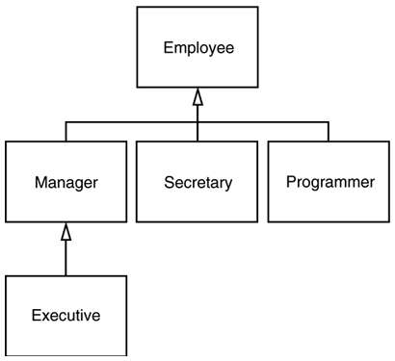
Inheritance Hierarchies

Slide 6
Inheritance Advantages
When you use inheritance you:
  Save time
  Reduce errors
  Ease understanding

Slide 7
Inheritance Terms
Base class – a class that is used as a basis for inheritance
  Superclass
  Parent class
  e.g. Employee class
Derived class – a class that inherits from a base class
  Subclass
  Child class
  e.g. Manager class
Manager has an “is-a” relationship to Employee.
Subclasses have more functionality than superclasses.
  Subclasses can use the fields and methods of superclass and can add additional fields and methods.

Slide 8
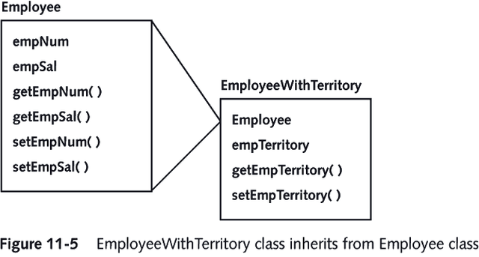

Slide 9
Extending classes
Use the keyword extends to achieve inheritance within the Java programming language
  public class EmployeeWithTerritory extends Employee
Creates a superclass-subclass relationship between Employee and EmployeeWithTerritory
You only need to indicate the differences between the subclass and the superclass in the subclass definition.

Slide 10
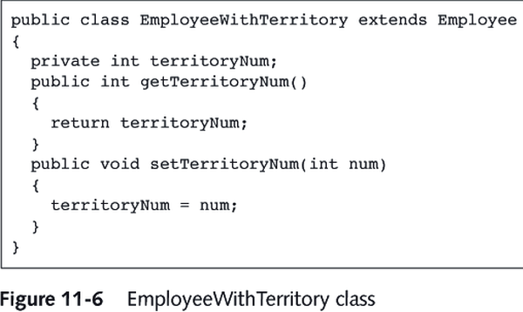

Slide 11

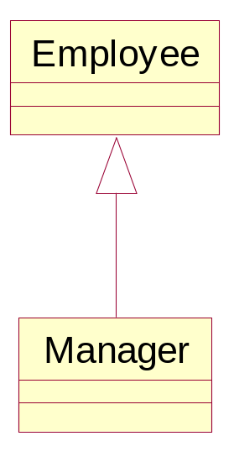
import java.util.*;
public class ManagerTest
{
public static void main(String[] args)
{
// construct a Manager object
Manager boss = new Manager("Carl Cracker", 80000,
1987, 12, 15);
boss.setBonus(5000);
Employee[] staff = new Employee[3];
// fill the staff array with Manager and Employee objects
staff[0] = boss;
staff[1] = new Employee("Harry Hacker", 50000,
1989, 10, 1);
staff[2] = new Employee("Tommy Tester", 40000,
1990, 3, 15);
// print out information about all Employee objects
for (int i = 0; i < staff.length; i++)
{
Employee e = staff[i];
System.out.println("name=" + e.getName()
+ ",salary=" + e.getSalary());
}
}
}
class Employee
{
public Employee(String n, double s,
int year, int month, int day)
{
name = n;
salary = s;

Slide 12
GregorianCalendar calendar
= new GregorianCalendar(year, month - 1, day);
// GregorianCalendar uses 0 for January
hireDay = calendar.getTime();
}
public String getName()
{
return name;
}
public double getSalary()
{
return salary;
}
public Date getHireDay()
{
return hireDay;
}
public void raiseSalary(double byPercent)
{
double raise = salary * byPercent / 100;
salary += raise;
}
private String name;
private double salary;
private Date hireDay;
}
class Manager extends Employee
{
/**
@param n the employee's name
@param s the salary

Slide 13
@param year the hire year
@param month the hire month
@param day the hire day
*/
public Manager(String n, double s,
int year, int month, int day)
{
super(n, s, year, month, day);
bonus = 0;
}
public double getSalary()
{
double baseSalary = super.getSalary();
return baseSalary + bonus;
}
public void setBonus(double b)
{
bonus = b;
}
private double bonus;
}

Slide 14
Overriding Superclass Methods
Polymorphism (More Details Later)
  Using the same method name to indicate different implementations
Each child class method overrides the method that has the same name in the parent class
  e.g. getSalary method is different for managers than from other employees.
    should return the base salary plus the bonus

Slide 15
The super keyword
A method in a subclass may need to invoke a method in the superclass.
You can use the keyword super to access the parent class method
For example, the Manager class's getSalary() method may need to call the Employee class's getSalary() to retrieve a base salary value:
  class Manager extends Employee
  {
  public double getSalary()
  {
  return bonus + super.getSalary();
  }
  …

Slide 16
Working with Superclasses that Have Constructors
When you create any subclass object, the superclass constructor must execute first, and then the subclass constructor executes
When you instantiate an object that is a member of a subclass, you are actually calling at least two constructors:
  the constructor for the base class
  the constructor for the extended, derived class

Slide 17
public class Manager extends Employee {
public Manager(String name, int salary) {
super(name, salary);
bonus=0;
}
}

Slide 18
Using Superclass Constructors that Require Arguments
When you create a class and do not provide a constructor, Java automatically supplies you with one that never requires arguments
When you write your own constructor, you replace the automatically supplied version
The constructor you create for a class might require arguments

Slide 19
Using Superclass Constructors that Require Arguments
When a superclass requires arguments, you must include a constructor for each subclass
In your subclass constructor, the first statement must call the superclass constructor
  super(list of arguments);
  For example, because subclasses cannot access private fields of superclass, it must initialize them thru the superclass constructor:
    super(n, s, year, month, day)

Slide 20
Information Hiding
Information Hiding
  The concept of keeping data private
When you employ information hiding, your data can be altered only by the methods you choose and only in ways that you control
Private members of the parent class are not inherited
  When a program is a class user, it cannot directly alter any private field

Slide 21
Methods You Cannot Override
There are four types of methods that you cannot override in a subclass:
  private methods
  static methods
  final methods
  Methods within final classes
  Final methods and classes have some advantages:
    Efficiency: Dynamic binding has more overhead and runs slower.
    Safety: Designer has no control over what a method will do in a subclass. Final methods guarantee what the method will do when called.

Slide 22
Advanced Inheritance Concepts

Slide 23
Abstract Classes
Sometimes it's useful to define a method or class which cannot be instantiated.
Abstract class
  A class from which you cannot create any concrete objects, but from which you can inherit
  You can only extend abstract classes
  Use the keyword abstract
  You cannot use the keyword new
  In C++, abstract classes are known as virtual classes

Slide 24
Abstract classes
A library application may have classes for Hardback, Paperback, and Magazine:
  All inherit from the Book class
  No Book object should ever be created
Mark the class definition with the abstract modifier:
  public abstract class Book {…

Slide 25
Abstract methods
Abstract method
  A method with no method statements
An abstract class can have non-abstract methods and fields.
If any method or field is abstract, the class must be marked abstract.
To create an abstract method, you provide
  the keyword abstract
  the intended method type, name, and arguments
  but you do not provide any statements within the method
You must code a subclass method to override any inherited abstract superclass method

Slide 26
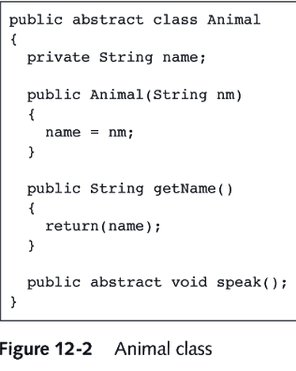

Slide 27
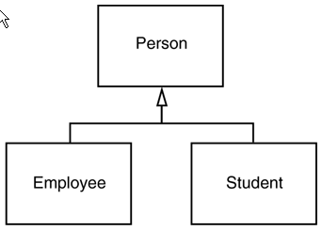
Example of Using Abstract Class

Slide 28
import java.text.*;
public class PersonTest
{
public static void main(String[] args)
{
Person[] people = new Person[2];
// fill the people array with Student and Employee objects
people[0]
= new Employee("Harry Hacker", 50000);
people[1]
= new Student("Maria Morris", "computer science");
// print out names and descriptions of all Person objects
for (int i = 0; i < people.length; i++)
{
Person p = people[i];
System.out.println(p.getName() + ", "
+ p.getDescription());
}
}
}
abstract class Person
{
public Person(String n)
{
name = n;
}
public abstract String getDescription();
public String getName()
{
return name;
}

Slide 29
private String name;
}
class Employee extends Person
{
public Employee(String n, double s)
{
// pass name to superclass constructor
super(n);
salary = s;
}
public double getSalary()
{
return salary;
}
public String getDescription()
{
NumberFormat formatter
= NumberFormat.getCurrencyInstance();
return "an employee with a salary of "
+ formatter.format(salary);
}
public void raiseSalary(double byPercent)
{
double raise = salary * byPercent / 100;
salary += raise;
}
private double salary;
}
class Student extends Person
{

Slide 30
/**
@param n the student's name
@param m the student's major
*/
public Student(String n, String m)
{
// pass n to superclass constructor
super(n);
major = m;
}
public String getDescription()
{
return "a student majoring in " + major;
}
private String major;
}

Slide 31
Using Dynamic Method Binding
Because every subclass “is a” superclass member, you can convert subclass objects to superclass objects
You can create a reference to a superclass
  But you do not use the keyword new
  You create a variable name to hold the memory address of a subclass concrete object
Dynamic method binding
  The program’s ability to select the correct subclass method
  Is also called late binding

Slide 32
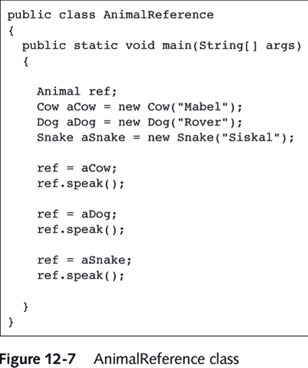

Slide 33
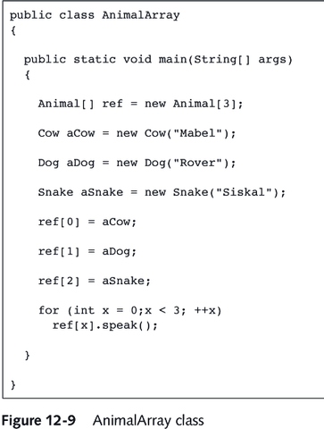

Slide 34
protected access modifier
Sometimes public is too exposed, and private is too hidden.
Java provides a protected modifier for the in-between cases.
A method or field labelled protected is accessible only to subclasses.

Slide 35
Array Lists

Slide 36
ArrayList
Once you set the array size, you cannot change it easily
  int actualSize = . . .;
  Employee[] staff = new Employee[actualSize];
Array lists are arraylike objects that can grow and shrink automatically
Vector vs. ArrayList
  The Vector class can be used for automatically resizing arrays
  but the ArrayList class is more efficient, and you should generally use it instead of vectors

Slide 37
ArrayList Vs. Array
ArrayList
  100 new ArrayList(100) // capacity is
  The array has 100 slots, ready for use.
Array
  new Employee[100] // size is 100
  An array list with a capacity of 100 elements has the potential of holding 100 elements, but at the beginning, an array list holds no elements at all.

Slide 38
java.util.ArrayList 1.2
ArrayList() // constructs an empty array list.
ArrayList(int initialCapacity) // constructs an empty array list with the specified capacity.
Parameters:
initialCapacity - the initial storage capacity of the array list
boolean add(Object obj)
// appends an element at the end of the array list. Always returns true.
Parameters:
obj - the element to be added
int size()
// returns the number of elements currently stored in the array list. (This is different from, and, of course, never larger than, the array list's capacity.)
void ensureCapacity(int capacity)
// ensures that the array list has the capacity to store the given number of elements without relocating its internal storage array.
Parameters:
capacity - the desired storage capacity
void trimToSize()
// reduces the storage capacity of the array list to its current size.
void set(int index, Object obj)
// puts a value in the array list at the specified index, overwriting the previous contents.
Parameters:
index - the position (must be between 0 and size() - 1)
obj - the new value

Slide 39
Object get(int index)
// gets the value stored at a specified index.
Parameters:
index - the index of the element to get (must be between 0 and size() - 1)
void add(int index, Object obj)
// shifts up elements to insert an element.
Parameters:
index - the insertion position (must be between 0 and size())
obj - the new element
void remove(int index)
// removes an element and shifts down all elements above it.
Parameters:
index - the position of the element to be removed (must be between 0 and size() - 1)

Slide 40
ArrayListTest.java
import java.util.*;
public class ArrayListTest
{
public static void main(String[] args)
{
// fill the staff array list with three Employee objects
ArrayList staff = new ArrayList();
staff.add(new Employee("Carl Cracker", 75000, 1987, 12, 15));
staff.add(new Employee("Harry Hacker", 50000, 1989, 10, 1));
staff.add(new Employee("Tony Tester", 40000, 1990, 3, 15));
// raise everyone's salary by 5%
for (int i = 0; i < staff.size(); i++)
{
Employee e = (Employee)staff.get(i);
e.raiseSalary(5);
}
// print out information about all Employee objects
for (int i = 0; i < staff.size(); i++)
{
Employee e = (Employee)staff.get(i);
System.out.println("name=" + e.getName()
+ ",salary=" + e.getSalary()
+ ",hireDay=" + e.getHireDay());
}
}
}
class Employee
{

Slide 41
public Employee(String n, double s, int year, int month, int day)
{
name = n;
salary = s;
GregorianCalendar calendar = new GregorianCalendar(year, month - 1, day);
// GregorianCalendar uses 0 for January
hireDay = calendar.getTime();
}
public String getName()
{
return name;
}
public double getSalary()
{
return salary;
}
public Date getHireDay()
{
return hireDay;
}
public void raiseSalary(double byPercent)
{
double raise = salary * byPercent / 100;
salary += raise;
}
private String name;
private double salary;
private Date hireDay;
}

Slide 42
Object wrappers for primitive classes
Generic structures (such as ArrayList) can store any type of object.
Unfortunately, the primitive types (int, long, char, etc.) aren't objects.
  ArrayList list = new ArrayList();
  list.add(3.14); // ERROR
  list.add(new Double(3.14)); // OK
Java provides a wrapper class for each primitive type:
An object of a wrapper class (like Integer, Double) can hold a value of its base type (int).

Slide 43
Wrapper Class Methods
Each wrapper class provides a number of utility functions for the primitive type, e.g.:
  int n = Integer.parseInt("-99");
  String a = Integer.toString(88)
  String s = “3.14”;
  double x = new Double(s).doubleValue(); or
  double x = Double.valueOf(s).doubleValue();

Slide 44
Quiz:
Will they work?
public static void increment(int x)
{
x++; // increments local copy
}
public static void main(String[] args)
{
int a = 3;
increment(a);
. . .
}
public static void increment(Integer x)
{
. . .
}
public static void main(String[] args)
{
Integer a = new Integer(3);
increment(a);
. . .
}

Slide 45
The “Class” Class
In Java, a special class – a “Class” object describes the properties of a particular class
Obtain and use the “Class” object
  Employee e; . . .
  Class cl = e.getClass();
  System.out.println(e.getClass().getName())
  // print out: the name of class – “Employee”
  String className = "Manager";
  Class cl = Class.forName(className);
  // obtain a Class object representing the Manager class
  Class cl1 = Manager.class; // Shorthand to obtain
  Class cl2 = int.class;
  Class cl3 = Double[].class;

Slide 46
Using “Class” (cont.)
You create an instance of a class as follows (very useful):
  e.getClass().newInstance();
  String s = "Manager";
  Object m = Class.forName(s).newInstance();
The newInstance method calls the default constructor (the one that takes no parameters) to initialize the newly created object.

Slide 47
Designing with inheritance
Place common operations and data in the superclass.
Don't use protected fields.
Use inheritance only to model the "is-a" relationship.
Don't use inheritance unless all inherited methods make sense.
Use polymorphism rather than type information.
  if (x is of type 1)
  action
  else if (x is of type 2) …
  // think polymorphism.

Slide 48
Case Study - Account Example

Slide 49
Account Example
Problem details:
  You need to store information for bank accounts
  Assume that you only need to store the current balance, and the total number of transactions for each account.
  The goal for the problem is to avoid duplicating code between the three types of account.
  An account needs to respond to the following messages:
    constructor(initialBalance)
    deposit(amount)
    withdraw(amount)
    endMonth()
  Apply the end-of-month charge, print out a summary, zero the transaction count.

Slide 50
Account Example
Types of Accounts
  Normal
    Fixed $5.0 fee at the end of the month
  Nickle ‘n Dime
    $0.50 fee for each withdrawal charged at the end of the month
  Gambler
    With probability 0.49 there is no fee
    With probability 0.51 the fee is twice the amount withdrawn

Slide 51
Design process
Factoring
  Put common behavior in one place
  Subclasses are used to implement the specific deviation from the common behavior
Abstract methods
  Provide prototypes for Abstract Methods to be implemented by subclasses

Slide 52
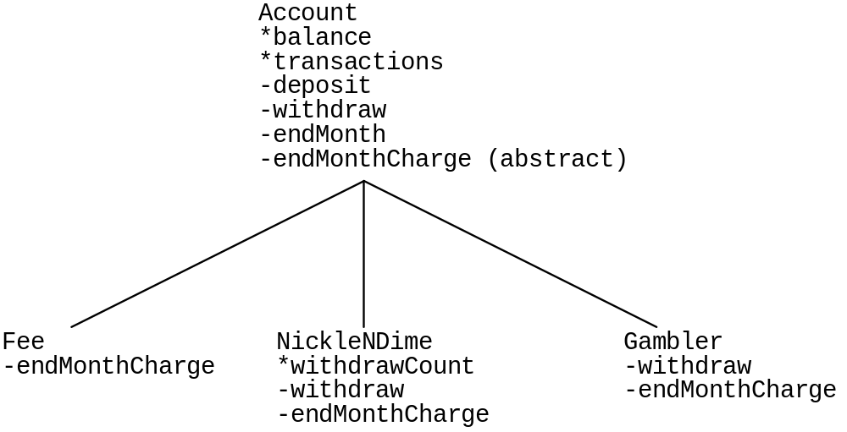
Class Design Diagram

Slide 53
// Account.java
/*
The Account class is an abstract super class with the default
characteristics of a bank account. It maintains a balance
and a current number of transactions.
There are default implementation for deposit(), withdraw(),
and endMonth() (prints out the end-month-summary). However
the endMonthCharge() method is abstract, and so must
be defined by each subclass.
This is a classic structure of using clever factoring to pull
common behavior up to the superclass.
The resulting sublclasses are very thin.
*/
import java.util.*;
public abstract class Account {
protected double balance; // protected = avaiable to subclasses
protected int transactions;
public Account(double balance) {
this.balance = balance;
transactions = 0;
}
// Withdraws the given amount and counts a transaction
public void withdraw(double amt) {
balance = balance - amt;
transactions++;
}
// Deposits the given amount and counts a transaction
public void deposit(double amt) {
balance = balance + amt;
transactions++;
}
public double getBalance() {
return (balance);

Slide 54
}
/*
Sent to the account at the end of the month so
it can settle fees and print a summary.
Relies on the endMonthCharge() method for
each class to implement its own charge policy.
Then does the common account printing and maintenance.
*/
public void endMonth() {
// 1. Pop down to the subclass for their
// specific charge policy (abstract method)
endMonthCharge();
String myClassName = (getClass()).getName();
System.out.println("transactions:" + transactions +
"\t balance:" + balance + "\t(" + myClassName + ")");
transactions = 0;
}
/*
Applies the end-of-month charge to the account.
This is "abstract" so subclasses must override
and provide a definition. At run time, this will
"pop down" to the subclass definition.
*/
protected abstract void endMonthCharge();
// Allocate a Random object shared by these static methods
private static Random rand = new Random();
// Return a new random account of a random type.
private static Account randomAccount() {
int pick = rand.nextInt(3);
Account result = null;
switch (pick) {
case 0: result = new Gambler(rand.nextInt(100)); break;
case 1: result = new NickleNDime(rand.nextInt(100)); break;
case 2: result = new Fee(rand.nextInt(100)); break;
}
// Another way to create new instances -- needs a default ctor

Slide 55
try {
Class gClass = Class.forName("Gambler");
result = (Gambler) gClass.newInstance();
}
catch (Exception e) {
e.printStackTrace();
}
return (result);
}
private static final int NUM_ACCOUNTS = 20;
// Demo polymorphism across Accounts.
public static void main(String args[]) {
// 1. Build an array of assorted accounts
Account[] accounts = new Account[NUM_ACCOUNTS];
// Allocate all the Account objects.
for (int i = 0; i<accounts.length; i++) {
accounts[i] = Account.randomAccount();
}
// 2. Simulate a bunch of transactions
for (int day = 1; day<=31; day++) {
int accountNum = rand.nextInt(accounts.length); // choose an account
if (rand.nextInt(2) == 0) { // do something to that account
accounts[accountNum].withdraw(rand.nextInt(100) + 1);//Polymorphism
}
else {
accounts[accountNum].deposit(rand.nextInt(100) + 1);
}
}
// 3. Have each account print its state
System.out.println("End of month summaries...");
for (int acct = 0; acct<accounts.length; acct++) {
accounts[acct].endMonth(); // Polymorphism Yay!
}
}

Slide 56
// Fee.java
// An Account where there's a flat $5 fee per month.
// Implements endMonth() to get the fee effect.
public class Fee extends Account {
public final double FEE = 5.00;
public Fee(double balance) {
super(balance);
}
public void endMonthCharge() {
withdraw(FEE);
}
}
// NickleNDime.java
// An Acccount subclass where there's a $0.50 fee per withdrawal.
// Overrides withdraw() to count the withdrawals and
// endMonthCharge() to levy the charge.
public class NickleNDime extends Account {
public final double WITHDRAW_FEE = 0.50;
private int withdrawCount;
public NickleNDime(double balance) {
super(balance);
withdrawCount = 0;;
}
public void withdraw(double amount) {
super.withdraw(amount);
withdrawCount++;
}
public void endMonthCharge() {
withdraw(withdrawCount * WITHDRAW_FEE);
withdrawCount = 0;
}
}

Slide 57
// Gambler.java
// An Account where sometimes withdrawals deduct 0
// and sometimes they deduct twice the amount. No end of month fee.
// Has an empty implementation of endMonthCharge,
// and overrides withdraw() to get the interesting effect.
public class Gambler extends Account {
public final double PAY_ODDS = 0.51;
public Gambler(double balance) {
super(balance);
}
public void withdraw(double amt) {
if (Math.random()<= PAY_ODDS) {
super.withdraw(2 * amt); // unlucky
}
else {
super.withdraw(0.0); // lucky (still count the transaction)
}
}
public void endMonthCharge() {
// ha ha, we don't get charged anything!
}
}

Slide 58
Account example: Points of note
Gambler.withdraw() uses super.withdraw() to decrement balance
Account.endMonth() does a popdown by sending itself the endMonthCharge() message
Account.main() uses polymorphism
  The right method gets called
  Pop-down to the right implementation of withdraw depending upon the runtime type of the receiver.

