Slide 1
Graphics programming

Slide 2
AWT and Swing
Java 1.0 was introduced with a class library called Abstract Window Toolkit (AWT)
  used for basic user interface
  delegated creation and behavior of interface elements to the native GUI tookit on the target platform
    Windows vs. Solaris vs. Macintosh, etc
  Downside to AWT:
    Worked well for simple applications but difficult to write high-quality portable graphics
    Limited graphics programming to the lowest common denominator.
    Different platforms had different bugs

Slide 3
AWT and Swing
In 1996 Sun worked with Netscape to create Swing
  In Swing user interface elements are painted onto blank windows
  Swing is not a complete replacement of AWT. Instead it works with AWT.
  Swing simply gives you more capable user interface components.
  However, even though AWT components are still available, you will rarely use them.

Slide 4
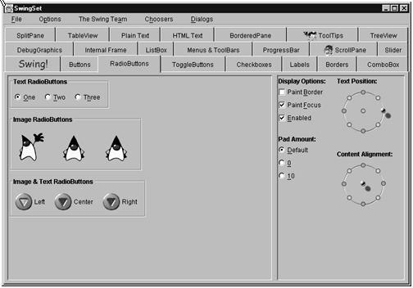
A Swing GUI example

Slide 5
Swing
Reasons to choose Swing:
  much richer and more convenient set of user interface elements
  depends far less on the underlying platform so it is less vulnerable to platform-specific bugs
  gives a consistent user experience across platforms
  fullfill’s Java’s promise of “Write Once, Run Anywhere”
  Easier to use than AWT

Slide 6
How to Create Graphics in Java
Here are the basic steps you need to take to include graphics in your program:
  Create a frame
  Create a panel
  Override the paintComponent() method in your panel

Slide 7
Creating a frame
A frame is a top-level GUI (Graphical User Interface) window.
In Swing, the frame class is called JFrame.
A frame is a container for other user interface components (buttons, text fields, etc).
To create a frame, subclass javax.swing.JFrame.

Slide 8
Creating a frame
import javax.swing.*;
class TFrame extends JFrame
{
public TFrame()
{
setSize(300,200);
setTitle("This is a test");
}
}

Slide 9
Creating a frame (continued)
public class TryFrame
{
public static void main(String[] argv)
{
TFrame f = new TFrame();
f.setDefaultCloseOperation(
JFrame.EXIT_ON_CLOSE);
f.show();
}
}

Slide 10
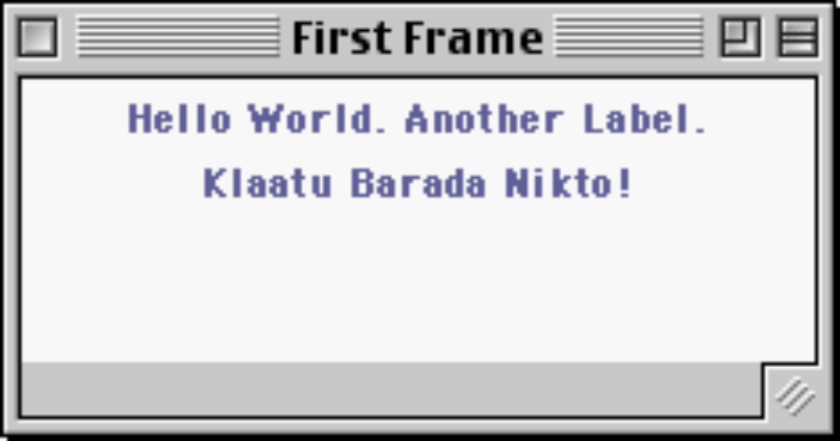
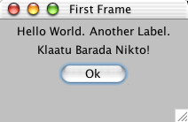
FirstFrame example

Slide 11
FirstFrame Code: getting started
// FirstFrame.java
/*
Demonstrates bringing up a frame with some labels.
*/
import java.awt.*;
import javax.swing.*;
import java.util.*;
import java.awt.event.*;
public class FirstFrame extends JFrame {
public FirstFrame(String title) {
super(title); // superclass ctor takes frame title
// Get content pane -- contents of the window
JComponent content = (JComponent) getContentPane();

Slide 12
FirstFrame Code: adding components
// Set to use the "flow" layout
// (controls the arrangement of the components in the content)
content.setLayout(new FlowLayout());
// Background color is a property of all components --
// set it to white
content.setBackground(Color.lightGray);
// Use add() to install components
content.add(new JLabel("Hello World."));
content.add(new JLabel("Another Label."));
content.add(new JLabel("Klaatu Barada Nikto!"));
content.add(new JButton("Ok"));

Slide 13
FirstFrame example: finishing touch
// Force the frame to size/layout its components
pack();
setDefaultCloseOperation(JFrame.EXIT_ON_CLOSE);
// Java 1.3 or later
setVisible(true); // make it show up on screen
}
public static void main(String[] args) {
new FirstFrame("First Frame");
}
}

Slide 14

SimpleFrameTest.java
import javax.swing.*;
public class SimpleFrameTest
{
public static void main(String[] args)
{
SimpleFrame frame = new SimpleFrame();
frame.setDefaultCloseOperation(JFrame.EXIT_ON_CLOSE);
frame.show();
}
}
class SimpleFrame extends JFrame
{
public SimpleFrame()
{
setSize(DEFAULT_WIDTH, DEFAULT_HEIGHT);
}
public static final int DEFAULT_WIDTH = 300;
public static final int DEFAULT_HEIGHT = 200;
}

Slide 15
Frame properties and methods
A JFrame inherits most of its behavior from its superclasses.
Some methods of interest are:
  setSize() from java.awt.Component
  dispose() from java.awt.Window
  setIconImage() from java.awt.Frame
  setTitle() from java.awt.Frame
  add() from java.awt.Container

Slide 16
Frame Positioning
Most methods for working the size and position of a frame come from the various superclasses of JFrame. Some important methods include:
  the dispose() method: closes the window and reclaims system resources.
  the setIconImage() method: takes an Image object to use as the icon when the window is minimized
  the setTitle() method: changes the text in the title bar.
  the setResizable() method: takes a boolean to determine if a frame will be resizeable by the user.
  the setLocation() method: repositions a frame
  the setBounds() method: both repositions and resizes a frame.
  the setExtendedState(Frame.MAXIMIZED_BOTH): maximizes the size of a frame

Slide 17
Frame Positioning
Note: If you don’t explicitly size the frame, it will default to being 0 by 0 pixels, which is invisible.
  In a professional application, you should check the resolution of the user’s screen to determine the appropriate frame size.

Slide 18
The Toolkit class
To determine simple properties of a system, you can use the Toolkit class, which interfaces to the host system at a low level.
Toolkit.getDefaultToolkit() returns a Toolkit object representing the host system.
tkObject.getScreenSize() returns the dimensions of the primary screen as a Dimension object.
tkObject.getImage(filename) loads an Image object from disk.
In more sophisticated applications, use other methods (GraphicsConfiguration, GraphicsDevice, ImageIO) to perform these functions.

Slide 19
CenteredFrameTest.java
import java.awt.*;
import java.awt.event.*;
import javax.swing.*;
public class CenteredFrameTest
{
public static void main(String[] args)
{
CenteredFrame frame = new CenteredFrame();
frame.setDefaultCloseOperation(JFrame.EXIT_ON_CLOSE);
frame.show();
}
}
class CenteredFrame extends JFrame
{
public CenteredFrame()
{
// get screen dimensions
Toolkit kit = Toolkit.getDefaultToolkit();
Dimension screenSize = kit.getScreenSize();
int screenHeight = screenSize.height;
int screenWidth = screenSize.width;
// center frame in screen
setSize(screenWidth / 2, screenHeight / 2);
setLocation(screenWidth / 4, screenHeight / 4);
// set frame icon and title
Image img = kit.getImage("icon.gif");
setIconImage(img);
setTitle("CenteredFrame");
}
}

Slide 20
Destroying a frame
Starting with JDK 1.3, you can use the JFrame's setDefaultCloseOperation() method to control the disposition of the frame.
By default, a frame hides itself when it is closed.
Set JFrame.EXIT_ON_CLOSE to exit the GUI thread when it is closed.

Slide 21
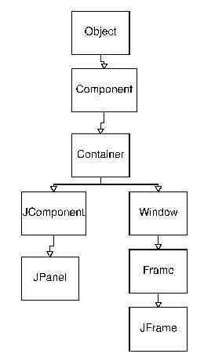
Frame and panel hierarchy

Slide 22
JComponent
JComponent Basics
  Superclass of all things that can be drawn on the screen
  Size and position on screen
    bounds rectangle
  Draws itself
    nature of objects
227 public methods
  Check out the API docs!
Class Hierarchy
  java.awt.Component
    java.awt.Container
      javax.swing.JComponent

Slide 23
Component Location/Size
Each JComponent has its own coordinate system
  (0,0) is in the top left corner
  x grows to the right
  Y grows to the left
Bounds
  Upper left corner (0,0)
  component.getWidth()
  component.getHeight()
Local coordinate system
  Does not change as the component is moved

Slide 24
Geometry methods
Mostly inherited from java.awt.Component
Constructor
  Constructs a component with initial size zero
Methods
  int getWidth(), getHeight()
  Dimension getSize()
  int getX(), getY()
  Point getLocation()
  get/setPreferredSize()
  Rectangle getBounds()
  boolean contains(x,y), boolean contains(Point p)
  setBounds(x,y,width, height), setBounds(Rectangle)
  getParent()

Slide 25
OOP GUI Drawing Theory
Subclass JComponent
Override paintComponent()
  Draw within the bound of the component
  Install your components in a window/container
Remember:
  Objects are anthropomorphic (like a person)
    So we tell them how to do something (draw themselves)
    Then send a message asking them to do the action (draw itself)

Slide 26
Drawing on the screen
GUI programs don't normally draw directly on a JFrame.
Instead, the JFrame is used as a container for other objects.
The most generic container is the JPanel, which you can subclass to create your own panels.
The JPanel.paintComponent(Graphics g) method is called by the Java runtime whenever the panel must be redrawn.
The Graphics object passed to the panel provides a drawing context (like a device context in a Windows program).

Slide 27
Displaying Information in a Panel
It is possible to draw messages and objects directly onto a frame, but this is not considered good programming practice.
  In Java frames are really designed to be containers for components such as menu bars and other user interface elements.
  You normally draw on another component called a panel.
  You add a panel to your frame.
  Swing programmers are most concerned with the content pane

Slide 28
Displaying Information in a Panel
The content pane can be obtained this way:
Container contentPane = frame.getContentPane();
Once we have the content pane, we can add a panel to it.
Panels:
  implemented by extending the JPanel class
  have a surface onto which you can draw
  are themselves containers so they can hold other user interface components like menus, buttons, etc.

Slide 29
Displaying Information in a Panel
To draw on a panel you need to:
  define a class that extends JPanel
  override the paintComponent mehtod in that class
The paintComponent method takes in one parameter of type Graphics.

Slide 30
Graphics object
Passed in to paintComponent()
The Graphics object:
  remembers a collection of settings for drawing images and text (e.g. fonts, current color, etc.)
  all drawing in Java must go through a Graphics object
  has methods to draw patterns, images, and text
    These operations are limited though (e.g. can’t vary line thickness or rotate shapes, etc.)
  So, Sun created the Graphics2D class which is much more powerful (Discussed later)

Slide 31
Graphics Object
AWT Graphics
  Simple. (More complex: Graphics2D)
  (0,0) is upper left, x extends right, y extends down
  g.drawRect(x, y, width, height)
    Extends past width and height by 1 pixel, therefore used with -1
  g.fillRect(x, y, width, height)
    Does not extend past!

Slide 32
Graphics Object
Methods
  drawLine(x1, y1, x2, y2)
  drawString(String, x, y)
    Use Font class to change the font of the string
  g.setColor(Color)
    Use constants in the Color class
  Component.getGraphics()
    Usually never want to call this
    Use the object that is passed to paintComponent instead

Slide 33
Displaying Information in a Panel
the paintComponent method
  the first line in your override of this method needs to be
  super.paintComponent(g)
  so that the superclass method gets executed
  never call the paintComponent method yourself in your programs
    Every time a window needs to be redrawn (e.g. user resizes a window), an event handler notifies the component causing the paintComponent method to be executed.
    To force a repainting of the screen, use the repaint method.

Slide 34
paintComponent(Graphics g)
Notification that is sent to a JComponent when it should draw itself
Override to provide custom drawing code
Call getWidth() etc to get geometry information
  Do not hardcode!
Do no need to erase
  Erased before paintComponent is called
Call super.paintComponent() for more complex cases
  Often subclass JPanel instead

Slide 35
paintComponent example
public void paintComponent(Graphics g) {
// not necessary for simple cases
// super.paintComponent(g);
int width = getWidth();
int height = getHeight();
// draw a rect around the bounds of the component
// -1 since drawRect overhangs by one
g.drawRect(0, 0, width-1, height-1);
// draw a line from upper-left, to lower-right
g.drawLine(0, 0, width-1, height-1);
}

Slide 36
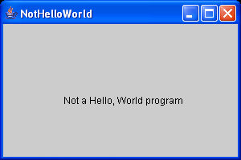
import javax.swing.*;
import java.awt.*;
public class NotHelloWorld
{
public static void main(String[] args)
{
NotHelloWorldFrame frame = new NotHelloWorldFrame();
frame.setDefaultCloseOperation(JFrame.EXIT_ON_CLOSE);
frame.show();
}
}
/**
A frame that contains a message panel
*/
class NotHelloWorldFrame extends JFrame
{
public NotHelloWorldFrame()
{
setTitle("NotHelloWorld");
setSize(DEFAULT_WIDTH, DEFAULT_HEIGHT);
// add panel to frame
NotHelloWorldPanel panel = new NotHelloWorldPanel();
Container contentPane = getContentPane();
contentPane.add(panel);
}
public static final int DEFAULT_WIDTH = 300;
public static final int DEFAULT_HEIGHT = 200;
}
/**
A panel that displays a message.
*/
class NotHelloWorldPanel extends JPanel
{
public void paintComponent(Graphics g)
{
super.paintComponent(g);
g.drawString("Not a Hello, World program",
MESSAGE_X, MESSAGE_Y);
}
public static final int MESSAGE_X = 75;
public static final int MESSAGE_Y = 100;
}

Slide 37
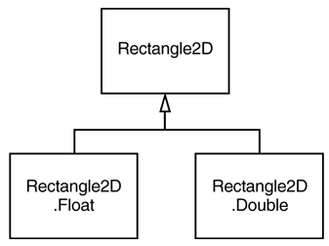
2D shapes
Swing includes a rich library for 2D graphics.
The library includes a number of classes which implement the Shape interface, including:
  Lines
  Ellipses
  Rectangles
The classes come in both single-precision (float) and double-precision (double) flavors, but both are subclasses of a generic superclass (for example, Rectangle2D.Float and Rectangle2D.Double are subclasses of Rectangle2D).

Slide 38
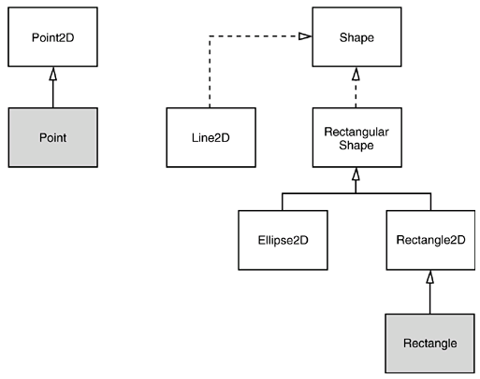
Relationships between the shape classes

Slide 39
2D shapes (continued)
Shapes require a Graphics2D plotting context.
A Graphics2D object can be cast from a Graphics object.
Use the draw() method to draw a shape:
  public void paintComponent(Graphics g)
  {
  Graphics2D g2 = (Graphics2D)g;
  Rectangle2D r = new
  Rectangle2D.Double(
  3.0,4.0,5.0,6.0);
  g2.draw(r);
  …

Slide 40
2D shapes (continued)
To fill a shape, call fill() instead of draw():
  public void paintComponent(Graphics g)
  {
  Graphics2D g2 = (Graphics2D)g;
  Rectangle2D r = new
  Rectangle2D.Double(
  3.0,4.0,5.0,6.0);
  g2.fill(r);
  …

Slide 41
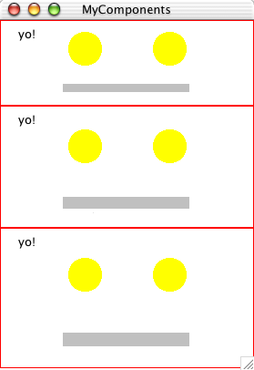
MyComponent Example

Slide 42
MyComponent Example Code
// MyComponent.java
import java.awt.*;
import javax.swing.*;
import java.util.*;
import java.awt.event.*;
/*
Demonstrates a component that draws itself
*/
class MyComponent extends JComponent {
MyComponent(int width, int height) {
super(); // reminder that we have a super ctor
// Set the preferred size -- used by the layout mgr
setPreferredSize(new Dimension(width, height));
}

Slide 43
MyComponent Example Code
/**
Draws a sort of face -- a rect at the bounds, two eyes,and a rect mouth. Draws a string "yo" string near the bottom.
Typical paint component:
-see how big you are
-draw within your bounds
-don't need to erase first -- canvas already erased
*/
public void paintComponent(Graphics g) {
//super.paintComponent(g); // not necessary for simple cases
// Could use this to get a sense of when drawing happens
// Toolkit.getDefaultToolkit().beep();
// see how big we are
int width = getWidth();
int height = getHeight();

Slide 44
My Component Example Code
// Draw a red rect at our bounds
g.setColor(Color.red);
g.drawRect(0, 0, width-1, height-1); // -1 for drawRect
// eyes 1/3 from top, 1/3 from each side
int eyeY = height/3;
int left = width/3;
int right = 2*width/3;
int radius = width/15;
// Draw two eyes
g.setColor(Color.yellow);
// fillOval(x, y, width, height) -- draws oval inside given rect
g.fillOval(left-radius, eyeY-radius, radius*2, radius*2);
g.fillOval(right-radius, eyeY-radius, radius*2, radius*2);

Slide 45
MyComponent Example Code
// Draw a little mouth from 1/4 to 3/4
g.setColor(Color.lightGray);
// fillRect(x, y, width, height)
g.fillRect(width/4, 3*height/4, width/2, height/10);
// Draw a string at 20, 20
g.setColor(Color.black);
g.drawString("yo!", 20, 20);
}
/*
Creates a frame with a few MyComponents in it.
*/
public static void main(String[] args) {
FirstFrame.main(null);
JFrame frame = new JFrame("MyComponents");

Slide 46
MyComponent Example Code
/*
Note: earlier examples subclassed off JFrame,
and set things up in its ctor. In this case,
we are just a client of JFrame, and send it
messages like getContentPane() and pack().
Both of these approaches are reasonable.
*/
// Get the content area of the frame
JComponent content = (JComponent) frame.getContentPane();
content.setBackground(Color.white);
// The Box layout makes a vertical arrangement.
// Its components grow and shrink with the window
content.setLayout(new BoxLayout(content, BoxLayout.Y_AXIS));

Slide 47
MyComponent Example Code
// add a few components
content.add(new MyComponent(120, 80));
content.add(new MyComponent(120, 120));
content.add(new MyComponent(120, 140));
// Layout manager packs things to fit into the minimum window
frame.pack();
// frame.setSize(300, 200); // alternative to pack()
frame.setDefaultCloseOperation(JFrame.EXIT_ON_CLOSE);
frame.setVisible(true);
}
}

Slide 48
Colors
AWT includes a class to represent colors, Color.
Some standard color names are predefined (e.g., Color.RED, Color.LIGHT_GRAY).
Constants for system colors (e.g., menuText, controlShadow) are also available.
Colors can be constructed from RGB components:
  Color c = new Color(255,255,0);
Call the setPaint(c) method of a Graphics2D object (or the setColor(c) method of a Graphics object) to set the color for subsequent drawing operations.
  g2.setPaint(Color.RED);
  g2.drawString("Warning!", 100, 100);
The Component class includes methods such as setBackground().

Slide 49
Standard colors
Color.
BLACK
GREEN
RED
BLUE
LIGHT_GRAY
WHITE
CYAN
MAGENTA
YELLOW
DARK_GRAY
ORANGE
GRAY
PINK

Slide 50
FillTest.java
import java.awt.*;
import java.awt.geom.*;
import javax.swing.*;
public class FillTest
{
public static void main(String[] args)
{
FillFrame frame = new FillFrame();
frame.setDefaultCloseOperation(JFrame.EXIT_ON_CLOSE);
frame.show();
}
}
/**
A frame that contains a panel with drawings
*/
class FillFrame extends JFrame
{
public FillFrame()
{
setTitle("FillTest");
setSize(DEFAULT_WIDTH, DEFAULT_HEIGHT);
// add panel to frame
FillPanel panel = new FillPanel();
Container contentPane = getContentPane();
contentPane.add(panel);
}
public static final int DEFAULT_WIDTH = 400;
public static final int DEFAULT_HEIGHT = 400;
}

Slide 51
FillTest.java
/**
A panel that displays filled rectangles and ellipses
*/
class FillPanel extends JPanel
{
public void paintComponent(Graphics g)
{
super.paintComponent(g);
Graphics2D g2 = (Graphics2D)g;
// draw a rectangle
double leftX = 100;
double topY = 100;
double width = 200;
double height = 150;
Rectangle2D rect = new Rectangle2D.Double(leftX, topY,
width, height);
g2.setPaint(Color.RED);
g2.fill(rect);
// draw the enclosed ellipse
Ellipse2D ellipse = new Ellipse2D.Double();
ellipse.setFrame(rect);
g2.setPaint(new Color(0, 128, 128)); // a dull blue-green
g2.fill(ellipse);
}
}

Slide 52
Text and fonts
A Swing application can use many fonts.
A simple application can load a font and draw:
  String msg = “Hello!";
  Font f = new Font("Serif",Font.PLAIN,12);
  // Font f = new Font ("SansSerif", Font.BOLD, 14);
  g2.setFont(f)
  g2.drawString(msg,x,y);
Sophisticated applications can enumerate the fonts in a system, determine the geometry of a particular font, and measure a text string before drawing it.
AWT provides logical font names (like SansSerif) which are mapped to existing system fonts.

Slide 53
Available fonts
To find out which fonts are available on a particular computer, call the getAvailableFontFamilyNames method of the GraphicsEnvironment class.
  The method returns an array of strings that contains the names of all available fonts.
To obtain an instance of the GraphicsEnvironment class that describes the graphics environment of the user's system, use the static getLocalGraphicsEnvironment method.

Slide 54
The program gives a printout of the names of all fonts on your system
import java.awt.*;
public class ListFonts
{
public static void main(String[] args)
{
String[] fontNames = GraphicsEnvironment
.getLocalGraphicsEnvironment()
.getAvailableFontFamilyNames();
for (int i = 0; i < fontNames.length; i++)
System.out.println(fontNames[i]);
}
}
// On one system, the list starts out like this:
Abadi MT Condensed Light
Arial
Arial Black
Arial Narrow
Arioso
Baskerville
Binner Gothic
. . .

Slide 55
Obtain the bounds of a text
Get the bounds of a text
  Use getFontRenderContext method of Graphics2D Obtain an object that represents the font characteristics of the screen device.
  It returns an object of the FontRenderContext class.
  Then, pass that object to the getStringBounds method of the Font object
    FontRenderContext context = g2.getFontRenderContext();
    Rectangle2D bounds = f.getStringBounds(message, context);
  The getStringBounds method returns a rectangle that encloses the string.

Slide 56
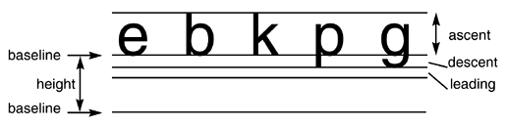
Basic typesetting terms
Obtain string width, height, and ascent:
  double stringWidth = bounds.getWidth();
  double stringHeight = bounds.getHeight();
  double ascent = -bounds.getY();
Obtain the descent and leading:
  LineMetrics metrics = f.getLineMetrics(message, context);
  float descent = metrics.getDescent();
  float leading = metrics.getLeading();

Slide 57
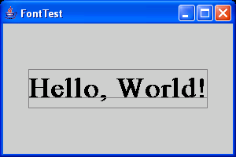
FontTest.java
import java.awt.*;
import java.awt.font.*;
import java.awt.geom.*;
import javax.swing.*;
public class FontTest
{
public static void main(String[] args)
{
FontFrame frame = new FontFrame();
frame.setDefaultCloseOperation(JFrame.EXIT_ON_CLOSE);
frame.show();
}
}
/**
A frame with a text message panel
*/
class FontFrame extends JFrame
{
public FontFrame()
{
setTitle("FontTest");
setSize(DEFAULT_WIDTH, DEFAULT_HEIGHT);
// add panel to frame
FontPanel panel = new FontPanel();
Container contentPane = getContentPane();
contentPane.add(panel);
}
public static final int DEFAULT_WIDTH = 300;
public static final int DEFAULT_HEIGHT = 200;
}

Slide 58
FontTest.java
/**
A panel that shows a centered message in a box.
*/
class FontPanel extends JPanel
{
public void paintComponent(Graphics g)
{
super.paintComponent(g);
Graphics2D g2 = (Graphics2D)g;
String message = "Hello, World!";
Font f = new Font("Serif", Font.BOLD, 36);
g2.setFont(f);
// measure the size of the message
FontRenderContext context = g2.getFontRenderContext();
Rectangle2D bounds = f.getStringBounds(message, context);
// set (x,y) = top left corner of text
double x = (getWidth() - bounds.getWidth()) / 2;
double y = (getHeight() - bounds.getHeight()) / 2;
// add ascent to y to reach the baseline
double ascent = -bounds.getY();
double baseY = y + ascent;
// draw the message
g2.drawString(message, (int)x, (int)(baseY));
g2.setPaint(Color.GRAY);

Slide 59
FontTest.java
// draw the baseline
g2.draw(new Line2D.Double(x, baseY,
x + bounds.getWidth(), baseY));
// draw the enclosing rectangle
Rectangle2D rect = new Rectangle2D.Double(x, y,
bounds.getWidth(),
bounds.getHeight());
g2.draw(rect);
}
}

Slide 60
Images
You can display images on the Graphics object.
You can use images stored locally or someplace on the Internet.
If an image is stored locally call:
Image icon = ImageIO.read(new File(fname));
  int ix = getWidth() - icon.getWidth(this);
  int iy = getHeight() - icon.getHeight(this);
  g.drawImage(icon,ix,iy,null);
If an image is on the Internet, use the url:
String filename = “…”;
Image image = ImageIO.read(new URL(url);
To draw the image:
g.drawImage(image, x, y, null)

Slide 61
Copying an Area
copyArea() method - Use to copy an area
Requires 6 parameters
  x-coordinate and y-coordinate of the upper-left corner of the area to be copied
  Width and height of the area to be copied
  The horizontal and vertical displacement of the destination of the copy

Slide 62
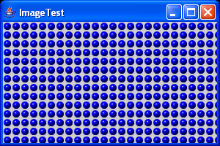
import java.awt.*;
import java.awt.event.*;
import java.io.*;
import javax.imageio.*;
import javax.swing.*;
public class ImageTest
{
public static void main(String[] args)
{
ImageFrame frame = new ImageFrame();
frame.setDefaultCloseOperation(JFrame.EXIT_ON_CLOSE);
frame.show();
}
}
/**
A frame with an image panel
*/
class ImageFrame extends JFrame
{
public ImageFrame()
{
setTitle("ImageTest");
setSize(DEFAULT_WIDTH, DEFAULT_HEIGHT);
// add panel to frame
ImagePanel panel = new ImagePanel();
Container contentPane = getContentPane();
contentPane.add(panel);
}

Slide 63
public static final int DEFAULT_WIDTH = 300;
public static final int DEFAULT_HEIGHT = 200;
}
/**
A panel that displays a tiled image
*/
class ImagePanel extends JPanel
{
public ImagePanel()
{
// acquire the image
/*
image = Toolkit.getDefaultToolkit().getImage
("blue-ball.gif");
MediaTracker tracker = new MediaTracker(this);
tracker.addImage(image, 0);
try { tracker.waitForID(0); }
catch (InterruptedException exception) {}
*/
try
{
image = ImageIO.read(new File("blue-ball.gif"));
}
catch (IOException exception)
{
exception.printStackTrace();
}
}
public void paintComponent(Graphics g)
{
super.paintComponent(g);
if (image == null) return;
int imageWidth = image.getWidth(this);
int imageHeight = image.getHeight(this);

Slide 64
// draw the image in the upper-left corner
g.drawImage(image, 0, 0, null);
// tile the image across the panel
for (int i = 0; i * imageWidth <= getWidth(); i++)
for (int j = 0; j * imageHeight <= getHeight(); j++)
if (i + j > 0)
g.copyArea(0, 0, imageWidth, imageHeight,
i * imageWidth, j * imageHeight);
}
private Image image;
}

