Slide 1
Event handling

Slide 2
Basics of Event Handling
Event handling is a basic concept of graphical user interfaces.
What is event handling?
  It is the way we capture events in Java. Java GUI programmers are particularly interested in events like:
    mouse clicks
    keyboard entries
    time intervals
  We can also implement simple GUI objects in Java such as buttons.

Slide 3
Basics of Event Handling
The way event handling works is this:
  Any operating system that supports GUIs constantly monitors events such as keystrokes and mouse clicks.
  The operating system reports these events to programs that are running.
  The programs decide what, if anything, they want to do with these events.
In Java, you control how to handle these events by setting up event source objects and event listener objects.

Slide 4
Basics of Event Handling
Event sources are objects like buttons and scroll bars.
Event listeners can be any object.
Here is how to set up event sources and listeners:
  A listener object is an instance of a class that implements a listener interface.
  An event source is an object that can register listener objects and send them event objects.
  The event source sends out event objects to all the registered listeners when that event occurs.
  The listener objects will then use information in the event object to determine their reaction to the event.

Slide 5
Event handling in Swing
Swing uses an event delegation model, with event objects passed around from event sources to event listeners.
Events are subclasses of java.util.EventObject:
  WindowEvent
  MouseEvent
  ActionEvent
  …

Slide 6
Controls and Listeners
Theory
  Source
    Buttons, controls etc.
  Listener
    An Object that wants to know when the control is operated
  Notification Message
    A message sent from the source to the listener as a notification that the event has occured
Essentially: registering callbacks

Slide 7
Listeners and Interface
An Object may be interested in multiple events
  It can implement multiple listener interfaces
Once an object implements a listener interface, it can then be added to the source by using
  source.addListener(Listener l)
Interfaces are key in the ability to implement the Listener model

Slide 8
Source-Listener Interaction
Source
Listener
addListener
Listener
addListener
Notification of event

Slide 9
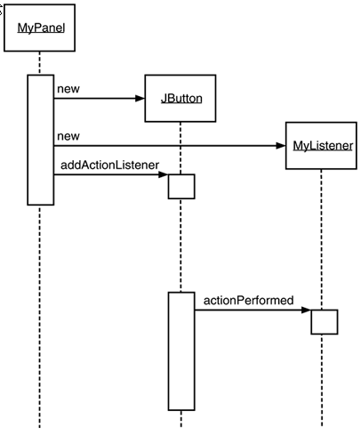
Event notification

Slide 10
Registering Listeners
First, you create an event source object like a button.
  JButton button = new JButton(“Ok”);
Second, instantiate an object that implements a listener interface.
  ActionListener listener = new ColorAction(Color.red);
  where ColorAction implements ActionListener
Third, register the listener object with the event source object.
  button.addActionListener(listener);

Slide 11
Registering Listeners
Note: JButton objects require an ActionListener interface. Other objects may require different interfaces
  The ActionListener interface requires the programmer to override the actionPerformed method that accepts an Event object.
So, now when the button is clicked, the JButton object creates an ActionEvent object (which is a subclass of an Event object) and calls the actionPerformed method in listener object (ColorAction).
Note, multiple listeners can be registered to one event source.

Slide 12
Event handling in Swing (example)
  class MyListener implements ActionListener
  {
  public void actionPerformed(ActionEvent e)
  {
  // respond to a button press
  }
  }
  MyListener listener = new MyListener();
  JButton b = new JButton("OK");
  b.addActionListener(listener);

Slide 13
Notification Prototype
The message prototype defined in the ActionListener Interface
  The message the button sends
ActionEvent parameter includes extra info
  A pointer to the source object (e.getSource())
  When the event happened
  Any modifier keys held down
public void actionPerformed(ActionEvent e);

Slide 14
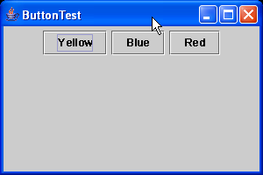
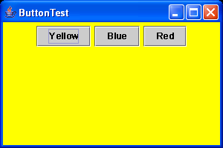
Event handling - The button test example

Slide 15

ButtonTest.java
import java.awt.*;
import java.awt.event.*;
import javax.swing.*;
public class ButtonTest
{
public static void main(String[] args)
{
ButtonFrame frame = new ButtonFrame();
frame.setDefaultCloseOperation(JFrame.EXIT_ON_CLOSE);
frame.show();
}
}
/**
A frame with a button panel
*/
class ButtonFrame extends JFrame
{
public ButtonFrame()
{
setTitle("ButtonTest");
setSize(DEFAULT_WIDTH, DEFAULT_HEIGHT);
// add panel to frame
ButtonPanel panel = new ButtonPanel();
Container contentPane = getContentPane();
contentPane.add(panel);
}
public static final int DEFAULT_WIDTH = 300;
public static final int DEFAULT_HEIGHT = 200;
}

Slide 16
/**
A panel with three buttons.
*/
class ButtonPanel extends JPanel
{
public ButtonPanel()
{
// create buttons
JButton yellowButton = new JButton("Yellow");
JButton blueButton = new JButton("Blue");
JButton redButton = new JButton("Red");
// add buttons to panel
add(yellowButton);
add(blueButton);
add(redButton);
// create button actions
ColorAction yellowAction = new ColorAction(Color.YELLOW);
ColorAction blueAction = new ColorAction(Color.BLUE);
ColorAction redAction = new ColorAction(Color.RED);
// associate actions with buttons
yellowButton.addActionListener(yellowAction);
blueButton.addActionListener(blueAction);
redButton.addActionListener(redAction);
}

Slide 17
/**
An action listener that sets the panel's background color.
*/
private class ColorAction implements ActionListener
{
public ColorAction(Color c)
{
backgroundColor = c;
}
public void actionPerformed(ActionEvent event)
{
setBackground(backgroundColor);
}
private Color backgroundColor;
}
}

Slide 18
Revisiting Inner Classes
Listener objects are often strategically placed as inner classes inside the class whose state the listener should modify.
  Again, inner classes have access to the private data of the outer class.
You can also use anonymous inner classes to dramatically reduce the amount of code needed.

Slide 19
Another example with inner classes
  class ButtonPanel extends JPanel
  {
  public ButtonPanel()
  {
  JButton one = new JButton("Red");
  add(one);
  BAction act_one =
  new BAction(Color.RED);
  one.addActionListener(act_one);
  }
  // define BAction inner class here!
  }

Slide 20
Inner class example (continued)
The inner class definition:
  class BAction implements ActionListener
  {
  public BAction(Color c)
  {
  myColor = c;
  }
  public void actionPerformed(ActionEvent e)
  {
  setBackground(myColor);
  }
  private Color myColor;
  }

Slide 21
Some comments
This example is a JPanel which contains one button, that sets the JPanel's background color to red when it is clicked.
We use an inner class for the ActionListener because that gives the listener access to the JPanel's methods (like setBackground()).
You can add multiple listeners to a single event source.
More complicated event functions can examine the properties of the ActionEvent object and respond accordingly.

Slide 22
Again, with an anonymous inner class
  class ButtonPanel extends JPanel {
  public ButtonPanel() {
  mkButton("Red",Color.RED);
  mkButton("Yellow",Color.YELLOW);
  mkButton("Green",Color.GREEN);
  }
  void mkButton(String name,final Color bg) {
  JButton jb = new JButton(name);
  add(jb);
  jb.addActionListener(new ActionListener() {
  public void actionPerformed(ActionEvent e)
  { setBackground(bg); }
  });
  }
  }

Slide 23
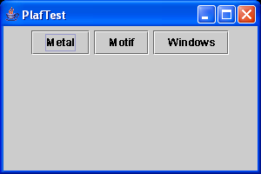
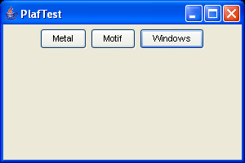
Event handling – Using anonymous inner example
This program demonstrates how to switch the look and feel using an anonymous inner class to specify the button action.

Slide 24
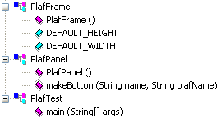
import java.awt.*;
import java.awt.event.*;
import javax.swing.*;
public class PlafTest
{
public static void main(String[] args)
{
PlafFrame frame = new PlafFrame();
frame.setDefaultCloseOperation(JFrame.EXIT_ON_CLOSE);
frame.show();
}
}
/**
A frame with a button panel for changing look and feel
*/
class PlafFrame extends JFrame
{
public PlafFrame()
{
setTitle("PlafTest");
setSize(DEFAULT_WIDTH, DEFAULT_HEIGHT);
// add panel to frame
PlafPanel panel = new PlafPanel();
Container contentPane = getContentPane();
contentPane.add(panel);
}
public static final int DEFAULT_WIDTH = 300;
public static final int DEFAULT_HEIGHT = 200;
}

Slide 25
/**
A panel with buttons to change the pluggable look and feel
*/
class PlafPanel extends JPanel
{
public PlafPanel()
{
makeButton("Metal",
"javax.swing.plaf.metal.MetalLookAndFeel");
makeButton("Motif",
"com.sun.java.swing.plaf.motif.MotifLookAndFeel");
makeButton("Windows",
"com.sun.java.swing.plaf.windows.WindowsLookAndFeel");
}
/**
Makes a button to change the pluggable look and feel.
@param name the button name
@param plafName the name of the look and feel class
*/
void makeButton(String name, final String plafName)
{
// add button to panel
JButton button = new JButton(name);
add(button);

Slide 26
// set button action
button.addActionListener(new
ActionListener()
{
public void actionPerformed(ActionEvent event)
{
// button action: switch to the new look and feel
try
{
UIManager.setLookAndFeel(plafName);
SwingUtilities.updateComponentTreeUI
(PlafPanel.this);
}
catch(Exception e) { e.printStackTrace(); }
}
});
}
}

Slide 27
Misc Listeners
JCheckBox
  Uses ActionListener, like JButton
  Responds to boolean isSelected() to see if it is currently checked
JSlider
  Component with min/max/current values
  Users StateChangedListener interface
    Notification is stateChanged(ChangeEvent e)
    e.getSource() to get a pointer to the source
  Responds to int getValue() to get current value

Slide 28
Event handling Strategies
Listener strategy
  Our approach so far
  Event based
Polling strategy
  Do not listen to the control
  Check the value when you choose
  Often fraught with problems, but may have an appropriate use in some cases

Slide 29
Capturing Window Events

Slide 30
Capturing Window Events
Like buttons, windows generate events called WindowEvents.
To capture window events (such as when the user closes a window), you must have an object that implements the WindowListener interface. The JFrame is the source of a WindowEvent.
  e.g. WindowListener listener = …;
  frame.addWindowListener(listener);
The WindowListener interface has seven distinct events that can happen. That means you must override seven abstract methods.

Slide 31
Window events
Use the (complicated) WindowListener interface to capture WindowEvents.
  public interface WindowListener {
  void windowOpened(WindowEvent e);
  void windowClosing(WindowEvent e);
  void windowClosed(WindowEvent e);
  void windowIconified(WindowEvent e);
  void windowDeiconified(WindowEvent e);
  void windowActivated(WindowEvent e);
  void windowDeactivated(WindowEvent e);
  }

Slide 32
Capturing Window Events
If you're only listening for one event type, implementing WindowListener (or another listener interface) is a lot of work, because you have to provide empty methods for the methods you don't want.
AWT provides adapter classes which implement each interface with all empty methods to make it easier for programmers
Each AWT listener interface with more than one method comes with a companion adapter class.
  You can then just extend your class from these adapter classes if you don’t need to extend it from anything else.

Slide 33
Adapter Classes
The adapter class for the WindowListener interface is WindowAdapter. You can use it like this:
  class Terminator extends WindowAdapter {…}
Creating a listener class that extends the WindowAdapter is even easier than that. There is no need to give a name to the listener object.
  frame.addWindowListener(new Terminator());
You can go even further by using an anonymous inner class:
  frame.addWindowListener(new WindowAdapter() {
  public void windowClosing(WindowEvent e) {
  System.exit(0)
  }
  });
You can see how much less code there is.

Slide 34
Adapters and anonymous inner classes
Adapter classes make anonymous inner classes feasible even for complicated Listener classes like WindowListener:
  myFrame.addWindowListener(new
  WindowAdapter() {
  public void windowClosing(WindowEvent e)
  { System.exit(0); }
  }
  );

Slide 35
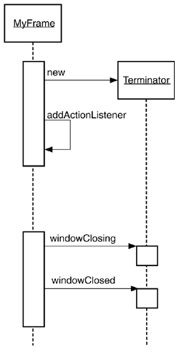
Example

Slide 36
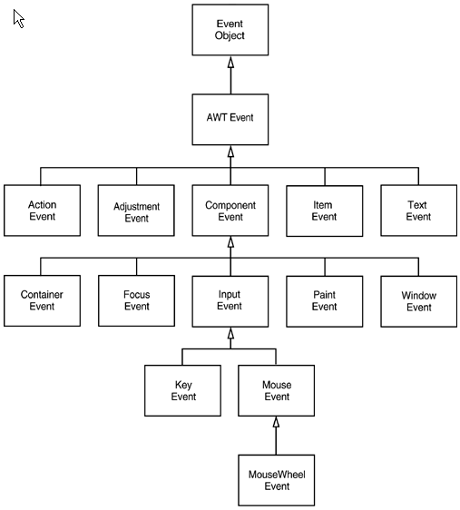
The AWT Event Hierarchy

Slide 37
Semantic and Low-Level Events
Semantic events express what the user is doing.
  e.g. clicking a button
Low-level events are those that make semantic events possible.
  e.g. mouse moves, mouse clicks, keyboard strokes etc.
The 4 semantic event classes in java.awt.event package
  ActionEvent
    (for button clicks, menu selections, ENTER typed in text field, selecting a list item)
  AdjustmentEvent
    (the user adjusted a scroll bar)
  ItemEvent
    (the user made a selection from a set of checkboxes or list items)
  TextEvent
    (the contents of a text field or text area were changed)

Slide 38
Semantic and Low-Level Events
The 7 low-level event classes in java.awt.event package
  ComponentEvent
    (the component was resized, moved, shown, or hidden)
  KeyEvent
    (key was pressed or released)
  MouseEvent
    (the mouse button was pressed, released, moved, or dragged)
  MouseWheelEvent
    (the mouse wheel was rotated)
  FocusEvent
    (a component got focus or lost focus)
  WindowEvent
    (the window state changed)
  ContainerEvent
    (a component has been added or removed)

Slide 39
Event handling summary
See page 293 table 8-1 shows all AWT listener interfaces, events, and event sources.

Slide 40
Low-Level Event Types

Slide 41
Keyboard Events
Keyboard Events
  When the user pushes a key, a KEY_PRESSED KeyEvent is generated.
  When the user releases a key, a KEY_RELEASED KeyEvent is generated.
  You trap these events in the keyPressed and the keyReleased methods of any class that implements the KeyListener interface.
  A third method, keyTyped, combines the two and it reports on the characters that were generated by the user’s keystrokes.

Slide 42
Keyboard Events
The difference between characters and virtual key codes:
  Virtual key codes correspond to keys on the keyboard.
    e.g. VK_A denotes the key marked A
    There is no separate lowercase virtual key code - the keyboard does not have separate lowercase keys.
    Virtual key codes are indicated with a prefix of VK_ such as VK_A or VK_SHIFT
  Here are the five events that are generated when a user tyes an uppercase A
    Pressed the shift key (keyPressed called for VK_SHIFT)
    Pressed the A key (keyPressed called for VK_A)
    Typed “A” (keyTyped called for an “A”)
    Released the A key (keyReleased called for VK_A)
    Released the shift key (keyReleased called for VK_SHIFT)

Slide 43
Keyboard events
Keyboard events are sent as KeyEvent objects to a KeyListener.
The keyPressed() and keyReleased() methods of a KeyListener handle KeyEvent objects for raw keystrokes.

Slide 44
Keyboard Events
Use e.getKeyCode() to get the keycode from a KeyEvent.
public void keyPressed (KeyEvent event) {
int keyCode = event.getKeyCode();
}
Use the isShiftDown, isControlDown, isAltDown, and isMetaDown instead of looking for the virtual key codes
public void keyPressed (KeyEvent event) {
int keyCode = event.getKeyCode();
if (keyCode == KeyEvent.VK_RIGHT && event.isShiftDown()) {…}
}

Slide 45
Keyboard Events
To obtain the actual character that was typed use the keyTyped method and call the getKeyChar method.
public void keyTyped (KeyEvent event) {
char keyChar = event.getKeyChar();
}
Note: not all keystrokes result in a call to keyTyped. Only those keystrokes that generate a Unicode character can be captured in the keyTyped method. You need the keyPressed method to check for cursor keys and other command keys.

Slide 46
Simple Example
…
public void keyPressed(KeyEvent event)
{
int keyCode = event.getKeyCode();
if (keyCode == KeyEvent.VK_RIGHT && event.isShiftDown())
{
. . .
}
}

Slide 47
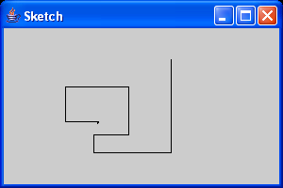
Keyboard Events Handling Example
The sketch example shows how to handle keystrokes

Slide 48
import java.awt.*;
import java.awt.geom.*;
import java.util.*;
import java.awt.event.*;
import javax.swing.*;
public class Sketch
{
public static void main(String[] args)
{
SketchFrame frame = new SketchFrame();
frame.setDefaultCloseOperation(JFrame.EXIT_ON_CLOSE);
frame.show();
}
}
/**
A frame with a panel for sketching a figure
*/
class SketchFrame extends JFrame
{
public SketchFrame()
{
setTitle("Sketch");
setSize(DEFAULT_WIDTH, DEFAULT_HEIGHT);
// add panel to frame
SketchPanel panel = new SketchPanel();
Container contentPane = getContentPane();
contentPane.add(panel);
}
public static final int DEFAULT_WIDTH = 300;
public static final int DEFAULT_HEIGHT = 200;
}

Slide 49
/**
A panel for sketching with the keyboard.
*/
class SketchPanel extends JPanel
{
public SketchPanel()
{
last = new Point2D.Double(100, 100);
lines = new ArrayList();
KeyHandler listener = new KeyHandler();
addKeyListener(listener);
setFocusable(true);
}
/**
Add a new line segment to the sketch.
@param dx the movement in x direction
@param dy the movement in y direction
*/
public void add(int dx, int dy)
{
// compute new end point
Point2D end = new Point2D.Double(last.getX() + dx,
last.getY() + dy);
// add line segment
Line2D line = new Line2D.Double(last, end);
lines.add(line);
repaint();
// remember new end point
last = end;
}

Slide 50
public void paintComponent(Graphics g)
{
super.paintComponent(g);
Graphics2D g2 = (Graphics2D)g;
// draw all lines
for (int i = 0; i < lines.size(); i++)
g2.draw((Line2D)lines.get(i));
}
private Point2D last;
private ArrayList lines;
private static final int SMALL_INCREMENT = 1;
private static final int LARGE_INCREMENT = 5;
private class KeyHandler implements KeyListener
{
public void keyPressed(KeyEvent event)
{
int keyCode = event.getKeyCode();
// set distance
int d;
if (event.isShiftDown())
d = LARGE_INCREMENT;
else
d = SMALL_INCREMENT;
// add line segment
if (keyCode == KeyEvent.VK_LEFT) add(-d, 0);
else if (keyCode == KeyEvent.VK_RIGHT) add(d, 0);
else if (keyCode == KeyEvent.VK_UP) add(0, -d);
else if (keyCode == KeyEvent.VK_DOWN) add(0, d);
}
public void keyReleased(KeyEvent event) {}

Slide 51
public void keyTyped(KeyEvent event)
{
char keyChar = event.getKeyChar();
// set distance
int d;
if (Character.isUpperCase(keyChar))
{
d = LARGE_INCREMENT;
keyChar = Character.toLowerCase(keyChar);
}
else
d = SMALL_INCREMENT;
// add line segment
if (keyChar == 'h') add(-d, 0);
else if (keyChar == 'l') add(d, 0);
else if (keyChar == 'k') add(0, -d);
else if (keyChar == 'j') add(0, d);
}
}
}

Slide 52
Mouse events
You do not need to listen for mouse events if the user interface consists of Swing components (like buttons, menus, and text boxes). Each object generates its own higher-level events.
When a user clicks a mouse button, 3 listener methods are called:
  mousePressed, mouseReleased and mouseClicked

Slide 53
Mouse events (continued)
Just as window events are passed via the WindowListener interface, mouse events use the MouseListener interface:
  public interface MouseListener
  {
  void mouseClicked(MouseEvent e);
  void mouseEntered(MouseEvent e);
  void mouseExited(MouseEvent e);
  void mousePressed(MouseEvent e);
  void mouseReleased(MouseEvent e);
  }
Swing also provides a MouseAdapter class to make it easy to write mouse listeners.
Mouse move and drag events are defined in a separate interface called MouseMotionListener.
  If the user presses a button while the mouse is in motion, mouseDragged calls are generated instead of mouseClicked calls.

Slide 54
Mouse events (continued)
Given a MouseEvent object passed to a MouseListener:
  Use m.getX() and m.getY() to get the coordinates.
  Use m.getModifiers() and one or more masks (BUTTON1_DOWN_MASK, ALT_DOWN_MASK, etc.) to get the button and keyboard modifier states.
  If you want to distinguish between single, double and triple clicks, use the getClickCount method.
  You can also change the cursor moved by the mouse with the getPredefinedCursor method of the Cursor class.
    See pg. 302 for sample cursor shapes.

Slide 55
public void mousePressed(MouseEvent event)
{
current = find(event.getPoint());
if (current == null) // not inside a square
add(event.getPoint());
}
public void mouseClicked(MouseEvent event)
{
current = find(event.getPoint());
if (current != null && event.getClickCount() >= 2)
remove(current);
}

Slide 56
Focus events
The currently-active control or component is said to have the focus.
AWT/Swing generally handle the focus automatically.
Panels, labels, and other mostly-static components don't normally get the focus. If you need to override this behavior, call component.setFocusable(true).
Fine-grained focus handling can get very complicated; see the book for details.

Slide 57
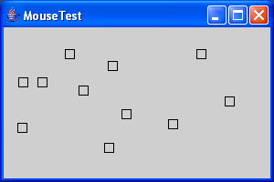
import java.awt.*;
import java.awt.event.*;
import java.util.*;
import java.awt.geom.*;
import javax.swing.*;
public class MouseTest
{
public static void main(String[] args)
{
MouseFrame frame = new MouseFrame();
frame.setDefaultCloseOperation(JFrame.EXIT_ON_CLOSE);
frame.show();
}
}
/**
A frame containing a panel for testing mouse operations
*/
class MouseFrame extends JFrame
{
public MouseFrame()
{
setTitle("MouseTest");
setSize(DEFAULT_WIDTH, DEFAULT_HEIGHT);
// add panel to frame
MousePanel panel = new MousePanel();
Container contentPane = getContentPane();
contentPane.add(panel);
}
public static final int DEFAULT_WIDTH = 300;
public static final int DEFAULT_HEIGHT = 200;
}

Slide 58
/**
A panel with mouse operations for adding and removing squares.
*/
class MousePanel extends JPanel
{
public MousePanel()
{
squares = new ArrayList();
current = null;
addMouseListener(new MouseHandler());
addMouseMotionListener(new MouseMotionHandler());
}
public void paintComponent(Graphics g)
{
super.paintComponent(g);
Graphics2D g2 = (Graphics2D)g;
// draw all squares
for (int i = 0; i < squares.size(); i++)
g2.draw((Rectangle2D)squares.get(i));
}
/**
Finds the first square containing a point.
@param p a point
@return the first square that contains p
*/
public Rectangle2D find(Point2D p)
{
for (int i = 0; i < squares.size(); i++)
{
Rectangle2D r = (Rectangle2D)squares.get(i);
if (r.contains(p)) return r;
}
return null;
}

Slide 59
/**
Adds a square to the collection.
@param p the center of the square
*/
public void add(Point2D p)
{
double x = p.getX();
double y = p.getY();
current = new Rectangle2D.Double(
x - SIDELENGTH / 2,
y - SIDELENGTH / 2,
SIDELENGTH,
SIDELENGTH);
squares.add(current);
repaint();
}
/**
Removes a square from the collection.
@param s the square to remove
*/
public void remove(Rectangle2D s)
{
if (s == null) return;
if (s == current) current = null;
squares.remove(s);
repaint();
}
private static final int SIDELENGTH = 10;
private ArrayList squares;
private Rectangle2D current;
// the square containing the mouse cursor

Slide 60
private class MouseHandler extends MouseAdapter
{
public void mousePressed(MouseEvent event)
{
// add a new square if the cursor isn't inside a square
current = find(event.getPoint());
if (current == null)
add(event.getPoint());
}
public void mouseClicked(MouseEvent event)
{
// remove the current square if double clicked
current = find(event.getPoint());
if (current != null && event.getClickCount() >= 2)
remove(current);
}
}
private class MouseMotionHandler
implements MouseMotionListener
{
public void mouseMoved(MouseEvent event)
{
// set the mouse cursor to cross hairs if it is inside
// a rectangle
if (find(event.getPoint()) == null)
setCursor(Cursor.getDefaultCursor());
else
setCursor(Cursor.getPredefinedCursor
(Cursor.CROSSHAIR_CURSOR));
}

Slide 61
public void mouseDragged(MouseEvent event)
{
if (current != null)
{
int x = event.getX();
int y = event.getY();
// drag the current rectangle to center it at (x, y)
current.setFrame(
x - SIDELENGTH / 2,
y - SIDELENGTH / 2,
SIDELENGTH,
SIDELENGTH);
repaint();
}
}
}
}

Slide 62
Actions

Slide 63
Actions
Most programs provide multiple ways to produce the same semantic event.
  Toolbar item
  Menu pick
  Keyboard shortcut
The Action interface defines an object that can encapsulate commands and attach them to multiple event sources.

Slide 64
Actions (continued)
The Action interface provides seven methods:
  void actionPerformed(ActionEvent e)
  void setEnabled(boolean b)
  boolean isEnabled()
  void putValue(String key,Object value)
  Object getValue(String key)
  void addPropertyChangeListener(listener)
  void removePropertyChangeListener(listener)

Slide 65
Actions (continued)
putValue() and getValue() allow you to store and retrieve arbitrary data in an Action object.
There are some predefined key names for putValue() and getValue():
  NAME
  SMALL_ICON
  SHORT_DESCRIPTION
  LONG_DESCRIPTION
  MNEMONIC_KEY
  ACCELERATOR_KEY
  ACTION_COMMAND_KEY
  DEFAULT

Slide 66
import java.awt.*;
import java.awt.event.*;
import javax.swing.*;
public class ActionTest
{
public static void main(String[] args)
{
ActionFrame frame = new ActionFrame();
frame.setDefaultCloseOperation(JFrame.EXIT_ON_CLOSE);
frame.show();
}
}
/**
A frame with a panel that demonstrates color change actions.
*/
class ActionFrame extends JFrame
{
public ActionFrame()
{
setTitle("ActionTest");
setSize(DEFAULT_WIDTH, DEFAULT_HEIGHT);
// add panel to frame
ActionPanel panel = new ActionPanel();
Container contentPane = getContentPane();
contentPane.add(panel);
}
public static final int DEFAULT_WIDTH = 300;
public static final int DEFAULT_HEIGHT = 200;
}

Slide 67
/**
A panel with buttons and keyboard shortcuts to change
the background color.
*/
class ActionPanel extends JPanel
{
public ActionPanel()
{
// define actions
Action yellowAction = new ColorAction("Yellow",
new ImageIcon("yellow-ball.gif"),
Color.YELLOW);
Action blueAction = new ColorAction("Blue",
new ImageIcon("blue-ball.gif"),
Color.BLUE);
Action redAction = new ColorAction("Red",
new ImageIcon("red-ball.gif"),
Color.RED);
// add buttons for these actions
add(new JButton(yellowAction)); // since 1.3
add(new JButton(blueAction));
add(new JButton(redAction));
// associate the Y, B, and R keys with names
InputMap imap = getInputMap( // since 1.3
JComponent.WHEN_ANCESTOR_OF_FOCUSED_COMPONENT);
imap.put(KeyStroke.getKeyStroke("ctrl Y"), "panel.yellow");
imap.put(KeyStroke.getKeyStroke("ctrl B"), "panel.blue");
imap.put(KeyStroke.getKeyStroke("ctrl R"), "panel.red");

Slide 68
// associate the names with actions
ActionMap amap = getActionMap();
amap.put("panel.yellow", yellowAction);
amap.put("panel.blue", blueAction);
amap.put("panel.red", redAction);
}
public class ColorAction extends AbstractAction
{
/**
Constructs a color action.
@param name the name to show on the button
@param icon the icon to display on the button
@param c the background color
*/
public ColorAction(String name, Icon icon, Color c)
{
putValue(Action.NAME, name);
putValue(Action.SMALL_ICON, icon);
putValue(Action.SHORT_DESCRIPTION,
"Set panel color to " + name.toLowerCase());
putValue("color", c);
}
public void actionPerformed(ActionEvent event)
{
Color c = (Color)getValue("color");
setBackground(c);
}
}
}

Slide 69
Actions (continued)
We'll discuss Actions more in the next class

