Slide 1
A Review System Using
Sentiment Analysis From Tweets
Group Members
MAHFUZUR RAHMAN CHOWDHURY, ID : 17101082
WASIM MAHMUD SURJO, ID : 19341019
SHOAIB AHMED DIPU, ID : 17101482

Slide 2
Explanation On Topic
Area of work : Supervised learning
Specifically: Classification
Area Covered: Opinion mining, Service recommendation, Text analysis, Sentimental analysis etc.
Motivations

Slide 3
Dataset
Used Twitter API to collect data.
Consider only the tweets as data which has the same word or words that the user wants to know as review.
Will calculate the polarity of each tweet of our data and make an average of those.
Then, predict the sentiment of people about that word or test according to our result.

Slide 4
Explanation On Used Algorithm
There exist two types of Sentiment Analysis, i.e, Rule based and Automatic.
We worked on the basis of automatic approach.
Used algorithm : Naive Bayes

Slide 5
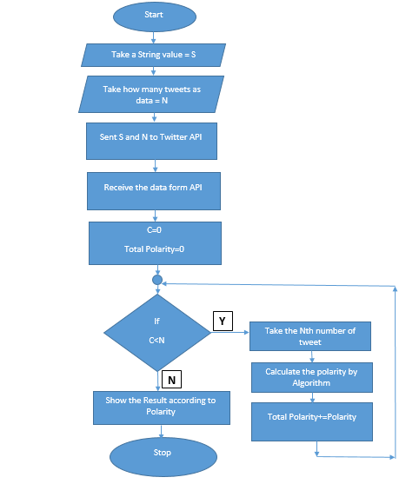
Flow Chart Of Work Pipeline

Slide 6
Pseudocode Of Naive Bayes
Step 1: Take the String and number of tweet to analysis.
Step 2: Take data from Twitter API.
Step 3: Take a tweet and divided the tweets into individual words.
Step 4: Check frequency of each word.
Step 5: Check the word is positive or negative from textblob.
Step 6: Calculate the probability of each word for positive and negative.
Step 7: Multiply the probabilities of all positive and all negative separately.
Step 8: Divide those results into by probability of positive and probability of negative.
Step 9: The probability which is greater is the result
Step 10: Save the result
Step 11: If there is tweet remaining then go to Step 3
Step 12: Make an average
Step 13: Show the result

Slide 7
Explain About Used Algorithm (Cont.)
Algorithm available that fits your problem/dataset : Decision tree, Support vector machine, Naive bayes classifier.
Naive bayes classifier works better while dealing with multivariable, in probabilistic problems.

Slide 8
Explanation About The Code/Library
Had enough resources available in the internet.
Got the code from github repository.
Got the data using Twitter API.

Slide 9
Used Libraries
tweepy | re
textblob | time

Slide 10
Result Analysis
Strongly Negative: -1<=Polarity<-0.6
Negative: -0.6<=Polarity<-0.3
Weakly Negative: -0.3<=Polarity<0
Neutral: Polarity=0
Weakly Positive: 0<Polarity<=0.3
Positive: 0.3<Polarity<=0.6
Strongly Positive: 0.6<Polarity<=1

Slide 11
Confusion Matrix
 | Positive | Negative
True | 69.8630 | 2.7397
False | 19.1780 | 8.2197

Slide 12
Result Analysis Using Confusion Matrix
 | Formula | Calculation | Result
Accuracy | (TP + TN) / (P + N) | (69.8630+2.7397) / (100) | 0.7808
Precision | TP / (TP + FP) | 69.8630 / (69.8630+19.1780) | 0.7846
Recall | TP / (TP+FN) | 69.8630/ (69.8630+8.2197) | 0.8947
F1 Score | 2*((Precision * Recall) / (Precision + Recall)) | 2*((0.7846*0.8947)/ (0.7846+0.8947)) | 0.8360

Slide 13
Explanation About Our Program
Link : https://drive.google.com/drive/folders/1ShSrDqhUrPboxXmjqg8tF6zioVFUC9fp

Slide 14
Conclusion
Twitter error response: status code = 429 error.
Difficulty in handling large dataset.
Future plan : To build a user interface based system.

Slide 15
Reference (Idea)
[1] https://github.com/the-javapocalypse/Twitter-Sentiment-Analysis
[2] Cai, K., Spangler, S., Chen, Y., & Zhang, L. (2008). Leveraging Sentiment Analysis for Topic Detection. IEEE/WIC/ACM International Conference on Web Intelligence and Intelligent Agent Technology, 1, 265-271. 10.1109/WIIAT.2008.188
[3] Gamon, M., Aue, A., Corston-Oliver, S., & Ringger, E. (2005). Pulse: Mining customer opinions from free text. Lecture Notes in Computer Science, 36(6), 121–1324. doi:10.1007/11552253_12
[4] Hu, M., & Liu, B. (2004). Mining and summarizing customer reviews. In Proceedings of the Tenth ACM SIGKDD International conference on Knowledge discovery and Data mining (pp. 168-177), ACM.
[5] Pang, B., & Lee, L. (2008). Opinion mining and sentiment analysis. Foundations and Trends in Information Retrieval, 1(2), 1–135. doi:10.1561/1500000011
[6] Prabowo, R., & Thelwall, M. (2009). Sentiment Analysis: A Combined Approach. Journal of Informetrics, 3(2), 143–157. doi:10.1016/j.joi.2009.01.003
[7] Rajeev, P. V., & Rekha, V. S. (2016). Opinion Mining of User Reviews Using Machine Learning Techniques and Ranking of Products Based on Features. Advances in Intelligent Systems and Computing., 39(8), 78–85.
[8] Sharma, R., Nigam, S., & Jain, R. (2013). Supervised Opinion Mining Techniques:A Survey. International Journal of Information and Computation Technology, 3(8), 737–742.

Slide 16
Reference (All Others)
Dataset : Using Twitter API
Code Repository : https://github.com/the-javapocalypse/Twitter-Sentiment-Analysis
Tutorials : https://www.youtube.com/watch?v=eFdPGpny_hY

