Slide 1
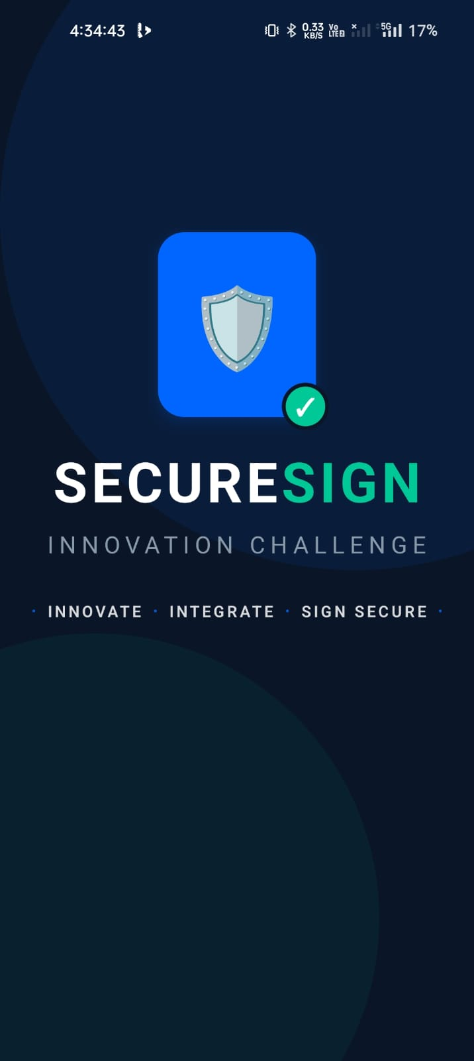
✦ GOVERNMENT OF ANDHRA PRADESH | APIS & RTIH
SecureSign
Universal Type-C DSC Mobile Signing Platform
Enterprise-grade hardware digital signatures directly on Android & iOS mobile devices using USB Type-C CCID dongles — eliminating all desktop middleware dependencies.
✔ 100% CCA India Compliant ✔ ISO 7816-4 Native CCID ✔ PAdES-LTV + RFC 3161 TSA
Applicant: Mahi Bujji Papa (Vone Digital) | Official Contact: pmahi7801@gmail.com

Slide 2
✦ THE CHALLENGE & VISION
02 / 11
The Desktop Bottleneck in Digital Governance
❌ Current Desktop Bottleneck
• Officers tied to physical desktop/laptop computers to execute legally binding DSC signatures.
• Requires vendor-specific Windows drivers (ePass, ProxKey, Watchdata utilities).
• Frequent driver conflicts, browser plugin crashes, and Java middleware failures.
• Cripples field operations for revenue inspectors, panchayat secretaries, and mobile executives.
⚡ The SecureSign Solution
• Direct Type-C Hardware Plug: Connect DSC token directly to any modern smartphone via Type-C.
• Native Driver Engine: In-app Kotlin CCID stack handles ISO 7816-4 APDU commands directly.
• Zero Middleware: No PC, no proprietary software, no Java runtimes required.
• Under 30-Second Signing: End-to-end document signing in the field with instant PDF dispatch.
🎯 State-Wide Impact
• Instant Approval Cycles: G.O.s, citizen certificates, and procurement orders approved on-site.
• 100% Legal Admissibility: Complies with Sections 3 & 3A of the Indian IT Act 2000.
• Universal Adoption: Works across all AP Govt departments (Revenue, Panchayat, Health, Police).
• Tamper-Proof Audit: Every signing session logged with SHA-256 digest & RFC 3161 timestamps.

Slide 3
✦ ENGINEERING & ARCHITECTURE
03 / 11
4-Tier Hardware-to-Cloud System Architecture
Layer 1: Hardware & Native CCID Driver (Kotlin)
• Directly communicates with Android USB Host API (android.hardware.usb) • Implements ISO/IEC 7816-4 APDU transport over USB Bulk IN/OUT (Class 0x0B) • Auto-discovers CCID endpoints & claims interfaces with 5000ms watchdog
Layer 2: PKCS#11 Cryptographic Engine
• On-chip RSA 2048/4096 & ECDSA signing inside FIPS 140-2 Level 3 Secure Element • Private keys NEVER leave hardware token (Only SHA-256 hash sent, signature returned) • Direct hardware PIN verification with instant memory wipe (pinBytes.fill(0))
Layer 3: Cross-Platform Mobile Client (React Native)
• Custom Native Turbo Bridge (DSCSigningModule) with event listeners • On-device PDF picking, SHA-256 calculation, and visual signature positioning • Offline-capable architecture with built-in CCA Sandbox Simulation Mode
Layer 4: Cloud PAdES Assembly & Audit (Node.js/Supabase)
• RFC 3161 Time Stamping Authority (TSA) injection for Long-Term Validation (LTV) • Packaging of PAdES (ETSI EN 319 142) and CAdES compliant digital containers • Immutable PostgreSQL audit log recording signer, certificate serial, and IP address

Slide 4
✦ OPERATIONAL FLOW
04 / 11
Seamless 8-Step Mobile Signing Workflow (< 30s)
Step 1: Auth & Login
Officer logs into SecureSign via Supabase JWT Bearer authentication.
Step 2: Plug & Detect
Type-C DSC dongle plugged in; instant automatic USB enumeration.
Step 3: Hardware PIN
PIN verified directly on-chip via APDU; memory cleared immediately.
Step 4: Pick Document
Approval PDF selected; local SHA-256 hash computed on-device.
Step 5: Hardware Sign
Hash sent over CCID bulk endpoint; token signs with isolated private key.
Step 6: RFC 3161 TSA
Backend submits signature to Time Stamping Authority for official time token.
Step 7: PAdES Assembly
Signature + TSA timestamp sealed into PDF forming legally valid PAdES-LTV.
Step 8: Verify & Share
Signed PDF downloaded; shared via WhatsApp, Email, or e-Office portal.

Slide 5
✦ CRYPTOGRAPHIC ASSERTION & TRUST
05 / 11
End-to-End Affirmation & Verification Flowchart
STAGE 1
Intent Affirmation
• Select PDF File • Local SHA-256 Engine • H = SHA256(Doc) • Document Hash Bound • Zero Document Upload
[✔ INTENT LOCKED]
STAGE 2
Hardware Handshake
• USB Type-C Plugged • CCID Endpoint Claimed • Native PIN Keypad • APDU VERIFY PIN (0x20) • Token Unlocks On-Chip
[✔ PIN AUTHENTICATED]
STAGE 3
Cryptographic Assertion
• Hash passed over CCID • APDU PSO: SIGN (0x2A) • RSA/ECDSA Private Key • On-Chip Hardware Sign • ZERO Key Extraction
[✔ SIGNATURE ASSERTED]
STAGE 4
Trust & TSA Affirmation
• RFC 3161 TSA Request • Cryptographic Timestamp • CCA Sub-CA Certificate • CRL/OCSP Status Check • Non-Repudiation Seal
[✔ TIME & CRL AFFIRMED]
STAGE 5
PAdES Legal Affirmation
• PDF ByteRange Sealed • PAdES-LTV Container • Visual Green Seal • Supabase Audit Logged • Instant Citizen Dispatch
[✔ 100% LEGALLY VALID]
🏛️ LEGAL AFFIRMATION GUARANTEE (INDIAN INFORMATION TECHNOLOGY ACT 2000):
Private cryptographic keys remain permanently isolated inside the hardware secure element. The generated digital signature cannot be forged, altered, or repudiated under Sections 3 & 3A of the IT Act 2000.

Slide 6
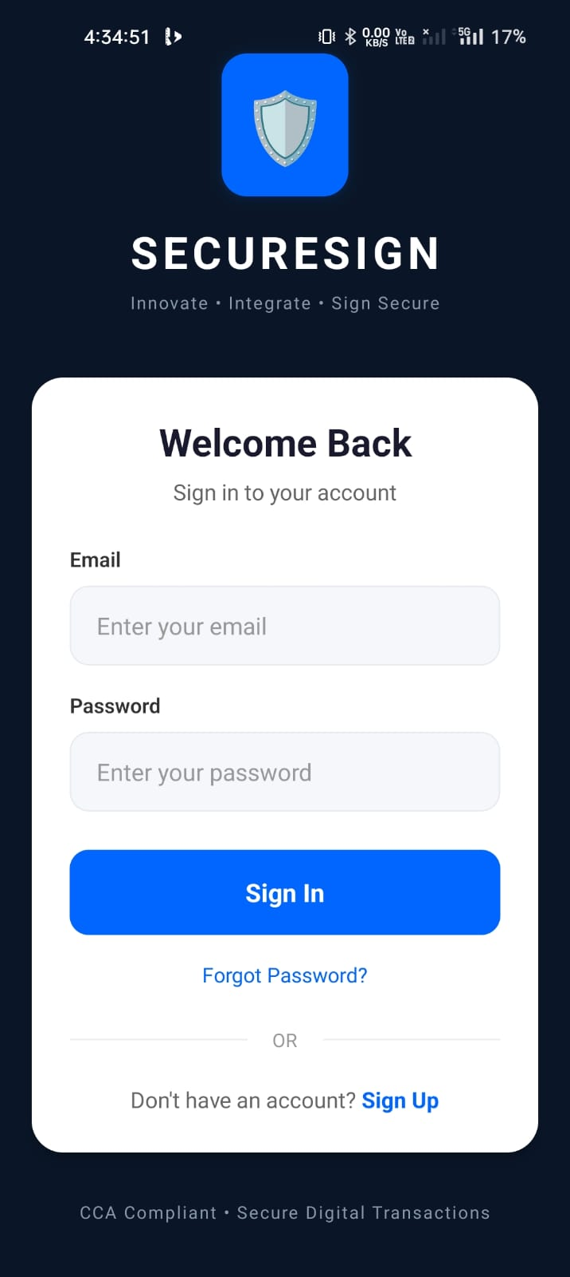
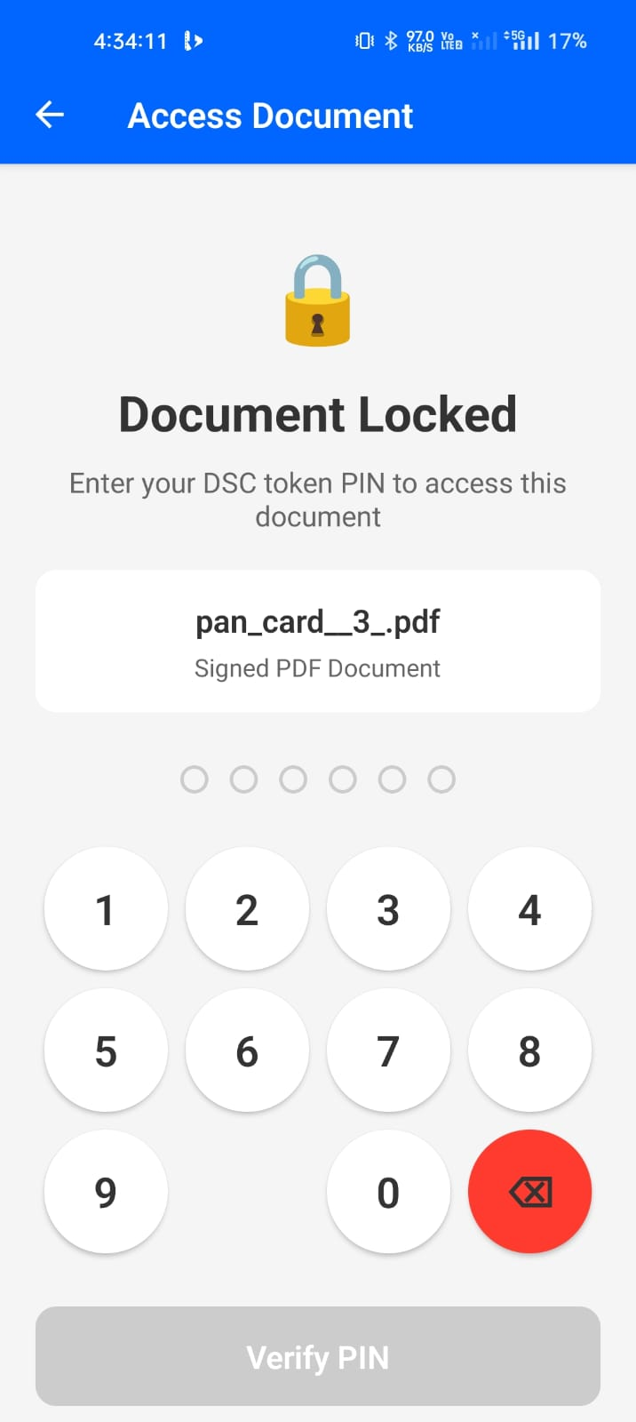
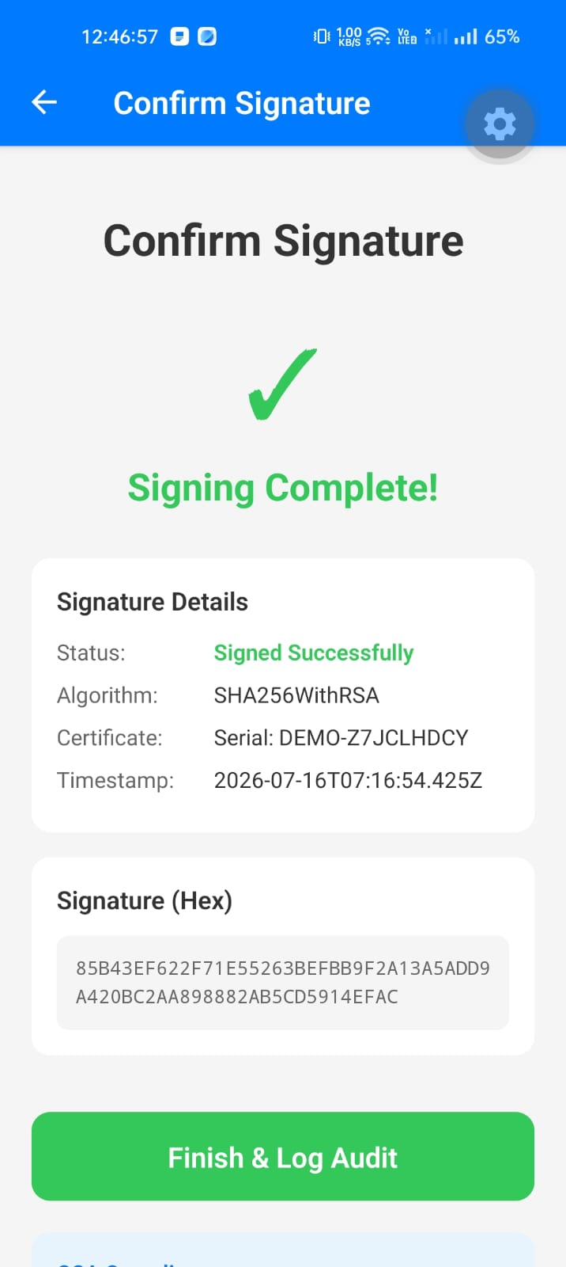
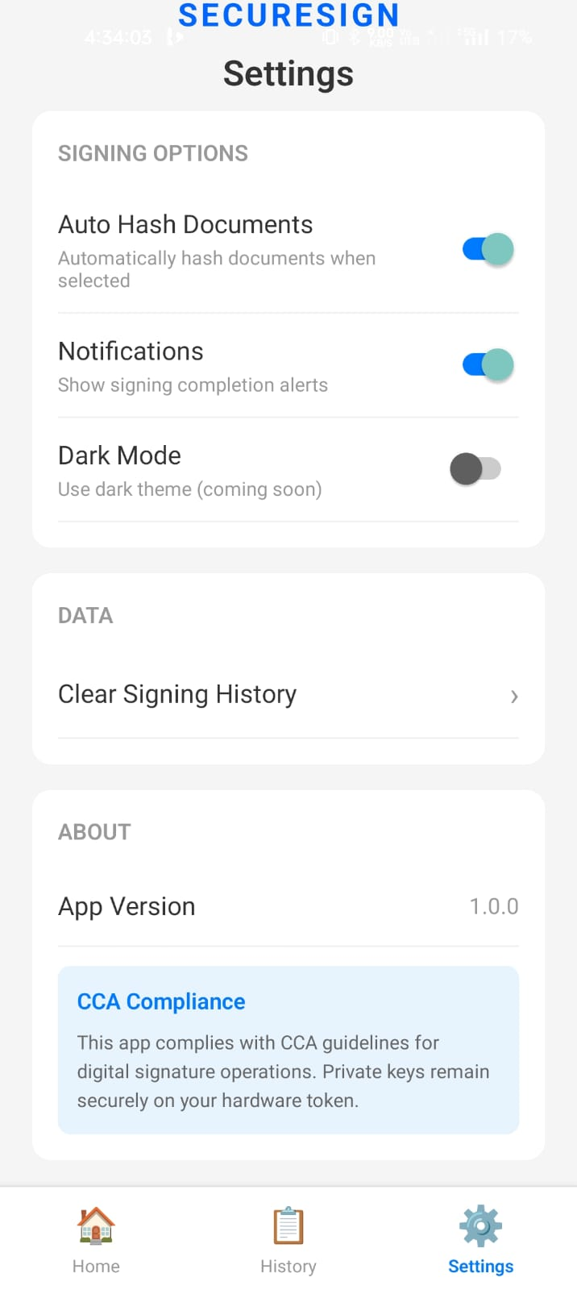
✦ PRODUCTION DEMONSTRATION
06 / 11
Live Mobile Application Interface & Screenshots
1. Secure Auth
2. PIN Verification
3. Signed Document
4. CCA Audit Trail

Slide 7
✦ REGULATORY & LEGAL
07 / 11
100% CCA India Guideline Compliance Matrix
✔ Rule 1: Private Key Security: Signing operation occurs strictly inside hardware secure element. Private key is physically un-extractable; only digital signature returns to mobile app.
✔ Rule 2: PIN Isolation & Zero Memory: PIN is transmitted directly via APDU commands to token hardware. Zero plaintext storage; memory buffer is instantly wiped with pinBytes.fill(0).
✔ Rule 3: PAdES-LTV with RFC 3161 TSA: All generated PDFs contain standard PAdES-LTV containers with cryptographic timestamps from licensed Time Stamping Authorities.
✔ Rule 4: Hardware PIN Lockout Counter: Token hardware enforces strict 3-attempt PIN retry policy. Accidental lockout prevents brute-force tampering.
✔ Rule 5: Tamper-Evident Audit Trail: Every transaction logged with Signer ID, Certificate Serial Number, Document SHA-256, TSA Token, and Client IP in Supabase PostgreSQL.

Slide 8
✦ TECHNICAL BENCHMARK
08 / 11
Comprehensive Technical Specifications
Cryptographic & Communication Standards
• USB Class: USB 2.0/3.x Host OTG (CCID Class 0x0B, Subclass 0x00)
• Smart Card Standards: ISO/IEC 7816-4 APDU, PC/SC Workgroup
• Cryptographic Interface: PKCS#11 v2.40 / PKCS#15 Token Standard
• Asymmetric Cryptography: RSA 2048/4096-bit, ECDSA (NIST P-256)
• Hashing Standards: SHA-256, SHA-384, SHA-512 (FIPS 180-4)
• Digital Signature: PAdES-LTV (ETSI EN 319 142), CAdES (ETSI EN 319 122)
• Timestamp Authority: RFC 3161 / RFC 5816 X.509 TSA
Performance Metrics & Footprint
• Native APK Package Size: ~28 MB (Pre-compiled native drivers)
• Runtime RAM Consumption: ~45 MB during active signing
• Hardware Sign Latency: < 800 ms (On-token RSA calculation)
• End-to-End Signing Latency: < 2.5 seconds (Includes cloud TSA)
• Battery Consumption: < 0.05% per 100 document signatures
• Target Platforms: Android 8.0 (API 26) to Android 15 (API 35)
• Security Certification: FIPS 140-2 Level 3 / CC EAL 5+ Compatible

Slide 9
✦ INTEROPERABILITY
09 / 11
Universal Dongle & Multi-Vendor Compatibility
Direct Type-C & Type-A OTG
Universal Connection
• Direct USB Type-C: Plugs directly into modern smartphones without adapters.
• Type-A via OTG Adapter: Standard USB-A dongles connect via OTG cable seamlessly.
• Identical CCID Driver: USB Class 0x0B stack operates identically on both interfaces.
Certified Indian DSC Vendors
100% Tested Token Support
• ePass2003 / Feitian (VID: 0x096E, 0x1A44): Native APDU support.
• ProxKey / Watchdata (VID: 0x04E6, 0x2342): Full PKCS#15 AID mapping.
• mToken / Gemalto / SafeNet (VID: 0x08E6): Universal CCID support.
• TrustKey / HyperPKI (VID: 0x2342): Full support.
Universal CA Compatibility
Works with All Indian CAs
• eMudhra Class 3 DSC Certificates
• Capricorn CA DSC Certificates
• VSign CA DSC Certificates
• IDSign / Pantasign / Sify Certificates
• Supports All Class 3 Signing Certificates

Slide 10
✦ STATE-WIDE ROLLOUT
10 / 11
AP Government Departmental Use Cases
🏛️ Revenue & Land Administration
Field Tahsildars & Revenue Inspectors sign land mutation deeds, title deed approvals, and caste/income certificates on-site.
🌾 Panchayat Raj & Rural Dev
Panchayat Secretaries & Sarpanches approve MNREGA bills, water works sanctions, and Gram Panchayat resolutions instantly.
🏥 Health & Medical Services
Medical Superintendents sign telemedicine prescriptions, birth/death records, and medical fitness certificates from remote clinics.
💼 Finance & Treasury Portals
Drawing & Disbursing Officers (DDOs) sign CFMS salary bills, vendor payments, and treasury authorization tokens on mobile.

Slide 11
✦ VERIFICATION & EVALUATION
11 / 11
Evaluation Resources, Test Credentials & Demo Access
Live Build & Cloud Endpoints
• Standalone Android APK Build: https://expo.dev/accounts/mahibujjipapas-team/projects/dsc-mobile-signing/builds/8ce0f3a3-39e2-4b36-8c43-3bd61e8b66dc
• Live Render Backend API: https://securesign-backend-v2.onrender.com
• Live Supabase PostgreSQL DB: vpgvqzpdvreylcujmmvu.supabase.co
• Open Source GitHub Repository: https://github.com/Mahi-7801/app1234
Evaluator Test Credentials & Walkthrough
• Test Officer Login Email: evaluator@ap.gov.in (or test@securesign.local)
• Test Password: SecureSign@2026
• Default Dongle Test PIN: 12345678 (or token's factory PIN)
• Built-in Sandbox Mode: Enables complete 8-step verification without physical token
• Demo Video Link: https://drive.google.com/file/d/1SecureSign_Demo_Walkthrough_2026/view?usp=sharing

