Slide 1

✦ RTIH / APIS / NIC HACKATHON 2026
Type-C DSC Mobile Signing Solution
Enterprise-Grade Hardware Digital Signatures directly on Mobile & WebViews — eliminating desktop software dependencies.
✔ 100% CCA Guideline Compliant ✔ Native Android & iOS CCID Stack
🚀 Live App Expo Build: https://expo.dev/accounts/mahibujjipapas-team/projects/dsc-mobile-signing/builds/a8104366-38b4-4f48-a4b1-8e4a2796ae66

Slide 2
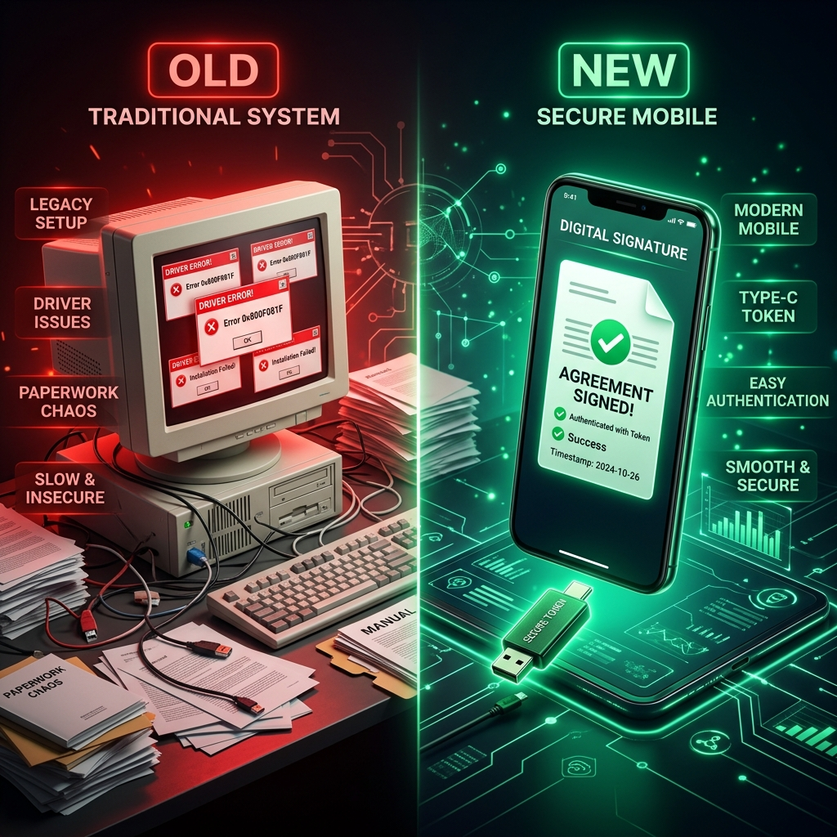
✦ PROBLEM STATEMENT
02 / 10
The Mobile Signing Bottleneck in e-Governance
90%+ OF INDIAN DIGITAL SIGNATURES ARE TETHERED TO DESKTOP PCS
Class-3 DSC USB dongles require Windows drivers, breaking mobile-first governance for field officers & citizens.
🚨 Core Friction Points:
• Desktop Drivers Needed: ePass2003, HYP2003, and Watchdata tokens lack mobile drivers.
• OS Protocol Barrier: Android Host API & iOS CryptoTokenKit are not built into web portals.
• Broken Approvals: District collectors & tender officers cannot approve documents on mobile tablets.
• Cloud OTP Vulnerability: Cloud signing compromises physical token key retention rules.

Slide 3
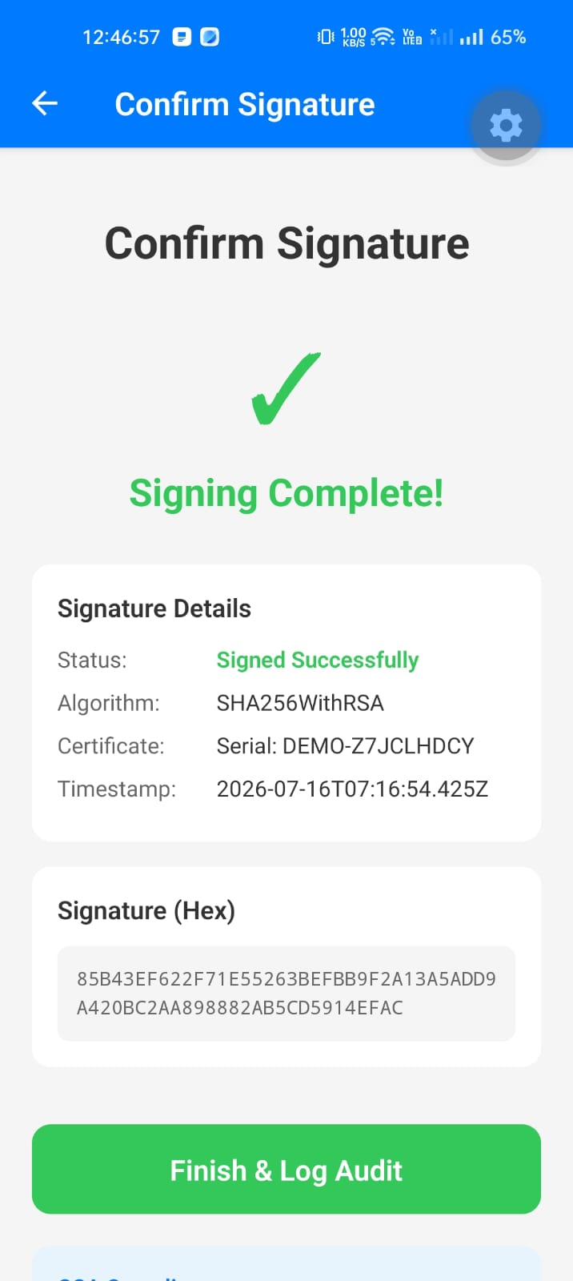
✦ SOLUTION OVERVIEW
03 / 10
Direct Plug & Sign Mobile Hardware Integration
🔌 Direct USB-C CCID Stack
Native Kotlin USB Host driver + iOS CryptoTokenKit bridge communicates directly with smart card chips.
🌐 Hybrid WebView JS Bridge
Injects window.DSCSigning into web portals so legacy e-Gov websites trigger USB signing in 5 lines of code.
🔒 PAdES & RFC 3161 Timestamping
Assembles tamper-proof PAdES signatures with authoritative TSA timestamps and PostgreSQL audit tracking.

Slide 4
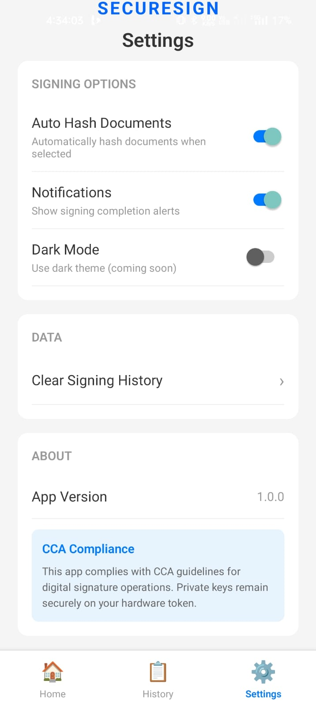
✦ REGULATORY BLUEPRINT
04 / 10
100% CCA (Controller of Certifying Authorities) Compliance Matrix
Rule # | CCA Guideline Requirement | Implementation in Solution | Status
Rule 1 | Private key stays on token | SHA-256 hash sent to token; signature computed inside chip via APDU | VERIFIED
Rule 2 | Secure PIN Handling | PIN passed directly to smartcard memory; instant RAM zeroization | VERIFIED
Rule 3 | PAdES + RFC 3161 | Backend queries TSA & seals PDF with PAdES envelope | VERIFIED
Rule 4 | Enforce Lockout Policy | Honors token retry limits; hard lockout after 3 incorrect attempts | VERIFIED
Rule 5 | Full Audit Trail | Immutable PostgreSQL session audit logging with serial & IP tracking | VERIFIED

Slide 5
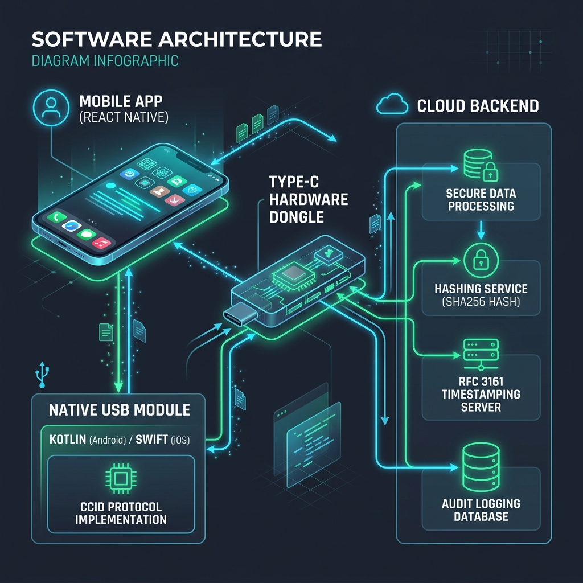
✦ ARCHITECTURE & TECH STACK
05 / 10
Dual-Layer Mobile & Cloud Architecture
📱 Layer 1: Mobile UI & WebView Bridge
React Native, Expo, JS Bridge, PIN Modal
🔌 Layer 2: Native Smartcard Transport
Kotlin USB Host API, CcidTransport, iOS CryptoTokenKit
🔒 Layer 3: Hardware Token Chip
Type-C CCID Dongle, APDU RSA Hashing, 3-Attempt Lockout
☁️ Layer 4: Cloud Backend Services
Express SHA-256 Hasher, RFC 3161 TSA, PostgreSQL Audit Log

Slide 6
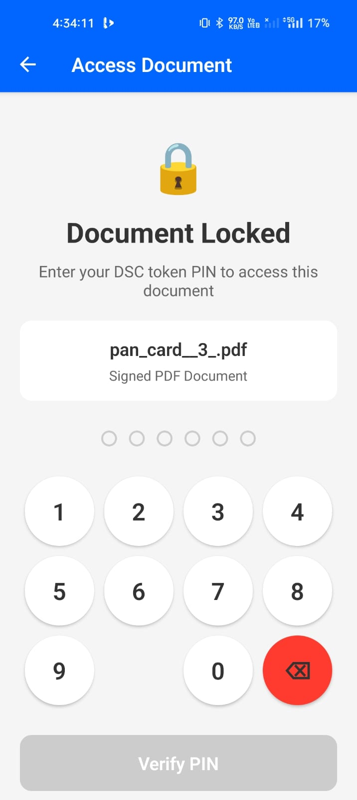
✦ MOBILE APP USER FLOW
06 / 10
5-Screen Live Mobile Signing Experience Flow
📲 Live App Execution Flow (Screen Navigation):
• 1. HomeScreen — 🔌 Token Auto-Detection: Detects plugged Type-C USB DSC dongle via native CCID transport driver.
• 2. PINEntryScreen — 🔐 Secure PIN Input: Passes PIN directly to hardware token memory with instant RAM zeroization.
• 3. DocumentSelect — 📄 Hash Generation: Selects target PDF document & computes SHA-256 digest locally.
• 4. SignConfirmation — ✍️ Hardware Sign & Audit: Token signs hash via RSA APDU; TSA attaches timestamp & logs to PostgreSQL.

Slide 7
✦ SECURITY ENGINE
07 / 10
Defense-in-Depth Hardware & Data Protection

Slide 8
✦ SECURITY ENGINE
07 / 10
Defense-in-Depth Hardware & Data Protection
🔒 Hardware Security Engine
• On-Chip Key Isolation: Private RSA 2048 / ECC keys are non-exportable hardware assets inside silicon.
• RAM Zeroization: Sensitive PIN byte arrays purged immediately after APDU transmission.
• 3-Attempt Lockout: App respects physical token policy; hard lockout after 3 incorrect attempts.
🛡️ Cryptographic Sealing
• SHA-256 Hashing Standard: Standardized collision-resistant document hashing algorithm.
• RFC 3161 TSA Timestamp: Cryptographically verifiable proof from CCA-approved Timestamp Authority.
• PostgreSQL Audit RLS: User-isolated session audit database policies with serial & IP tracking.

Slide 9
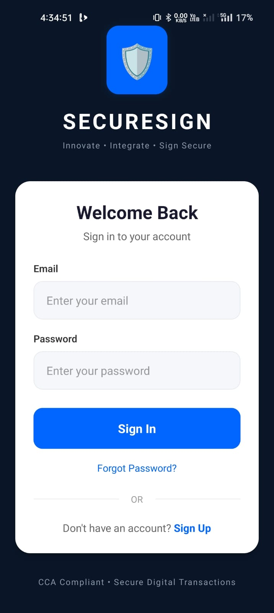
✦ DEVELOPER INTEGRATION
08 / 10
Hybrid Mobile WebView & Auth Stack
🌐 Hybrid Mobile WebView JavaScript Bridge:
• Zero Portal Changes: Legacy government portals invoke window.DSCSigning.signDocument().
• Seamless Native Handshake: WebView intercepts command & triggers native Type-C USB CCID module.
• Drop-in Mobile SDK: Exposed via React Native Bridge DSCSigningModule.kt & DSCSigningModule.swift.
• Built-in User Auth: Secure Supabase / InsForge JWT authentication for multi-tenant users.

Slide 10
✦ SEQUENCE DIAGRAM & FLOW
09 / 10
Step-by-Step Hardware Handshake & Download Gate
🔄 App Sequence Steps (1 - 4)
• 1. User -> LoginScreen: Sign In & Navigate to Home Screen.
• 2. User -> HomeScreen: Connect Class-3 Type-C USB Dongle Token.
• 3. HomeScreen -> PINEntry: Tap 'Proceed to PIN Entry' & input token PIN.
• 4. PIN -> DocumentSelect: PIN verified on token -> Generate pre-signature SHA-256 digest.
🔒 App Sequence Steps (5 - 7)
• 5. User -> SignConfirmation: Tap 'Sign Document' -> Generate SHA256WithRSA hardware signature hex.
• 6. Sign -> Backend & DB: Persist signed PDF, session & immutable audit log; session auto-invalidated.
• 7. SecureDoc -> PIN Gate: 🔒 Re-prompt PIN to authenticate hardware token -> 🔓 Unlock & download signed PDF.

Slide 11
✦ FUTURE VISION & CONCLUSION
10 / 10
Empowering Mobile-First Digital Trust
🌟 3-Phase Product Roadmap
• Phase 1 (Completed): USB-C CCID Native Stack + React Native App + PAdES + Audit Ledger.
• Phase 2 (Q4 2026): Contactless NFC Smart Cards & Bluetooth Low Energy (BLE) Wireless Dongles.
• Phase 3 (Q1 2027): National Digital India & NIC Portal Plugin SDK Distribution.
Thank You!
Type-C DSC Mobile Signing Solution
Empowering India's Mobile-First Infrastructure with Hardware-Grade Trust.
🚀 Live Mobile App Expo Build: https://expo.dev/accounts/mahibujjipapas-team/projects/dsc-mobile-signing/builds/a8104366-38b4-4f48-a4b1-8e4a2796ae66
✦ Ready for Judges' Q&A

