Slide 1
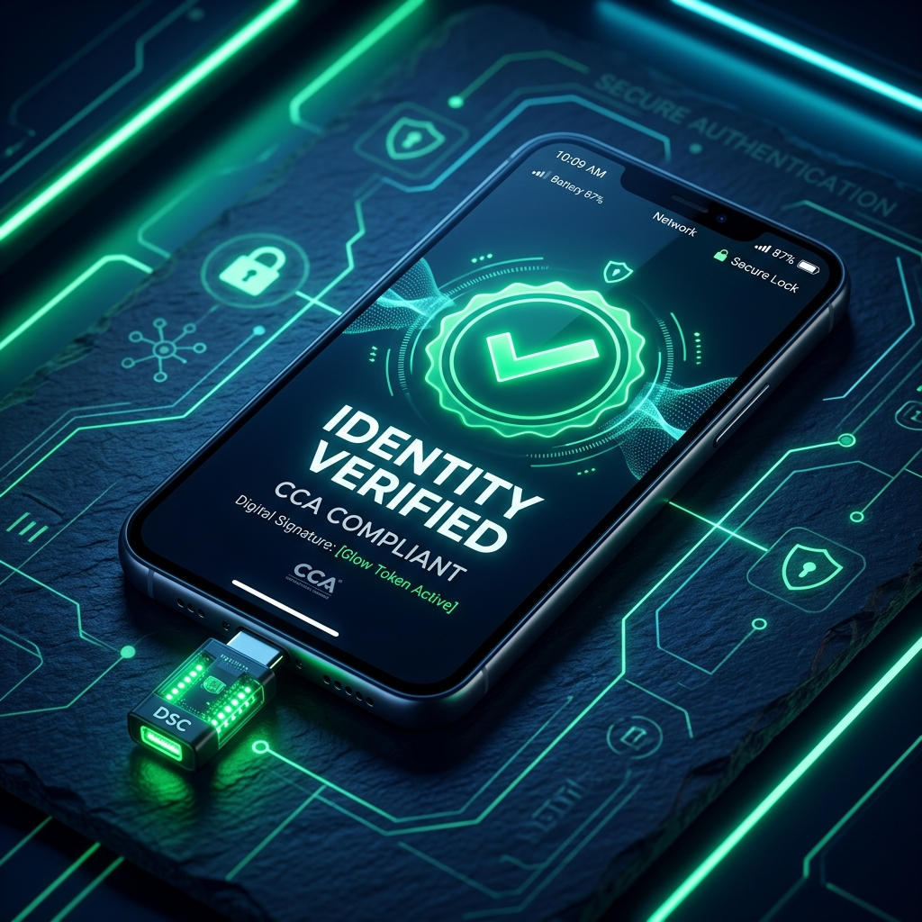
✦ RTIH / APIS / NIC HACKATHON 2026
Type-C DSC Mobile Signing Solution
Enterprise-Grade Hardware Digital Signatures directly on Mobile & WebViews — eliminating desktop software dependencies.
✔ 100% CCA Guideline Compliant ✔ Native Android & iOS CCID Stack
👥 PRESENTED BY:
• Charan (CEO, Vone Digital) • Mahankali (Lead Developer)

Slide 2
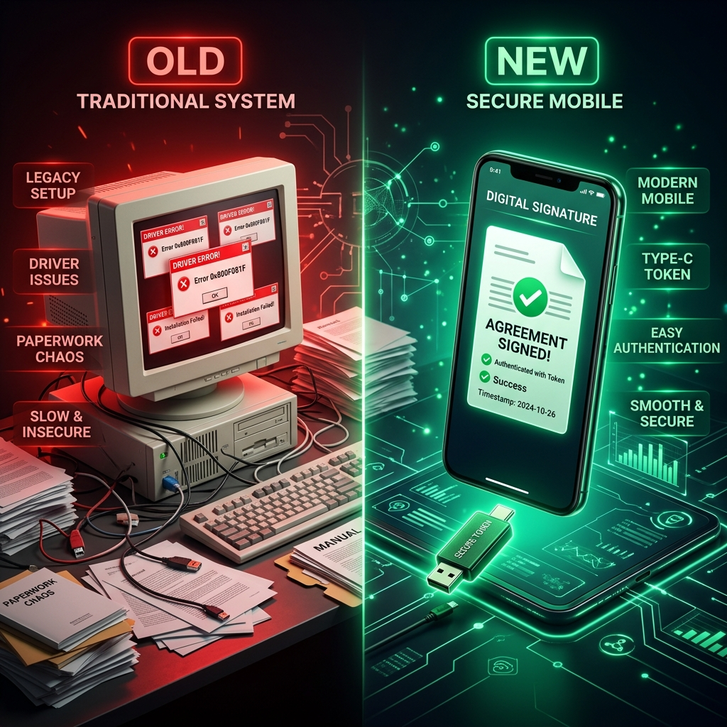
✦ PROBLEM STATEMENT
02 / 10
The Mobile Signing Bottleneck in e-Governance
90%+ OF INDIAN DIGITAL SIGNATURES ARE TETHERED TO DESKTOP PCS
Class-3 DSC USB dongles require Windows drivers, breaking mobile-first governance for field officers & citizens.
🚨 Core Friction Points:
• Desktop Drivers Needed: ePass2003, HYP2003, and Watchdata tokens lack mobile drivers.
• OS Protocol Barrier: Android Host API & iOS CryptoTokenKit are not built into web portals.
• Broken Approvals: District collectors & tender officers cannot approve documents on mobile tablets.
• Cloud OTP Vulnerability: Cloud signing compromises physical token key retention rules.

Slide 3
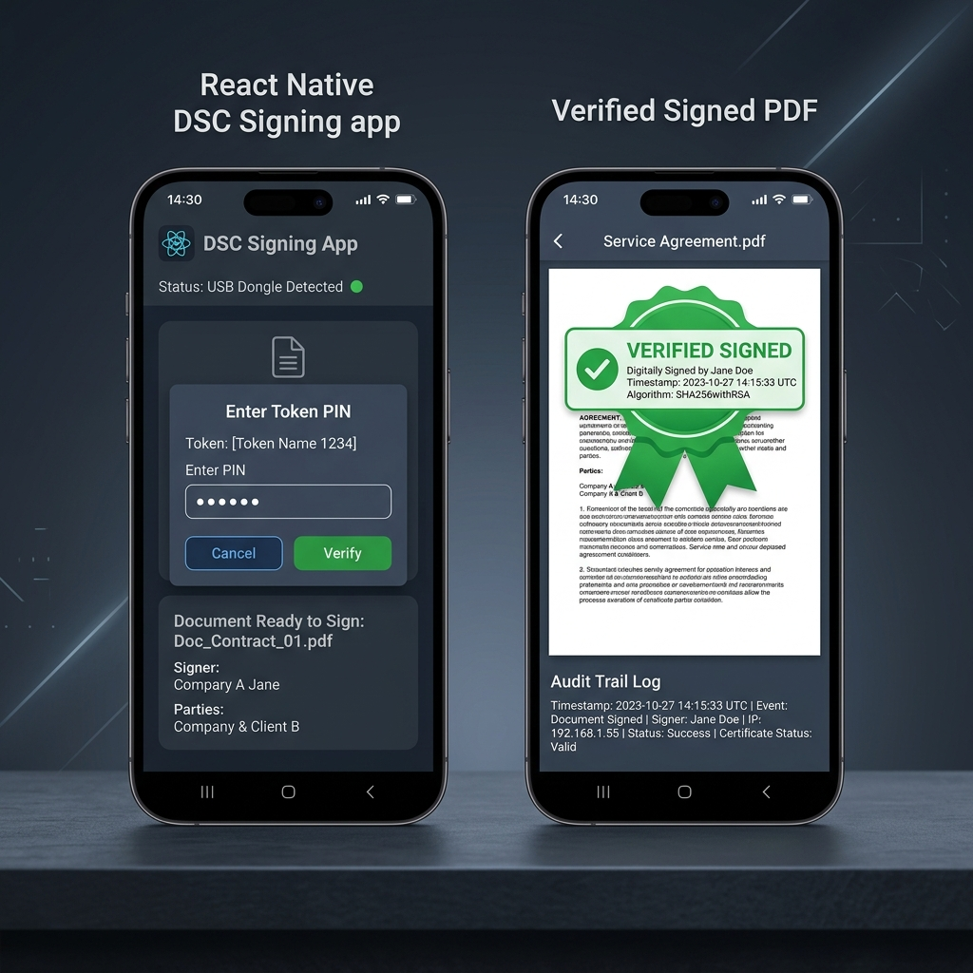
✦ SOLUTION OVERVIEW
03 / 10
Direct Plug & Sign Mobile Hardware Integration
🔌 Direct USB-C CCID Stack
Native Kotlin USB Host driver + iOS CryptoTokenKit bridge communicates directly with smart card chips.
🌐 Hybrid WebView JS Bridge
Injects window.DSCSigning into web portals so legacy e-Gov websites trigger USB signing in 5 lines of code.
🔒 PAdES & RFC 3161 Timestamping
Assembles tamper-proof PAdES signatures with authoritative TSA timestamps and PostgreSQL audit tracking.

Slide 4
✦ REGULATORY BLUEPRINT
04 / 10
100% CCA (Controller of Certifying Authorities) Compliance Matrix
Rule # | CCA Guideline Requirement | Implementation in Solution | Status
Rule 1 | Private key never leaves hardware token | SHA-256 hash sent to token; signature computed inside chip via APDU | ✅ VERIFIED
Rule 2 | Secure PIN Handling | PIN passed directly to native smartcard memory; instant RAM zeroization | ✅ VERIFIED
Rule 3 | PAdES / CAdES + RFC 3161 Timestamp | Backend queries CCA-approved TSA & seals PDF with PAdES envelope | ✅ VERIFIED
Rule 4 | Enforce Token Lockout Policy | Honors token retry limits; hard lockout after 3 incorrect attempts | ✅ VERIFIED
Rule 5 | Full Audit Trail | Immutable PostgreSQL session audit logging with serial & IP tracking | ✅ VERIFIED

Slide 5
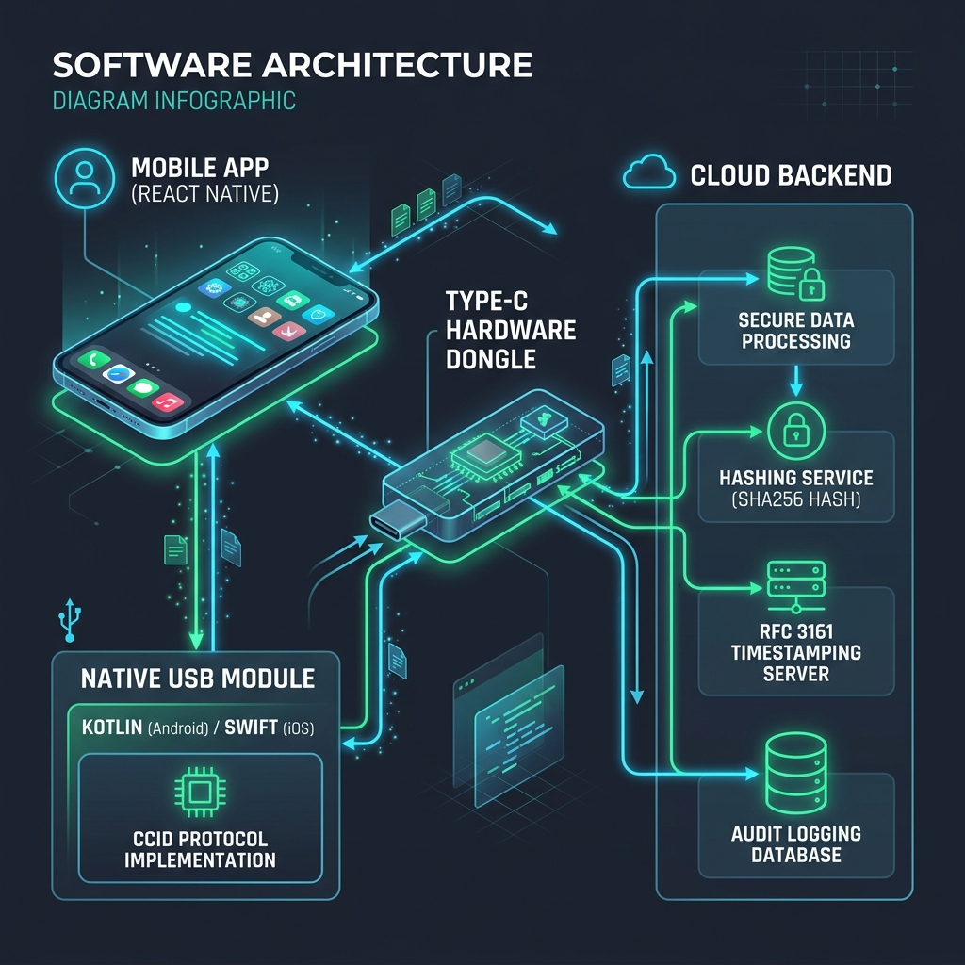
✦ ARCHITECTURE & TECH STACK
05 / 10
Dual-Layer Mobile & Cloud Architecture
⚙️ System Core Stack Components:
• React Native & Expo UI: Cross-platform mobile application interface.
• Android Native (Kotlin): USB Host API + CcidTransport protocol layer + P11Wrapper.
• iOS Native (Swift): Apple CryptoTokenKit (TKSmartCard) integration.
• Cloud Backend Stack: Express server + RFC 3161 TSA submitter + InsForge PostgreSQL audit database.

Slide 6

✦ END-TO-END WORKFLOW
06 / 10
5-Step Cryptographic Signing Lifecycle
🔄 Step-by-Step Execution Sequence:
• 1. Document Hashing: App computes SHA-256 cryptographic digest of file.
• 2. Hardware Handshake: Native USB Host detects plugged Type-C DSC dongle.
• 3. On-Chip RSA Signing: PIN entered; token hardware chip signs digest inside dongle.
• 4. RFC 3161 Timestamping: Signature blob timestamped by authoritative TSA.
• 5. PAdES Assembly & Audit: Signed PDF generated & session logged to PostgreSQL database.

Slide 7
✦ SECURITY ENGINE
07 / 10
Defense-in-Depth Hardware & Data Protection
🔒 Hardware Key Protection
• Zero Key Leakage: Private keys are non-exportable hardware assets physically inside silicon.
• RAM Zeroization: Sensitive PIN byte arrays purged immediately after APDU transmission.
• Auto Lockout: Session auto-locks upon backgrounding or physical USB removal.
🛡️ Cryptographic Integrity
• SHA-256 Hashing: Standard collision-resistant document hashing algorithm.
• RSA 2048 / ECC Support: Compatible with standard Indian CCA cert algorithms.
• Row Level Security (RLS): Granular PostgreSQL policies protecting audit records.

Slide 8
✦ DEVELOPER INTEGRATION
08 / 10
Hybrid Mobile WebView JavaScript Bridge
🌐 WebView JS Injected Bridge
• Zero Portal Changes: Legacy government web portals invoke window.DSCSigning.signDocument().
• Seamless Native Handshake: WebView intercepts command & triggers native USB module.
• Cross-Browser Support: Works inside embedded WebViews on iOS & Android.
📦 Modular Mobile SDK
• Reusable RN Library: Standalone module ready for state government mobile apps.
• Clean Promise API: Simple async/await integration pattern.
• Error Propagation: Handles token disconnects & invalid PIN alerts gracefully.

Slide 9
✦ IMPACT & APPLICABILITY
09 / 10
Transforming Governance & Enterprise Signing
🏛️ e-Tenders & Procurement
District collectors & tender officers approving official procurement files on tablets.
🏦 High-Value Corporate Banking
Multi-million wire transfers and credit authorizations signed securely on mobile.
⚖️ Judiciary & Legal Orders
Judges and advocates digitally signing court orders and legal notices on phones.
🚀 90% Time Savings & Zero Upgrade
Reduces approval delays from days to seconds with zero new hardware investment.

Slide 10
✦ FUTURE VISION & CONCLUSION
10 / 10
Empowering Mobile-First Digital Trust
🌟 Product Roadmap
• Phase 1 (Completed): USB-C CCID Native Stack + React Native App + PAdES + Audit Trail.
• Phase 2 (Q4 2026): Contactless NFC & Bluetooth Low Energy (BLE) Smart Card support.
• Phase 3 (Q1 2027): National NIC & Digital India Portal SDK distribution.
Thank You!
Type-C DSC Mobile Signing Solution
👥 PROJECT LEADERSHIP & TEAM:
• Charan — CEO, Vone Digital
• Mahankali — Lead Developer
✦ Ready for Judges' Q&A

