Slide 1
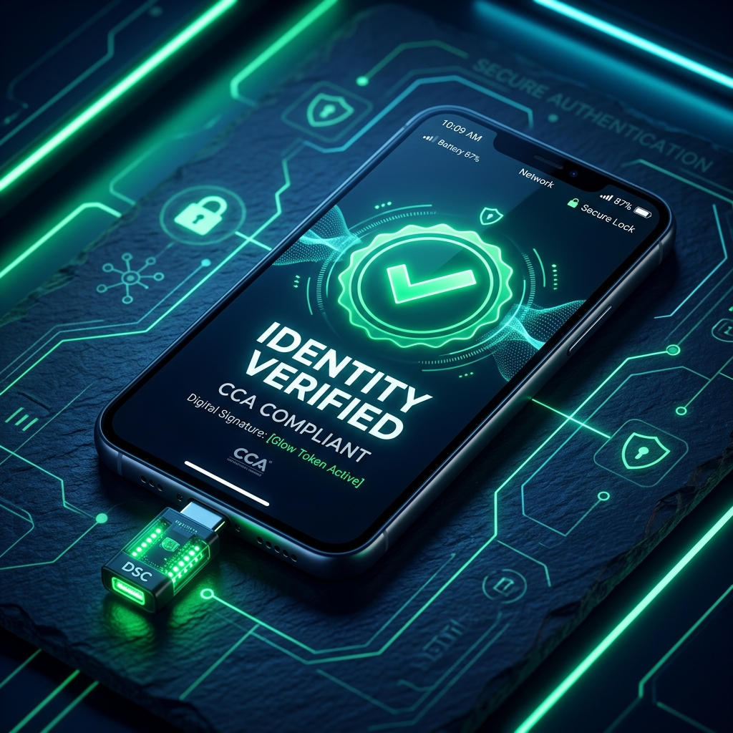
RTIH / APIS / NIC HACKATHON
Type-C DSC Mobile Signing Solution
Enterprise-Grade Hardware Digital Signatures directly on Mobile & WebViews without Desktop Dependencies.

Slide 2
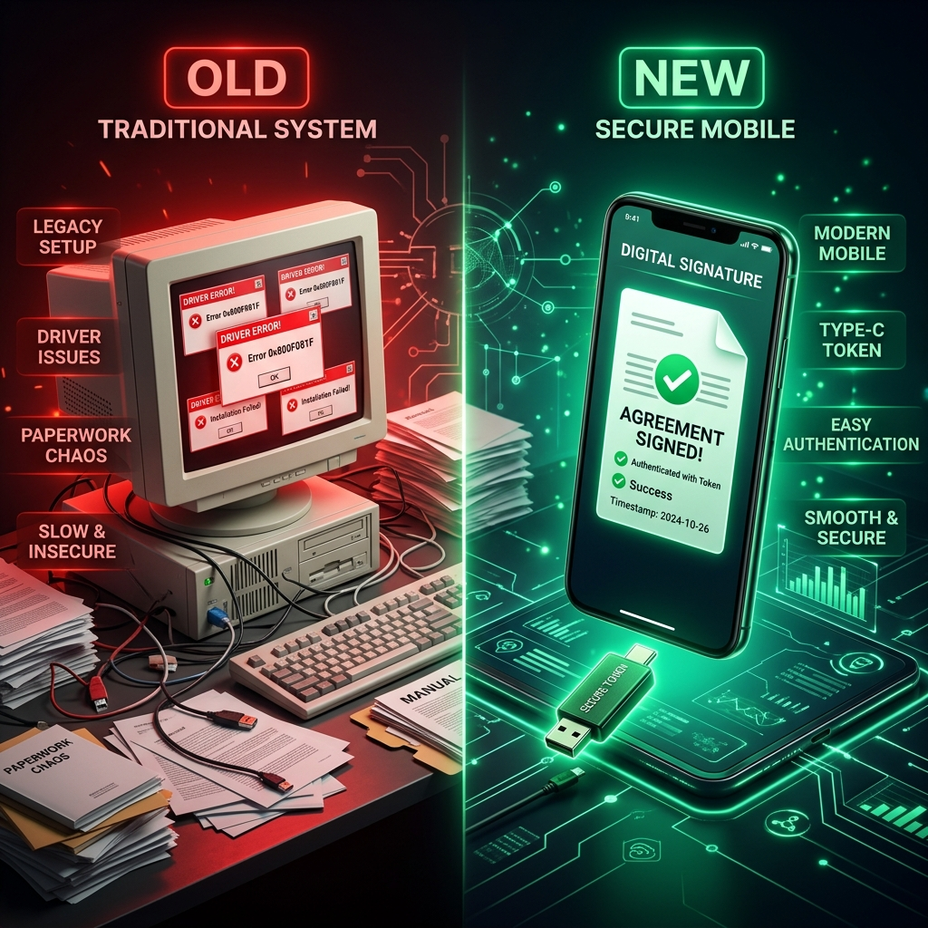
PROBLEM STATEMENT
02 / 10
The Mobile Signing Bottleneck in e-Governance
🚨 Core Friction Points:
• Desktop Middleware Dependency: Over 90% of Class-3 DSC dongles require Windows/macOS drivers (ePass2003, HYP2003, etc.).
• No Native Mobile USB Stack: Android and iOS standard OS layers cannot natively talk to CCID smart card protocols.
• Broken Field Workflows: Officers and citizens are forced back to desktop computers to sign e-Tenders & tax forms.
• Compliance Risk: Cloud OTP signing breaches physical key retention requirements mandated by CCA guidelines.

Slide 3
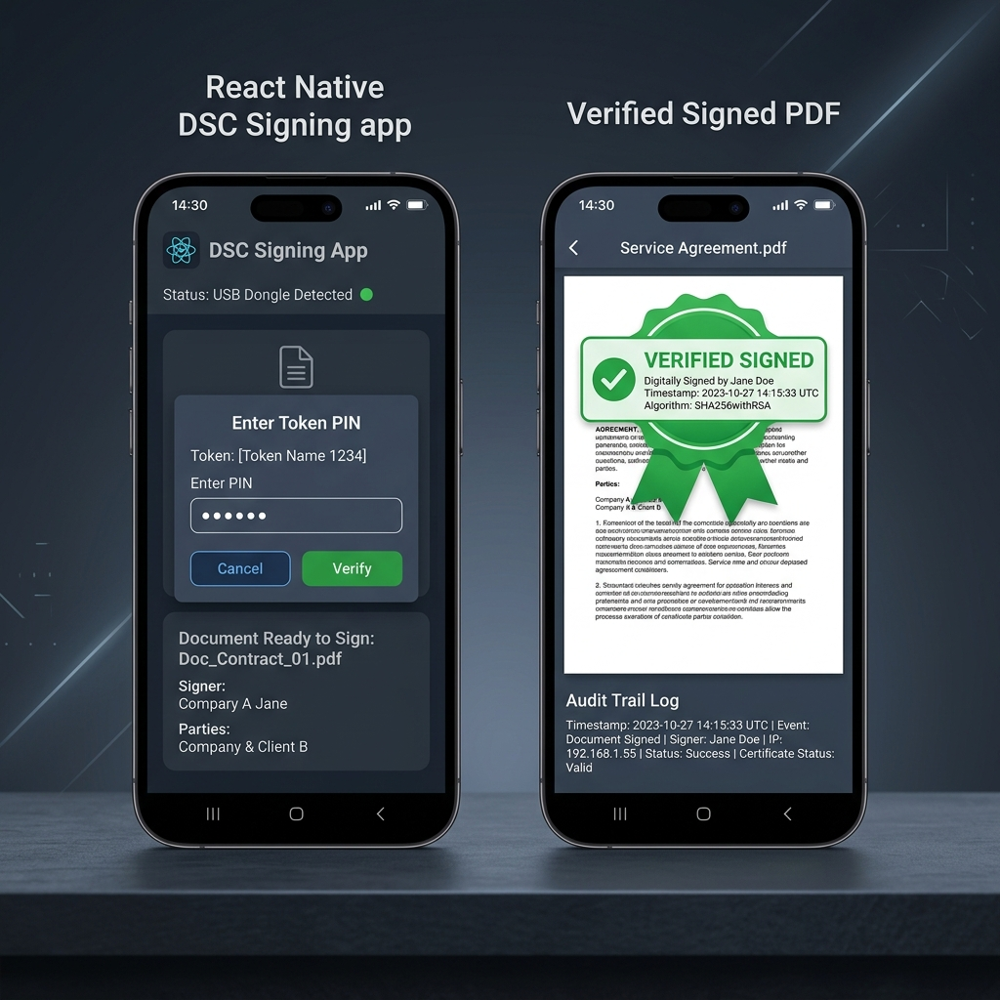
SOLUTION OVERVIEW
03 / 10
Direct Plug & Sign Mobile Hardware Integration
✨ Key Solution Capabilities:
• Direct USB-C CCID Stack: Native Kotlin USB Host API driver + iOS CryptoTokenKit bridge.
• Zero Middleware Required: Interacts directly with physical smartcard chip APDUs on mobile.
• Hybrid WebView JS Bridge: Injects window.DSCSigning into existing web portals without frontend code rewrites.
• PAdES & RFC 3161 Timestamping: End-to-end PDF signature container sealing with authoritative TSA timestamp.

Slide 4
REGULATORY BLUEPRINT
04 / 10
100% CCA (Controller of Certifying Authorities) Compliance Matrix
Rule # | CCA Requirement | Solution Implementation | Status
Rule 1 | Private key never leaves hardware token | SHA-256 hash sent to token; signature computed inside chip via APDU | ✅ VERIFIED
Rule 2 | Secure PIN Handling | PIN passed directly to native smartcard memory; instant RAM zeroization | ✅ VERIFIED
Rule 3 | PAdES / CAdES + RFC 3161 Timestamp | Backend queries CCA-approved TSA & seals PDF with PAdES envelope | ✅ VERIFIED
Rule 4 | Enforce Token Lockout Policy | Honors token retry limits; hard lockout after 3 incorrect attempts | ✅ VERIFIED
Rule 5 | Full Audit Trail | Immutable PostgreSQL session audit logging with serial & IP tracking | ✅ VERIFIED

Slide 5
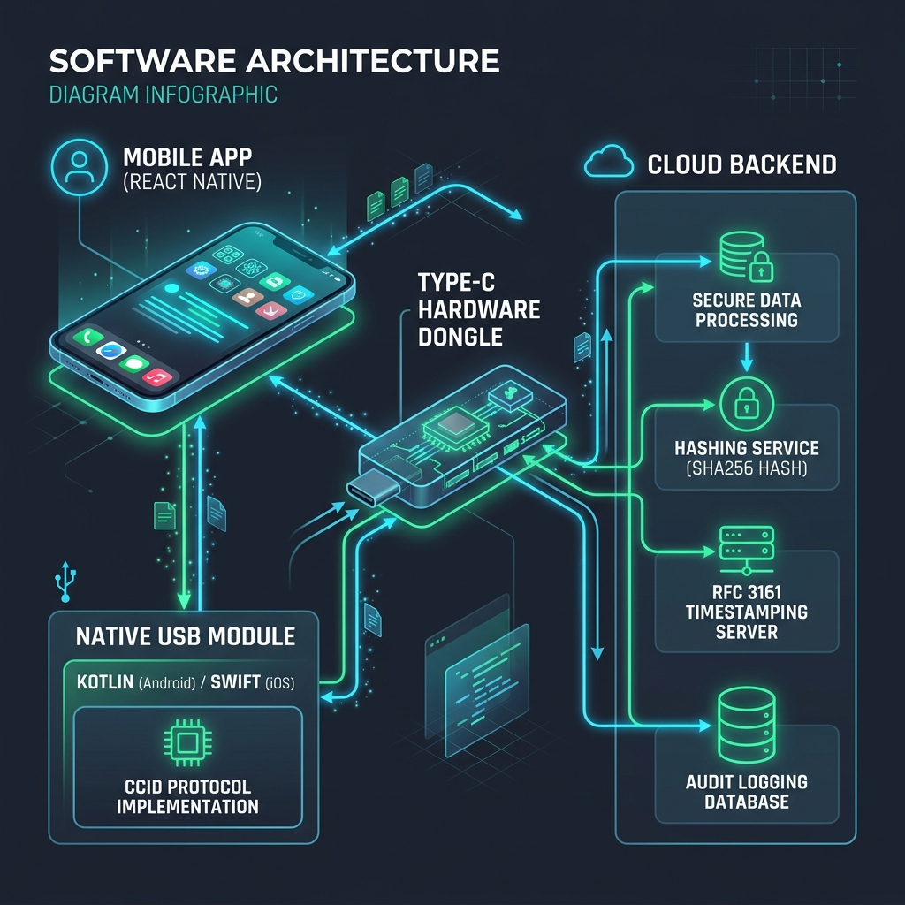
ARCHITECTURE & TECH STACK
05 / 10
Dual-Layer Mobile & Cloud Architecture
⚙️ System Core Stack:
• React Native & Expo UI: Cross-platform mobile front-end.
• Android Native (Kotlin): USB Host API + CcidTransport protocol layer + P11Wrapper.
• iOS Native (Swift): Apple CryptoTokenKit (TKSmartCard) integration.
• Backend (Express/Node.js): SHA-256 hash generator + RFC 3161 TSA submitter + InsForge PostgreSQL audit database.

Slide 6

END-TO-END WORKFLOW
06 / 10
5-Step Cryptographic Signing Lifecycle
🔄 Step-by-Step Execution:
• 1. Document Hashing: App calculates SHA-256 digest of document.
• 2. Hardware Detection: App detects plugged Type-C DSC token via native USB Host.
• 3. RSA/ECC Signing: PIN entered; token hardware chip signs digest inside dongle.
• 4. RFC 3161 Timestamping: Signature blob timestamped by authoritative TSA.
• 5. PAdES Assembly: Signed PDF container created & audit trail logged to DB.

Slide 7
SECURITY ENGINE
07 / 10
Defense-in-Depth Hardware & Data Protection
🔒 Hardware Protection
• Zero Key Exposure: Private keys are non-exportable hardware assets.
• RAM Zeroization: PIN byte arrays purged immediately after token transmission.
• Auto Lockout: Session auto-locks upon backgrounding or USB disconnection.
🛡️ Cryptographic Integrity
• SHA-256 Digest Standard: Collision-resistant hashing for all documents.
• RSA 2048 / ECC Support: Compatible with standard CCA cert algorithms.
• Row Level Security (RLS): Granular Postgres policies protecting audit records.

Slide 8
DEVELOPER INTEGRATION
08 / 10
Hybrid Mobile WebView JavaScript Bridge
🌐 WebView JS Injected Bridge
• Zero Web Portal Changes: Legacy government portals call window.DSCSigning.signDocument().
• Seamless Native Handshake: WebView intercepts command & invokes native USB module.
• Cross-Browser Compatibility: Works in embedded WebViews on iOS & Android.
📦 Drop-In SDK Package
• Modular React Native Library: Reusable package for state apps.
• Clean Promise-based API: Simple async/await integration.
• Automatic Error Handling: Propagates token disconnects & invalid PIN alerts.

Slide 9
IMPACT & APPLICABILITY
09 / 10
Transforming Governance & Enterprise Signing
🏛️ Key Governance Use Cases
• e-Tenders & Public Procurement: District collectors approving tenders on tablets.
• Corporate Banking: High-value wire transfers signed securely on mobile.
• Judiciary & Legal: Judges signing digital court orders remotely.
🚀 Quantifiable Advantages
• 90% Faster Turnaround: Authorizations completed in seconds.
• Zero Hardware Upgrade Cost: Compatible with existing USB Type-C tokens.
• National Scale: Fits smoothly into Digital India infrastructure.

Slide 10
FUTURE VISION & CONCLUSION
10 / 10
Empowering Mobile-First Digital Trust
🌟 Product Roadmap
• Phase 1 (Completed): USB-C CCID Stack + React Native App + PAdES + Audit Trail.
• Phase 2 (Q4 2026): Contactless NFC & Bluetooth Low Energy (BLE) Smart Card support.
• Phase 3 (Q1 2027): National NIC & Digital India Portal SDK distribution.
Thank You!
Type-C DSC Mobile Signing Solution
Ready for Judges' Q&A

