Slide 1
nopCommerce demo store
Under Guidance of Mrs. Vaishali Sonanis Mam.

Slide 2
Introduction :
The nopCommerce demo store is a fully functional demonstration website showcasing the features and capabilities of nopCommerce. This demo site allows visitors to experience both the customer-facing storefront and the backend administration system, providing a realistic environment for evaluating how nopCommerce can be used to create and manage online stores of any size.
The nopCommerce demo store is ideal for anyone wishing to study or test e-commerce features before setting up a live online shop using nopCommerce.

Slide 3
Members of Team
Mahender Reddy

Slide 4
Responsibilities
Assign the sub-module and tasks to the team member.
Review the test cases
Execute all the test cases.
Create defect report.

Slide 5
Overview
What is nopcomerce?
Trusted by thousands of companies worldwide, nopCommerce offers both a feature-rich customer storefront and a powerful backend administration system, ensuring stability, scalability, and seamless performance, while benefiting from a strong global developer community that continuously updates the platform for security and enterprise-level reliability.

Slide 6
Modules
Module 1 : login
Checked all the functionalities on login in page which included email field, password field and login button.
Also checked that only for valid credentials only user is able to login else give error message.
Module 2 : search
Checked all the functionalities on Search box by entering combination of characters and combination of characters and numbers and verifying that the results are as expected.
Used Gherkin language to write code and give multiple inputs using examples.
.
Module 3 : wishlist
Checked functionality of wishlist which includes searching of item, add to wishlist button, update wishlist.
Also verified that product can be added to cart from the wishlist.
Notes:
Module 1: Signn in page
Checked all the functionalities on Sign in page which included personal info as email
address, password
Module 2: Women page
Checked all the functionalities on Women page which included item details, Quantity, Filters,compare button,Add to cart button,product info,grid,list button
Module 3: Tshirt page
Checked all the functionalities on T-Shirt page which included item details, Quantity, Filters,compare button,Add to cart button,product info,grid,list button
Module 4: All Buttons and Drop Down Arrow :
team checked if all the buttons and drop down arrows of different fields are functioning properly or not

Slide 7
Module 4 : cart
Checked all the functionalities of add to cart button by searching the product and clicking on add to cart button.
Verifying that item is added to the cart Verifying that item is removed from the cart.
It’s mandatory to have item in the cart to remove any item.
So there is dependency of addtocart() method for remove_cart() method to execute.
Module 5 : sort
checked all the functionalities of sort in price, name and also checked for displaying the quantity of the products, and for the type like grid and list forms.
Verifying that all select options are displaying the exact outcomes or not.
Module 6 : book
tested the Booking functionality by giving the valid and invalid tokens and gift coupons, also tested for the address verification and user credentials conformation while booking the product to the mentioned address.

Slide 8
Defects
While running a testcase at certain point some fields are not working as it is expected which is nothing but a defect, so team have created a Defect report on those defects.
Found 4 defects, but two are of login ang register which are not prior than which are displayed in post the page.

Slide 9
Defect identifier :- B_001
Defect summary :- while booking the product, in address conformation is taking mobile no as any kind of digit.
Ø Test Id :- TC_020
Ø Test case name :- TC_information_booking_addressconform
Ø Module name :- Book
Ø Reproducible :-
Ø Severity :- high
Ø Priority :- high
Ø Raised by :- mahender reddy
Ø Assigned to :- developer Team lead
Ø Date of assignment :-
Ø Status :- pending
Ø Snap shots :-
Ø Fixed by :- developer
Ø Date of fixing :-

Slide 10
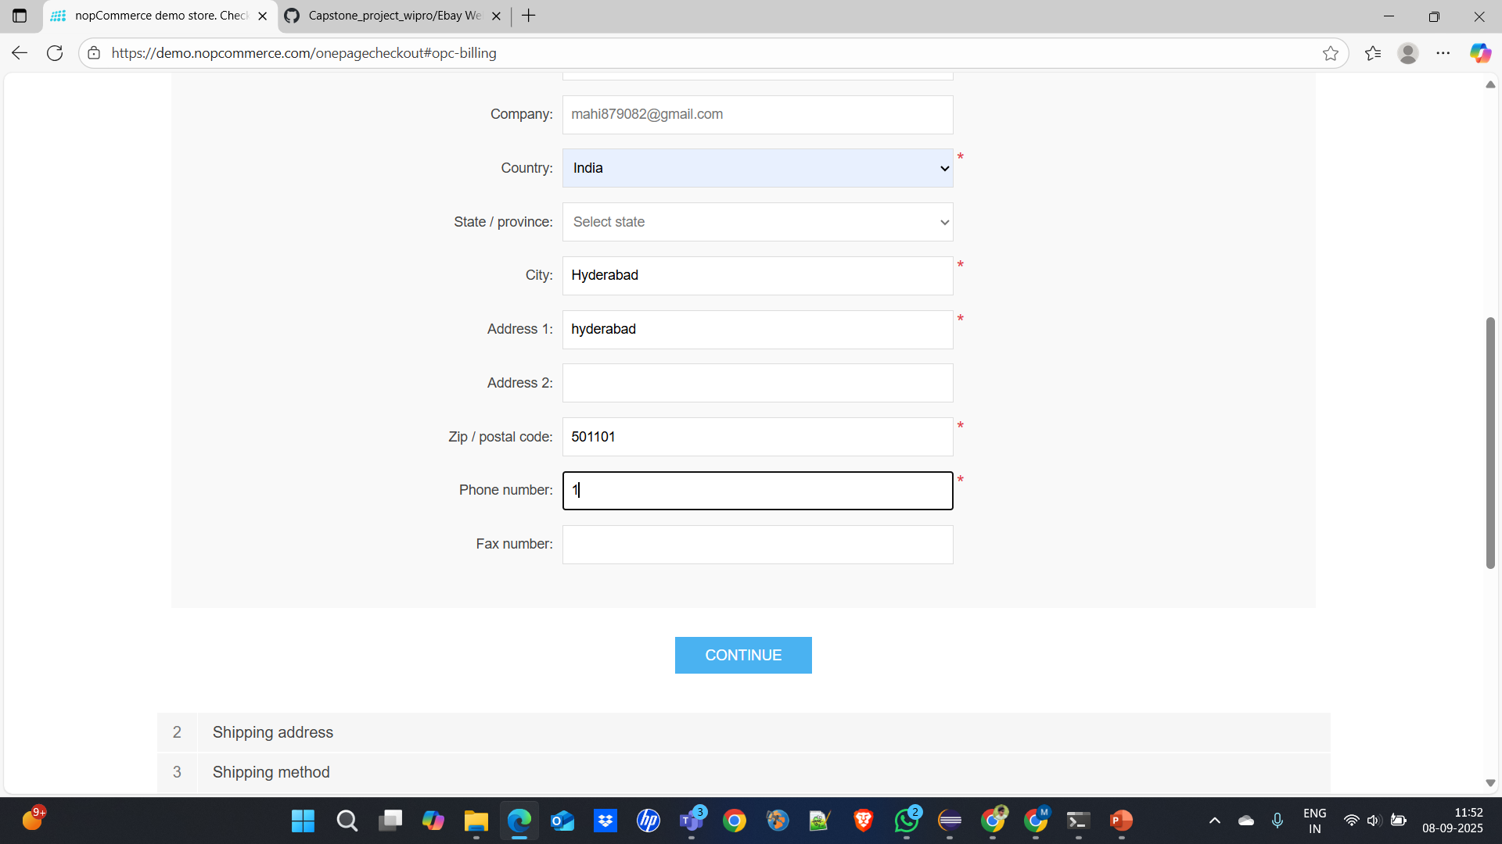


Slide 11
Defect identifier :- B_002
Ø Defect summary :- products are not displayed according their respective display quantity.
Ø Test Id :- TC_007
Ø Test case name :- TC_assiginment _sortdisplay
Ø Module name :- most of modules
Ø Reproducible :-
Ø Severity :- high
Ø Priority :- medium
Ø Raised by :- mahender reddy
Ø Assigned to :- developer Team lead
Ø Date of assignment :-
Ø Status :- pending
Ø Snap shots :-
Ø Fixed by :- developer
Ø Date of fixing :-

Slide 12
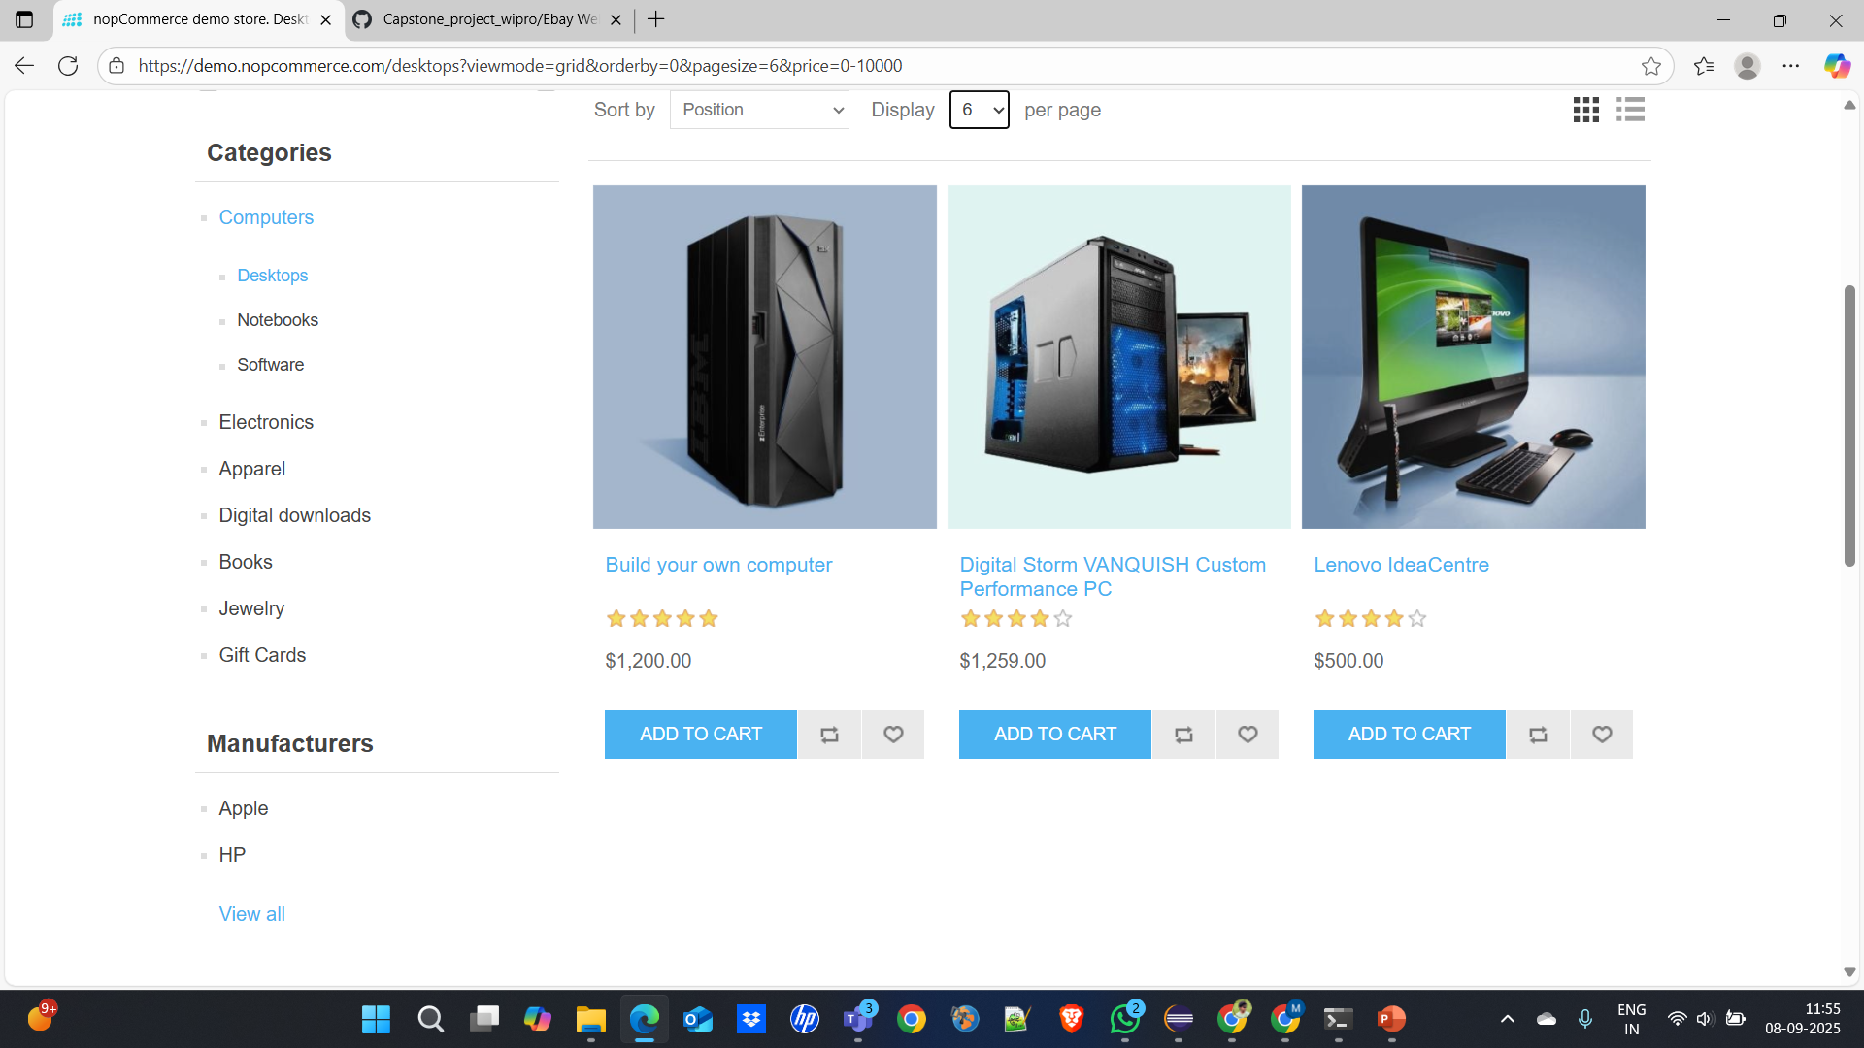




Slide 13
Defect identifier :- B_002
Ø Defect summary :- After Registering it again shows to register and user not found after few hours.
Ø Test Id :- TC_009
Ø Test case name :- TC_login
Ø Module name :- register and login
Ø Reproducible :-
Ø Severity :- high
Ø Priority :- medium
Ø Raised by :- mahender reddy
Ø Assigned to :- developer Team lead
Ø Date of assignment :-
Ø Status :- pending
Ø Snap shots :-
Ø Fixed by :- developer
Ø Date of fixing :-

Slide 14
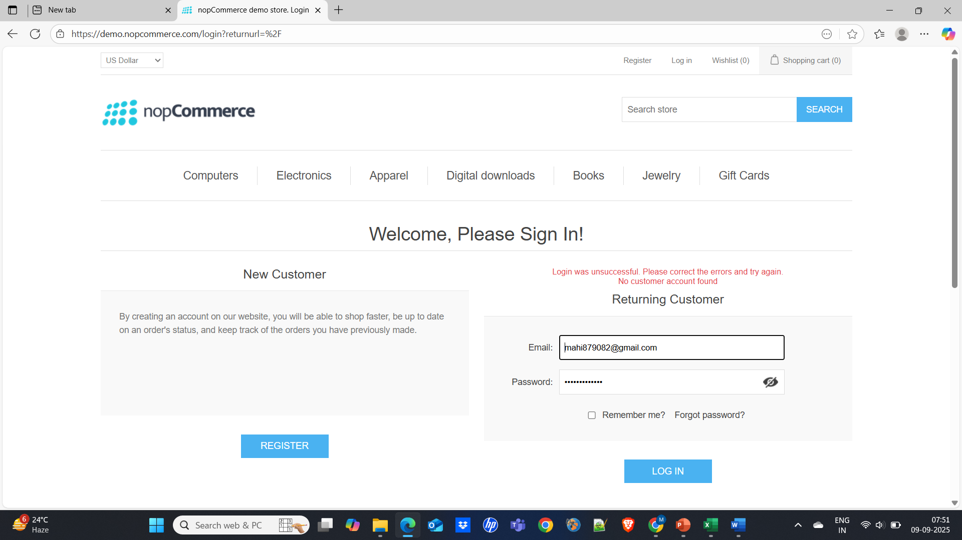

Slide 15
Defect identifier :- B_002
Ø Defect summary :- It does not respond though mail even after subscribing(no reply mail )
Ø Test Id :- TC_025
Ø Test case name :- TC_Subscribe
Ø Module name :- most of modules
Ø Reproducible :-
Ø Severity :- high
Ø Priority :- medium
Ø Raised by :- mahender reddy
Ø Assigned to :- developer Team lead
Ø Date of assignment :-
Ø Status :- pending
Ø Snap shots :-
Ø Fixed by :- developer
Ø Date of fixing :-

Slide 16
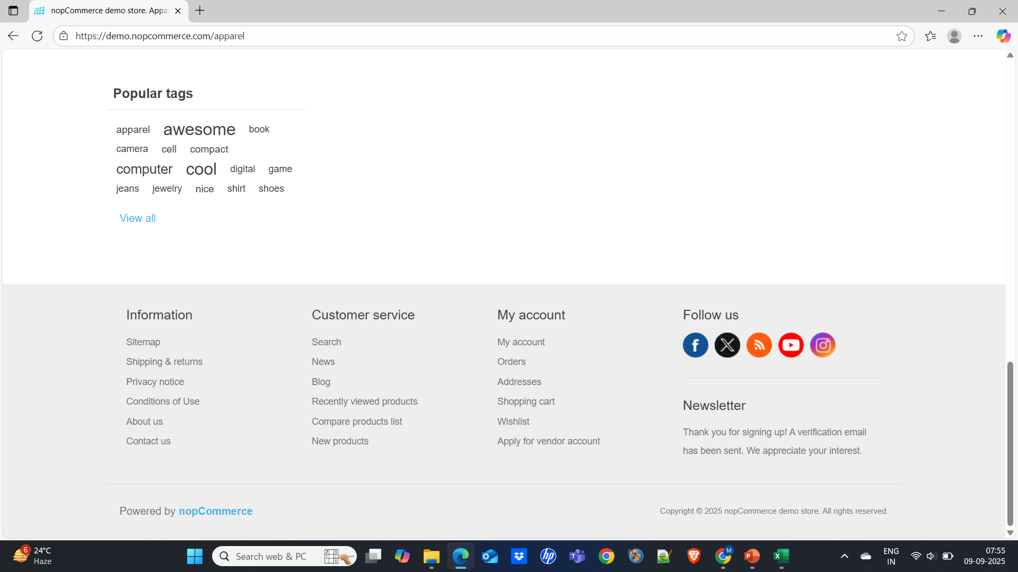



Slide 17
Challenges
While testing big website which contains huge data we faced some challenges about:
There is comes difference in writing a test case and while running it.
Interacting with elements before ready due to asynchronous loading.
Unstable tests due to timing or locator failures.
No active support for mobile applications.
No Notifications (email) delivery after registering.

Slide 18
Experience
Help to find out bugs.
Helps us test products manually in module wise.
Can get better understanding in sdlc methodologies like agile in which project is divided in iterators and sprints.
By using jira tool we know when to update the project in time and what the bug is.
Performed cucumber based data driven testing etc.
Performed many inbuilt methods which makes testing ease and fast.
Using pom eases the code reusability and encapsulate the code.
By using maven build generated the reports like html, json and html.

Slide 19
Thank You!!!
Vaishali Mam For Guiding Us through out the Project.

