Slide 1


SMART INDIA HACKATHON 2026
ENGINE-TWIN
AI-ENABLED DIGITAL TWIN FOR MALE UAV AERO
PISTON ENGINES
Problem Statement ID – SIH26054
Problem Statement Title – AI-Enabled Real-Time Digital Twin System for Health Monitoring, Fault Prediction and Mission Reliability Enhancement of Aero Piston Engines used in MALE UAVs
Theme – Robotics and Drones
PS Category – Software
Team ID – [ENTER PORTAL TEAM ID]
Team Name – [ENTER REGISTERED TEAM NAME]
DRDO
SOFTWARE
ROBOTICS & DRONES

Slide 2
YOUR
TEAM
NAME
PROPOSED SOLUTION | Reactive Alarms → Predictive Engine Intelligence
SENSE
ANALYZE
PREDICT
EXPLAIN
REPLAY
PROPOSED SOLUTION ARCHITECTURE
• Live Software Twin of MALE-UAV piston engine using real aerodynamic flight state + thermodynamic CAN telemetry.
• Physics-Informed Neural Network (PINN) Baseline fused with Isolation Forest anomaly detection and Weibull RUL estimation (β=1.8, η=1500h).
• Dual WebGL 3D Visualization: 60 FPS Engine Cutaway (crankshaft/valvetrain kinematics) + Full 3D UAV Flight Dynamics Viewport.
• Interactive Causal Fault Injection: Live cylinder misfire, turbo overpressure boost, or oil loss triggers instant causal chain: Telemetry deviation → 3D Cylinder highlight → Speech alert → RUL degradation.
CLOSED-LOOP DIGITAL TWIN
FLIGHT
STATE
ENGINE
TELEMETRY
⚙
TWIN
PHYSICS
BASELINE
AI / RUL
ANALYTICS
One synchronized telemetry stream drives every view — no page reload, no separate demo logic.
5–10 Hz TELEMETRY
60 FPS RENDER TARGET
LOCAL + DOCKER
Reactive threshold alarm → continuous state estimation → early anomaly signal → actionable mission/maintenance insight
@SIH Idea submission- Template
2

Slide 3
YOUR
TEAM
NAME
TECHNICAL APPROACH | 5-Layer Modular Architecture & Sensor Fusion
01
FLIGHT
CONTROL
02
SYNTHETIC
DATA
03
DATA
INGESTION
04
DIGITAL TWIN
+ AI
05
3D +
DASHBOARD
Throttle • Altitude • Weather
UAV kinematic state
Physics-correlated RPM / CHT / EGT
Oil • Fuel • Vib + fault injection
Fixed JSON contract
WebSocket / MQTT-ready (10 Hz)
PINN thermodynamic baseline
Anomaly detection + Weibull RUL
WebGL Live engine + Flight sim
Charts + Speech audio alarms
Telemetry Channel | Sensor Hardware | Source
Rotational Speed (RPM) | RPM Hall Sensor | CAN-fused, live
In-Cylinder Pressure | Piezoelectric transducer | Physics-derived
Cylinder Head Temp (CHT) | K-type thermocouple (Cyl 1–4) | CAN-fused, live
Exhaust Gas Temp (EGT) | Exhaust thermocouple | Physics-derived
Oil Pressure / Temp | Oil Transducer (PSI/°C) | CAN-fused, live
3-Axis Vibration (RMS) | Piezo Accelerometer / IMU | CAN-fused, live
28V Bus Electrical | Voltage-divider ADC channel | Physics-derived
PHYSICS GOVERNING LAWS & AI FORMULATION
Thermodynamic CHT: T_cyl = T_amb + 38 + (Load × 52) − (V_kts / 75) × 22
In-Cylinder Pressure: P_max = (MAP / 100) × (r_c)^1.35 × (2.4 + 1.2 × Throttle)
PINN Loss Function: Loss = MSE(actual, pred) + λ·|Q_comb − (W_shaft + Q_exh + Q_cool)|
Weibull RUL Model: R_t = exp( − (t / 1500)^1.8 ) → TTF countdown in seconds
Structural Thresholds: P_cyl > 88.5 bar, CHT > 138°C, Oil < 25 psi trigger predictive alert
@SIH Idea submission- Template
3

Slide 4
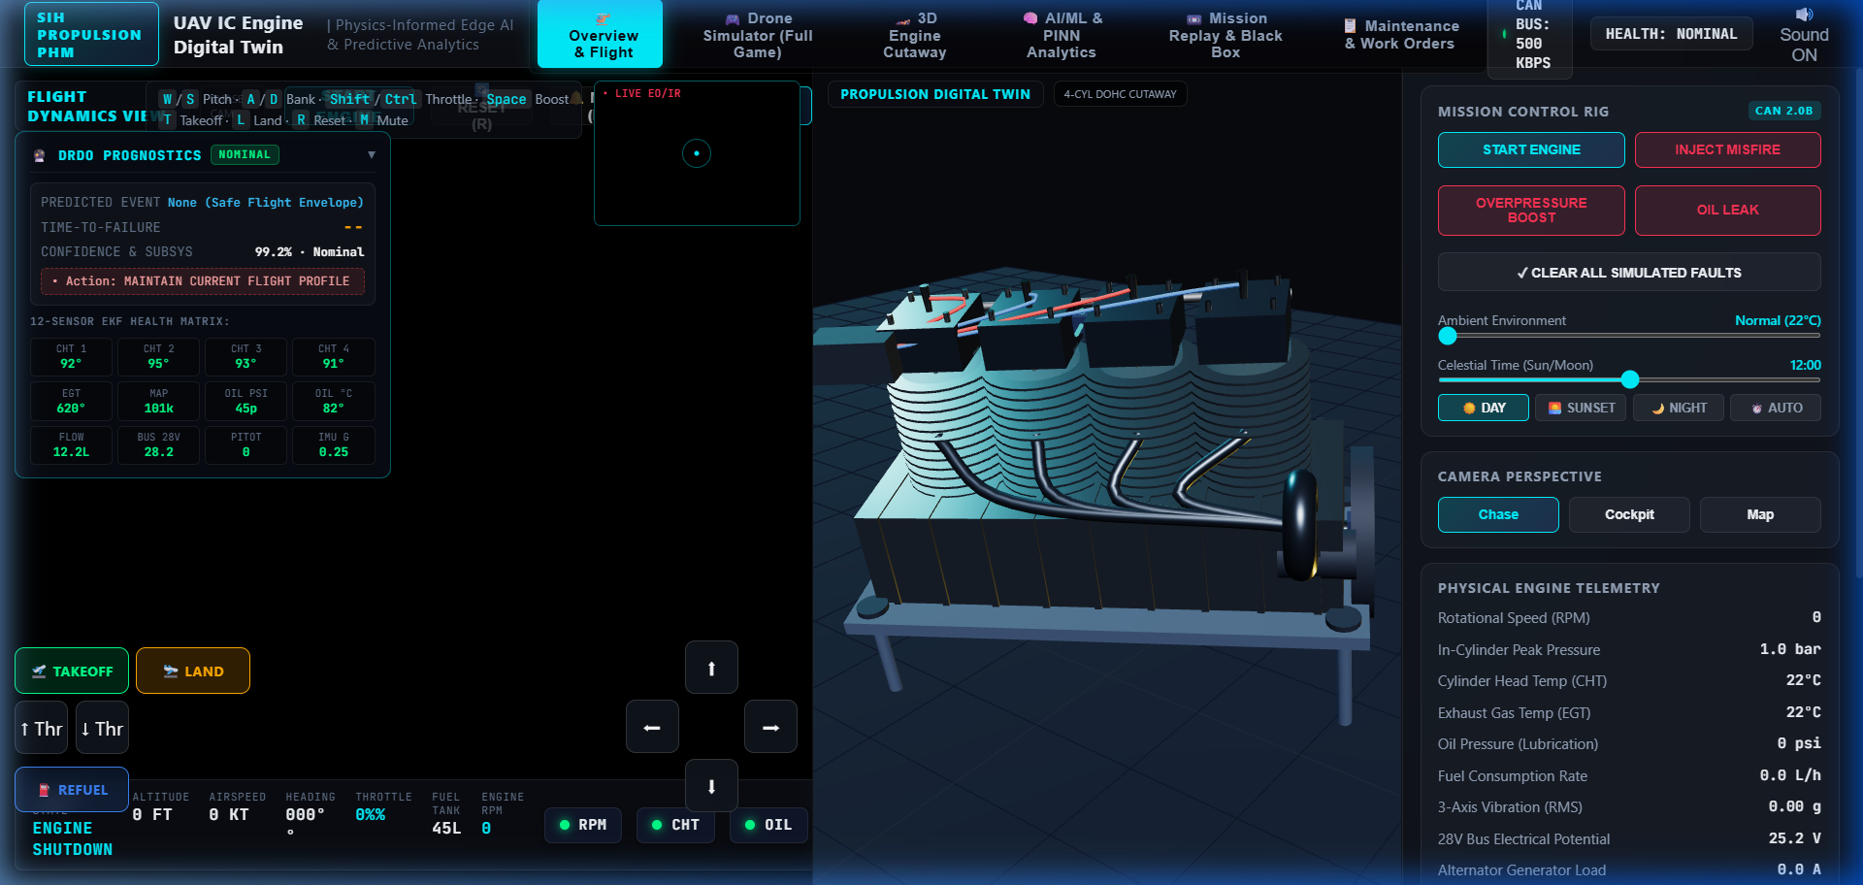
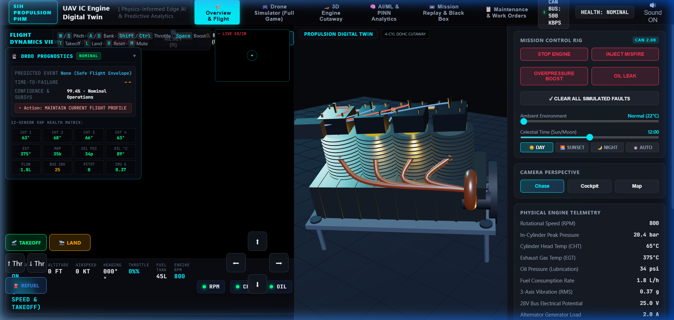
YOUR
TEAM
NAME
PROTOTYPE WALKTHROUGH | Live System Screens & Parameter Validation
CAN BUS INTERFACE
COMBUSTION SPEC
500 kbps · CAN 2.0B protocol
6 CAN-fused + 3 physics-derived channels
Rotax 914 Turbo · 1211 cc · 84.5 kW
Firing order 1-3-4-2 · AFR λ = 1.0
LIVE RUL ESTIMATION
SAFETY MARGINS
Dual Viewport Live Build — 3D Flight Dynamics (Left) + 3D Engine Cutaway (Right) driven synchronously at 60 FPS by real-time physics telemetry. Features live RPM / CHT / EGT / Oil gauges and speech alert engine.
Nominal: 73% RUL (≈ 1089 h)
Drops dynamically under fault injection
88.5 bar max cyl pressure · 138°C CHT
25 psi minimum oil pressure threshold
Live Working Demonstration: https://mahi-887.github.io/Virtual-UAV-engine-/ | Zero Installation, 100% WebGL Accessible
@SIH Idea submission- Template
4

Slide 5
YOUR
TEAM
NAME
FEASIBILITY & VIABILITY | Challenges, Mitigations & Phased Deployment Path
SOFTWARE-ONLY NOW
REAL-TIME
DROP-IN DATA SOURCE
DEPLOYABLE NOW
No physical engine/sensors required for prototype evaluation.
WebSocket target 5–10 Hz; render loop decoupled for smooth 60 FPS 3D.
Synthetic generator → later CAN/ECU/FADEC without downstream rewrite.
Docker Compose + GitHub Pages for repeatable local demo & instant validation.
CHALLENGES → MITIGATION
Challenge | Risk to Demo / Validation | Mitigation Built into Design
No aero-engine run-to-failure data | Synthetic validation can overstate accuracy | Label synthetic results honestly; validate physics + residual behavior first; replace source when real ECU/CAN data becomes available.
RUL needs a defined end-of-life target | RUL can become a misleading single number | Use degradation trend + explicit condition threshold (Weibull hazard rate); move to confidence-bounded RUL when real flight history is available.
Faults may look like sensor failures | False maintenance alarms | Compare multi-sensor relationships + physics residuals; separate sensor drift (EKF innovation covariance) from engine-state divergence.
PHASED PATH TO DEPLOYMENT
P1
Synthetic Validation
P2
HIL + ECU/CAN Feed
P3
Flight-Test Integration
Physics engine + synthetic CAN data generator validating AI pipelines.
Hardware-in-the-loop testbed feeding live serial/CAN packets into twin.
Onboard telemetry downlink connected to Ground Control Station twin.
@SIH Idea submission- Template
5

Slide 6
YOUR
TEAM
NAME
IMPACT & BENEFITS | Predictive Mission Reliability & Demo Walkthrough
1
LIVE DATA
2
TWIN STATE
3
EARLY SIGNAL
4
ACTION
5
REPLAY
Engine + flight state
Expected vs observed
Anomaly / trend detection
Voice alert / pilot advisory
Post-flight learning loop
DEFENSE STAKEHOLDER IMPACT
PROTOTYPE → 5-STEP DEMO STORY
UAV OPERATOR
Live health status, tactical fault voice alerts, zero sensory overload.
1
START
Engine transitions OFF → RUNNING (Idle 2000 RPM, nominal baseline).
PROPULSION CREW
Condition-based overhaul, RUL tracking, black-box incident replay.
2
THROTTLE ↑
Press W key: RPM / CHT / EGT / fuel rise; drone climbs into tactical flight.
3
FAULT INJECT
Inject Misfire / Overboost: cylinder pressure spikes/drops; vibration jumps.
TEST & VALIDATION
Repeatable fault injection (misfire, overpressure, oil loss) & border weather.
4
3D VISUALIZE
Affected cylinder highlights red in 3D cutaway; voice audio warning sounds.
DEFENSE FLEET
Common CAN digital twin standard for TAPAS & Rustom-II UAV squadrons.
5
PREDICT & ACT
Prognostic banner shows TTF countdown; Weibull RUL drops; advisory issued.
Predictive: Trend before threshold
Transparent: Physics + AI
Reusable: Synthetic → CAN/ECU
Operational: Simulate + Replay
JUDGE TAKEAWAY: CAUSE → EFFECT (Fully Transparent Closed-Loop Digital Twin) | PS SIH26054 DRDO
@SIH Idea submission- Template
6

