Slide 1


SMART INDIA HACKATHON 2026
ENGINE-TWIN
AI-ENABLED DIGITAL TWIN FOR MALE UAV AERO
PISTON ENGINES
Problem Statement ID – SIH26054
Problem Statement Title – AI-Enabled Real-Time Digital Twin System for Health Monitoring, Fault Prediction and Mission Reliability Enhancement of Aero Piston Engines used in MALE UAVs
Theme – Robotics and Drones
PS Category – Software
Team ID – [ENTER PORTAL TEAM ID]
Team Name – [ENTER REGISTERED TEAM NAME]
DRDO
SOFTWARE
ROBOTICS & DRONES

Slide 2
YOUR
TEAM
NAME
ENGINE-TWIN | Reactive Alarms → Predictive Engine Intelligence
SENSE
ANALYZE
PREDICT
EXPLAIN
REPLAY
PROPOSED SOLUTION
• Create a live software twin of a MALE-UAV piston engine using real-world flight state + physics telemetry.
• Fuse a physics-informed thermodynamic baseline with Isolation Forest anomaly detection & Weibull RUL estimation (β=1.8, η=1500 h).
• Mirror real-time telemetry into a 3D cutaway engine + UAV flight simulator (WebGL Three.js) for operator-ready spatial visualization.
• Inject in-flight faults (misfire, overpressure boost, oil loss) and demonstrate immediate causal chain: telemetry deviation → 3D cylinder alert → prognostic hazard → RUL degradation.
CLOSED-LOOP DIGITAL TWIN
FLIGHT
STATE
ENGINE
TELEMETRY
⚙
TWIN
PHYSICS
BASELINE
AI / RUL
ANALYTICS
5–10 Hz TELEMETRY
60 FPS RENDER TARGET
LOCAL + DOCKER
One synchronized telemetry stream drives every view — no page reload, no separate demo logic.
Reactive threshold alarm → continuous state estimation → early anomaly signal → actionable mission/maintenance insight
@SIH Idea submission- Template
2

Slide 3
YOUR
TEAM
NAME
TECHNICAL APPROACH | Modular & Source-Agnostic
5-LAYER ARCHITECTURE
01
FLIGHT
CONTROL
02
SYNTHETIC
DATA
03
DATA
INGESTION
04
DIGITAL TWIN
+ AI
05
3D +
DASHBOARD
Throttle • Altitude • Weather
UAV kinematic state
Physics-correlated RPM / CHT / EGT
Oil • Fuel • Vib + fault injection
Fixed JSON contract
WebSocket / MQTT-ready (10 Hz)
PINN thermodynamic baseline
Anomaly detection + Weibull RUL
WebGL Live engine + Flight sim
Charts + Speech audio alarms
FIXED TELEMETRY CONTRACT
PHYSICS-INFORMED SYNTHETIC TELEMETRY
{
timestamp, engine_status, rpm, cht_c[4], egt_c,
oil_pressure_psi, oil_temp_c, fuel_flow_lph,
vibration_rms_g, battery_voltage_v, fault_active,
fault_type, flight_state{throttle, altitude, weather}
}
RPM 800 + throttle × 5000 × (P_amb / 101.3) Rotational Inertia
CHT T_amb + 38 + (Load × 52) − RamAirCooling Thermodynamic Heat
EGT 360 + (Load × 320) + MixtureResidual Combustion Gas
Oil PSI 28 + (RPM / 5800) × 42 Hydrodynamic Lube
Fuel Flow 1.8 + (Power_kW × 0.32) L/h BSFC Consumption
Vibration 0.25 + (RPM / 5800) × 0.85 + FaultTerm Structural Health
Analytics Layer: PINN Thermodynamic Loss + Isolation Forest + Weibull RUL (β=1.8, η=1500h)
SOURCE SWAPPABLE
JSON CONTRACT
WEBSOCKET 10Hz
@SIH Idea submission- Template
3

Slide 4
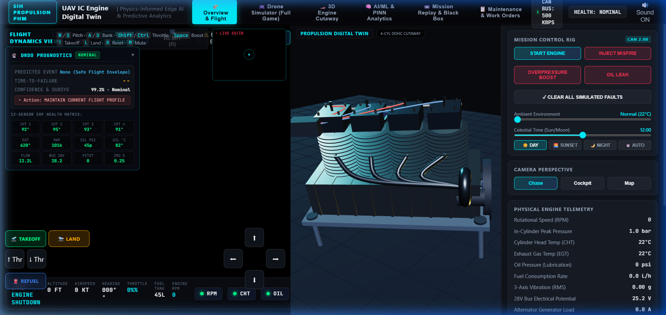
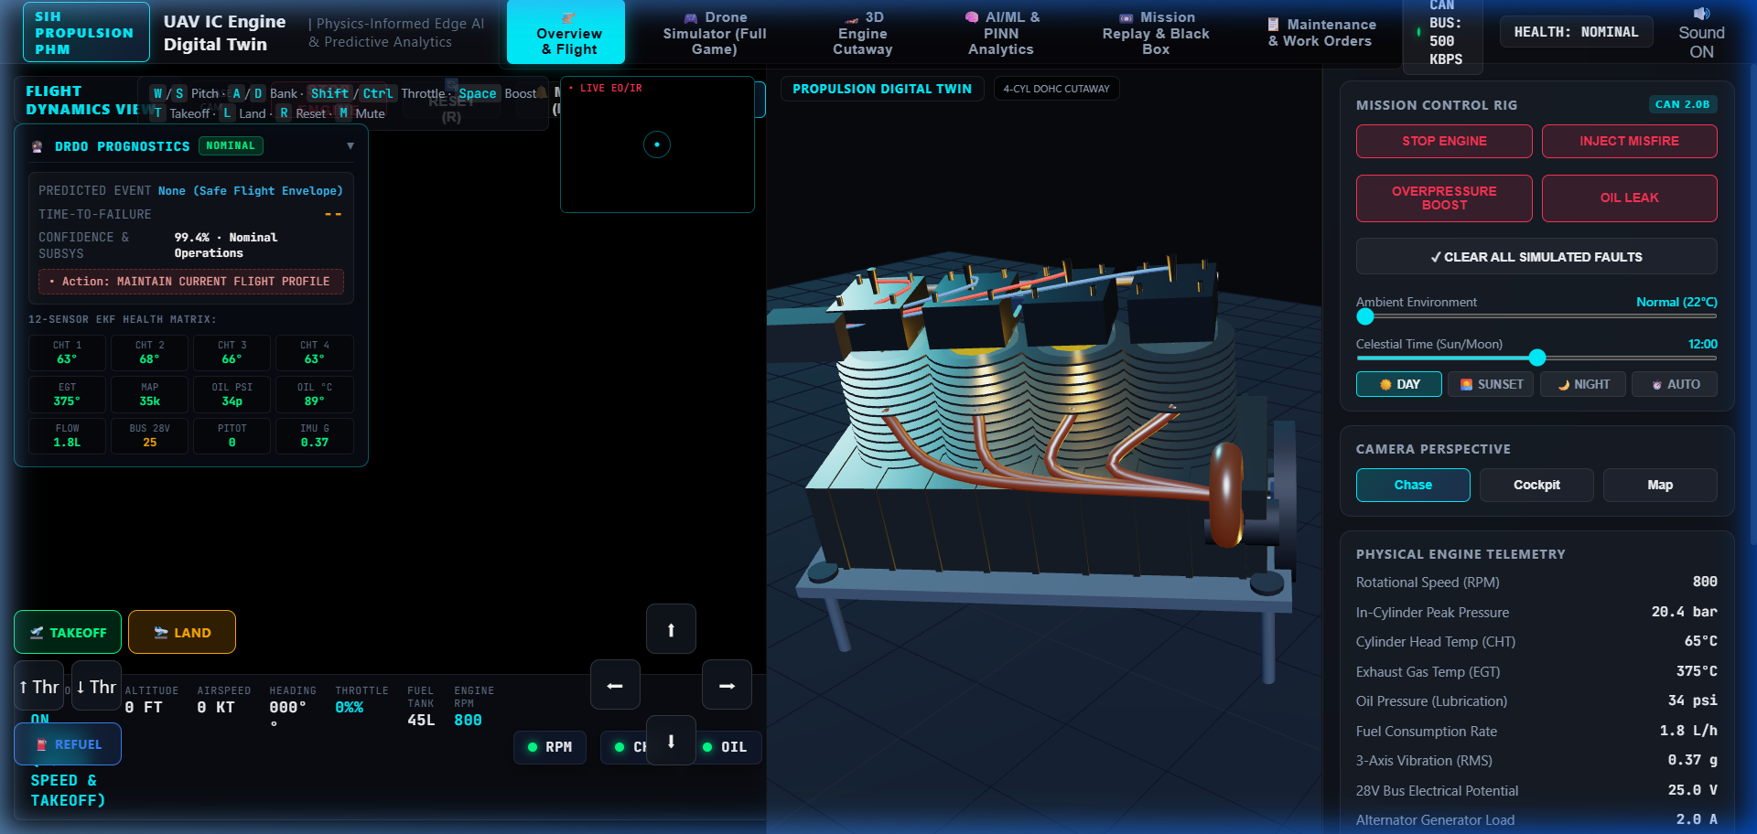
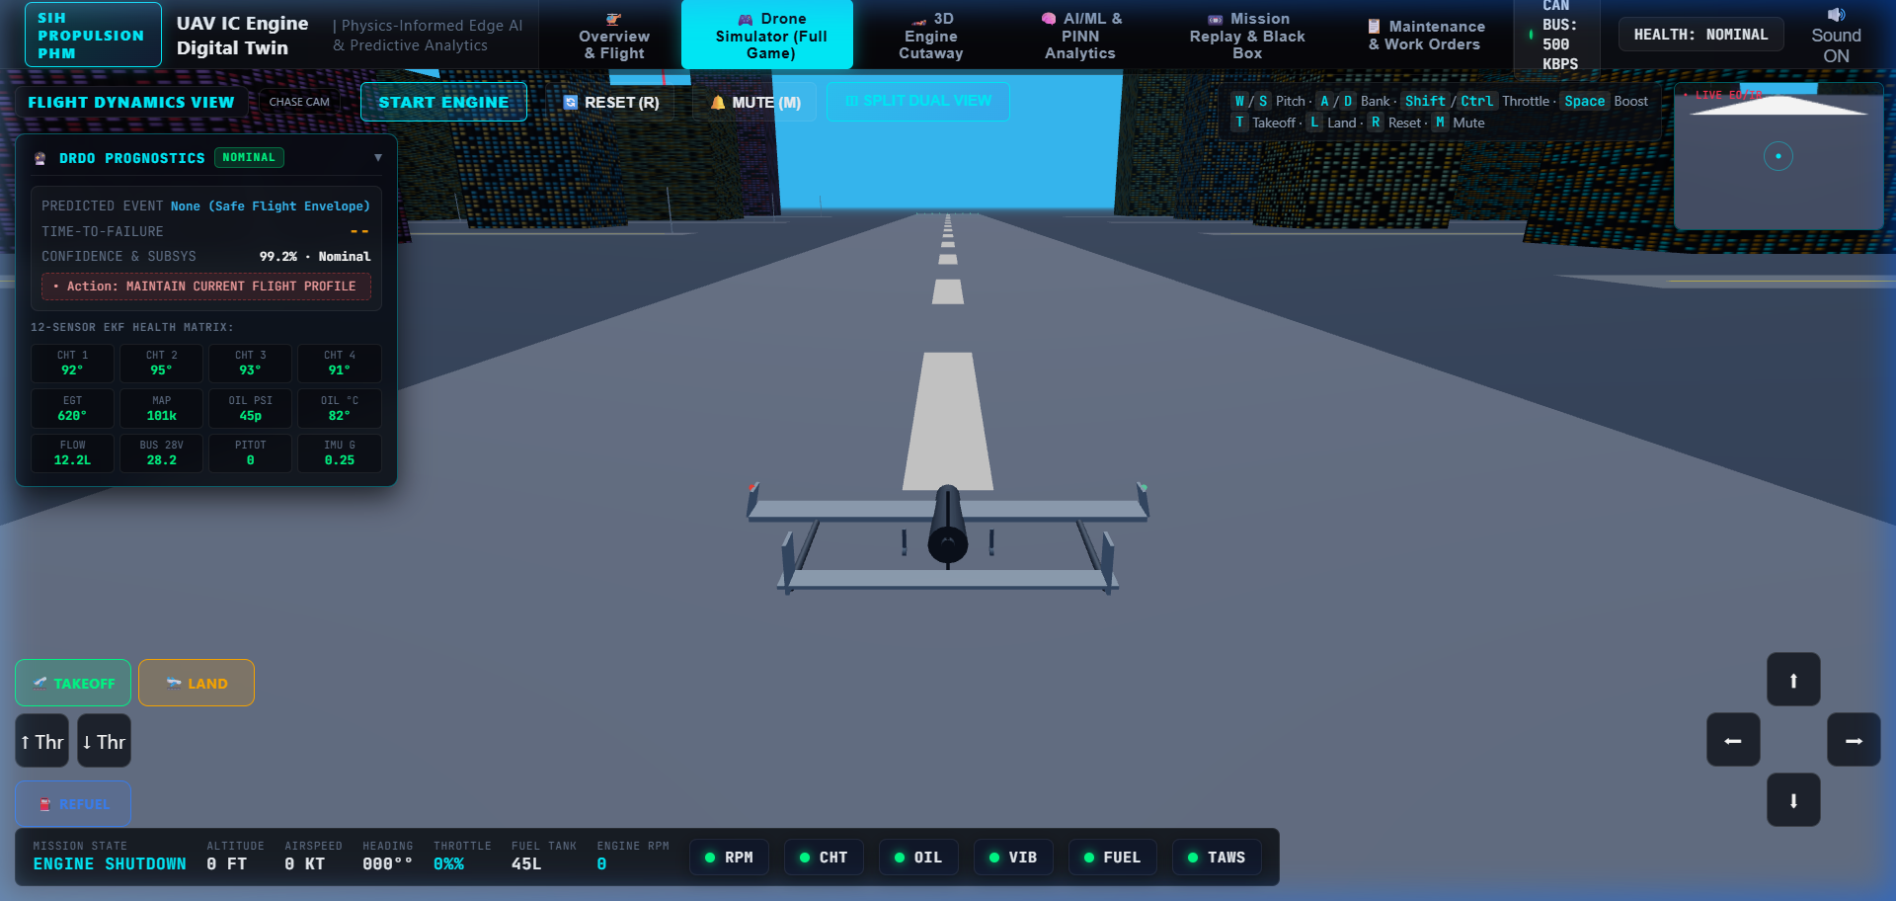
YOUR
TEAM
NAME
PROTOTYPE WALKTHROUGH | Live Screens from the Working Build
Captured directly from the running prototype — 7 live views (Overview & Flight, Dual View, Drone Flight Simulator, 3D Engine Cutaway, AI/ML & PINN Analytics, Mission Replay) driven by one shared telemetry state.
3D Engine Cutaway — PINN loss formulation, crankshaft/valvetrain kinematics, combustion-chamber physics, mission-replay scenarios.
Dual View — Flight Simulator + 3D Engine Cutaway side-by-side. Live RPM / CHT / EGT / Oil / Vibration telemetry, PINN health layer (Anomaly Score, RUL, Fuel, Airframe Integrity) and CAN sensor-fusion status, all fed from one state.
Drone Flight Simulator (Game Mode) — manual throttle/turn/takeoff/land controls drive the same physics engine as the twin.
@SIH Idea submission- Template
4

Slide 5
YOUR
TEAM
NAME
VALIDATION NUMBERS | Sensor Fusion & Physics-Informed AI Parameters
Left: 10 live telemetry channels and real-world sensor mapping. Right: exact combustion, fusion, and AI parameters running in the build.
Telemetry Channel | Real-World Sensor Equivalent | Source
Rotational Speed (RPM) | RPM Hall Sensor | CAN-fused, live
In-Cylinder Peak Pressure | Piezoelectric pressure transducer | Physics-model derived
Cylinder Head Temp (CHT) | CHT Thermocouple (Cyl 1–4) | CAN-fused, live
Exhaust Gas Temp (EGT) | K-type thermocouple | Physics-model derived
Oil Pressure (Lubrication) | Oil Transducer (PSI) | CAN-fused, live
Fuel Consumption Rate | Fuel Flowmeter / Float | CAN-fused, live
3-Axis Vibration (RMS) | Piezo Accelerometer / IMU | CAN-fused, live
28V Bus Electrical Potential | Voltage-divider ADC channel | Physics-model derived
Alternator Generator Load | Hall-effect current sensor | Physics-model derived
Airframe Proximity / Pitot | Pitot tube + GPWS Radar | CAN-fused, live
CAN BUS INTERFACE
COMBUSTION SPEC
500 kbps · CAN 2.0B protocol
6 CAN-fused channels + 3 physics-derived
Firing order 1-3-4-2 · CR 9.0:1
Spark 22° BTDC · AFR λ = 1.0 (Rotax)
PINN LOSS FUNCTION
LIVE RUL READING
Loss = MSE(actual, pred) +
λ·|Q_comb − (W_shaft+Q_exh+Q_cool)|
Nominal flight: 73% RUL (≈ 1089 h)
Degrades dynamically under fault injection
STRUCTURAL LIMITS
REFERENCE ENGINE
88.5 bar max cylinder pressure · 138° C CHT
25 psi minimum oil pressure threshold
4-cyl boxer · 1211 cc · 79.5×61 mm
Rotax-914 class · 84.5 kW rated power
@SIH Idea submission- Template
5

Slide 6
YOUR
TEAM
NAME
FEASIBILITY & VIABILITY | Phased Path to Real Data
SOFTWARE-ONLY NOW
REAL-TIME
DROP-IN DATA SOURCE
DEPLOYABLE NOW
No physical engine/sensors required for prototype evaluation.
WebSocket target 5–10 Hz; render loop decoupled for smooth 60 FPS 3D.
Synthetic generator → later CAN/ECU/FADEC without downstream rewrite.
Docker Compose + GitHub Pages for repeatable local demo & instant validation.
CHALLENGES → MITIGATION
Challenge | Risk to Demo / Validation | Mitigation Built into Design
No aero-engine run-to-failure data | Synthetic validation can overstate accuracy | Label synthetic results honestly; validate physics + residual behavior first; replace source when real ECU/CAN data becomes available.
RUL needs a defined end-of-life target | RUL can become a misleading single number | Use degradation trend + explicit condition threshold (Weibull hazard rate); move to confidence-bounded RUL when real flight history is available.
Faults may look like sensor failures | False maintenance alarms | Compare multi-sensor relationships + physics residuals; separate sensor drift (EKF innovation covariance) from engine-state divergence.
PHASED PATH TO DEPLOYMENT
P1
Synthetic Validation
P2
HIL + ECU/CAN Feed
P3
Flight-Test Integration
Physics engine + synthetic CAN data generator validating AI pipelines.
Hardware-in-the-loop testbed feeding live serial/CAN packets into twin.
Onboard telemetry downlink connected to Ground Control Station twin.
@SIH Idea submission- Template
6

Slide 7
YOUR
TEAM
NAME
IMPACT & BENEFITS | Predictive Mission Reliability
FROM TELEMETRY TO DECISION
1
LIVE DATA
2
TWIN STATE
3
EARLY SIGNAL
4
ACTION
5
REPLAY
Engine + flight state
Expected vs observed
Anomaly / trend detection
Voice alert / pilot advisory
Post-flight learning loop
WHO BENEFITS + HOW
UAV OPERATOR
Live health status, tactical fault voice alerts, mission-state spatial awareness without sensory overload.
PROPULSION / MAINTENANCE
Physics-derived degradation trend, RUL tracking, black-box replay and condition-based overhaul planning.
TEST & VALIDATION
Repeatable fault injection (misfire, overpressure, oil loss) and simulated border weather scenarios.
PROGRAM / DEFENSE FLEET
Standardized CAN telemetry contract for multi-aircraft integration across TAPAS and Rustom-II fleets.
Predictive: Trend before threshold
Transparent: Physics + AI
Reusable: Synthetic → CAN/ECU
Operational: Simulate + Replay
@SIH Idea submission- Template
7

Slide 8
YOUR
TEAM
NAME
RESEARCH & REFERENCES | SIH Requirement + Prototype Evidence
REFERENCE BASE
PROTOTYPE → DEMO STORY
1
[1] SIH 2026 Problem Statement SIH26054
1
START
DRDO • Robotics & Drones • Software
Official problem scope: digital twin, health monitoring, fault prediction, RUL, simulation/replay and real-time dashboard.
Engine transitions OFF → RUNNING (Idle 2000 RPM, nominal baseline).
2
THROTTLE ↑
Press W key: RPM / CHT / EGT / fuel flow / vibration rise; drone climbs into tactical flight.
2
[2] Prototype: UAV Engine Digital Twin
Local & Live working prototype provided with submission.
Demonstrates flight view, 3D engine cutaway, 12-sensor telemetry panel, sensor status matrix, anomaly/RUL estimation, predictive warning banner and live fault injection.
3
FAULT INJECTION
Inject Misfire / Overpressure: cylinder pressure spikes or drops; vibration RMS jumps.
4
3D VISUALIZE
3
[3] Technology Stack Specification
Affected cylinder highlights red in 3D cutaway; tactile speech audio warning sounds.
Project build specification supplied by team.
Python/NumPy • FastAPI • WebSocket/MQTT • Three.js WebGL • Chart.js • Docker. Working prototype includes PINN thermodynamic loss engine + scikit-learn analytics track (Isolation Forest, Weibull RUL) submitted alongside the WebGL build.
5
PREDICT & ADVISE
Prognostic banner displays TTF countdown; Weibull RUL drops; safe pilot advisory issued.
SIH Problem Statement: https://sih2026.vuce.in/ps/SIH26054
Live Prototype: https://mahi-887.github.io/Virtual-UAV-engine-/
JUDGE TAKEAWAY: CAUSE → EFFECT (Fully Transparent Closed-Loop Digital Twin)
@SIH Idea submission- Template
8

