Slide 1

CROSSWORD
Members:
Ananya Tiwari(202302626010138)
Marhama Shaikh(202302626010124)
Mahi K Panchal(202302626010095)

Slide 2
INTRODUCTION
  The cossword game is a simple, console-based interactive crossword game created using Java.
  The game involves navigating through a grid, writing letters in predefined locations, and solving a puzzle.
  The game consists of three fixed levels, each with its own crossword puzzle with words related to a particular theme.
  The game has easy-to-use controls for navigation and letter placement.

Slide 3
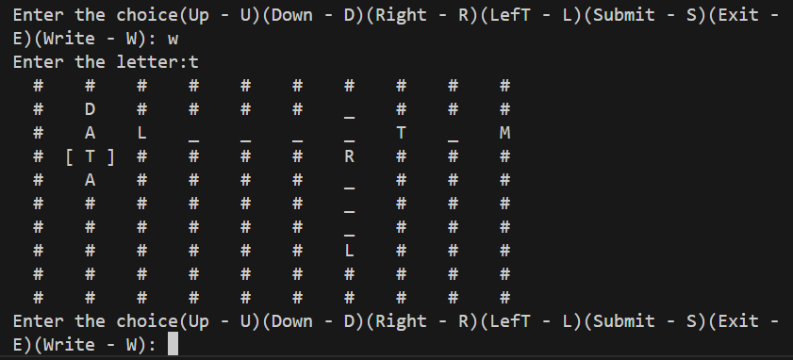
GAME OBJECTIVE
Goal of the Game: Navigate through a 10x10 grid and replace missing letters with correct answers.
Actions:
  Use different keys to move through the grid (Up, Down, Left, Right).
  Write letters at specific locations.
  Submit the solution when all letters are filled.
Levels: Each level involves solving a puzzle by placing the right letters at the right locations.

Slide 4
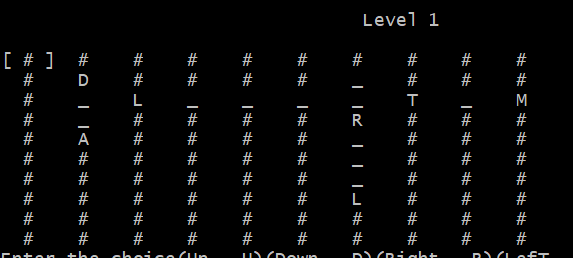
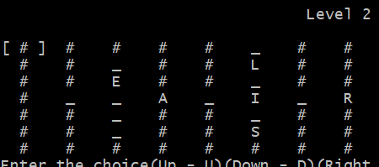
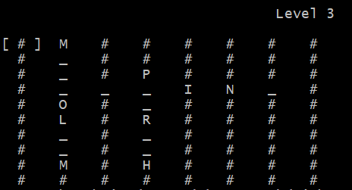
LEVELS

Slide 5
GAME STRUCTURE
    Main Method (Controller): Manages the flow of the game (Level 1 → Level 2 → Level 3).
    Level Classes (Level1, Level2, Level3): Each level is defined by its own grid setup, player movement, and specific puzzle-solving logic.
    Grid and Cell Representation: The grid consists of cells that can either be walls, empty spaces, or letters. Cells are represented as objects of the Grid, Wall, or Letter class.

Slide 6
TECHNICAL IMPLEMENTATION (CLASS STRUCTURE)
Grid Class
  Base class for grid cells.
Wall Class
  Represents non- editable cells.
(#)
Letter Class
  Represents editable calls.
Level Class
  Each level has a unique grid setup with predefined letters and walls.

Slide 7
THANK YOU

