Slide 1

SANTANDER CUSTOMER SATISFACTION
Mahindra Venkat Lukka

Slide 2
Objective: Predict Target
Available Data Sets: Train data with Target, Test data without Target.

Slide 3
Modelling Process
Model the train data
Test on train data
Accuracy check
Predict test data

Slide 4
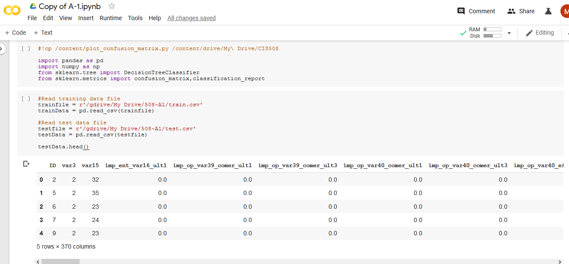
Model #1 – Default Parameters

Slide 5
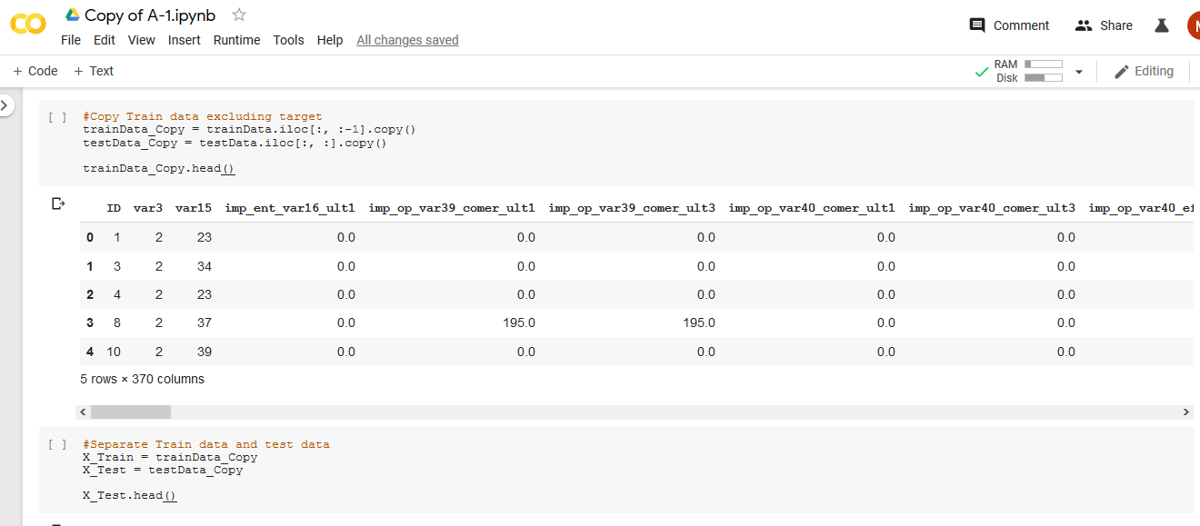
Model #1 – Default Parameters

Slide 6
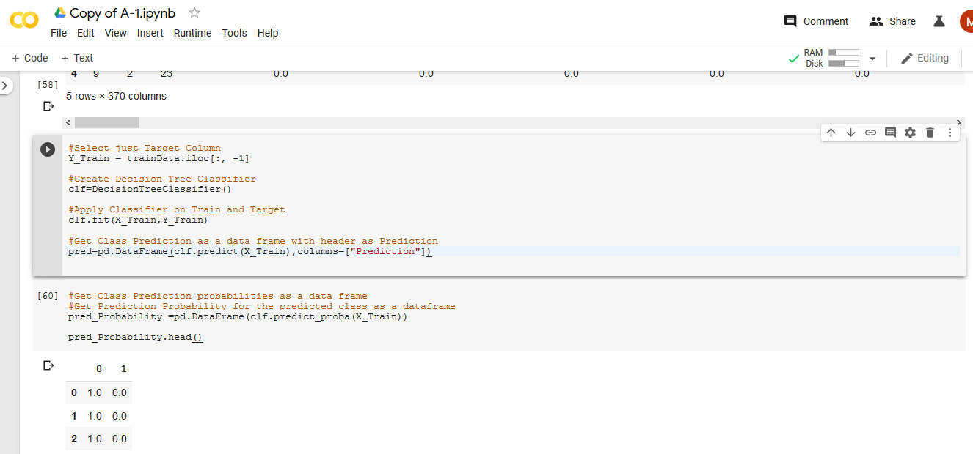
Model #1 – Default Parameters

Slide 7
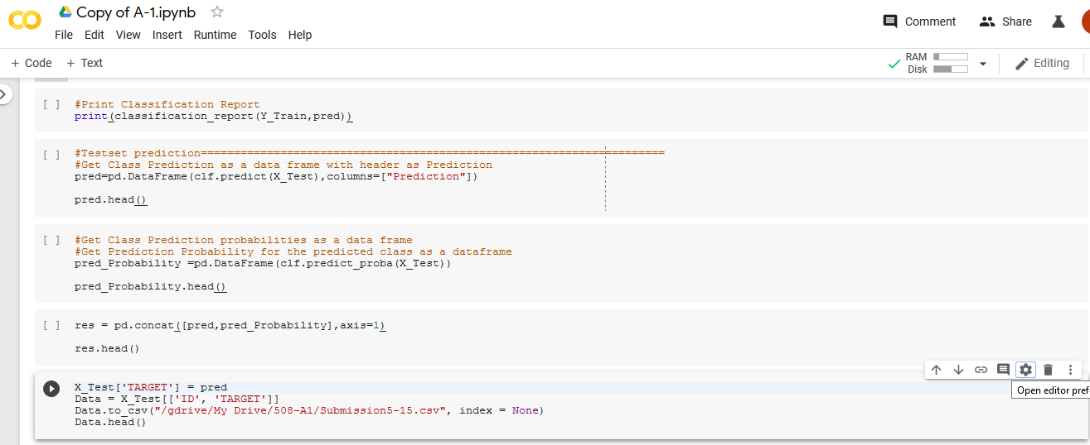
Model #1 – Default Parameters

Slide 8
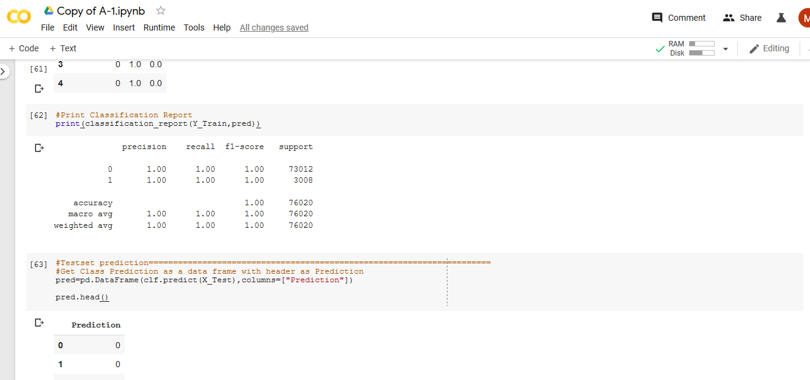
Report – Model #1

Slide 9
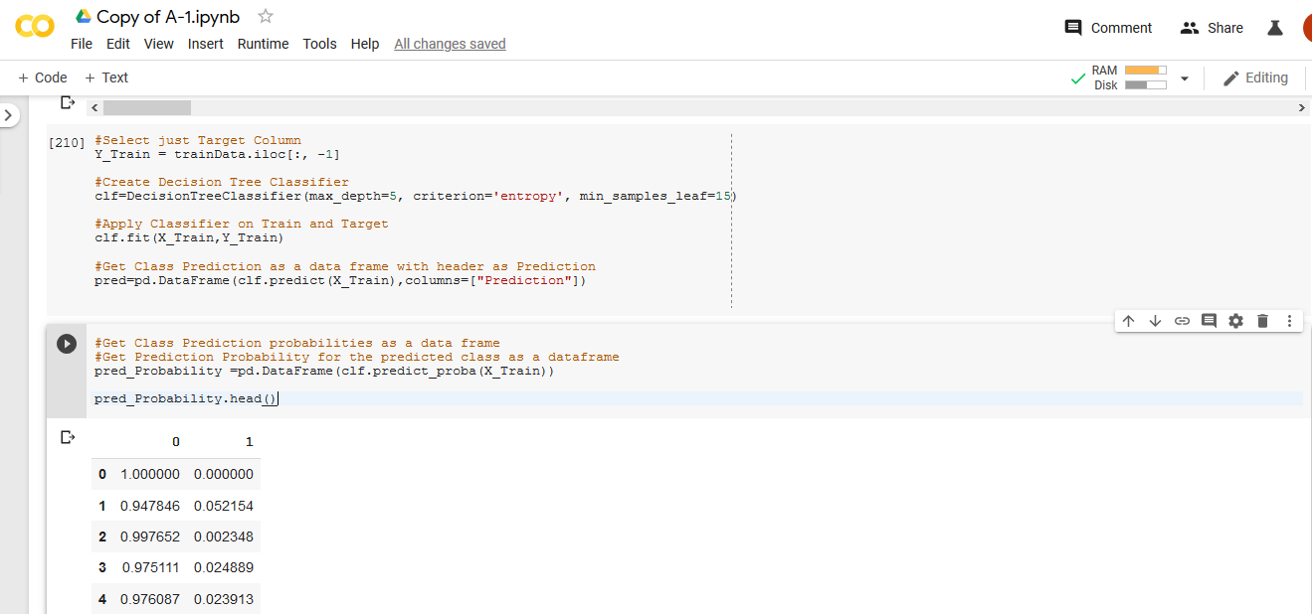
Model #2

Slide 10
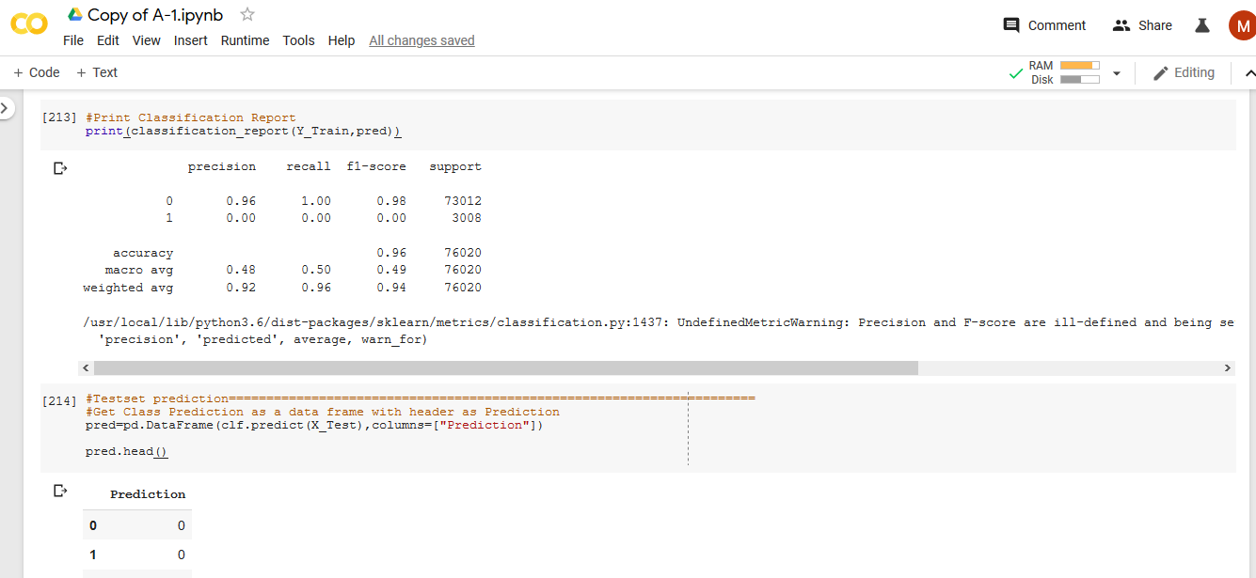
Report – Model #2

Slide 11
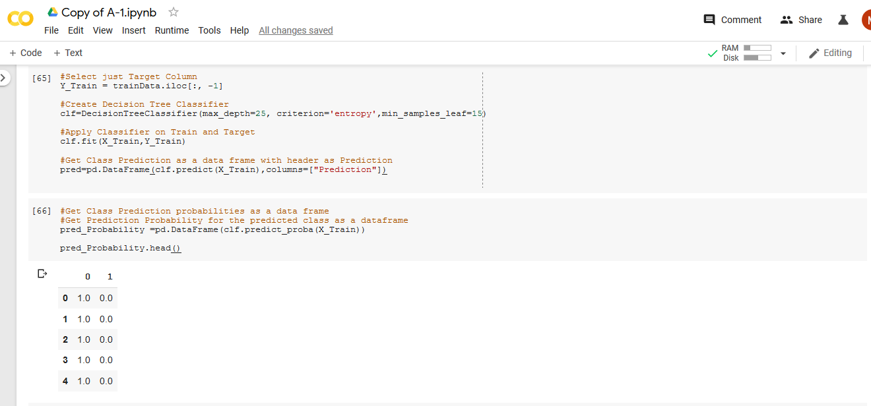
Model #3

Slide 12
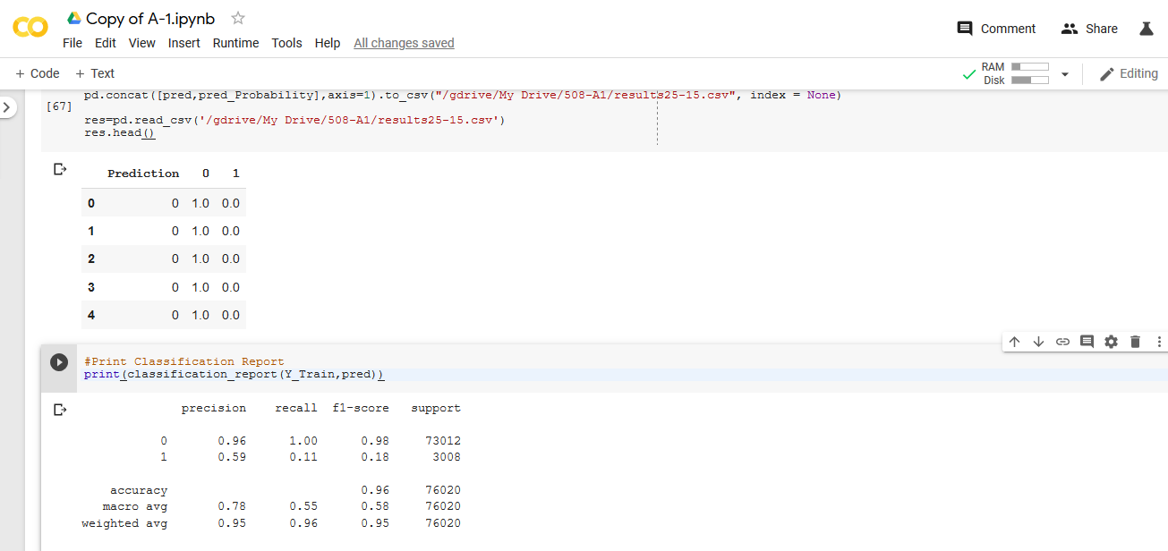
Report – Model #3

Slide 13
Kaggle Solutions
Sample # | max_depth | criterion | min_samples_leaf | Accuracy on Train Data | Kaggle Private Score
1 | None | Default = Gini | 2 | 1.00 | 0.55650
2 | 5 | Entropy | 15 | 0.96 | 0.50000
3 | 25 | Entropy | 15 | 0.96 | 0.51843
4 | 40 | Entropy | 15 | 0.96 | 0.51980
5 | 25 | Gini | 15 | 0.96 | 0.51637
6 | 25 | Gini | 25 | 0.96 | 0.50838

Slide 14
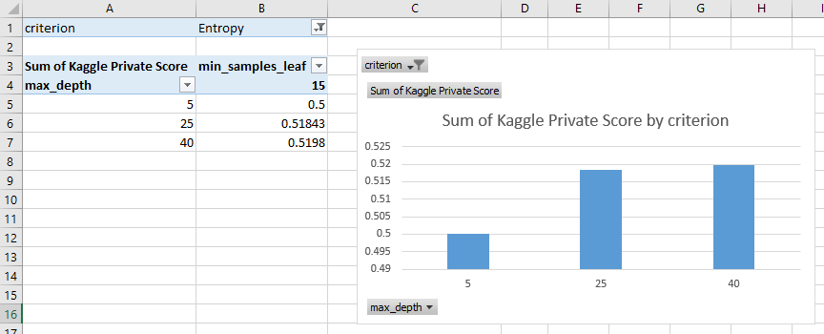
Model Comparison with Entropy

Slide 15
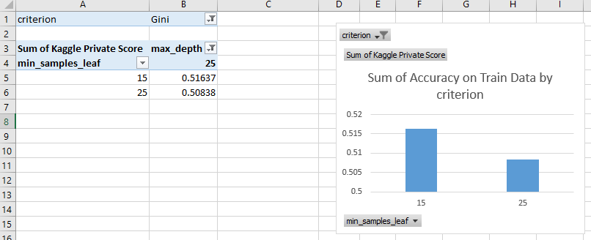
Model Comparison with Gini

Slide 16
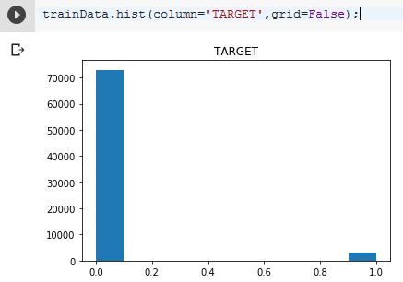
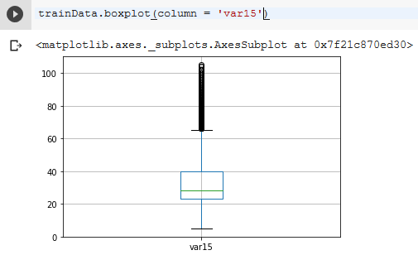
In Machine Learning Point of View
Biased Data
Outliers

Slide 17
THANKYOU

