Slide 1

CIS - 508
Assignment - 2
Mahindra Venkat Lukka

Slide 2
Problem - Fraud Detection
Objective: Predict Fraud Found
There are two datasets –
1. Insurance Fraud – TRAIN-3000, and
2. Insurance Fraud – TEST-12900.

Slide 3
Modelling Process
Model the train data
Predict test data
Accuracy check

Slide 4
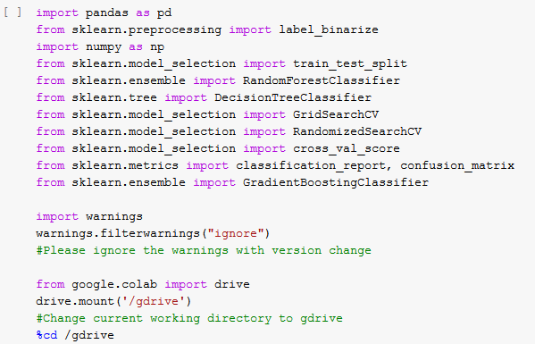
Python Code

Slide 5
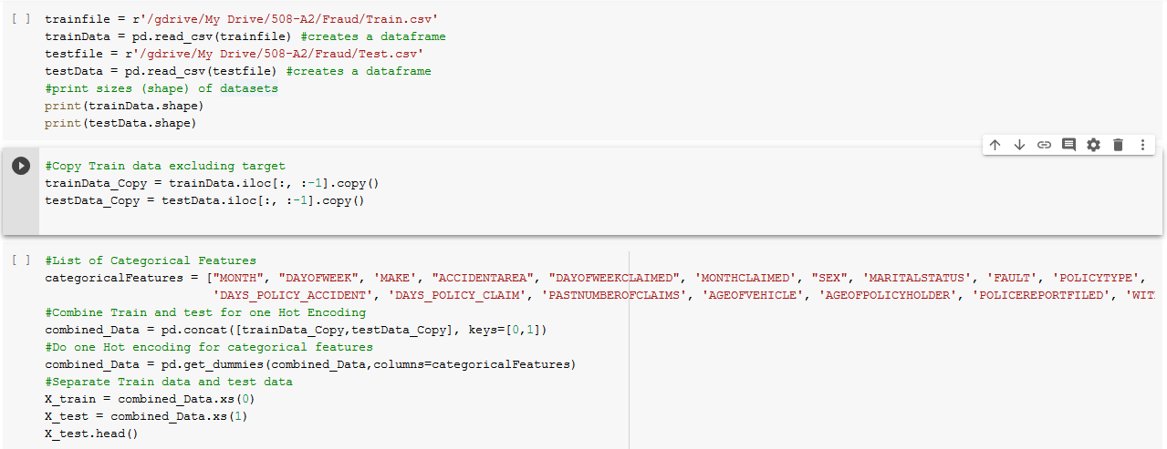
Python Code

Slide 6
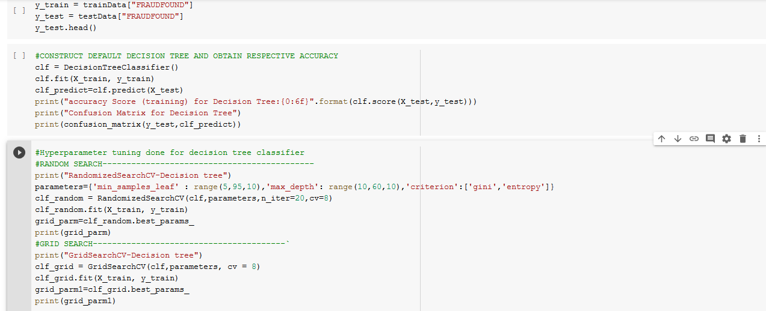
Python Code

Slide 7
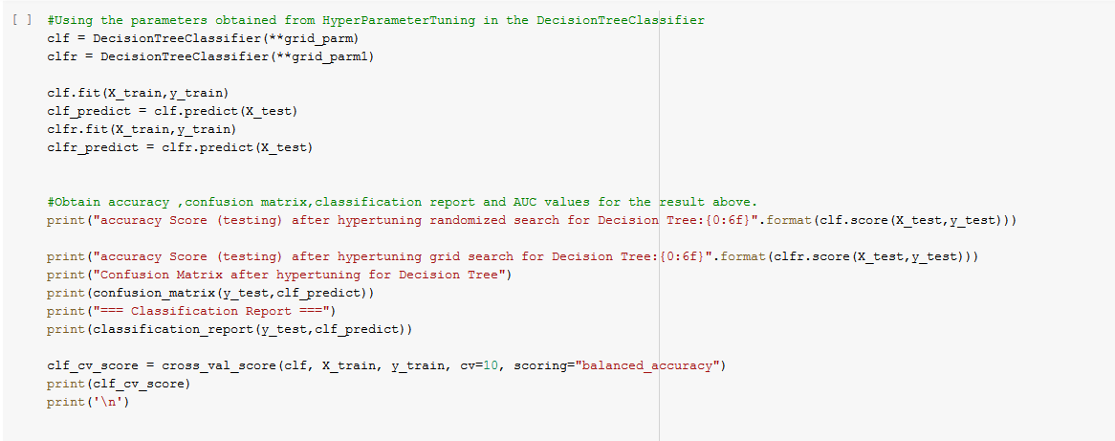
Python Code

Slide 8
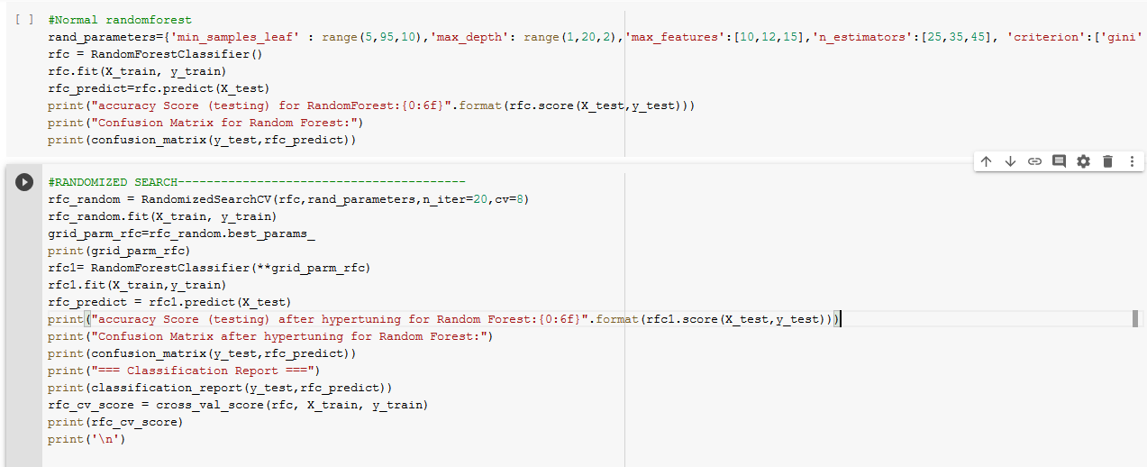
Python Code

Slide 9
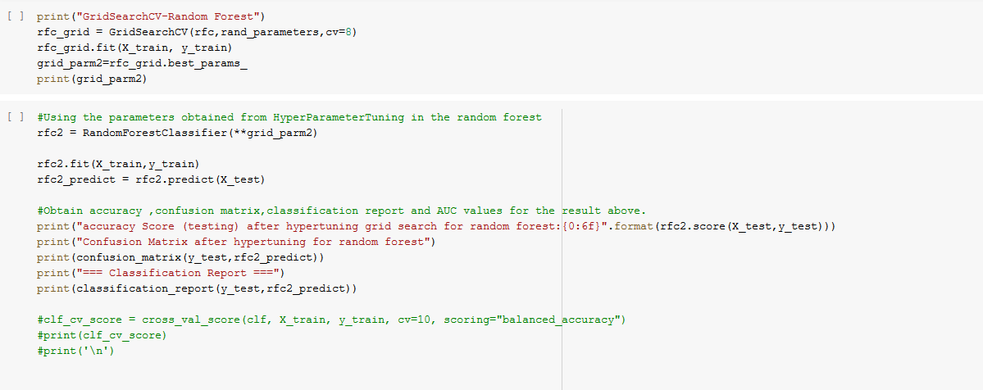
Python Code

Slide 10
Decision Tree Vs RandomForest – Model 1
Decision Tree
Hyperparameter | min_samples_leaf | max_depth | criterion | n_iter | cv | Accuracy
Default |  |  |  |  |  | 0.881
Random Search | range(10,100,10) | range(5,30,5) | ['gini','entropy'] | 15 | 5
Random Best | 30 | 15 | entropy |  |  | 0.897
Grid Search | range(10,100,10) | range(5,30,5) | ['gini','entropy'] |  | 5
Grid Best | 90 | 5 | entropy |  |  | 0.883
Random Forest
Hyperparameter | min_samples_leaf | max_depth | criterion | max_features | n_estimators | n_iter | cv | Accuracy
Default |  |  |  |  |  |  |  | 0.953
Random Search | range(10,100,10) | range(1,10,2) | ['gini','entropy'] | [2,3,4] | [20,30,40] | 15 | 5
Random Best | 70 | 9 | entropy | 3 | 40 |  |  | 0.961
Grid Search | range(10,100,10) | range(1,10,2) | ['gini','entropy'] | [2,3,4] | [20,30,40] |  | 5
Grid Best | 10 | 1 | gini | 2 | 20 |  |  | 0.961

Slide 11
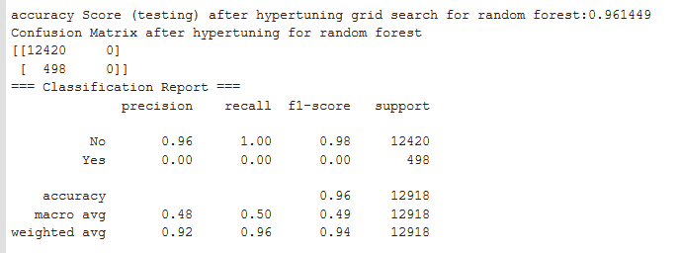
Random Vs Grid – Classification Report

Slide 12
Decision Tree Vs RandomForest – Model 2
Decision Tree
Hyperparameter | min_samples_leaf | max_depth | criterion | n_iter | cv | Accuracy
Default |  |  |  |  |  | 0.881
Random Search | range(5,95,10) | range(10,60,10) | ['gini','entropy'] | 20 | 8
Random Best | 35 | 30 | entropy |  |  | 0.907
Grid Search | range(5,95,10) | range(10,60,10) | ['gini','entropy'] |  | 8
Grid Best | 35 | 0 | entropy |  |  | 0.907
Random Forest
Hyperparameter | min_samples_leaf | max_depth | criterion | max_features | n_estimators | n_iter | cv | Accuracy
Default |  |  |  |  |  |  |  | 0.953
Random Search | range(5,95,10) | range(1,20,2) | ['gini','entropy'] | [10,12,15] | [25,35,45] | 20 | 8
Random Best | 15 | 17 | gini | 15 | 35 |  |  | 0.948
Grid Search | range(5,95,10) | range(1,20,2) | ['gini','entropy'] | [10,12,15] | [25,35,45] |  | 8
Grid Best | 5 | 19 | gini | 12 | 35 |  |  | 0.939

Slide 13
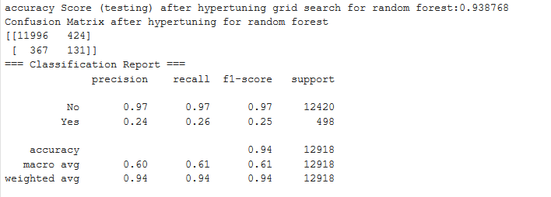
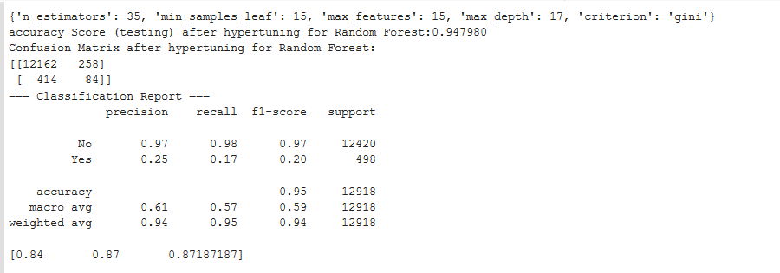
Grid Vs Random – Classification Report
Grid
Random

Slide 14
Problem - Direct Marketing
Objective: Predict whether client subscribed to a term deposit?
There are two datasets –
1. Train,
2. Test

Slide 15
Decision Tree Vs RandomForest – Model 1
Decision Tree
Hyperparameter | min_samples_leaf | max_depth | criterion | n_iter | cv | Accuracy
Default |  |  |  |  |  | 0.884
Random Search | range(5,95,10) | range(10,60,10) | ['gini','entropy'] | 20 | 8
Random Best | 25 | 10 | entropy |  |  | 0.899
Grid Search | range(5,95,10) | range(10,60,10) | ['gini','entropy'] |  | 8
Grid Best | 5 | 10 | gini |  |  | 0.901
Random Forest
Hyperparameter | min_samples_leaf | max_depth | criterion | max_features | n_estimators | n_iter | cv | Accuracy
Default |  |  |  |  |  |  |  | 0.906
Random Search | range(5,95,10) | range(1,20,2) | ['gini','entropy'] | [5,6,7] | [15,25,35] | 10 | 8
Random Best | 25 | 13 | entropy | 7 | 35 |  |  | 0.893
Grid Search | range(5,95,10) | range(1,20,2) | ['gini','entropy'] | [5,6,7] | [15,25,35] |  | 8
Grid Best | 5 | 19 | gini | 6 | 15 |  |  | 0.899

Slide 16
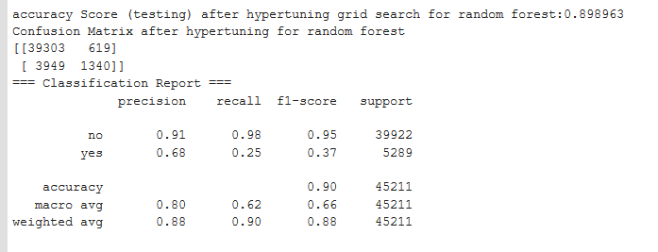
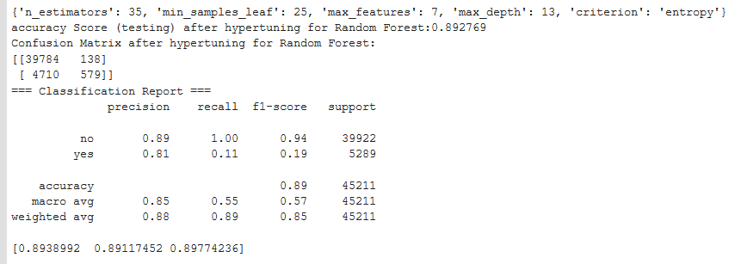
Grid Vs Random – Classification Report
Grid
Random

Slide 17
Decision Tree Vs RandomForest – Model 2
Decision Tree
Hyperparameter | min_samples_leaf | max_depth | criterion | n_iter | cv | Accuracy
Default |  |  |  |  |  | 0.884
Random Search | range(10,100,10) | range(5,30,5) | ['gini','entropy'] | 15 | 5
Random Best | 40 | 5 | entropy |  |  | 0.897
Grid Search | range(10,100,10) | range(5,30,5) | ['gini','entropy'] |  | 5
Grid Best | 30 | 5 | entropy |  |  | 0.896
Random Forest
Hyperparameter | min_samples_leaf | max_depth | criterion | max_features | n_estimators | n_iter | cv | Accuracy
Default |  |  |  |  |  |  |  | 0.906
Random Search | range(10,100,10) | range(1,10,2) | ['gini','entropy'] | [2,3,4] | [20,30,40] | 10 | 5
Random Best | 60 | 9 | gini | 3 | 30 |  |  | 0.883
Grid Search | range(10,100,10) | range(1,10,2) | ['gini','entropy'] | [2,3,4] | [20,30,40] |  | 5
Grid Best | 10 | 9 | entropy | 4 | 30 |  |  | 0.892

Slide 18
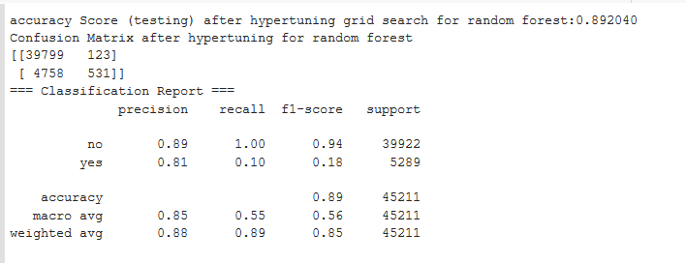
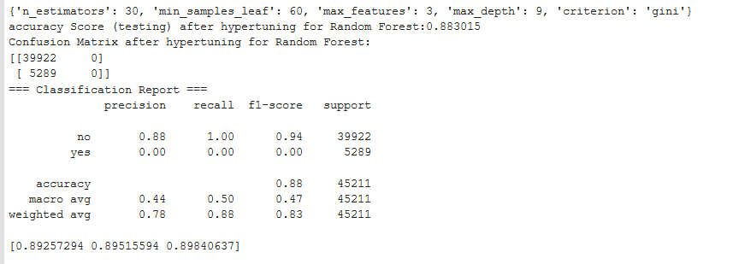
Grid Vs Random – Classification Report
Grid
Random

Slide 19
Learnings
Hyper tuning and Cross validation
Decision Tree Vs Random Forest
Grid Search Vs Random Search

Slide 20
THANKYOU

