Slide 1

CIS - 508 Assignment - 3
Mahindra Venkat Lukka

Slide 2
Problem – Predict Customer Action
Objective: Predict QuoteConversion_Flag
There are two datasets –Train and Test.
One hot encoded data sets

Slide 3
Modelling Process
Model the train data
Predict test data
Accuracy check

Slide 4
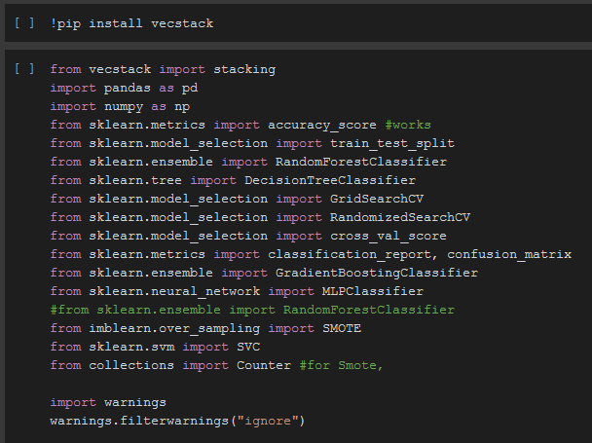
Python Code

Slide 5
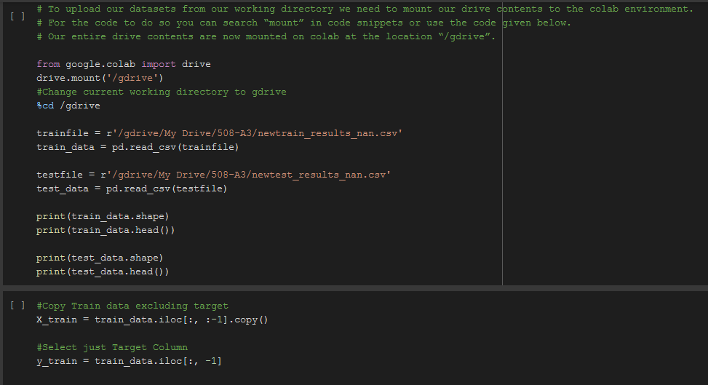
Python Code

Slide 6
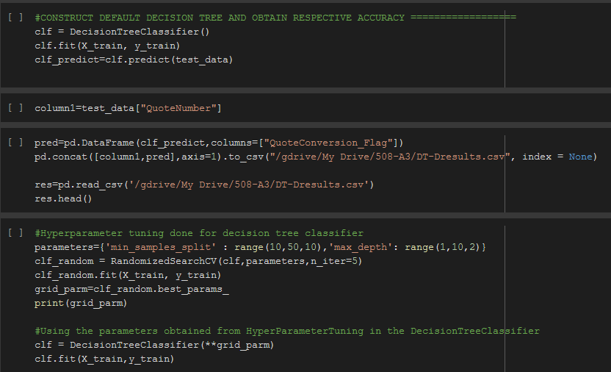
Python Code

Slide 7
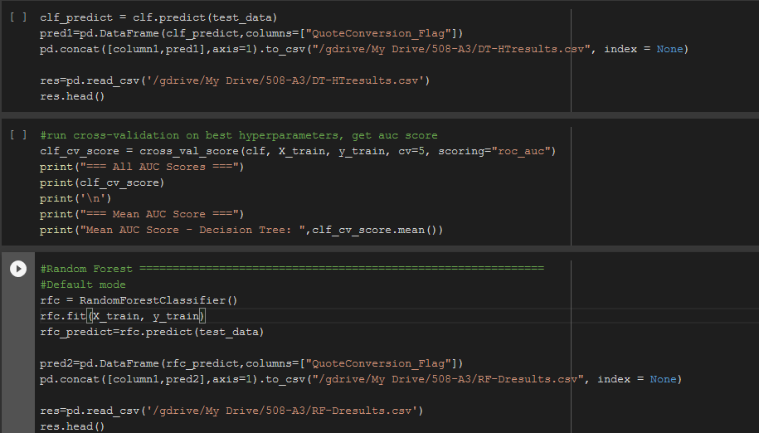
Python Code

Slide 8
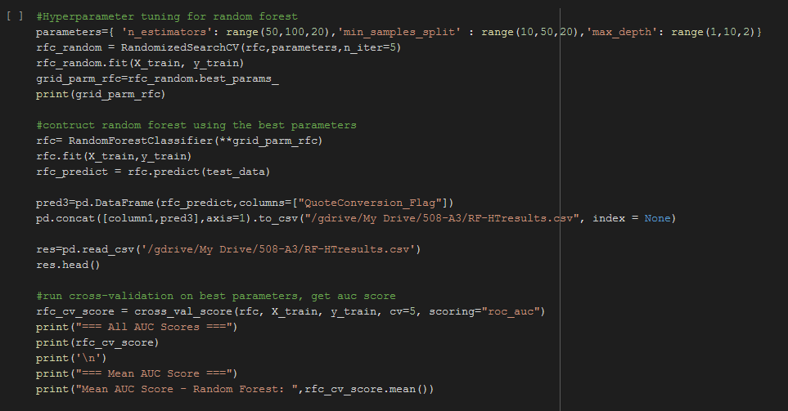
Python Code

Slide 9
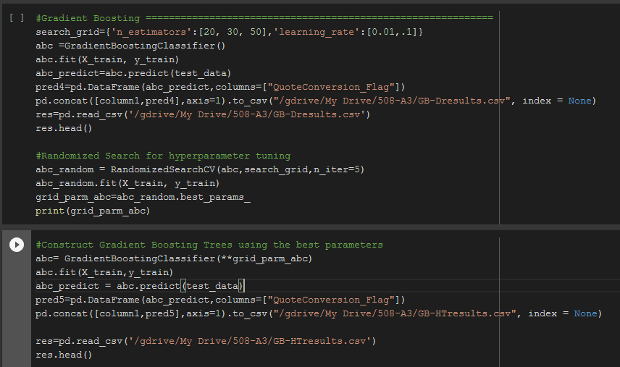
Python Code

Slide 10
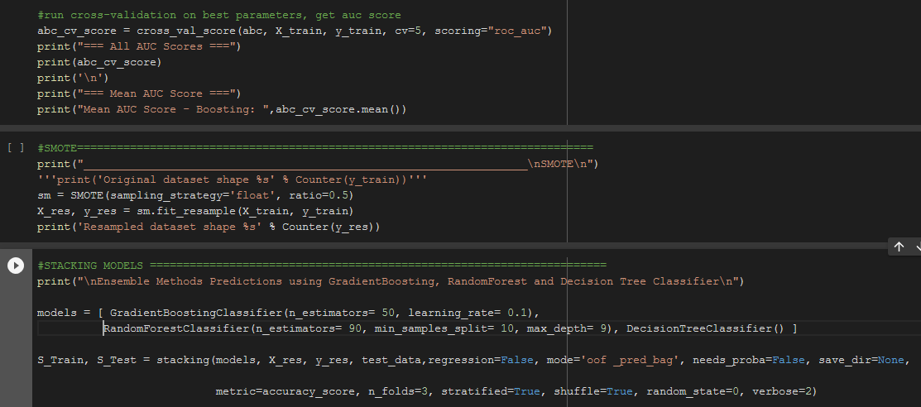
Python Code

Slide 11
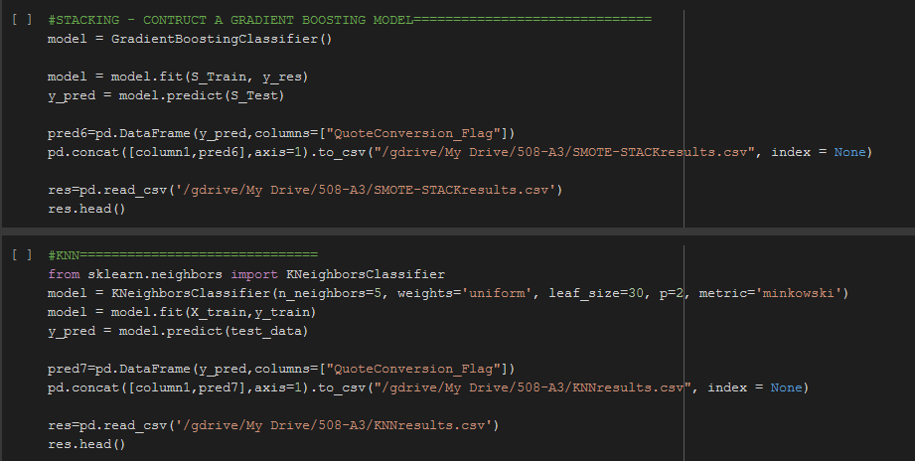
Python Code

Slide 12
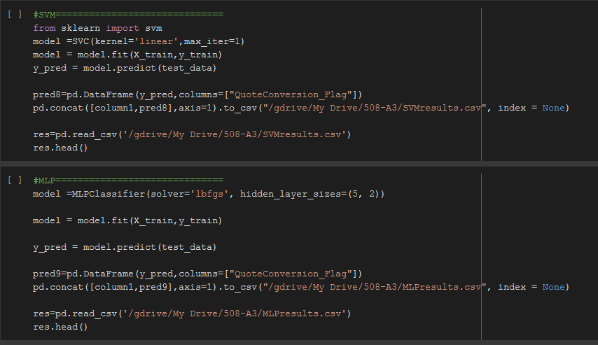
Python Code

Slide 13
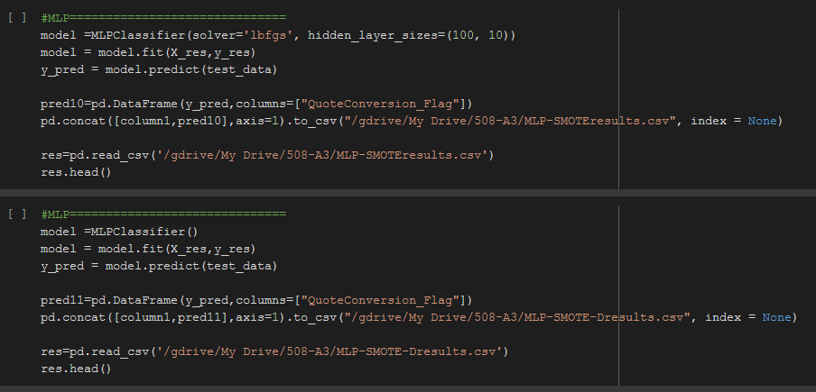
Python Code

Slide 14
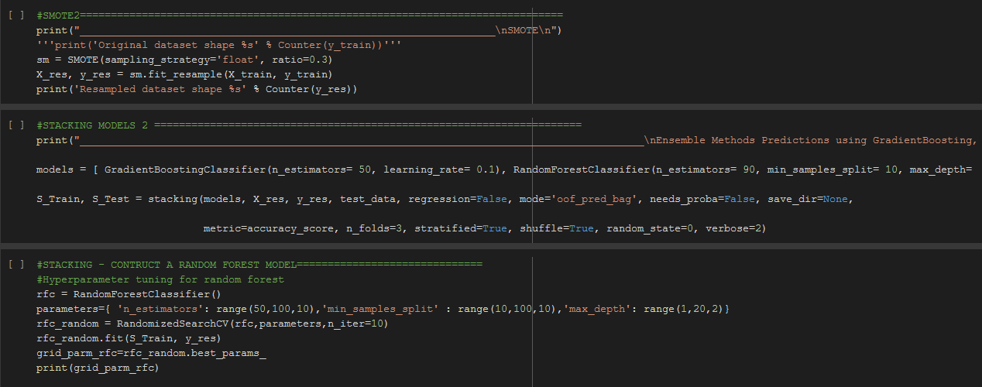
Python Code

Slide 15
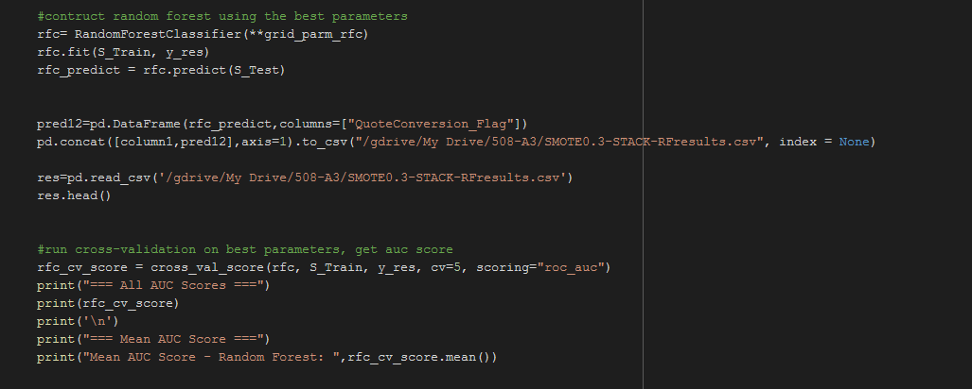
Python Code

Slide 16
Kaggle Scores Comparison
 | Classifiers | Kaggle Score
 | Decision Tree
 | Default | 0.82543
 | Hyper Parameter Tuning | 0.80522
 | Gradient Boosting
 | Default | 0.81431
 | Hyper Parameter Tuning | 0.79360
 | Random Forest
 | Default | 0.74844
 | Hyper Parameter Tuning | 0.59672
 | SMOTE Stacked
 | Gradient Boosting with 0.5 SMOTE Default | 0.82684
 | Random Forest with 0.3 SMOTE Hyper parameter tuning | 0.81078
 | KNN
 | Parameters | 0.50123
 | MLP
 | Parameters | 0.50000
 | SMOTE 50% with Parameters | 0.49947
 | SMOTE 50% Default | 0.56704

Slide 17
Learnings
Effect of Stacking on accuracy.
Decision Tree, Gradient Boosting, Random Forest Vs KNN, MLP on categorical data set.

Slide 18
THANKYOU

