Slide 1

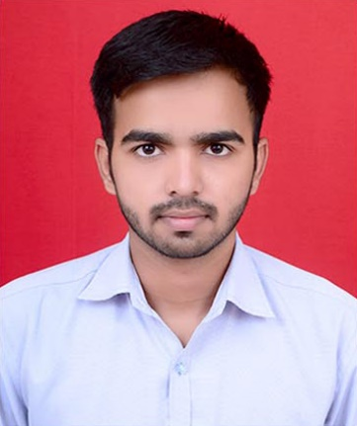




Mahesh Prakash Tanpure
Education and certificates
Bachelor of Engineering
Mechanical Engineering : 2016 - 2020
Skills
Analyst/Software Engineer
Base Location:Mumbai
JavaScript | JavaScript Basics, Prototype, Closure, Scope Chain and Promise.
Angular | Components, Services, Modules, Routing, Forms & Validation, Testing using Jasmine & Karma.
React | Components, Hooks, Event handling, Reducers, Testing using Jasmin & Karma
Database | MongoDB
UI Tech | HTML 5 & CSS 3,JavaScript, ES6 & TypeScript Reusable templates, Optimized UI Designed.
Tools | Git, Postman.
Add On skills | Communications, Team management. Peer learning.
Email ID:
mahesh-prakash.tanpure@capgemini.com
_{Mobile No:} +918329739788
Grade: A4
Strengths
Achievement
MEAN(Mongo, Express, Angular and Node) and
MERN(Mongo, Express, React and Node) developer
Completed end to end case study of Shopping Cart
Application named nature’s paradise along with JWT authentication, responsive UI with CSS and Angular used for user interface.
Hands on experience in developing web pages
using HTML5, CSS3, Object Oriented Java script, ES6, AJAX, JSON, XML. Good understanding of Document Object Model (DOM) and DOM Functions and experience in implementing MVC architecture with Node Js.
Completed end to end case study of Shopping Cart
Application named nature’s paradise along with JWT authentication, responsive UI with CSS and ReactJS used for user interface and database for MongoDB.
Good Knowledge in React JS with concepts on React Props and Hooks.
Practical understanding of advanced Javascript concepts, such as Prototype, Closure, Scope Chain and Promise.
Implemented Nodejs and ExpressJs in Angular case study and upskilling its knowledge continuously.
Presentation Title | Author | Date © Capgemini 2017. All rights reserved | 1

