Slide 1
Scale Federated Learning for Label Set Mismatch in Medical Image Classification
Zhipeng Deng, Luyang Luo and Hao Chen
MICCAI, 2023
CS6680: Multimedia Content Analysis
Presenter:
Mahesh Deshmukhe
CC23MTECH11003
IIT Hyderabad

Slide 2
Contents
Major Aspects of FL
Existing Limitations/Assumptions in FL
Introduction to FedLSM
Methodology of FedLSM
Datasets
Experimental Setup
Hyperparameters
Reproduction of Results
Conclusion
Future Work

Slide 3
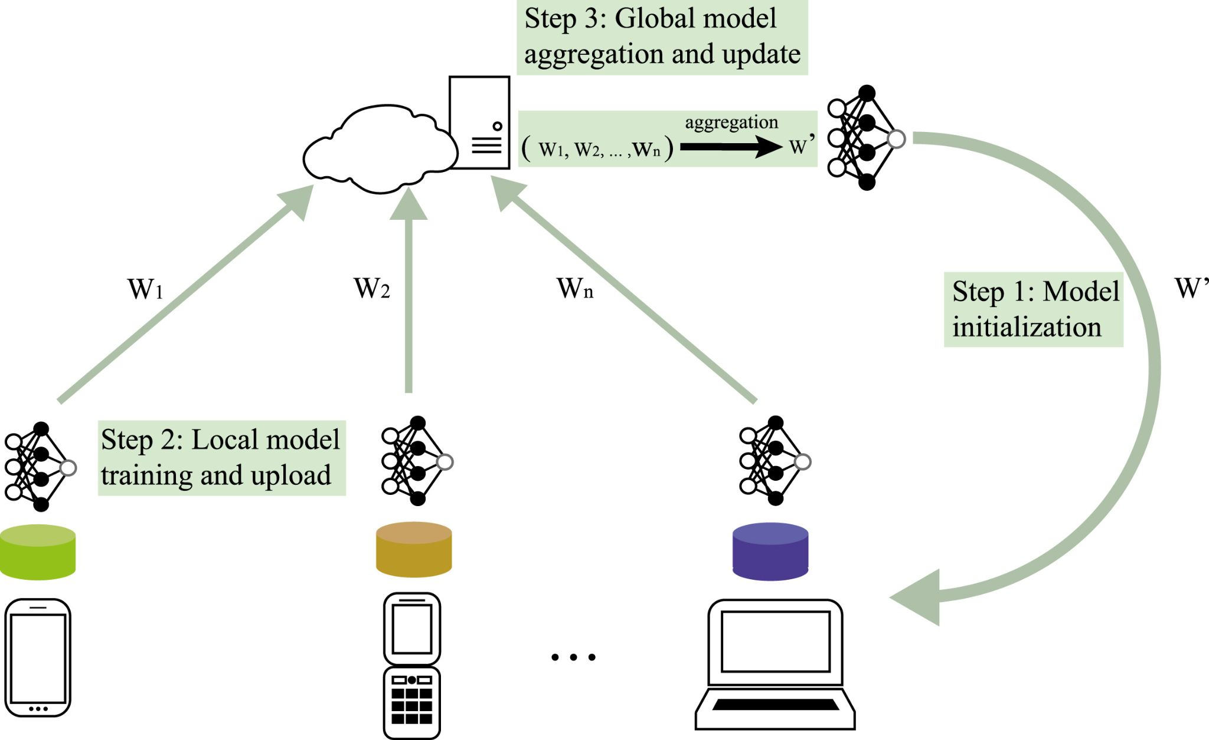
Major aspects of FL
Data Partitioning
Privacy Mechanism
Machine Learning Model
Communication Architecture
Systems Heterogeneity
Reference: A survey on federated learning

Slide 4
Existing Limitations/Assumptions in FL
Non-IID FL assumes that each client holds an identical label set
In the medical field, datasets from different hospitals are annotated based on their domain of interest
FedRS assumed that each client only owns locally identified classes
FedPU assumed that each client owns labels of locally identified classes and unlabeled data of all classes but was not applied to multi-label classification.
FedSemi assumes that only some of the clients or server owns labels of all the classes.
References: Entropy to Mitigate Non-IID Data Problem on Federated Learning for the Edge Intelligence Environment, Federated Learning with Positive and Unlabeled Data, FedRS: Federated Learning with Restricted Softmax for Label Distribution Non-IID Data

Slide 5
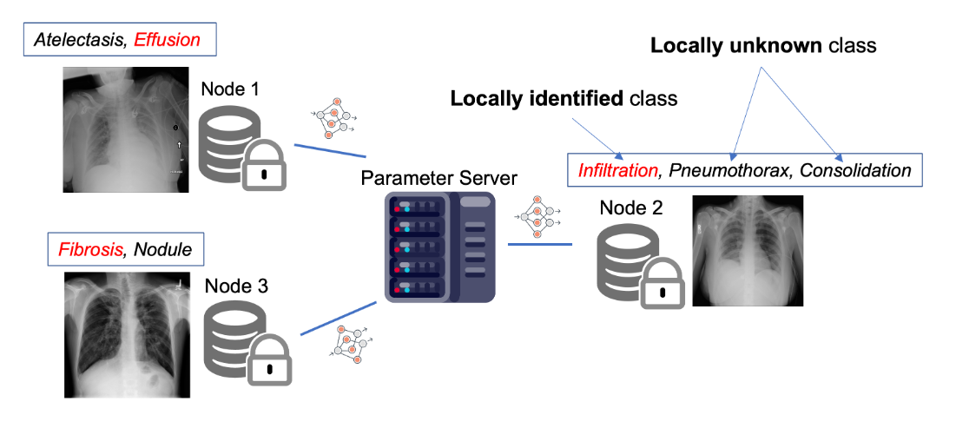
What is the Label Mismatch in FL
Fig. 1. Illustration of the Label Set Mismatch problem. Each node (client) has its own identified class set, which can differ from other nodes. The label in the box represents the correct complete label, while the label in the red text represents the partial label actually assigned to the image.

Slide 6
Main Contributions of this Paper
The proposed framework is designed for both Single and Multi-label classification.
Evaluation of the uncertainty(Uncertainty Estimation) of each sample using entropy and annotate the samples as:
low uncertainty and medium uncertainty with pseudo-labels
low uncertainty and high uncertainty combined using MixUp model
An EDD(Estimation of Disease Distribution) is calculated using the existing and pseudo-labels
An Adaptive Weighted Averaging for the classification layer that considers the client class-wise data numbers.

Slide 7
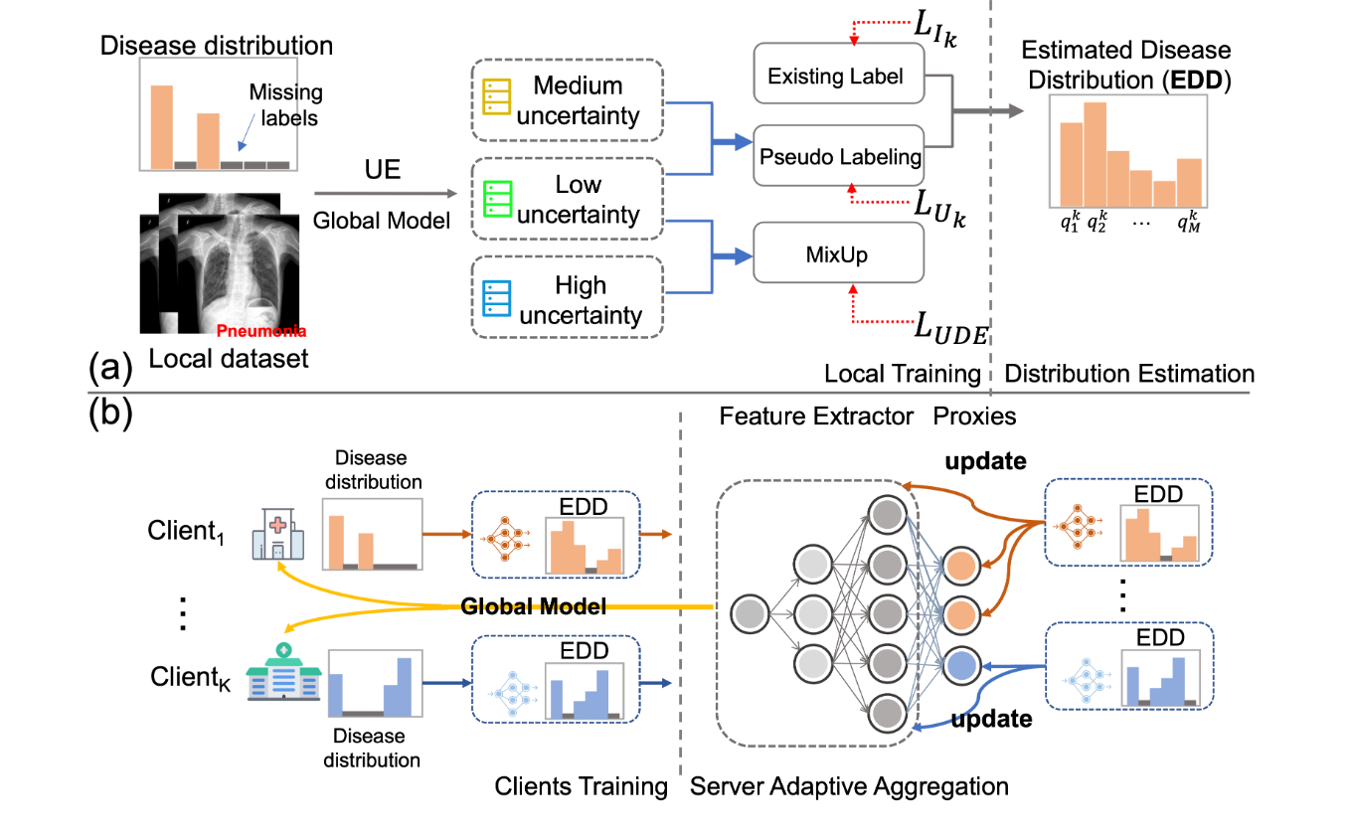
Introduction to FedLSM
Fig. 2. Overview of the FedLSM framework. (a) Client training details, including uncertainty estimation (UE) and different training strategies for data with different uncertainty levels. The estimated disease distribution (EDD) is calculated using existing labels and pseudo labels. (b) Overview of the proposed scenario and FL paradigm, where each client has non-identical missing labels. EDD represents each client’s contribution to each proxy in the adaptive classification layer aggregation.

Slide 8
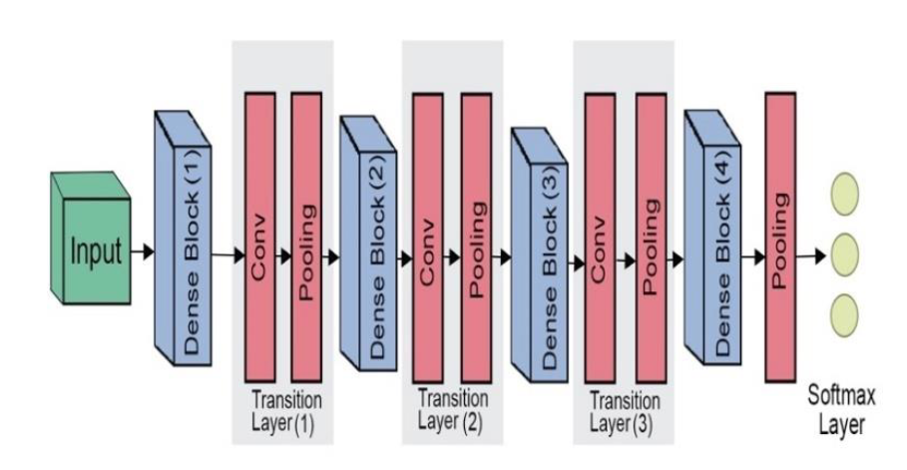
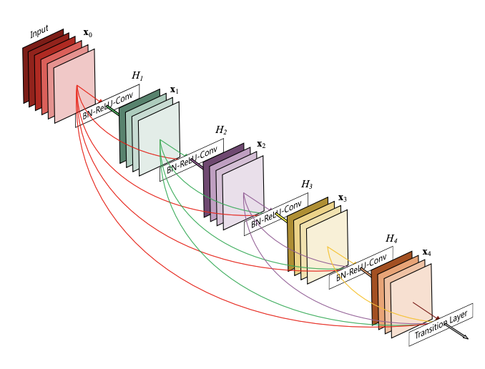
Introduction to FedLSM
FedLSM uses DenseNet121 as the backbone for all the tasks
Image Reference: Densely Connected Convolutional Networks, Deep Architecture based on DenseNet-121 Model for Weather Image Recognition

Slide 9



Methodology of FedLSM
Problem Setting:
K clients and one central server
Each client owns a locally-identified class and a locally unknown class
and can vary among clients and may even be disjoint
All the clients share an identical class set:

Slide 10











Methodology of FedLSM
Problem Setting:
The local dataset can be denoted as:
, denotes the number of data
, denotes the i-th input image
, denotes the i-th label vector
, is the number of classes in
, refers to the label of class
The backbone model is
, refers to the feature extractor with parameters 𝜃 and
, refers to the last classification layer with parameters:
, refers to proxies and is the c-th proxy

Slide 11
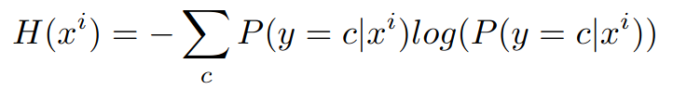





Methodology of FedLSM
Local Model Training: Uncertainty Estimation
The UE is calculated using entropy using the global model:
and are used to determine uncertain dataset and confident dataset
The remaining data is
Predicted probability of class ‘c’, for a given input ‘x^{i}’

Slide 12

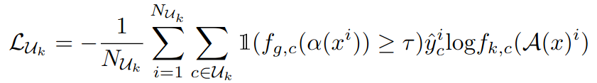

Methodology of FedLSM
Local Model Training: Pseudo Labeling
For unlabeled data, pseudo labels are proposed using a teacher model. For the locally identified class, the loss is cross-entropy loss.
For locally unknown class, the loss for a single-label classification:
This is the number of unlabeled samples
Indicator function gives the probability for weakly augmented input image x^{i} and checks if it is greater than the threshold 𝜏
This is the pseudo label assigned to x^{i} i.e
Predicted probability for the strongly augmented input image x^{i}

Slide 13
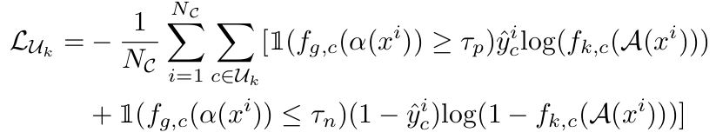

Methodology of FedLSM
Local Model Training: Pseudo Labeling
The teacher model is updated using Exponential Moving Average(EMA) with the weights of the student model during training.
For multi-label classification,
The loss is binary cross-entropy loss.
For the locally unknown class, the loss is:
and are the confidence thresholds for positive and negative labels.

Slide 14
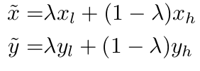


Methodology of FedLSM
Local Model Training: Uncertain data Enhancing(UDE)
Data filtering in the previous step makes it difficult to acquire pseudo-labels for uncertain data and do not contribute to the training process
To overcome this, MixUp is used to create a dataset from confident dataset and uncertain dataset , to generate softer labels and input :
corresponding label
pseudo-label

Slide 15

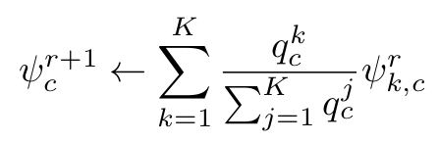
Methodology of FedLSM
Server Model Aggregation
In the r-th round, the aggregate feature extractors is given by:
Adaptive Weighted Proxy Aggregation(AWPA)
Missing labels of locally unknown classes, on the k-th client, the corresponding proxies are inaccurate and will cause error accumulation during model aggregation.
Existing and pseudo-labels are used to indicate the contribution of aggregation of proxies:
No of training data of the c-th class for the k-th client

Slide 16
Experiments
Datasets
NIH CXR Diagnosis(multi-label)
This consists of 112,120 frontal-view CXR images from 32,717 patients.
Each image is annotated with 14 possible abnormalities (positive or negative)
This was used for Task-1
Skin Lesion Diagnosis(single-label)
HAM10000, was used which contains 10,015 dermoscopy images.
This was used for Task-2
Training, Validation and Testing sets for both were divided into 7:1:2

Slide 17
Experiments
Setup
FL Setup
K client training sets and s classes which are locally identified for each client, are divided at random
Task-1: k=8 and s=3
Task-2: k=5 and s=3
Data augmentation and preprocessing
Images in Task-1, were resized to 320x320
Images in Task-2, were resized to 224x224
Weak Augmentation: Horizontal Flip
Strong Augmentation: Combination of Random Flip, Rotation, Translation

Slide 18
Experiments
Setup
Evaluation Metric
Task-1: AUC was adopted
Task-2: Macro average of AUC, Accuracy, F1, Precision and Recall
Implementation Details
The total batch size was 64 with 4 generated samples using UDE.
Local training iterations were 200 for Task-1 and 30 for Task-2
Communication Rounds were 50 in both the Tasks

Slide 19
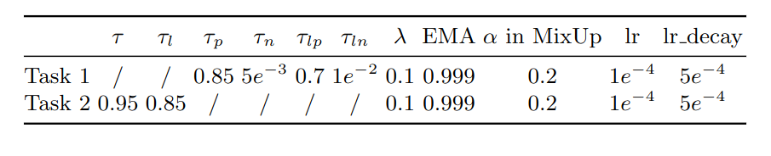
Hyperparameters

Slide 20
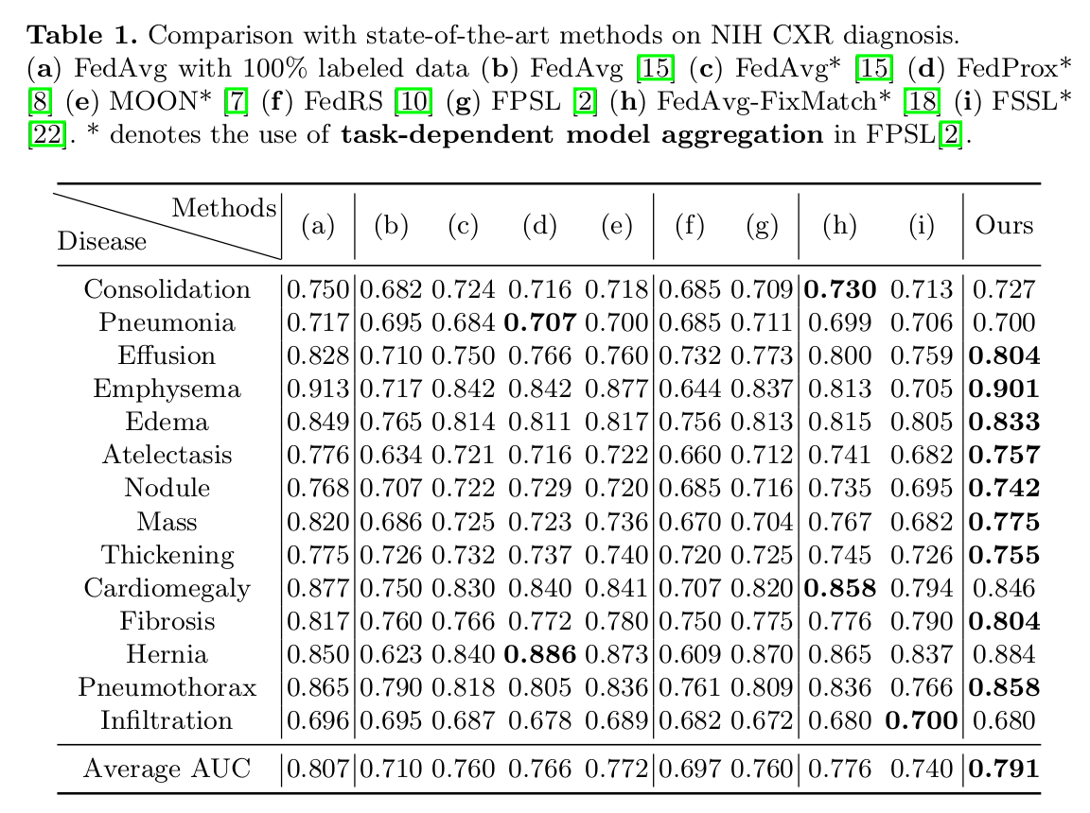
Results: Task-1

Slide 21
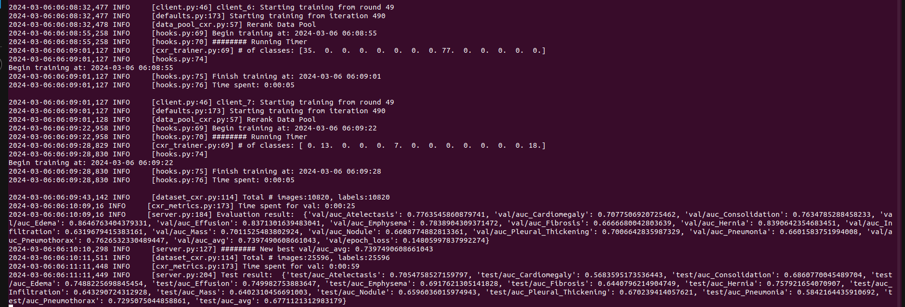
Results Reproduction for Task-1

Slide 22
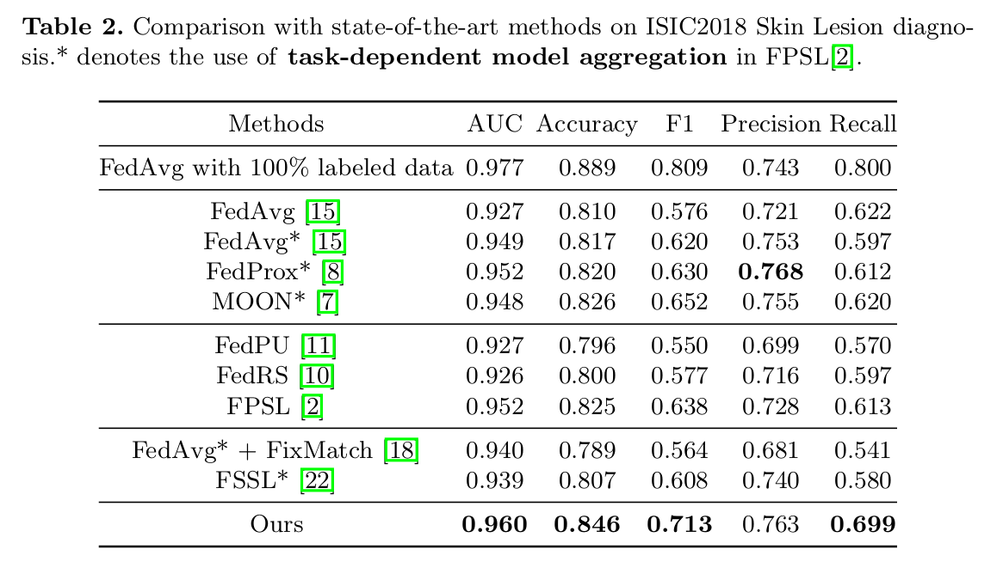
Results: Task-2

Slide 23
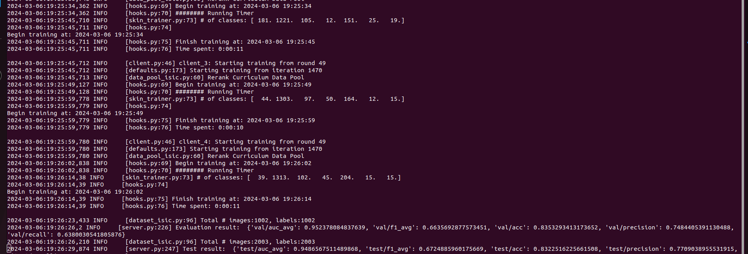
Results Reproduction for Task-2

Slide 24
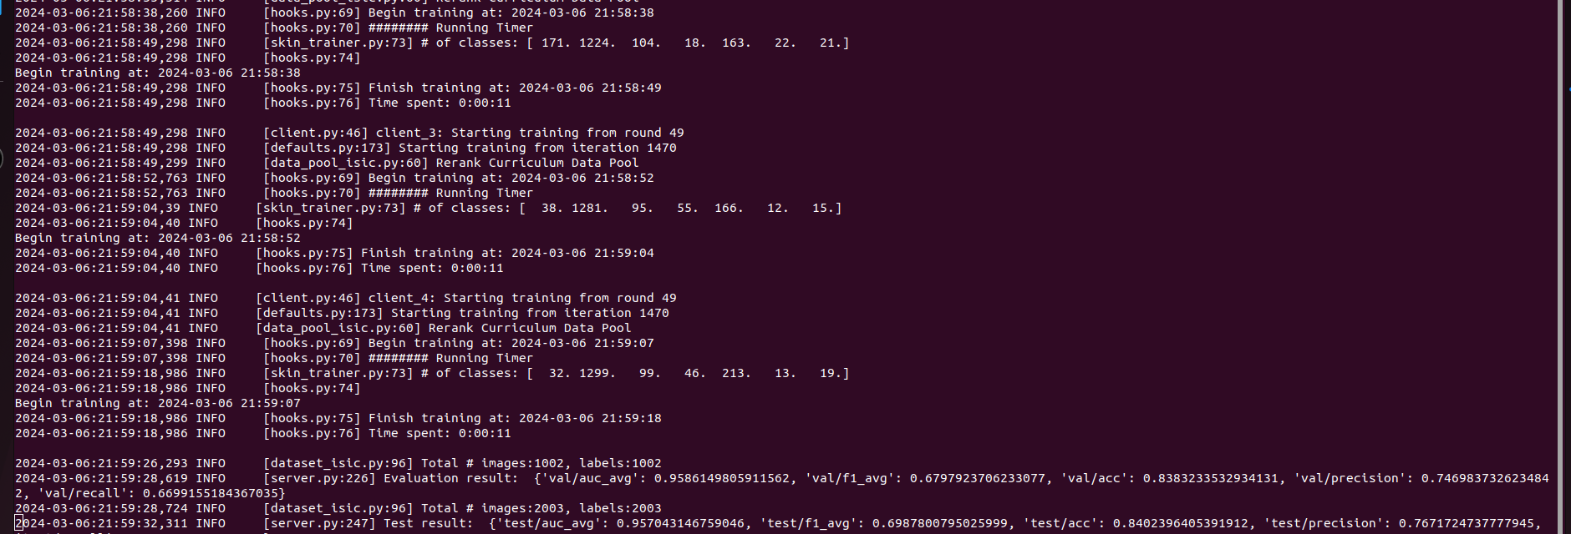
Results Reproduction for Task-2

Slide 25
Conclusion
FedLSM proposes an effective framework to tackle the issue of Label Set Mismatch.
UE(Uncertainty Estimation) is used to partition the data into distinct levels of uncertainty.
Pseudo-labels are applied to confident and uncertain data
In the server aggregation phase, adaptive weighted proxies averaging on the classification layer was used.
FedLSM shows notable effectiveness in both single-label and multi-label classification tasks

Slide 26
Future Work
Reproduce the results given in the paper - DONE
Try to apply this model on different datasets not used in the paper.
Think of ways to improve the filtering mechanism used in the pseudo-labeling methodology.
Implement this paper using other models like ResNet/AlexNet and do a comparative analysis.

Slide 27
References
Chen Zhang, Yu Xie, Hang Bai, Bin Yu, Weihong Li, Yuan Gao, A survey on federated learning,Knowledge-Based Systems, Volume 216, 2021
Lin, X., Chen, H., Xu, Y., Xu, C., Gui, X., Deng, Y., Wang, Y.: Federated learning with positive and unlabeled data. In: International Conference on Machine Learning. pp. 13344–13355. PMLR (2022)
Li, X.C., Zhan, D.C.: Fedrs: Federated learning with restricted softmax for label distribution non-iid data. In: Proceedings of the 27th ACM SIGKDD Conference on Knowledge Discovery & Data Mining. pp. 995–1005 (2021)
Zhang, H., Cisse, M., Dauphin, Y.N., Lopez-Paz, D.: mixup: Beyond empirical risk minimization. arXiv preprint arXiv:1710.09412 (2017)
Snell, J., Swersky, K., Zemel, R.: Prototypical networks for few-shot learning. Advances in neural information processing systems 30 (2017)

Slide 28
Questions ?

Slide 29
Thank you!

