Slide 1



SMS SPAM FILTER MACHINE LEARNING & TEXT ANALYTICS
Submitted By:
D22010 – Aswin Kumar I S
D22024 – Laxmi PanchaL
D22027 – Maheshkumar N
GUIDED By:
Prof. Gourab Nath

Slide 2

DATA PRE-PROCESSING FLOW DIAGRAM
Raw Text Messages
Removal of Extra White Spaces
Removal of Stop Words
Lemmatization
Cleaned Text Corpus
1
2
3
4
5

Slide 3

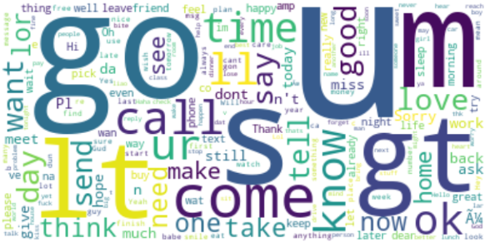
DATA EXPLORATION USING WORD CLOUD
HAM MESSAGE
SPAM MESSAGE
OBSERVATIONS:
The words like go, call, know, come, u, m, lt, ok, tell, time, want, need, make, send, love, good, take, one, think, say, today, ok, now are frequent words appeared in ham messages
OBSERVATIONS:
The words like free, call, txt, stop, reply, contact, award, please, claim, prize, service, customer, now, mobile, win, chance, voucher are frequent words appeared in spam messages

Slide 4

TERM FREQUENCY
Cleaned Data Frame
(5574 x 2)
Count Vectorization using TF
(BOW Model)
Data Frame with Words as Features
(5574 x 8014)
VECTORIZATION PIPELINE
By computing the term-frequency of each word in a given document, we can get a good understanding of what the document is about and its relevance to other documents

Slide 5
INVERSE DOCUMENT TERM FREQUENCY
Cleaned Data Frame
(5574 x 2)
Count Vectorization using TF_IDF
(BOW Model)
Data Frame with Words as Features
(5574 x 8014)
VECTORIZATION PIPELINE
The idea behind IDF is that if a word appears in many documents, it's less likely to be a good indicator of the content of any one document.
On the other hand, if a word appears in only a few documents, it's more likely to be a good indicator of the content of those documents.
By combining term-frequency with inverse document frequency, we can get a better understanding of what words are important for each document, and we can use this information to classify the documents.

Slide 6
DOC2VEC
Cleaned Data Frame
(5574 x 2)
Vectorization using Doc2Vec
(Google Word Embedding)
Data Frame with Vector of Size (300) as Features
(5574 x 300)
VECTORIZATION PIPELINE
This technique is based on the idea that words that are similar in meaning should have similar vectors, so words that are close together in the vector space are more likely to be related in meaning.
By using word2vec vectorization, we can convert our SMS messages into vectors that can be used as inputs to our classification models.

Slide 7
HEURISTIC
Cleaned Data Frame
(5574 x 2)
Engineered New Heuristic Features
Data Frame with Vector of Size (300) as Features
(5574 x 7)
HEURISTIC FEATURES CREATED:
1) Presence of Phone Number(Binary Feature)
2) Presence of $ sign (Binary Feature)
3) Presence of Capital letter Word (Binary Feature)
4) Proportion of Spelling Mistakes (Continuous numeric)
5) Proportion of Punctuations (Continuous numeric)
6) Subjectivity Score ()
7) Sentiment Score ()

Slide 8
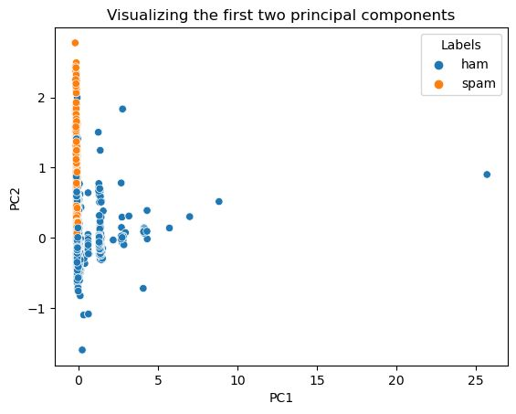
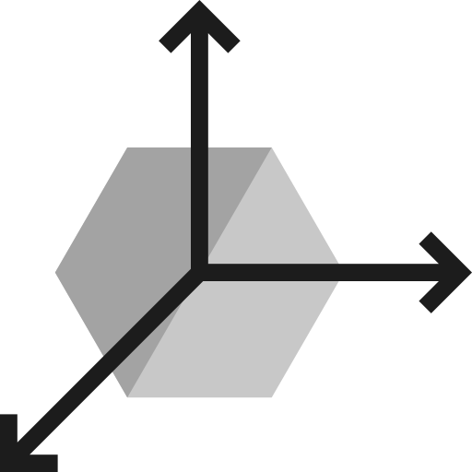
DIMENSION REDUCTION TF VECTORS Using PCA SELECTED 1796 PC’s WHICH EXPLAINED 95% OF VARIANCE
VISUALIZATION
First Two Principal Components
Used PCA (Principal Component Analysis) on TF Vectors.
First Two Principal Components for Plotting the 2D Graph

Slide 9
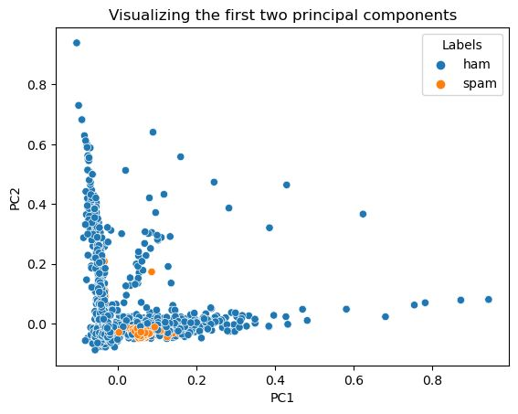
DIMENSION REDUCTION TF-IDF VECTORS Using PCA SELECTED 2591 PC’s WHICH EXPLAINED 95% OF VARIANCE
VISUALIZATION
First Two Principal Components
Used PCA (Principal Component Analysis) on TF-IDF Vectors.
First Two Principal Components for Plotting the 2D Graph

Slide 10
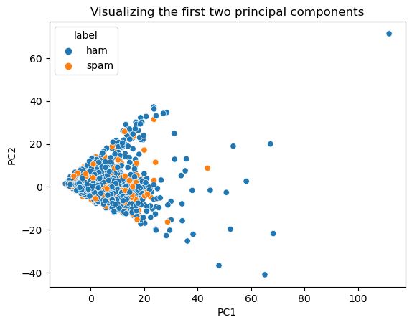
DIMENSION REDUCTION DOC2VEC Using PCA SELECTED 180 PC’s WHICH EXPLAINED 95% OF VARIANCE
VISUALIZATION
First Two Principal Components
Used PCA (Principal Component Analysis) on Doc2Vec.
First Two Principal Components for Plotting the 2D Graph

Slide 11
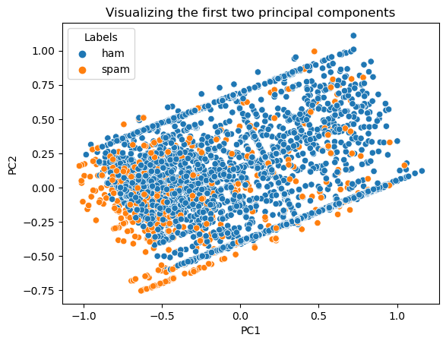
DIMENSION REDUCTION HEURISTIC Using PCA Using PCA SELECTED 3 PC’s WHICH EXPLAINED 95% OF VARIANCE
VISUALIZATION
First Two Principal Components
Used PCA (Principal Component Analysis) on Heuristic.
First Two Principal Components for Plotting the 2D Graph

Slide 12

AIM: To Classify Text Messages as Ham or Spam
MODEL 1:
LOGISTIC REGRESSION ON TF VECTOR MATRIX
ERROR METRICS | RESULTS
ACCURACY | 0.98
F1-SCORE | 0.92
RECALL | 0.86
PRECISION | 0.98
EXPERIMENT:
Fitted Logistic Regression Model on Term Frequency Vector Matrix.

Slide 13
AIM: To Classify Text Messages as Ham or Spam
MODEL 2:
LOGISTIC REGRESSION ON TF VECTOR MATRIX WITH DIMENSION REDUCTION USING PCA
ERROR METRICS | RESULTS
ACCURACY | 0.97
F1-SCORE | 0.91
RECALL | 0.85
PRECISION | 0.90
EXPERIMENT:
Fitted Logistic Regression Model on Term Frequency Vector Matrix After Dimensionality Reduction Using PCA.

Slide 14
AIM: To Classify Text Messages as Ham or Spam
MODEL 3:
LOGISTIC REGRESSION ON TF VECTOR MATRIX WITH DIMENSION REDUCTION USING ‘p’ %
ERROR METRICS | RESULTS
ACCURACY | 0.97
F1-SCORE | 0.90
RECALL | 0.84
PRECISION | 0.98
EXPERIMENT:
Fitted Logistic Regression Model on Term Frequency Vector Matrix After Dimensionality Reduction Using ‘p’ percentage.
1 % is Fixed as Threshold , Words appeared less than 1% in the Corpus is Removed.
SELECTED FEATURES - 200

Slide 15
AIM: To Classify Text Messages as Ham or Spam
MODEL 4:
RANDOM FOREST ON TF-IDF VECTOR MATRIX
ERROR METRICS | RESULTS
ACCURACY | 0.97
F1-SCORE | 0.90
RECALL | 0.82
PRECISION | 1.00
EXPERIMENT:
Fitted Random Forest Model on Inverse Document Term Frequency Vector Matrix.

Slide 16
AIM: To Classify Text Messages as Ham or Spam
MODEL 5:
ADABOOST ON TF-IDF VECTOR MATRIX WITH DIMENSIONALITY REDUCTION USING PCA
ERROR METRICS | RESULTS
ACCURACY | 0.97
F1-SCORE | 0.89
RECALL | 0.88
PRECISION | 0.90
EXPERIMENT:
Fitted Ada-boost Model on Inverse Document Term Frequency Vector Matrix After Dimensionality Reduction Using PCA.

Slide 17
AIM: To Classify Text Messages as Ham or Spam
MODEL 6:
RANDOM FOREST ON TF-IDF VECTOR MATRIX WITH DIMENSIONALITY REDUCTION USING ‘p’ %
ERROR METRICS | RESULTS
ACCURACY | 0.93
F1-SCORE | 0.72
RECALL | 0.65
PRECISION | 0.81
EXPERIMENT:
Fitted Random Forest Model on Inverse Document Term Frequency Vector Matrix After Dimensionality Reduction Using ‘p’ percentage.
1 % is Fixed as Threshold , Words appeared less than 1% in the Corpus is Removed.
SELECTED FEATURES – 15

Slide 18
AIM: To Classify Text Messages as Ham or Spam
MODEL 7:
DECISION TREE ON DOC2VEC METHOD
ERROR METRICS | RESULTS
ACCURACY | 0.76
F1-SCORE | 0.18
RECALL | 0.18
PRECISION | 0.17
EXPERIMENT:
Fitted Decision Tree Model with Depth= 5 on Doc2Vec Method.

Slide 19
AIM: To Classify Text Messages as Ham or Spam
MODEL 8:
LOGISTIC REGRESSION ON DOC2VEC WITH DIMENSIONALITY REDUCTION USING PCA
ERROR METRICS | RESULTS
ACCURACY | 0.99
F1-SCORE | 0.97
RECALL | 0.96
PRECISION | 0.99
EXPERIMENT:
Fitted Logistic Regression on Doc2Vec After Dimensionality Reduction Using PCA.

Slide 20
AIM: To Classify Text Messages as Ham or Spam
MODEL 9:
RANDOM FOREST ON HEURISTIC FEATURES
ERROR METRICS | RESULTS
ACCURACY | 0.94
F1-SCORE | 0.78
RECALL | 0.67
PRECISION | 0.93
EXPERIMENT:
Fitted Random Forest on Heuristic Features.

Slide 21
AIM: To Classify Text Messages as Ham or Spam
MODEL 10:
BAGGED DECISION TREE ON HEURISTIC FEATURES
ERROR METRICS | RESULTS
ACCURACY | 0.93
F1-SCORE | 0.75
RECALL | 0.65
PRECISION | 0.89
EXPERIMENT:
Fitted Bagged Decision Tree on Heuristic Features.

Slide 22
CONCLUSION:
We observed the performance of the different machine learning models with 4 different vectorization techniques along with dimensionality reduction techniques like PCA and ‘p’ percent.
The performance of machine learning models with Term Frequency Vectorization Method performs well when compared to other 3 Vectorization methods.
The Doc2Vec Vectorization Method gives worst performance with all machine learning models.
Machine learning model like Logistic Regression and Random Forest Performs well in all Vectorization approach.
The Heuristic approach performs better than Doc2vec approach and it performs well with only 7 features.
We observe that there is a great opportunity to develop more heuristic features which classifies the target accurately and are relatively easier to interpret than other vectorization methods

Slide 23

THANK YOU

