Slide 1



Accessibility Assistant for Public Services
Public Places and buildings

Slide 2




Identification of Problem and Stakeholders
Make the public service and government web site accessible to different subgroups:
Newcomers
Disabilities (motor, cognitive, vision)
Language barriers

Slide 3
Ethical Considerations
Low privacy risk (no contain PII)
Bias and fairness (distinguish between not accessible and not available)
Accountability : Make sure recommendation are based on uptodate data

Slide 4
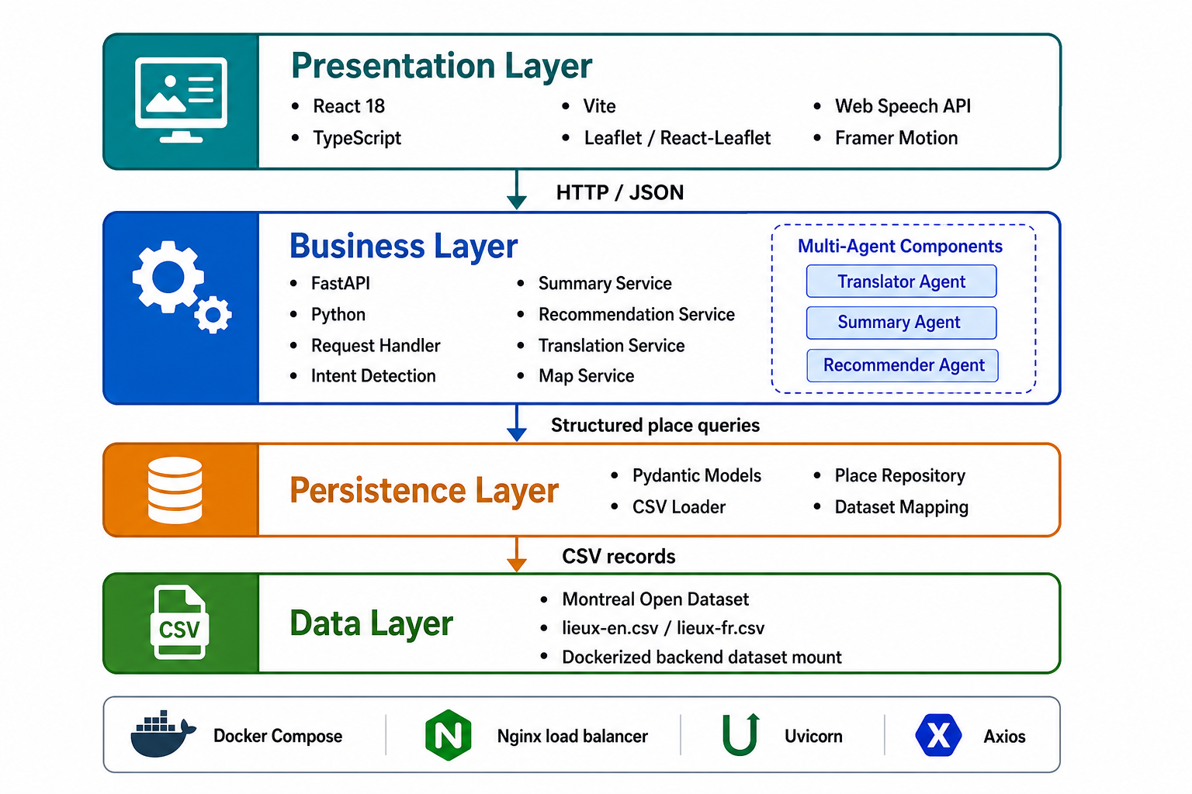
Technical Aspect

Slide 5
Scalability
Support concurrent users without slowing down the application.
Scale backend services horizontally.
Keep the React frontend and FastAPI backend independently deployable.
Protect the system from failures in translation, summarization, recommendation, speech, or dataset services.
Use health checks and load balancing to reduce downtime.

