Slide 1

DEPARTMENT OF COMPUTER SCIENCE AND ENGINEERING
Project name : Smart Water Fountain
Team name : Proj_224781_Team_6
Team members :
KIRUTHIKA K(113321104046)
KUNCHALA SRIHEMA(113321104049)
LAVANYA V(113321104050)
MAHI MITHRA R(113321104054)

Slide 2
PROBLEM DEFINITION
A smart water fountain project aims to enhance the maintenance of the fountain by installing IoT sensors to monitor the water quality and detect malfunctions.
This project includes defining objectives, designing the IoT sensor system, developing the water fountain, and integrating them using IoT.

Slide 3
OBJECTIVES
Water Quality
Reduced Environmental Impact
Enhanced Accessibility
User Convenience and Experience
Maintenance Efficiency
Energy-Efficient Lighting and Ventilation
Maintenance Alert
Safety and Security
Data Collection and Analytics

Slide 4
PROJECT Requirements
1.Real-Time Water Fountain Monitoring: Implement IoT sensors to monitor the status of public water fountains in real-time, including water flow rates and water quality.
2.Efficient Water Usage: Optimize water by detecting anomalies, leaks, or inefficient water flow patterns.
3.Malfunction Detection: Develop mechanisms to detect malfunctions or maintenance requirements promptly.
4.Resident Awareness: Create a public platform (e.g., mobile app) to provide residents with real-time information about water fountain status and quality

Slide 5
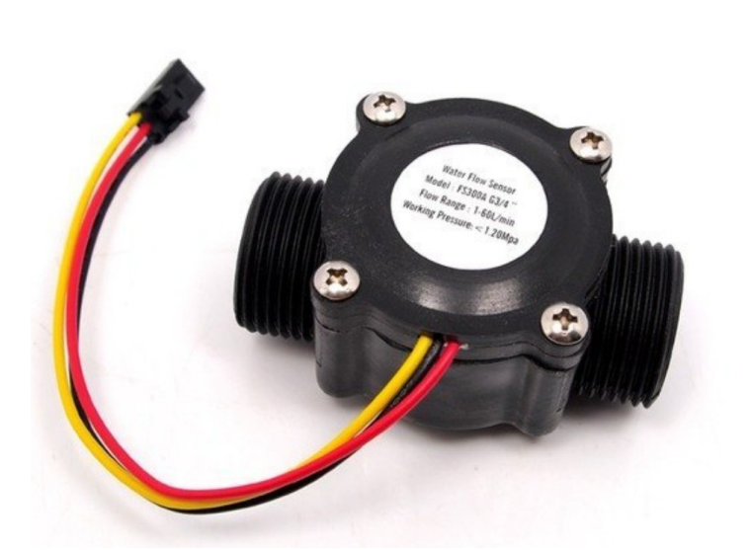
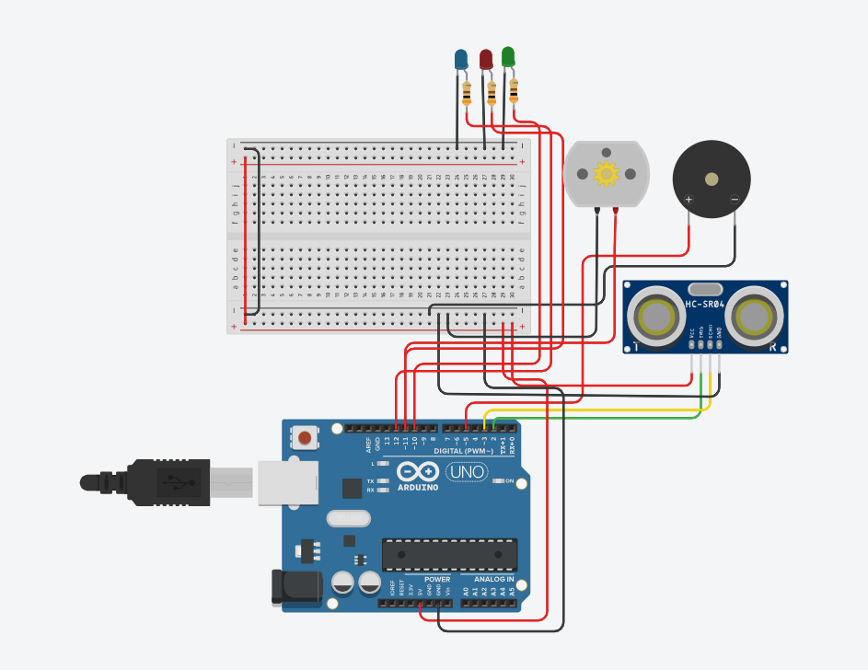
DEVICE SELECTION
Sensor Selection:
Flow rate sensors: Model XYZ123
Pressure sensors: Model ABC456
Water quality sensors: pH Sensor - Model DEF789,Turbidity Sensor - Model UVW987
Water Level sensor
Distance sensor

Slide 6
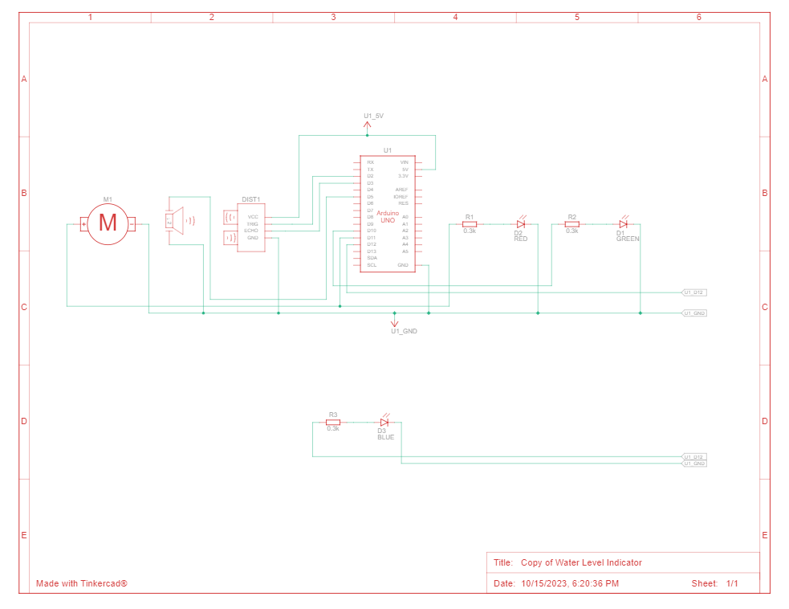
ARDUINO INTEGRATION

Slide 7
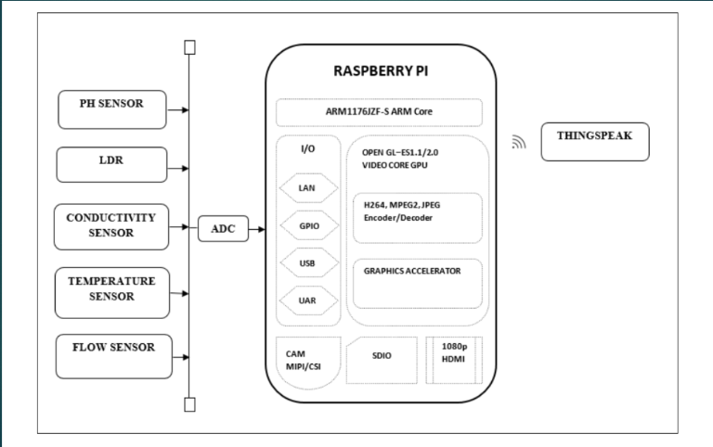
RASPBERRY PI INTEGRATION

Slide 8
CODE IMPLEMENTATION
HARDWARE REQUIREMENTS
SOFTWARE REQUIREMENTS
Raspberry Pi (or similar single-board computer)
Water Flow Sensor
Solenoid Valve (for controlling waterflow)
Wi-Fi Module (for internet connectivity)
Power Supply
Python (for programming)
MQTT (for communication)
Cloud server (for data storage and remote control)

Slide 9
Python Script Development
On IoT Devices:-
On Central Server:-
1. Set Up the Development Environment
2. Import Required Libraries
3. Initialize Device and Sensors
4. Data Collection
5. Data Processing
6. Data Transmission
7. Error Handling
8. Control Logic (If applicable)
9. Logging and Debugging
10. Power Management (If applicable)
11. Testing
12. Documentation
13. Integration with the Central Server
14. Deployment
1. Setting Up the Central Server Environment
2. Importing Required Libraries
3. Data Reception and Storage
4. Data Processing and Analysis
5. Data Visualization
6. User Authentication and Access
Control
7. Error Handling and Logging
8. Remote Device Control Logic
9. Security Measures
10. Automation and Script Execution
11. Testing and Debugging
12. Documentation
13. Integration with IoT Devices
14. Deployment and Scaling

Slide 10
CONCLUSION
This documentation provides a comprehensive overview of the Smart Water Fountains project , covering objectives , requirements , device selection , Arduino Integration , Raspberry PI Integration , Python Script Development and code implementation. It also explains how the system promotes water efficiency and public awareness.

Slide 11
THANK YOU

