Slide 1

Tetouan City Power Consumption
Mahi Patel , Rahee Chauhan, Usman Tahir, Mustafah Khan

Slide 2

Introduction and Motivation
Study power consumption in Tetouan City
Use weather data to predict electricity usage
Helps improve energy planning and efficiency
Important for smart cities and reducing waste

Slide 3
Research Question
Main Question :
Which weather variables are the best predictors of Zone 1 power consumption in Tetouan City?
Predictor Variables Studied :
Temperature
Humidity
Windspeed
General Diffuse Flows
Response Variable :
Zone 1 Power Consumption

Slide 4
Project Overview
Dataset Overview
Approx. 52,410 observations
Data collected every 10 minutes
Dataset includes weather measurements and electricity consumption in Tetouan City
Final cleaned dataset contained 13 variables after preprocessing
Modeling Setup
Response Variable: Zone 1 Power Consumption
Train/Test Split: 80% training, 20% testing
Random seed used: set.seed(2026)
Goal: Predict Zone 1 power consumption using weather variables
Models Used
Multiple Linear Regression
LASSO Regression
Decision Tree Regression
Evaluation Metric
Models compared using RMSE (Root Mean Squared Error) on the test dataset

Slide 5
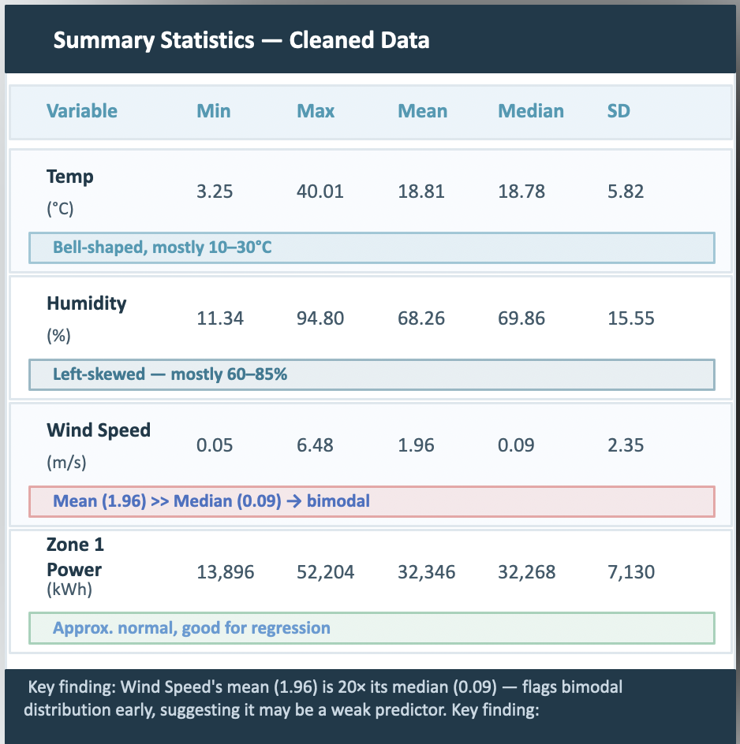
Data Cleaning
Loaded raw CSV file
Standardized names using make.names() so R could use column easily
Converted Data Time from text into data-time format
Checked missing values : only 6 rows had missing DateTime
Removes those rows because dataset is large
Checked for duplicates : none found
Added new columns : Hour, Day, Month, Year

Slide 6
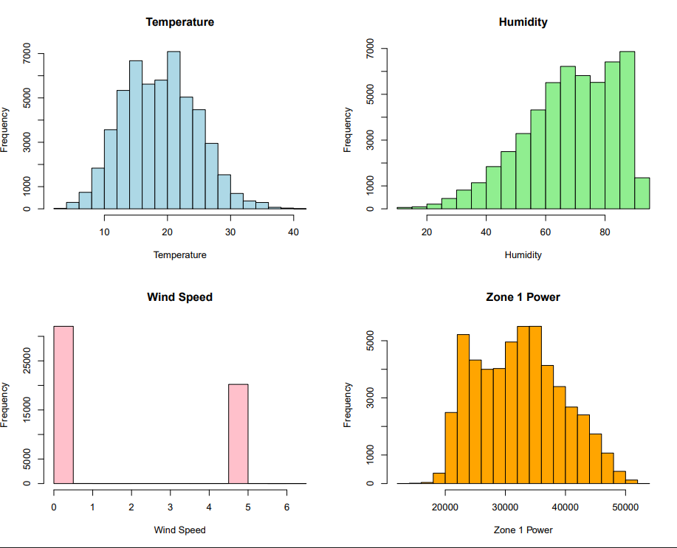
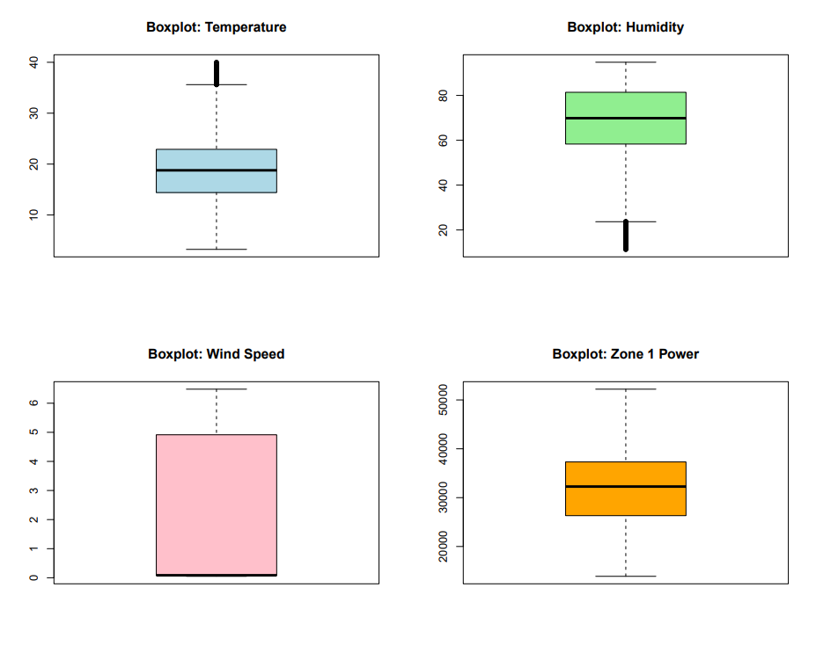
EDA – Variable Distributions
Key Findings
Temperature : Roughly bell shaped, ~19 C median. A few high temp outliers( > 36C)
Humidity : Left skewed, mostly 60-85%. Some extreme low outliers(~20%)
Wind Speed : Bimodal – clusters at 0 & ~5. Very little in between(unusual pattern)
Zone 1 Power : Approx. normal, centered ~32,000. No major outliers

Slide 7
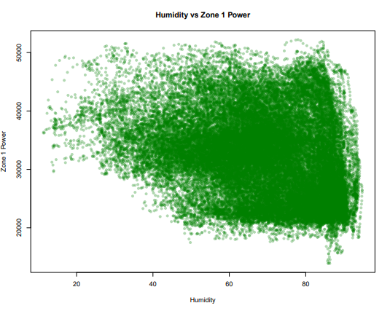
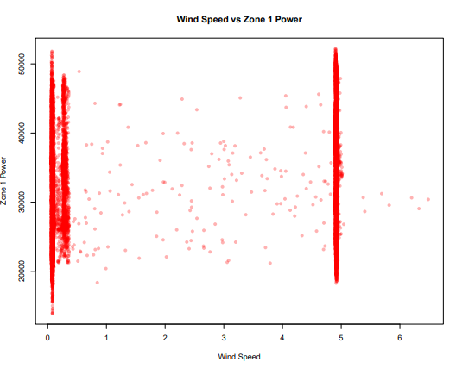
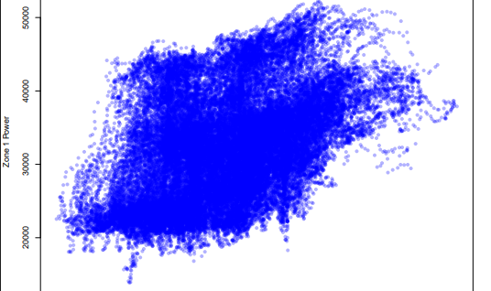
Predictor Relationships with Zone 1 Power
Temperature
Humidity
Wind speed
Strong Positive relationship.
Correlation is about +0.44
As temperature rises, power consumption generally rises.
Moderate negative relationship
Correlation is about -0.29
Higher humidity often appears with lower Zone 1 power.
Weak relationship overall
Points form vertical bands around 0 and 5
This suggests wind speed is recorded in discrete clusters.
Does not show clear linear pattern

Slide 8
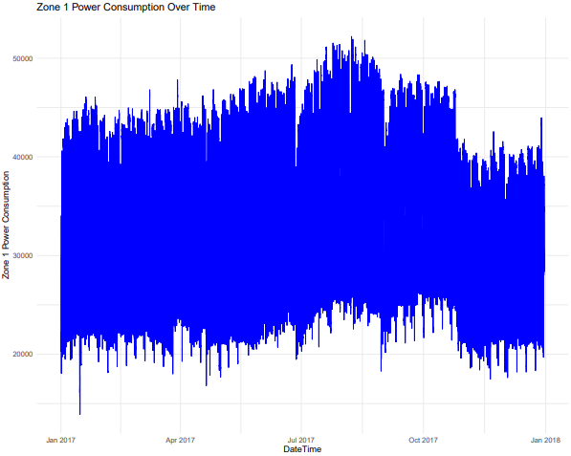
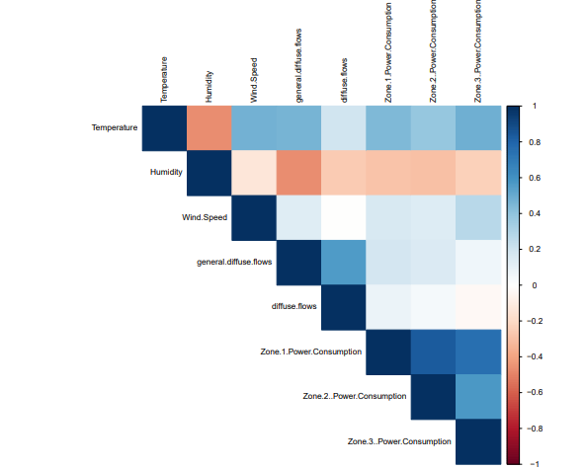
Correlation & Key Findings
Seasonal Pattern
Power peaks in Jul–Aug 2017 (summer AC use), dips in spring/fall.
Confirms temperature is a key driver of consumption.
Correlation Heatmap Takeaways
Temperature → Zone 1: strongest positive correlation
Humidity → Zone 1: moderate negative correlation
Wind Speed → Zone 1: near zero / very weak
Temperature & Humidity: negatively correlated with each other
Key Takeaway : Temperature is the strongest predictor, followed by Humidity. Wind Speed shows minimal predictive relationship with Zone 1 power.

Slide 9
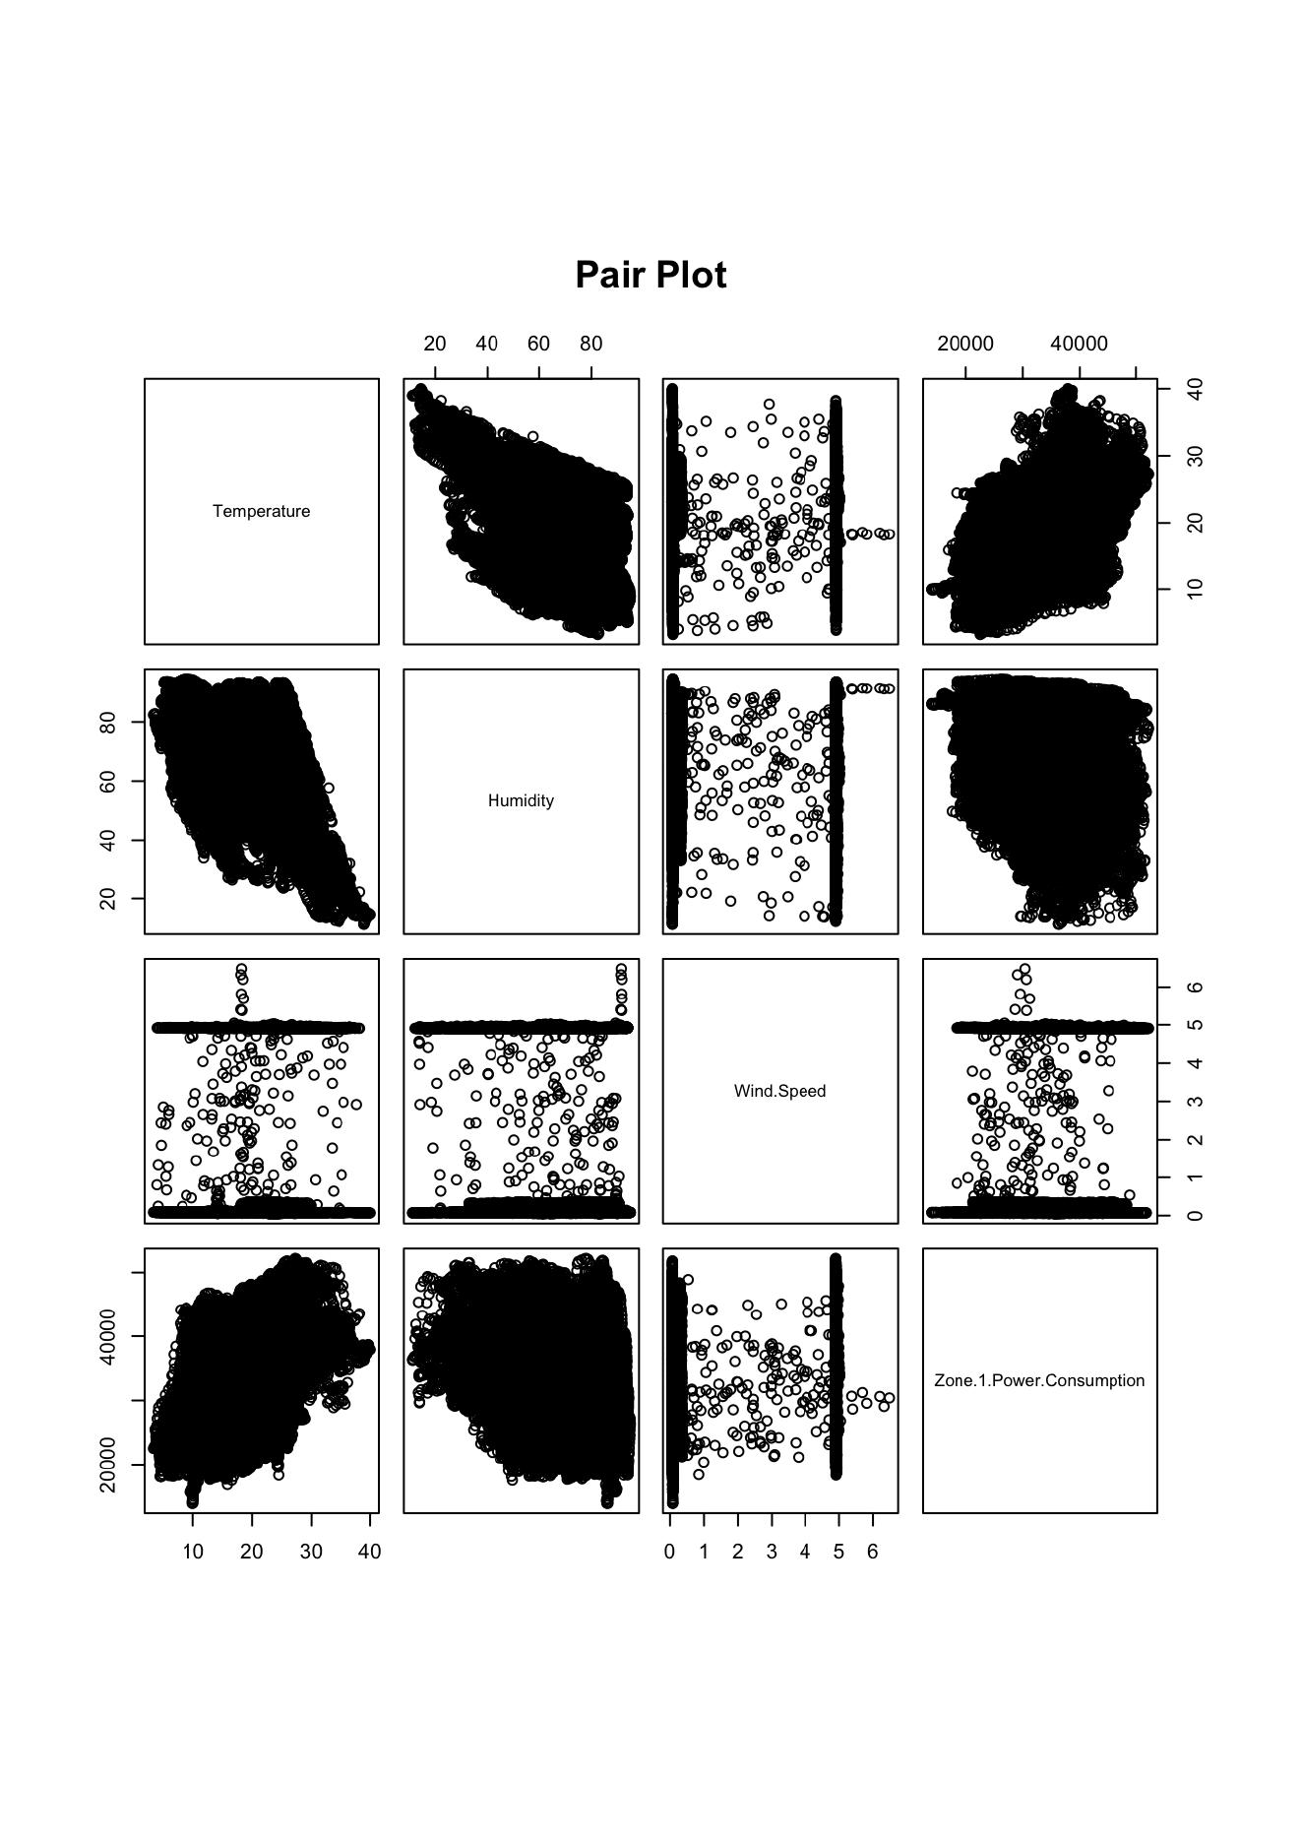
Pair plot : all Main relationship
Each small panel compares two variables
Temperature vs Zone 1 power shows an upward trend
Humidity vs Zone 1 power shows downward trend
Wind speed shows two distinct vertical bands
Temperature and Humidity are negatively related.

Slide 10
Model Building
LASSO Regression
Decision Tree Regression
Multiple Linear Regression
Interpretable baseline model using linear relationships and coefficients.
Predictors : Temperature, Humidity, Wind, Speed, general diffuse flows, diffuse flows
Regularized regression that can shrink weak coefficients and help with variable selection
Tuning : lambda selected using cross - validation
Nonlinear if-then model that splits data into groups and predicts average power in each leaf
Tuning : complexity parameter cp and pruning.
Evaluation step : 80% training data, 20% test data. All models used the same split and were compared using RMSE.

Slide 11
Multiple Linear Regression
Model Performance
R² = 0.206
Test RMSE = 6305.16
All predictors except Diffuse flows were statistically significant (p < 0.001)
Model explains about 20.6% of variation in Zone 1 power.
Thus, temperature had largest positive effect, so it is strongest predictor in linear model
Predictor | Coefficient | Interpretation
Temperature | 535.70 | Strongest +ve effect
Humidity | -55.70 | Moderate –ve effect
Wind speed | -153.57 | Small –ve effect
General Diffuse Flows | -1.67 | Very small –ve effect
Diffuse flows | -0.17 | Not significant
Model Equation (Linear Regression)
Zone 1 Power=β0​+β1​(Temperature)+β2​(Humidity)+β3​(Wind Speed)+β4​(General Diffuse Flows)+β5​(Diffuse Flows)+ε
Notes:
Interpretation temperature had largest positive effect, so it is the strongest predictor in the linear model. The model explain about 20.6% of variation in Zone 1 power. The test RMSE was about 6305 power units.

Slide 12
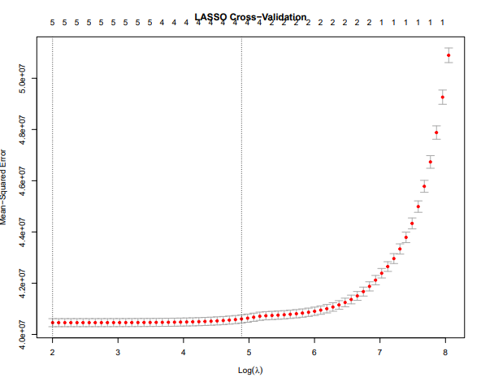
LASSO Regression Result
Key Findings
Best Lambda selected : 7.4028
Kept all five predictors, meaning none were shrunk completely to zero
Temperature remained the strongest predictor
Test RMSE = 6305.17
It performed nearly the same as Multiple Linear Regression while helping reduce overfitting

Slide 13
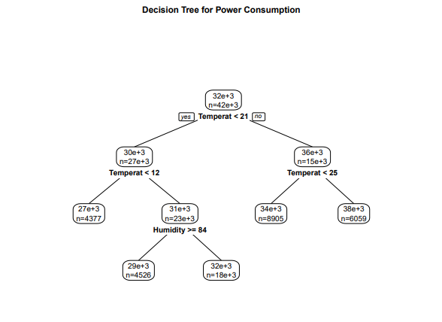
Decision Tree Results
Key Findings
Tree mainly used Temperature and Humidity for splits
Other variables(Wind speed, diffuse flows) were not important
Captures nonlinear relationships in the data
Produces simple if-then decision rules for prediction
Model Performance
Total RMSE : 6325.27

Slide 14
Conclusion & Recommendation
Answer to Research Question
Temperature is the strongest predictor of Zone 1 power consumption. Humidity is a moderate predictor and wind speed is the weakest main weather predictor
Best Model
Best Predictor
Model Limitation
Multiple Linear Regression had the lowest RMSE and its interpretable
Temperature had the clearest EDA pattern and strongest model effect
R² around 0.206 means weather explains part of power use, but not all of it
Possible Improvements
Add Hour, Month and Day of week into the models; test interactions like Temperature X Humidity; try Random Forest or boosting; compare Zone 1, Zone 2 and Zone 3 separately.

Slide 15
Future Works
Add more features
Include time-based variables like Hour, Day of Week, and Season
These can capture daily and weekly usage patterns
Try advanced models
Use Random Forest and Gradient Boosting
These can capture nonlinear patterns better than linear models
Improve accuracy
Incorporate non-weather factors
Holidays
Human activity patterns
Energy demand trends

Slide 16
Thank you for listening to us !
Any Questions?

