Slide 1
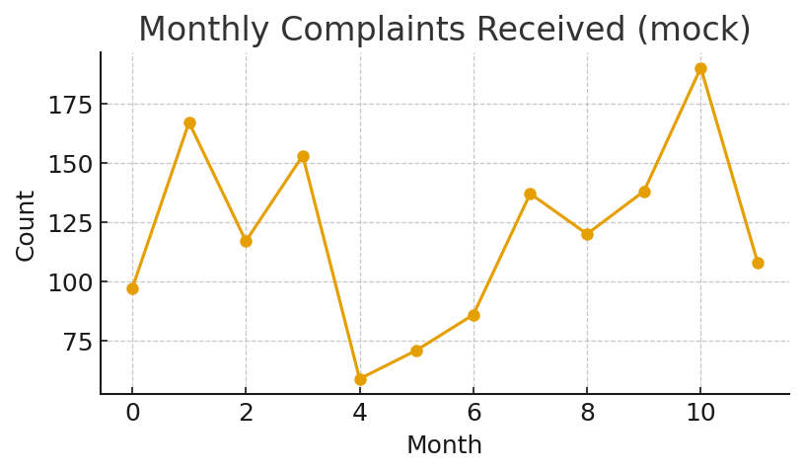
Dashboard Template
Key KPIs:
- Avg Resolution Time: 48 hrs
- Auto-classification Accuracy: 91%
Prepared by Mahesh | Government AI/ML Case Study

