Slide 1
Government AI/ML Case Study – by Mahesh
AI-Powered Citizen Grievance Redressal System (GovGrievanceAI)
Prepared by Mahesh
Prepared by Mahesh | Government AI/ML Case Study

Slide 2
Problem Statement
Citizens submit grievances across channels; manual routing causes delays and poor accountability.
Prepared by Mahesh | Government AI/ML Case Study

Slide 3
Solution Overview
Automated NLP classification, sentiment detection, SLA prediction, and dashboarding for transparency.
Prepared by Mahesh | Government AI/ML Case Study

Slide 4
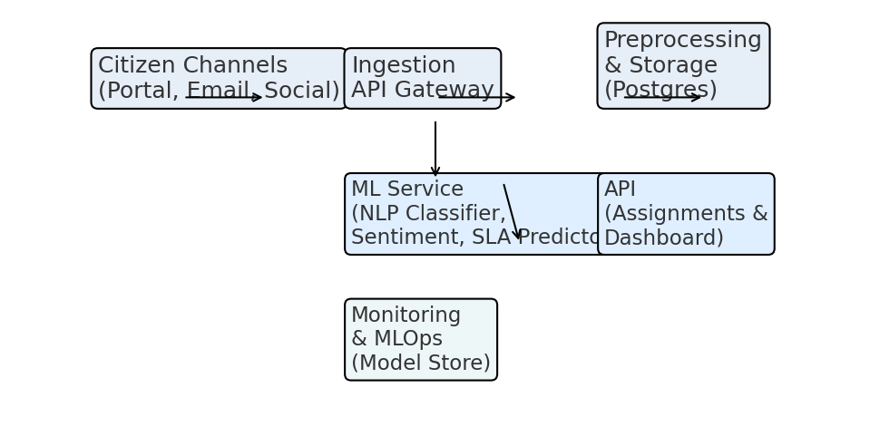
Technical Architecture
Prepared by Mahesh | Government AI/ML Case Study

Slide 5
Expected Impact
- Faster routing, improved SLA compliance
- Data-driven prioritization
- Transparency for citizens and ministers
Prepared by Mahesh | Government AI/ML Case Study

