Slide 1
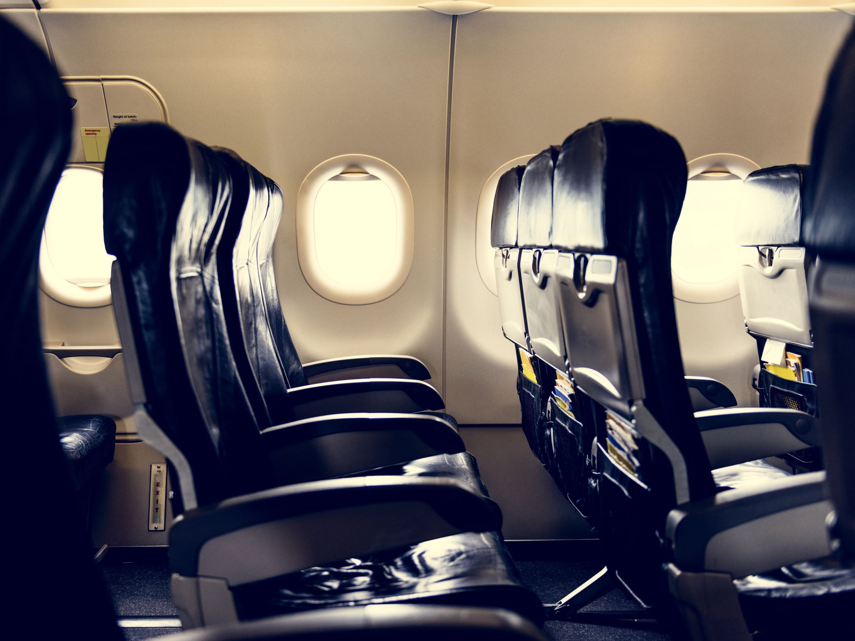
Predicting Customer Buying Behaviour
British Airways Internship Task 2
Mahibur Rahman

Slide 2
Project Objective
The objective of this project was to build a machine learning model that predicts whether a customer will complete a booking using customer browsing and booking behavior data.

Slide 3

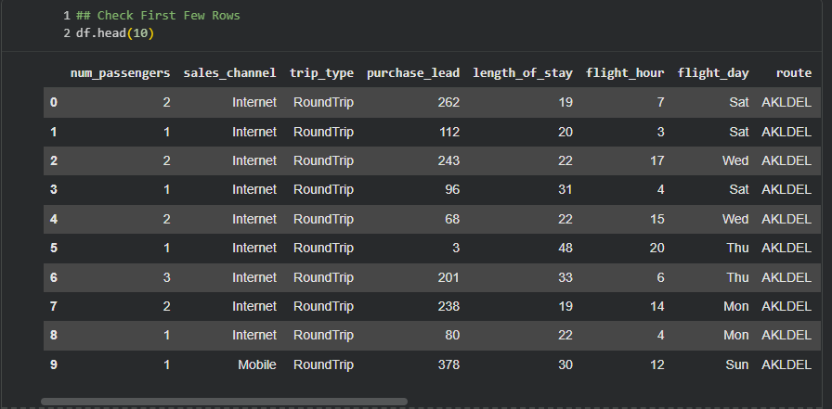
Dataset Overview
• Customer booking and browsing behavior data was used.
• Variables included passengers, sales channel, trip type, purchase lead, flight duration, and booking origin.
• Data preprocessing and feature encoding were completed before training the model.

Slide 4
Machine Learning Model
A Random Forest Classifier was used because it provides strong predictive performance and allows feature importance analysis.

Slide 5
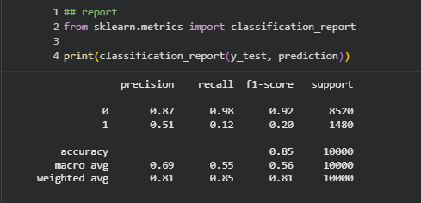
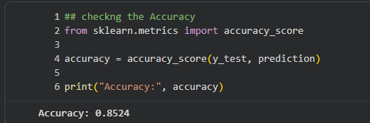
Model Performance
The model achieved an accuracy score of 85.24%, showing good predictive performance in identifying customer booking behavior.
Precision and recall metrics were also evaluated using a classification report.

Slide 6
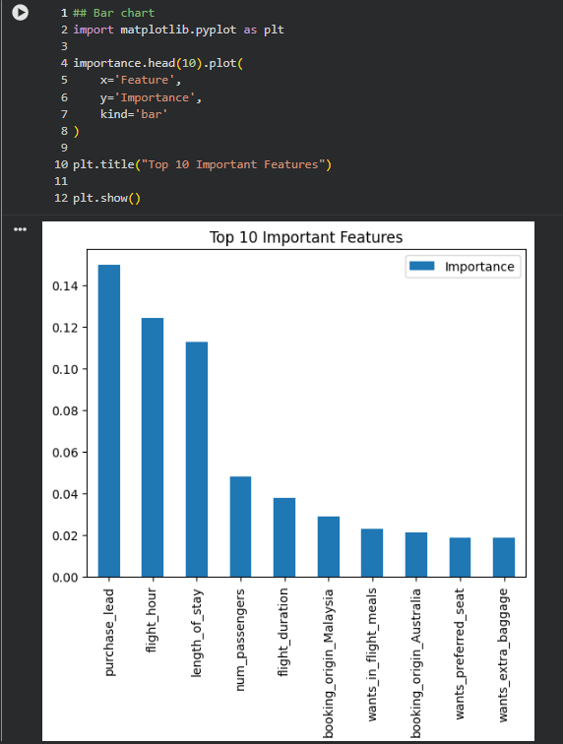
Top Important Features
The most influential variables in predicting customer bookings were purchase_lead, flight_hour, length_of_stay, number of passengers, and flight duration.

Slide 7

Business Insights
The analysis suggests that customer travel timing, trip duration, and booking behavior strongly influence booking decisions.
British Airways can use predictive analytics to improve targeted marketing and increase booking conversion rates.

Slide 8

Conclusion
This project demonstrated how machine learning can be used to predict customer buying behavior using historical booking data. The Random Forest model successfully identified important booking patterns and achieved strong predictive accuracy.

