Slide 1
React

Slide 2
Module 1:
Introduction

Slide 3
History
React was first created by Jordan Walke, a software engineer working for Facebook.
React allows developers to create large web applications that can change data, without reloading the page.
The main purpose of React is to be fast, scalable, and simple. It works only on user interfaces in the application.
React is a popular open-source JavaScript library that performs data viewing with the help of HTML.

Slide 4
History
It is also known as ReactJS and React.js, so don’t get confused if you read different notation in different places.
As it is developed by in Facebook, it is also popularly known as “Facebook React.js.”
Currently, it is maintained by the likes of Instagram, Facebook and community developers that are interested in the library.

Slide 5
History
React is a new technology when compared with other technologies in the market.
It came into existence in 2011, when Jordan Walke, a software engineer at Facebook created the library.
React is influenced by the likes of XHP which is a simple HTML component framework for PHP.
The first use case of React was in Facebook’s newsfeed in 2011. Later on, it is picked up by Instagram to use it in their system.

Slide 6
History
With time, React grew, and Facebook decided to make it open source in May 2013 at JSConf US.
In 2015 JSConf, React Native was announced which enabled easy development with Android and iOS deveopment.
In the same year, React Native was open-sourced to help it grow.

Slide 7
What is React JS ?
ReactJS is an open-source front-end JavaScript library for building user interfaces.
ReactJS is maintained by Facebook and a community of individual developers and companies.
It is widely used as a base in building single-page websites and mobile applications.
It is very easy to use, and it allows users to create reusable UI components.

Slide 8
Features Of React JS
JSX
Components
One-way Data Binding
Virtual DOM
Performance
Simplicity

Slide 9
JSX
JSX stands for JavaScript XML. It is a JavaScript syntax extension.
Its an XML or HTML like syntax used by ReactJS. This syntax is processed into JavaScript calls of React Framework.
It extends the ES6 so that HTML like text can co-exist with JavaScript react code.
It is not necessary to use JSX, but it is recommended to use in ReactJS.

Slide 10
Components
ReactJS is all about components.
ReactJS application is made up of multiple components, and each component has its own logic and controls.
These components can be reusable which help you to maintain the code when working on larger scale projects.

Slide 11
One-way Data Binding
ReactJS is designed in such a manner that follows unidirectional data flow or one-way data binding.
The benefits of one-way data binding give you better control throughout the application.
If the data flow is in another direction, then it requires additional features.

Slide 12
One-way Data Binding
It is because components are supposed to be immutable and the data within them cannot be changed.
Flux is a pattern that helps to keep your data unidirectional.
This makes the application more flexible that leads to increase efficiency.

Slide 13
Virtual DOM
A virtual DOM object is a representation of the original DOM object. It works like a one-way data binding.
Whenever any modifications happen in the web application, the entire UI is re-rendered in virtual DOM representation.
Then it checks the difference between the previous DOM representation and new DOM.
Once it has done, the real DOM will update only the things that have actually changed. This makes the application faster, and there is no wastage of memory.

Slide 14
Simplicity
ReactJS uses JSX file which makes the application simple and to code as well as understand.
We know that ReactJS is a component-based approach which makes the code reusable as your need.
This makes it simple to use and learn.

Slide 15
Performance
ReactJS is known to be a great performer.
This feature makes it much better than other frameworks out there today.
The reason behind this is that it manages a virtual DOM.
The DOM is a cross-platform and programming API which deals with HTML, XML or XHTML.

Slide 16
Performance
The DOM exists entirely in memory.
Due to this, when we create a component, we did not write directly to the DOM.
Instead, we are writing virtual components that will turn into the DOM leading to smoother and faster performance.

Slide 17
Advantages Of React
ReactJS uses virtual dom that makes use of in-memory data-structure cache, and only the final changes are updated in browsers dom. This makes the app faster.
You can create components of your choice by using the react component feature. The components can be reused and also helpful in code maintenance.
Reactjs is an open-source javascript library, so it is easy to start with.
ReactJS has become very popular in a short span and maintained by Facebook and Instagram. It is used by many famous companies like Apple, Netflix, etc.
Facebook maintains ReactJS, the library, so it is well maintained and kept updated.

Slide 18
ES6
ES6 stands for ECMAScript 6.
ECMAScript was created to standardize JavaScript, and ES6 is the 6th version of ECMAScript, it was published in 2015, and is also known as ECMAScript 2015.
ES6 is a new version of JavaScript that adds some nice syntactical and functional additions.

Slide 19
ES6
ES6 stands for ECMAScript 6.
ECMAScript was created to standardize JavaScript, and ES6 is the 6th version of ECMAScript, it was published in 2015, and is also known as ECMAScript 2015.
ES6 is a new version of JavaScript that adds some nice syntactical and functional additions.

Slide 20
Features in ES6
const and let
Arrow Functions
Classes
Import and Export

Slide 21
const and let
Before ES6, we used the keyword “var” to declare variables.
In ES6 afterward, Javascript has gained two new keywords to declare variables. let and const.
So what is the difference between “var” and “let and const”?
Variables declared using let and var exists only in the scope which defined that variable.
If you want to override the value assigned to a variable you should use “let” and if the reference of the variable will not be changed you can use “const”.

Slide 22
const and let
const is a signal that the variable won't be reassigned.
let is a signal that the variable may be reassigned.
Additional things to ponder: Use const by default.
Use let only if rebinding is needed
Consider this variable declaration:
const element = <h1>Hello, world!</h1>;

Slide 23
let
Syntax:
let name1 [= value1] [, name2 [= value2]] [, ..., nameN [= valueN];

Slide 24
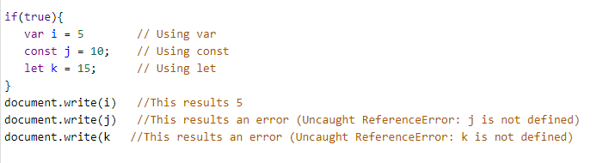

Slide 25
Arrow Functions
Before ES6 syntax, functions were written in javaScript using “function” keyword
function myFun(param1,param2)
{
return ( param1 + param2);
}

Slide 26
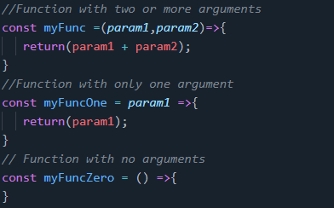
Arrow Functions
But in ES6, this code can be written like this

Slide 27
Classes
Class is a new concept that is introduced in ES6.
You can add a constructor in class to initialize some attributes within the class (Same as in Java).
Whenever you instantiate a new object from the class, the constructor gets called.

Slide 28
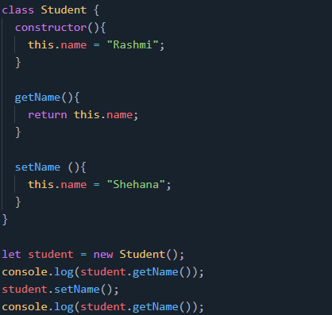
Classes

Slide 29
Import and Export
In JavaScript ES6, you can import and export functionalities from modules.
These can be functions, classes, components, constants, essentially anything you can assign to a variable.
You can export members one by one, by adding “export” keyword before each member or you can export all the members at the same time as a group.
You can define a default export with the “default” keyword as well.

Slide 30
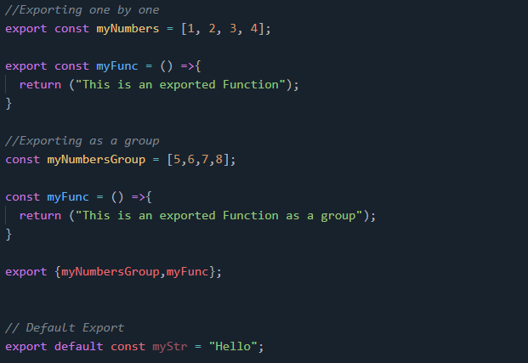

Slide 31
Import and Export
You can import those members as follows:
import {myNumbers,myFunc} , myStr from 'app.js';

Slide 32
Render
render() :
ReactDOM.render(element, container[, callback])
Render a React element into the DOM in the supplied container and return a reference to the component (or returns null for stateless components).
If the React element was previously rendered into container, this will perform an update on it and only mutate the DOM as necessary to reflect the latest React element.
If the optional callback is provided, it will be executed after the component is rendered or updated.

Slide 33
Render
ReactDOM.render() controls the contents of the container node you pass in.
Any existing DOM elements inside are replaced when first called. Later calls use React’s DOM diffing algorithm for efficient updates.
ReactDOM.render() does not modify the container node (only modifies the children of the container).
It may be possible to insert a component to an existing DOM node without overwriting the existing children.

Slide 34
Render
ReactDOM.render() currently returns a reference to the root ReactComponent instance.
However, using this return value is legacy and should be avoided because future versions of React may render components asynchronously in some cases.
If you need a reference to the root ReactComponent instance, the preferred solution is to attach a callback ref to the root element.

Slide 35
Module 1:
Outline concepts that are the building blocks of React

Slide 36
Basic Concepts
JSX
Components
State and props
Conditional rendering

Slide 37
JSX
Remember that everything in react is JS (JavaScript) even if doesn't look like it!
var jsx_element = <h1>hi!</h1>;
The variable declaration above, doesn't look either like HTML nor like JS, right?
That is because JSX is used, which is a syntax extension to JS, and in the end it all compiles to JS code using Babel (compiler for next-gen JS).

Slide 38
JSX
Therefore, we can use any JS expressions such as variables, getting object properties or even calling functions within JSX code by enclosing it in curly braces '{}'.

Slide 39
JSX
var address = { street: 'oxford street', number: 14, postcode: '3344' city : 'London' country: 'England' }
const getAddress (
{street, number}) { return street + ' ' + number; }
const jsx_element = <div> <h1>{getAddress(address)}</h1> </div>;
ReactDOM.render( jsx_element,document.getElementById('root') );

Slide 40
Components
A Component is one of the core building blocks of React.
In other words, we can say that every application you will develop in React will be made up of pieces called components.
Components make the task of building UIs much easier.
You can see a UI broken down into multiple individual pieces called components and work on them independently and merge them all in a parent component which will be your final UI.

Slide 41
Components
Components are independent and reusable bits of code.
They serve the same purpose as JavaScript functions, but work in isolation and return HTML via a render() function.
Components come in two types, Class components and Function components

Slide 42
Life Cycle of a Component
A component life cycle is divided into Initialization, Mounting, Update, and UnMounting stages.
Here is a detail explanation about each Component.
A component in reactjs has the following stages :
Initialization: This is the first stage of the component life cycle.
Here it will have the default props and the state at the initial level.

Slide 43
Life Cycle of a Component
Mounting: In this phase, the Component is rendered inside the dom. We having exposure to following methods in the mounting state.
componentDidMount(): This is also called when the Component is just added to the dom.
render(): You have this method for all the components created. It returns the Html node.

Slide 44
Life Cycle of a Component
Update: In this state, the dom is interacted by a user and updated. For example, you enter something in the textbox, so the state properties are updated.
Following are the methods available in update state:
shouldComponentUpdate() : called when the component is updated.
componentDidUpdate() : after the component is updated.

Slide 45
Life Cycle of a Component
UnMounting: this state comes into the picture when the Component is not required or removed.
Following are the methods available in unmount state:
Component willUnmount(): called when the Component is removed or destroyed.

Slide 46
Create a Class Component
When creating a React component, the component's name must start with an upper case letter.
The component has to include the extends React.Component statement, this statement creates an inheritance to React.Component, and gives your component access to React.Component's functions.
The component also requires a render() method, this method returns HTML.

Slide 47
Create a Class Component
Example
Create a Class component called Color
class Color extends React.Component
{ render()
{ return <h2>Blue!</h2>; }
}

Slide 48
Create a Class Component
Now your React application has a component called Color, which returns a <h2> element.
To use this component in your application, use similar syntax as normal HTML: <Color />
Example
Display the Color component in the "root" element:
ReactDOM.render(<Color/>,document.getElementById('root'));

Slide 49
Create a Function Component
A Function component also returns HTML, and behaves pretty much the same way as a Class component, but Class components have some additions.
Example
Create a Function component called Color
function Color()
{
return <h2>Blue!</h2>;
}

Slide 50
Create a Function Component
Display the Color component in the "root" element:
ReactDOM.render(<Color />, document.getElementById('root'));

Slide 51
Component Constructor
If there is a constructor() function in your component, this function will be called when the component gets initiated.
The constructor function is where you initiate the component's properties.
In React, component properties should be kept in an object called state.

Slide 52
Component Constructor
The constructor function is also where you honor the inheritance of the parent component by including the super() statement,
which executes the parent component's constructor function, and your component has access to all the functions of the parent component (React.Component).

Slide 53
Component Constructor
Example
Create a constructor function in the Car component, and add a color property:
class Car extends React.Component
{ constructor()
{ super(); this.state = {color: "red"};
}
render()
{ return <h2>I am a Car!</h2>; } }

Slide 54
Props
Props are arguments passed into React components. Props are passed to components via HTML attributes.
It is an object which stores the value of attributes of a tag and work similar to the HTML attributes.
It gives a way to pass data from one component to other components.

Slide 55
Props
It is similar to function arguments.
Props are passed to the component in the same way as arguments passed in a function.

Slide 56
Props
Props to Function Component
Here is an example of passing props to a function component.
import React from 'react';
import ReactDOM from 'react-dom'; function Hello(props) { return <h1>{props.msg}</h1>; }
const Hello_comp = <Hello msg="Hello,!" />;
export default Hello_comp;
we have added msg attribute to <Hello /> Component.
The same can be accessed as props inside Hello function, which is an object that will have the msg attribute details, and the same is used as an expression.

Slide 57
Props
The component receives the argument as a props object
import React from 'react';
import ReactDOM from 'react-dom';
class Color extends React.Component {
render() {
return <h2>I am a {this.props.msg}!</h2>
}
}
const var1 = <Color msg="Green" />;
ReactDOM.render(var1, document.getElementById('ex2'));

Slide 58
Props
Declaration of props
Firstly, define an attribute and its value(data)
Then pass it to child component(s) by using Props
Finally, render the Props Data
class ParentComponent extends Component { render() { return ( <h1> I'm the parent component. <ChildComponent /> </h1> ); } }
const ChildComponent = () =>
{ return <p>I'm the 1st child!</p>; };

Slide 59
Props
//index.js
class Color extends React.Component {
render() {
return <h2>I am a {this.props.color}!</h2>;
}
}
class Msg extends React.Component {
render() {
return (
<div>
<h1>What is your favourite color?</h1>
<Color color="red"/>
</div>
);
}
}
ReactDOM.render(<Msg />, document.getElementById('ex2'));

Slide 60
Props
Create a variable name "cname" and send it to the Color component:
//index.js
import React from 'react';
import ReactDOM from 'react-dom';
class Color extends React.Component {
render() {
return <h2>I am a {this.props.color}!</h2>;
}
}
class Msg extends React.Component {
render() {
const cname = "Green";
return (
<div>
<h1>What is your favourite color?</h1>
<Car color={cname} />
</div>
);
}
}
ReactDOM.render(<Msg />, document.getElementById(‘ex3'));

Slide 61
Props
if it was an object
import React from 'react';
import ReactDOM from 'react-dom';
class Color extends React.Component {
render() {
return <h2>I am a {this.props.color.shade}!</h2>;
}
}
class Msg extends React.Component {
render() {
const colorinfo = {name: "Green", shade: "dark"};
return (
<div>
<h1>What is your favourite color?</h1>
<Color color={colorinfo} />
</div>
);
}
}
ReactDOM.render(<Msg />, document.getElementById('ex4'));

Slide 62
Props
Props in the Constructor
If your component has a constructor function,
the props should always be passed to the constructor and
also to the React.Component via the super() method.

Slide 63
Props
Props in the Constructor
class Color extends React.Component {
constructor(props) {
super(props);
}
render() {
return <h2>I am a {this.props.shade}!</h2>;
}
}
ReactDOM.render(<Color shade="dark"/>, document.getElementById('ex3'));

Slide 64
Props
Note: React Props are read-only! You will get an error if you try to change their value.

Slide 65
State
The state is an instance of React Component Class can be defined as
an object of a set of observable properties that control the behavior of the component.
In other words, the State of a component is an object that holds some information that may change over the lifetime of the component.

Slide 66
Difference Between Props & State
Props are immutable i.e. once set the props cannot be changed, while
State is an observable object that is to be used to hold data that may change over time and to control the behavior after each change.
States can only be used in Class Components while Props don’t have this limitation.

Slide 67
Difference Between Props & State
While Props are set by the parent component, State is generally updated by event handlers.
For example, let us consider the toggle the theme of the webpage.
It can be implemented using State where the probable values of the State can be either light or dark and upon selection, the IDE changes its color.

Slide 68

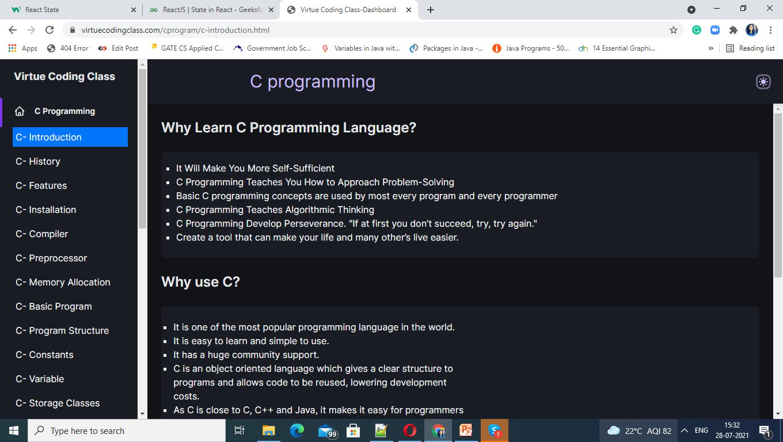
Difference Between Props & State

Slide 69
State should never be updated explicitly
React uses an observable object as the state that observes what changes are made to the state and helps the component behave accordingly.
For example, if we update the state of any component like the following the webpage will not re-render itself
because React State will not be able to detect the changes made.
this.state.attribute = "new-value";

Slide 70
State
Specify the state object in the constructor method:
class Color extends React.Component
{ constructor(props)
{
super(props); this.state = {color: “Red"};
}
render()
{ return ( <div> <h1>My Color</h1> </div> ); }
}

Slide 71
State
class Color extends React.Component
{
constructor(props)
{ super(props);
this.state = {color: “Green", shade: “dark", theme: “toggle", number: #0000 };
}
render()
{ return ( <div> <h1>My Color</h1> </div> ); }
}

Slide 72
State
Using the state Object
Refer to the state object anywhere in the component by using the
this.state.propertyname

Slide 73
State
Using the state Object
class Color extends React.Component
{
constructor(props)
{ super(props);
this.state =
{
color: "red", shade: “dark"};
}
render()
{ return
( <div>
<p> It is a {this.state.color} from {this.state.shade}. </p>
</div> ); }
}
ReactDOM.render(<Color />, document.getElementById('root'));

Slide 74
State
Changing the state Object
To change a value in the state object, use the this.setState() method.
When a value in the state object changes, the component will re-render, meaning that the output will change according to the new value(s).

Slide 75
State
Changing the state Object
class Color extends React.Component
{
constructor(props)
{
super(props);
this.state = { color: “red", shade: “dark"};
}
changeColor = () => { this.setState({color: "blue"}); }
render()
{
return ( <div>
<p> It is a {this.state.color} from {this.state.shade}. </p>
<button type="button" onClick={this.changeColor} >
Change color</button> </div> );
}
} ReactDOM.render(<Color />, document.getElementById('root'));

Slide 76
The component is used in index.js as follows:
index.js
import React from 'react'; import ReactDOM from 'react-dom'; import Hello_comp from './test.jsx'; ReactDOM.render( Hello_comp, document.getElementById('root') );

Slide 77
Create a Class Component
import React from 'react';
import ReactDOM from 'react-dom';
class Test extends React.Component {
render() {
return <p>Welcome To My Windows</p>;
}
}
ReactDOM.render(<Test/>, document.getElementById('ex2'));
Index.html
Index.js
<html>
<head>
<meta charset="utf-8" />
<meta name="viewport"
content="width=device-width, initial-scale=1" />
<title>React App</title>
</head>
<body>
<div id=“ex2"></div>
</body>
</html>

Slide 78
Create a Function Component
import React from 'react';
import ReactDOM from 'react-dom';
function Test()
{
return <h4>Welcome to my window</h4>;
}
ReactDOM.render(
<Test />, document.getElementById('ex3')
);
<html>
<head>
<meta charset="utf-8" />
<meta name="viewport"
content="width=device-width, initial-scale=1" />
<title>React App</title>
</head>
<body>
<div id="ex3"></div>
</body>
</html>
Index.js
Index.html

Slide 79
Create a Component Constructor
Index.js
import React from 'react';
import ReactDOM from 'react-dom';
class Test extends React.Component {
constructor() {
super();
this.state = {color: "green"};
}
render() {
return <h2>Welcome to my window</h2>;
}
}
ReactDOM.render(<Test />, document.getElementById('ex3'));
<html>
<head>
<meta charset="utf-8" />
<meta name="viewport"
content="width=device-width, initial-scale=1" />
<title>React App</title>
</head>
<body>
<div id="ex3"></div>
</body>
</html>
Index.html

Slide 80
Props
Index.js
import React from 'react';
import ReactDOM from 'react-dom';
class Test extends React.Component {
render() {
return <h3>Welcome To My Window</h3>;
}
}
ReactDOM.render(<Test color="black"/>, document.getElementById('ex3'));
<html>
<head>
<meta charset="utf-8" />
<meta name="viewport"
content="width=device-width, initial-scale=1" />
<title>React App</title>
</head>
<body>
<div id="ex3"></div>
</body>
</html>
Index.html

Slide 81
Components in components
import React from 'react';
import ReactDOM from 'react-dom';
class Test extends React.Component {
render() {
return <h3>Welcome to my window</h3>;
}
}
class Kil extends React.Component {
render() {
return (
<div>
<h4>Browse</h4>
<Test />
</div>
);
}
}
ReactDOM.render(<Kil />, document.getElementById('ex2'));
<html>
<head>
<meta charset="utf-8" />
<meta name="viewport"
content="width=device-width, initial-scale=1" />
<title>React App</title>
</head>
<body>
<div id="ex2"></div>
</body>
</html>
Index.js
Index.html

Slide 82
Life Cycle Of React Component

Slide 83
Life cycle of Components
Initialization: This is the stage where the component is constructed with the given Props and default state. This is done in the constructor of a Component Class.
Mounting: Mounting is the stage of rendering the JSX returned by the render method itself.
Updating: Updating is the stage when the state of a component is updated and the application is repainted.
Unmounting: As the name suggests Unmounting is the final step of the component lifecycle where the component is removed from the page.

Slide 84
Initialization
class Clock extends React.Component {
constructor(props)
{
// Calling the constructor of
// Parent Class React.Component
super(props);
// Setting the initial state
this.state = { date : new Date() };
}
}
In this phase, the developer has to define the props and initial state of the component this is generally done in the constructor of the component

Slide 85
Mounting
Mounting is the phase of the component lifecycle when the initialization of the component is completed and
the component is mounted on the DOM and rendered for the first time on the webpage.
Now React follows a default procedure in the Naming Conventions of these predefined functions
where the functions containing “Will” represents before some specific phase and “Did” represents after the completion of that phase.

Slide 86
Mounting
React has four built-in methods that gets called, in this order, when mounting a component:
constructor()
getDerivedStateFromProps()
render()
componentDidMount()
The render() method is required and will always be called, the others are optional and will be called if you define them.

Slide 87
Constructor
The constructor() method is called before anything else, when the component is initiated, and it is the natural place to set up the initial state and other initial values.
The constructor() method is called with the props, as arguments, and you should always start by calling the super(props) before anything else,
this will initiate the parent's constructor method and allows the component to inherit methods from its parent (React.Component).

Slide 88
Constructor
class Header extends React.Component
{
constructor(props)
{ super(props); this.state = {favoritecolor: "red"}; } render()
{ return ( <h1>My Favorite Color is {this.state.favoritecolor}</h1> ); }
}
ReactDOM.render(<Header />, document.getElementById('root'));

Slide 89
getDerivedStateFromProps
The getDerivedStateFromProps() method is called right before rendering the element(s) in the DOM.
This is the natural place to set the state object based on the initial props.
It takes state as an argument, and returns an object with changes to the state.
The example(next slide) starts with the favorite color being "red", but the getDerivedStateFromProps() method updates the favorite color based on the favcol attribute:

Slide 90
getDerivedStateFromProps
class Header extends React.Component
{
constructor(props)
{ super(props);
this.state = {favoritecolor: "red"};
}
static getDerivedStateFromProps
(props, state) {
return {favoritecolor: props.favcol };
}
render()
{ return ( <h1>My Favorite Color is {this.state.favoritecolor}</h1> ); }
}
ReactDOM.render(<Header favcol="yellow"/>, document.getElementById('root'));

Slide 91
render
The render() method is required, and is the method that actually outputs the HTML to the DOM.
Example:
A simple component with a simple render() method:
class Header extends React.Component
{ render()
{ return ( <h1>This is the content of the Header component</h1> ); }
}
ReactDOM.render(<Header />, document.getElementById('root'));

Slide 92
componentDidMount
The componentDidMount() method is called after the component is rendered.
This is where you run statements that requires that the component is already placed in the DOM.
Example (next slide)
At first my favorite color is red, but give me a second, and it is yellow instead:

Slide 93
componentDidMount
class Header extends React.Component
{
constructor(props) { super(props);
this.state = {favoritecolor: "red"}; } componentDidMount()
{
setTimeout(() => { this.setState({favoritecolor: "yellow"}) }, 1000)
}
render()
{
return ( <h1>My Favorite Color is {this.state.favoritecolor}
</h1> ); }
} ReactDOM.render(<Header />, document.getElementById('root'));

Slide 94
Updating
The next phase in the lifecycle is when a component is updated.
A component is updated whenever there is a change in the component's state or props.
React has five built-in methods that gets called, in this order, when a component is updated:
getDerivedStateFromProps()
shouldComponentUpdate()
render()
getSnapshotBeforeUpdate()
componentDidUpdate()
The render() method is required and will always be called, the others are optional and will be called if you define them.

Slide 95
getDerivedStateFromProps
Also at updates the getDerivedStateFromProps method is called. This is the first method that is called when a component gets updated.
This is still the natural place to set the state object based on the initial props.
The example (next slide) has a button that changes the favorite color to blue, but since the getDerivedStateFromProps() method is called, which updates the state with the color from the favcol attribute, the favorite color is still rendered as yellow

Slide 96
getDerivedStateFromProps
class Header extends React.Component { constructor(props) {
super(props);
this.state = {favoritecolor: "red"}; } static getDerivedStateFromProps(props, state)
{ return {favoritecolor: props.favcol }; } changeColor = () => { this.setState({favoritecolor: "blue"}); }
render()
{ return ( <div> <h1>My Favorite Color is {this.state.favoritecolor}</h1> <button type="button" onClick={this.changeColor}>
Change color</button> </div> ); } } ReactDOM.render(<Header favcol="yellow"/>, document.getElementById('root'));

Slide 97
getDerivedStateFromProps
This example has a button that changes the favorite color to blue, but since the getDerivedStateFromProps() method is called,
the favorite color is still rendered as yellow (because the method updates the state with the color from the favcol attribute). */

Slide 98
shouldComponentUpdate
In the shouldComponentUpdate() method you can return a Boolean value that specifies whether React should continue with the rendering or not.
The default value is true.
The example next slide shows what happens when the shouldComponentUpdate() method returns false:

Slide 99
shouldComponentUpdate
class Header extends React.Component { constructor(props)
{ super(props); this.state = {favoritecolor: "red"}; } shouldComponentUpdate()
{ return false; }
changeColor = () => { this.setState({favoritecolor: "blue"}); }
render()
{
return ( <div> <h1>My Favorite Color is {this.state.favoritecolor}</h1> <button type="button" onClick={this.changeColor}>
Change color</button> </div> ); }
}
ReactDOM.render(<Header />, document.getElementById('root'));

Slide 100
shouldComponentUpdate
Same example as before slide,
but this time the shouldComponentUpdate() method returns true instead:

Slide 101
shouldComponentUpdate
class Header extends React.Component { constructor(props)
{ super(props); this.state = {favoritecolor: "red"}; } shouldComponentUpdate()
{ return true; }
changeColor = () => { this.setState({favoritecolor: "blue"}); }
render()
{
return ( <div> <h1>My Favorite Color is {this.state.favoritecolor}</h1> <button type="button" onClick={this.changeColor}>
Change color</button> </div> ); }
}
ReactDOM.render(<Header />, document.getElementById('root'));

Slide 102
render
The render() method is of course called when a component gets updated , it has to re-render the HTML to the DOM, with the new changes.
The example (next slide) has a button that changes the favorite color to blue:

Slide 103
Render
class Header extends React.Component
{ constructor(props)
{ super(props);
this.state = {favoritecolor: "red"}; } changeColor = () => { this.setState({favoritecolor: "blue"}); }
render()
{ return ( <div> <h1>My Favorite Color is {this.state.favoritecolor}</h1> <button type="button" onClick={this.changeColor}>
Change color</button> </div> ); }
}
ReactDOM.render(<Header />, document.getElementById('root'));

Slide 104
getSnapshotBeforeUpdate
In the getSnapshotBeforeUpdate() method you have access to the props and state before the update, meaning that even after the update,
you can check what the values were before the update.
If the getSnapshotBeforeUpdate() method is present, you should also include the componentDidUpdate() method, otherwise you will get an error.

Slide 105
getSnapshotBeforeUpdate
The example below might seem complicated, but all it does is this:
When the component is mounting it is rendered with the favorite color "red".
When the component has been mounted, a timer changes the state, and after one second, the favorite color becomes "yellow".

Slide 106
getSnapshotBeforeUpdate
This action triggers the update phase, and since this component has a getSnapshotBeforeUpdate() method, this method is executed, and writes a message to the empty DIV1 element.
Then the componentDidUpdate() method is executed and writes a message in the empty DIV2 element:

Slide 107
getSnapshotBeforeUpdate
import React from 'react';
import ReactDOM from 'react-dom';
class Header extends React.Component
{ constructor(props) { super(props); this.state = {favoritecolor: "red"}; }
componentDidMount()
{ setTimeout(() => { this.setState({favoritecolor: "yellow"}) }, 1000) }
getSnapshotBeforeUpdate(prevProps, prevState)
{ document.getElementById("div1").
innerHTML = "Before the update, the favorite was " + prevState.favoritecolor;
}
componentDidUpdate() { document.getElementById("div2").innerHTML = "The updated favorite is " + this.state.favoritecolor; }
render() { return ( <div> <h1>My Favorite Color is {this.state.favoritecolor}</h1> <div id="div1"></div> <div id="div2"></div> </div> ); } } ReactDOM.render(<Header />, document.getElementById('root'));

Slide 108
componentDidUpdate
The componentDidUpdate method is called after the component is updated in the DOM.
The example next slide might seem complicated, but all it does is this:
When the component is mounting it is rendered with the favorite color "red".
When the component has been mounted, a timer changes the state, and the color becomes "yellow".
This action triggers the update phase, and since this component has a componentDidUpdate method, this method is executed and writes a message in the empty DIV element:

Slide 109
componentDidUpdate
class Header extends React.Component
{ constructor(props)
{ super(props); this.state = {favoritecolor: "red"}; }
componentDidMount()
{ setTimeout(() => { this.setState({favoritecolor: "yellow"}) }, 1000) }
componentDidUpdate() { document.getElementById("mydiv").innerHTML = "The updated favorite is " + this.state.favoritecolor; } render()
{ return ( <div> <h1>My Favorite Color is {this.state.favoritecolor}</h1> <div id="mydiv"></div> </div> ); } } ReactDOM.render(<Header />, document.getElementById('root'));

Slide 110
Unmounting
The next phase in the lifecycle is when a component is removed from the DOM, or unmounting as React likes to call it.
React has only one built-in method that gets called when a component is unmounted:
componentWillUnmount()
The componentWillUnmount method is called when the component is about to be removed from the DOM.

Slide 111
unmounting
import React from 'react'; import ReactDOM from 'react-dom'; class Container extends React.Component { constructor(props) { super(props); this.state = {show: true}; } delHeader = () => { this.setState({show: false}); } render() { let myheader; if (this.state.show) { myheader = <Child />; }; return ( <div> {myheader} <button type="button" onClick={this.delHeader}>Delete Header</button> </div> ); } }
class Child extends React.Component { componentWillUnmount()
{ alert("The component named Header is about to be unmounted."); }
render() { return ( <h1>Hello World!</h1> ); } }
ReactDOM.render(<Container />, document.getElementById('root'));

Slide 112
REACT
EVENT

Slide 113
Adding Events
React events are written in camelCase
syntax:
onClick instead of onclick.
React event handlers are written inside curly braces:
onClick={shoot} instead of onClick="shoot()".

Slide 114
Event Handlers
A good practice is to put the event handler as a method in the component class:

Slide 115
Event Handlers
import React from 'react'; import ReactDOM from 'react-dom';
class Football extends React.Component
{ shoot() { alert("Great Shot!"); }
render() { return ( <button onClick={this.shoot}>Take the shot!</button> ); } }
ReactDOM.render(<Football />, document.getElementById('root'));

Slide 116
Bind this
For methods in React, the this keyword should represent the component that owns the method.
That is why you should use arrow functions. With arrow functions, this will always represent the object that defined the arrow function.

Slide 117
Bind this
class Football extends React.Component
{ shoot = () => { alert(this); /* The 'this' keyword refers to the component object */ } render()
{ return ( <button onClick={this.shoot}>Take the shot!</button> ); } } ReactDOM.render(<Football />, document.getElementById('root'));

Slide 118
Why Arrow Functions?
In class components, the this keyword is not defined by default, so with regular functions the this keyword represents the object that called the method,
which can be the global window object, a HTML button, or whatever.
If you must use regular functions instead of arrow functions you have to bind this to the component instance using the bind() method:

Slide 119
Make this available in the shoot function by binding it in the constructor function: //Without the binding, the this keyword would return undefined.
class Football extends React.Component
{ constructor(props) { super(props) this.shoot = this.shoot.bind(this) }
shoot() { alert(this); /* Thanks to the binding in the constructor function, the 'this' keyword now refers to the component object */ }
render()
{ return ( <button onClick={this.shoot}>Take the shot!</button> ); } } ReactDOM.render(<Football />, document.getElementById('root'));

Slide 120
Passing Arguments
If you want to send parameters into an event handler, you have two options:
1. Make an anonymous arrow function:
Example:
Send "Goal" as a parameter to the shoot function, using arrow function:

Slide 121
Passing Arguments
import React from 'react';
import ReactDOM from 'react-dom';
class Football extends React.Component
{ shoot = (a) => { alert(a); } render() { return ( <button onClick={() => this.shoot("Goal")}>Take the shot!</button> ); } }
ReactDOM.render(<Football />, document.getElementById('root'));

Slide 122
Passing Arguments
Or:
2. Bind the event handler to this.
Note that the first argument has to be this.
Note on the second example: If you send arguments without using the bind method, (this.shoot(this, "Goal") instead of this.shoot.bind(this, "Goal")), the shoot function will be executed when the page is loaded instead of waiting for the button to be clicked.

Slide 123
Passing Arguments
Example:
Send "Goal" as a parameter to the shoot function:
class Football extends React.Component
{ shoot(a) { alert(a); }
render()
{ return ( <button onClick={this.shoot.bind(this, "Goal")}>Take the shot!</button> ); } } ReactDOM.render(<Football />, document.getElementById('root'));

Slide 124
React Event Object
Event handlers have access to the React event that triggered the function.
In example the event is the "click" event. Notice that once again the syntax is different when using arrow functions or not.
With the arrow function you have to send the event argument manually:

Slide 125
React Event Object
class Football extends React.Component
{ shoot = (a, b) =>
{ alert(b.type);
/* 'b' represents the React event that triggered the function, in this case the 'click' event */ }
render()
{ return
( <button
onClick={(ev) => this.shoot("Goal", ev)}>Take the shot!</button> ); }
}
ReactDOM.render(<Football />, document.getElementById('root'));

Slide 126
React Event Object
Without arrow function, the React event object is sent automatically as the last argument when using the bind() method:

Slide 127
React Event Object
With the bind() method, the event object is sent as the last argument:
class Football extends React.Component { shoot = (a, b) => { alert(b.type); /* 'b' represents the React event that triggered the function, in this case the 'click' event */ } render() { return ( <button onClick={this.shoot.bind(this, "Goal")}>Take the shot!</button> ); } } ReactDOM.render(<Football />, document.getElementById('root'));

Slide 128
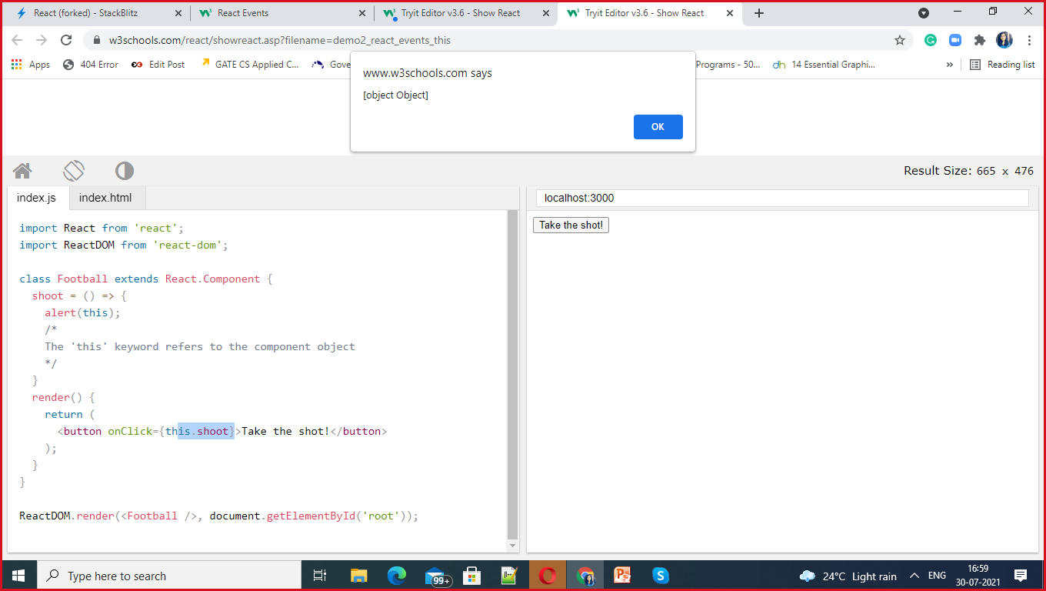

Slide 129
