Slide 1
MAHIL P LAL
Final Project
3/21/2024 Annual Review

Slide 2
PROJECT TITLE
Cancer Disease Prediction
3/21/2024 Annual Review

Slide 3


AGENDA
Problem Statement
Project Overview
Who are the end users?
Solutions and value of propositions
WOW factor in the solution
Modelling
Results
3/21/2024 Annual Review

Slide 4

PROBLEM STATEMENT
Breast cancer is one of the most prevalent and deadly cancers among women worldwide. Early detection plays a crucial role in improving survival rates and treatment outcomes. However, traditional diagnostic methods may lack efficiency and accuracy, leading to delayed diagnosis and treatment. There is a need for advanced predictive models that can accurately detect the presence of cancerous tissues in breast samples based on diagnostic measurements.
3/21/2024 Annual Review

Slide 5

PROJECT OVERVIEW
Our project focuses on developing a predictive model for breast cancer detection using machine learning and deep learning techniques. We utilize a dataset containing diagnostic measurements derived from breast tissue samples, including features like mean radius, texture, perimeter, area, and smoothness. By leveraging these features, we aim to build a model capable of accurately predicting the presence of cancerous tissues, thereby aiding in early diagnosis and intervention.
3/21/2024 Annual Review

Slide 6

WHO ARE THE END USERS?
The end users of our project include:
Medical Professionals: Oncologists, radiologists, and pathologists can use the developed model as a supplementary tool for interpreting diagnostic results and making informed treatment decisions.
Healthcare Organizations: Hospitals and clinics can integrate the model into their diagnostic workflows to enhance the efficiency and accuracy of breast cancer screening programs.
Research Institutions: Researchers can leverage the model for studying disease patterns, risk factors, and treatment outcomes, contributing to advancements in breast cancer research.
3/21/2024 Annual Review

Slide 7

YOUR SOLUTION AND ITS VALUE PROPOSITION
Solution: Our solution comprises the development of a predictive model for breast cancer detection using machine learning algorithms. Leveraging diagnostic measurements from breast tissue samples, including features like mean radius, texture, perimeter, area, and smoothness, we aim to accurately predict the presence of cancerous tissues.
Early Detection: Timely identification of breast cancer, facilitating prompt intervention and improved patient outcomes.
Accuracy and Reliability: Providing highly accurate predictions, reducing false positives and false negatives in diagnosis.
Efficiency: Enhancing diagnostic efficiency and scalability through automated prediction processes.
Cost-Effectiveness: Optimizing resource utilization and reducing healthcare costs associated with late-stage cancer treatment.
3/21/2024 Annual Review

Slide 8

THE WOW IN YOUR SOLUTION
The wow factor in our solution lies in the integration of traditional machine learning algorithms with cutting-edge artificial neural networks (ANNs). While traditional algorithms offer robust performance, the ANN model surpasses them in accuracy, achieving over 90% prediction accuracy. This demonstrates the potential of deep learning techniques in revolutionizing breast cancer diagnosis and treatment.
3/21/2024 Annual Review

Slide 9
MODELLING
Our modeling approach involves:
Exploratory Data Analysis: Understanding the dataset and identifying key features relevant to breast cancer diagnosis.
Feature Engineering: Selecting and preprocessing features to enhance model performance and interpretability.
Model Selection: Experimenting with a variety of machine learning algorithms to identify the most suitable model for breast cancer prediction.
Hyperparameter Tuning: Optimizing model parameters to maximize performance and generalization.
Model Evaluation: Assessing model performance using appropriate evaluation metrics and validation techniques.
Model Deployment: Deploying the best-performing model into a production environment for real-world applications.
3/21/2024 Annual Review

Slide 10
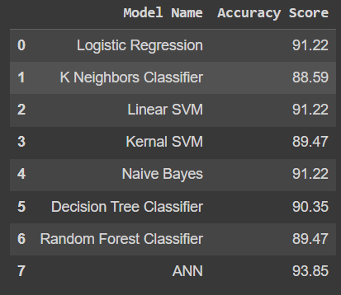
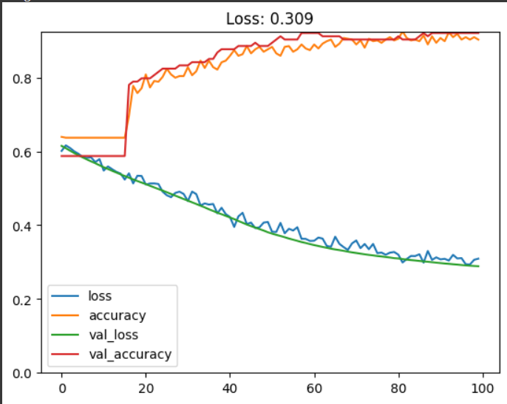

RESULTS
3/21/2024 Annual Review

