Slide 1







Looking into data from respondents
Mahim Rahaman
07/01/2024

Slide 2



OUTLINE
Executive Summary
Introduction
Methodology
Results
Visualization – Charts
Dashboard
Discussion
Findings & Implications
Conclusion
Appendix

Slide 3

INTRODUCTION
Why looking into DATA is so important?

Slide 4

METHODOLOGY
We investigated data from the respondents of a survey.
We sorted data, filtered and displayed in a way visible

Slide 5
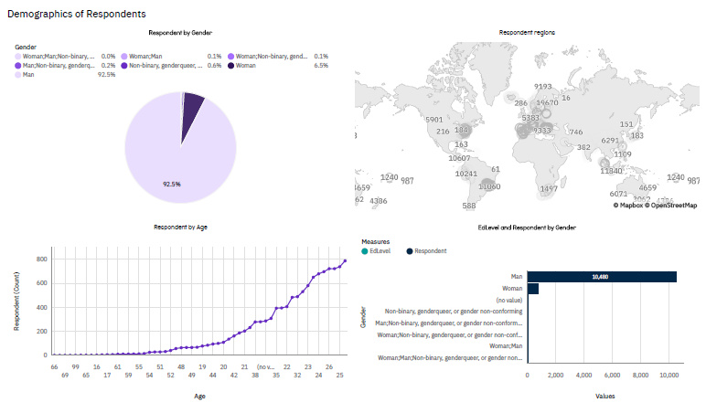
RESULTS

Slide 6
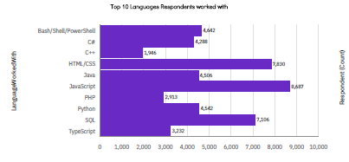
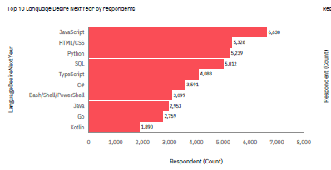
PROGRAMMING LANGUAGE TRENDS
Current Year
Next Year
<Bar chart of top 10 programming languages for the current year goes here.>
< Bar chart of top 10 programming languages for the next year goes here.>

Slide 7
PROGRAMMING LANGUAGE TRENDS - FINDINGS & IMPLICATIONS
Findings
1. JAVA Script
2. HTML/CSS
3. SQL
Implications
People can really learn from this!!

Slide 8
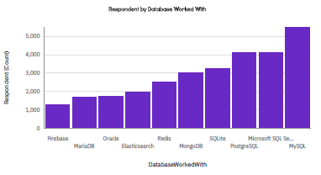
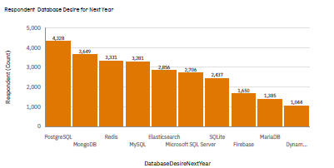
DATABASE TRENDS
Current Year
Next Year
< Bar chart of top 10 databases for the current year goes here >
< Bar chart of top 10 databases for the next year goes here.>

Slide 9

DASHBOARD
<https://github.com/Mahim00zz/DashBoards

Slide 10
DASHBOARD TAB 1
Screenshot of dashboard tab 1 goes here

Slide 11
DASHBOARD TAB 2

Slide 12
DASHBOARD TAB 3

Slide 13
DISCUSSION
Why do you think this is the way it is?
Is there a need for change?
If so how?

Slide 14

CONCLUSION
Point 1
Point 2
Point 3
Point 4

