Slide 1

Covid-19 Idea Contest by IEEE Computer Society BUET
TEAM_BASH
Farhan Tanvir Utshaw
Mahim Mahbub
Rafi Ur Rashid
Presenting
VChamber
Notes:
A large scale virtual health-care platform

Slide 2
OVERVIEW

Slide 3
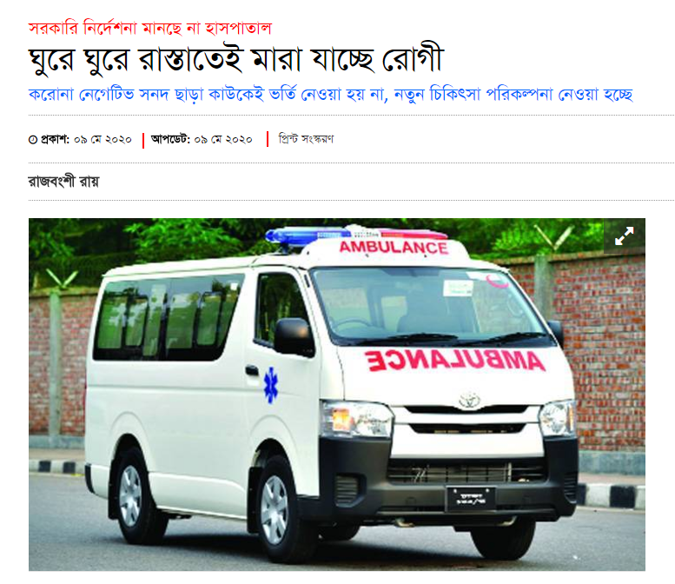
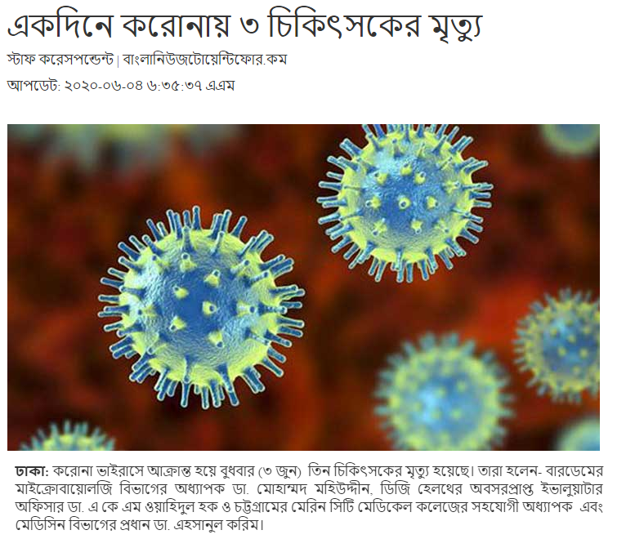

Slide 4
WORK-FLOW

Slide 5
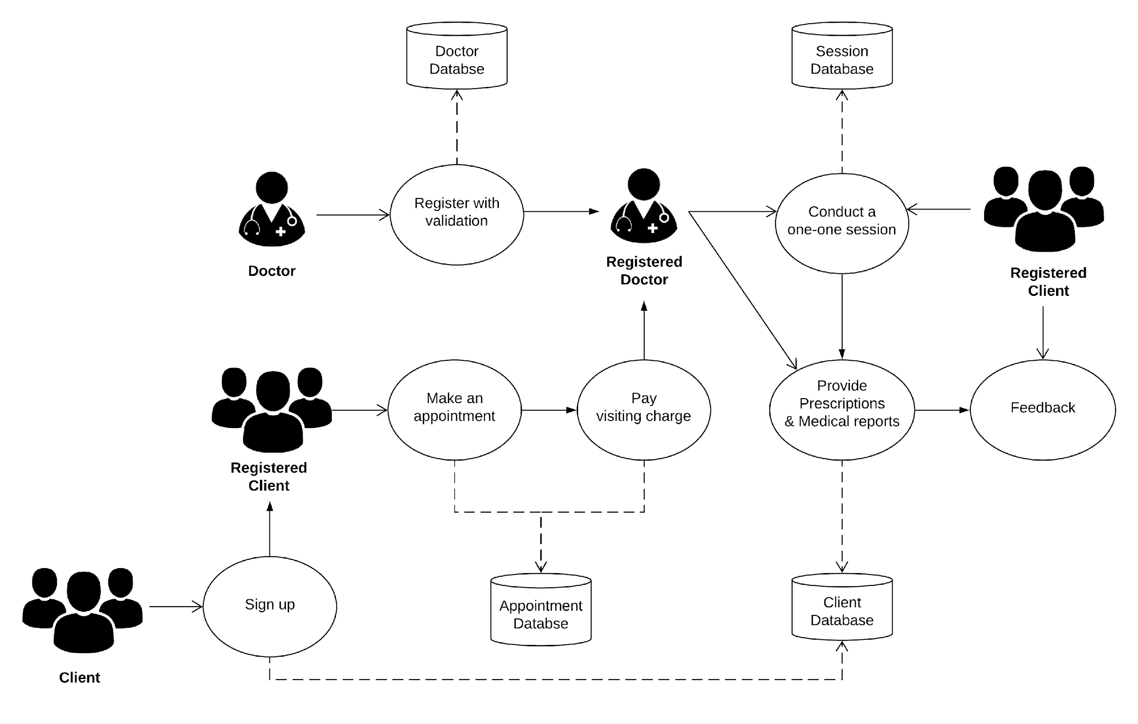

Slide 6
WORK BREAKDOWN STRUCTURE

Slide 7
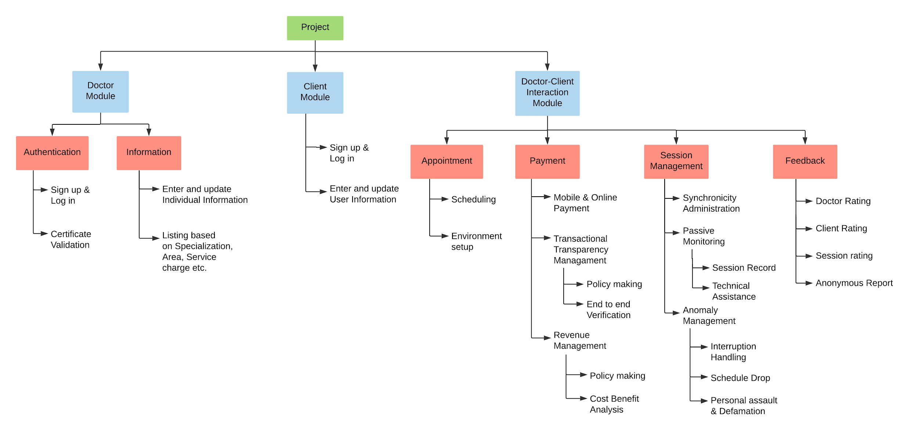

Slide 8
GANTT CHART

Slide 9
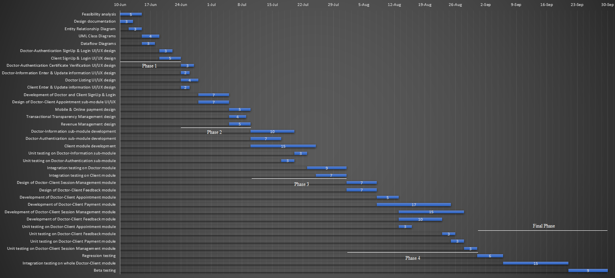

Slide 10
ENTITY RELATIONSHIP DIAGRAM

Slide 11
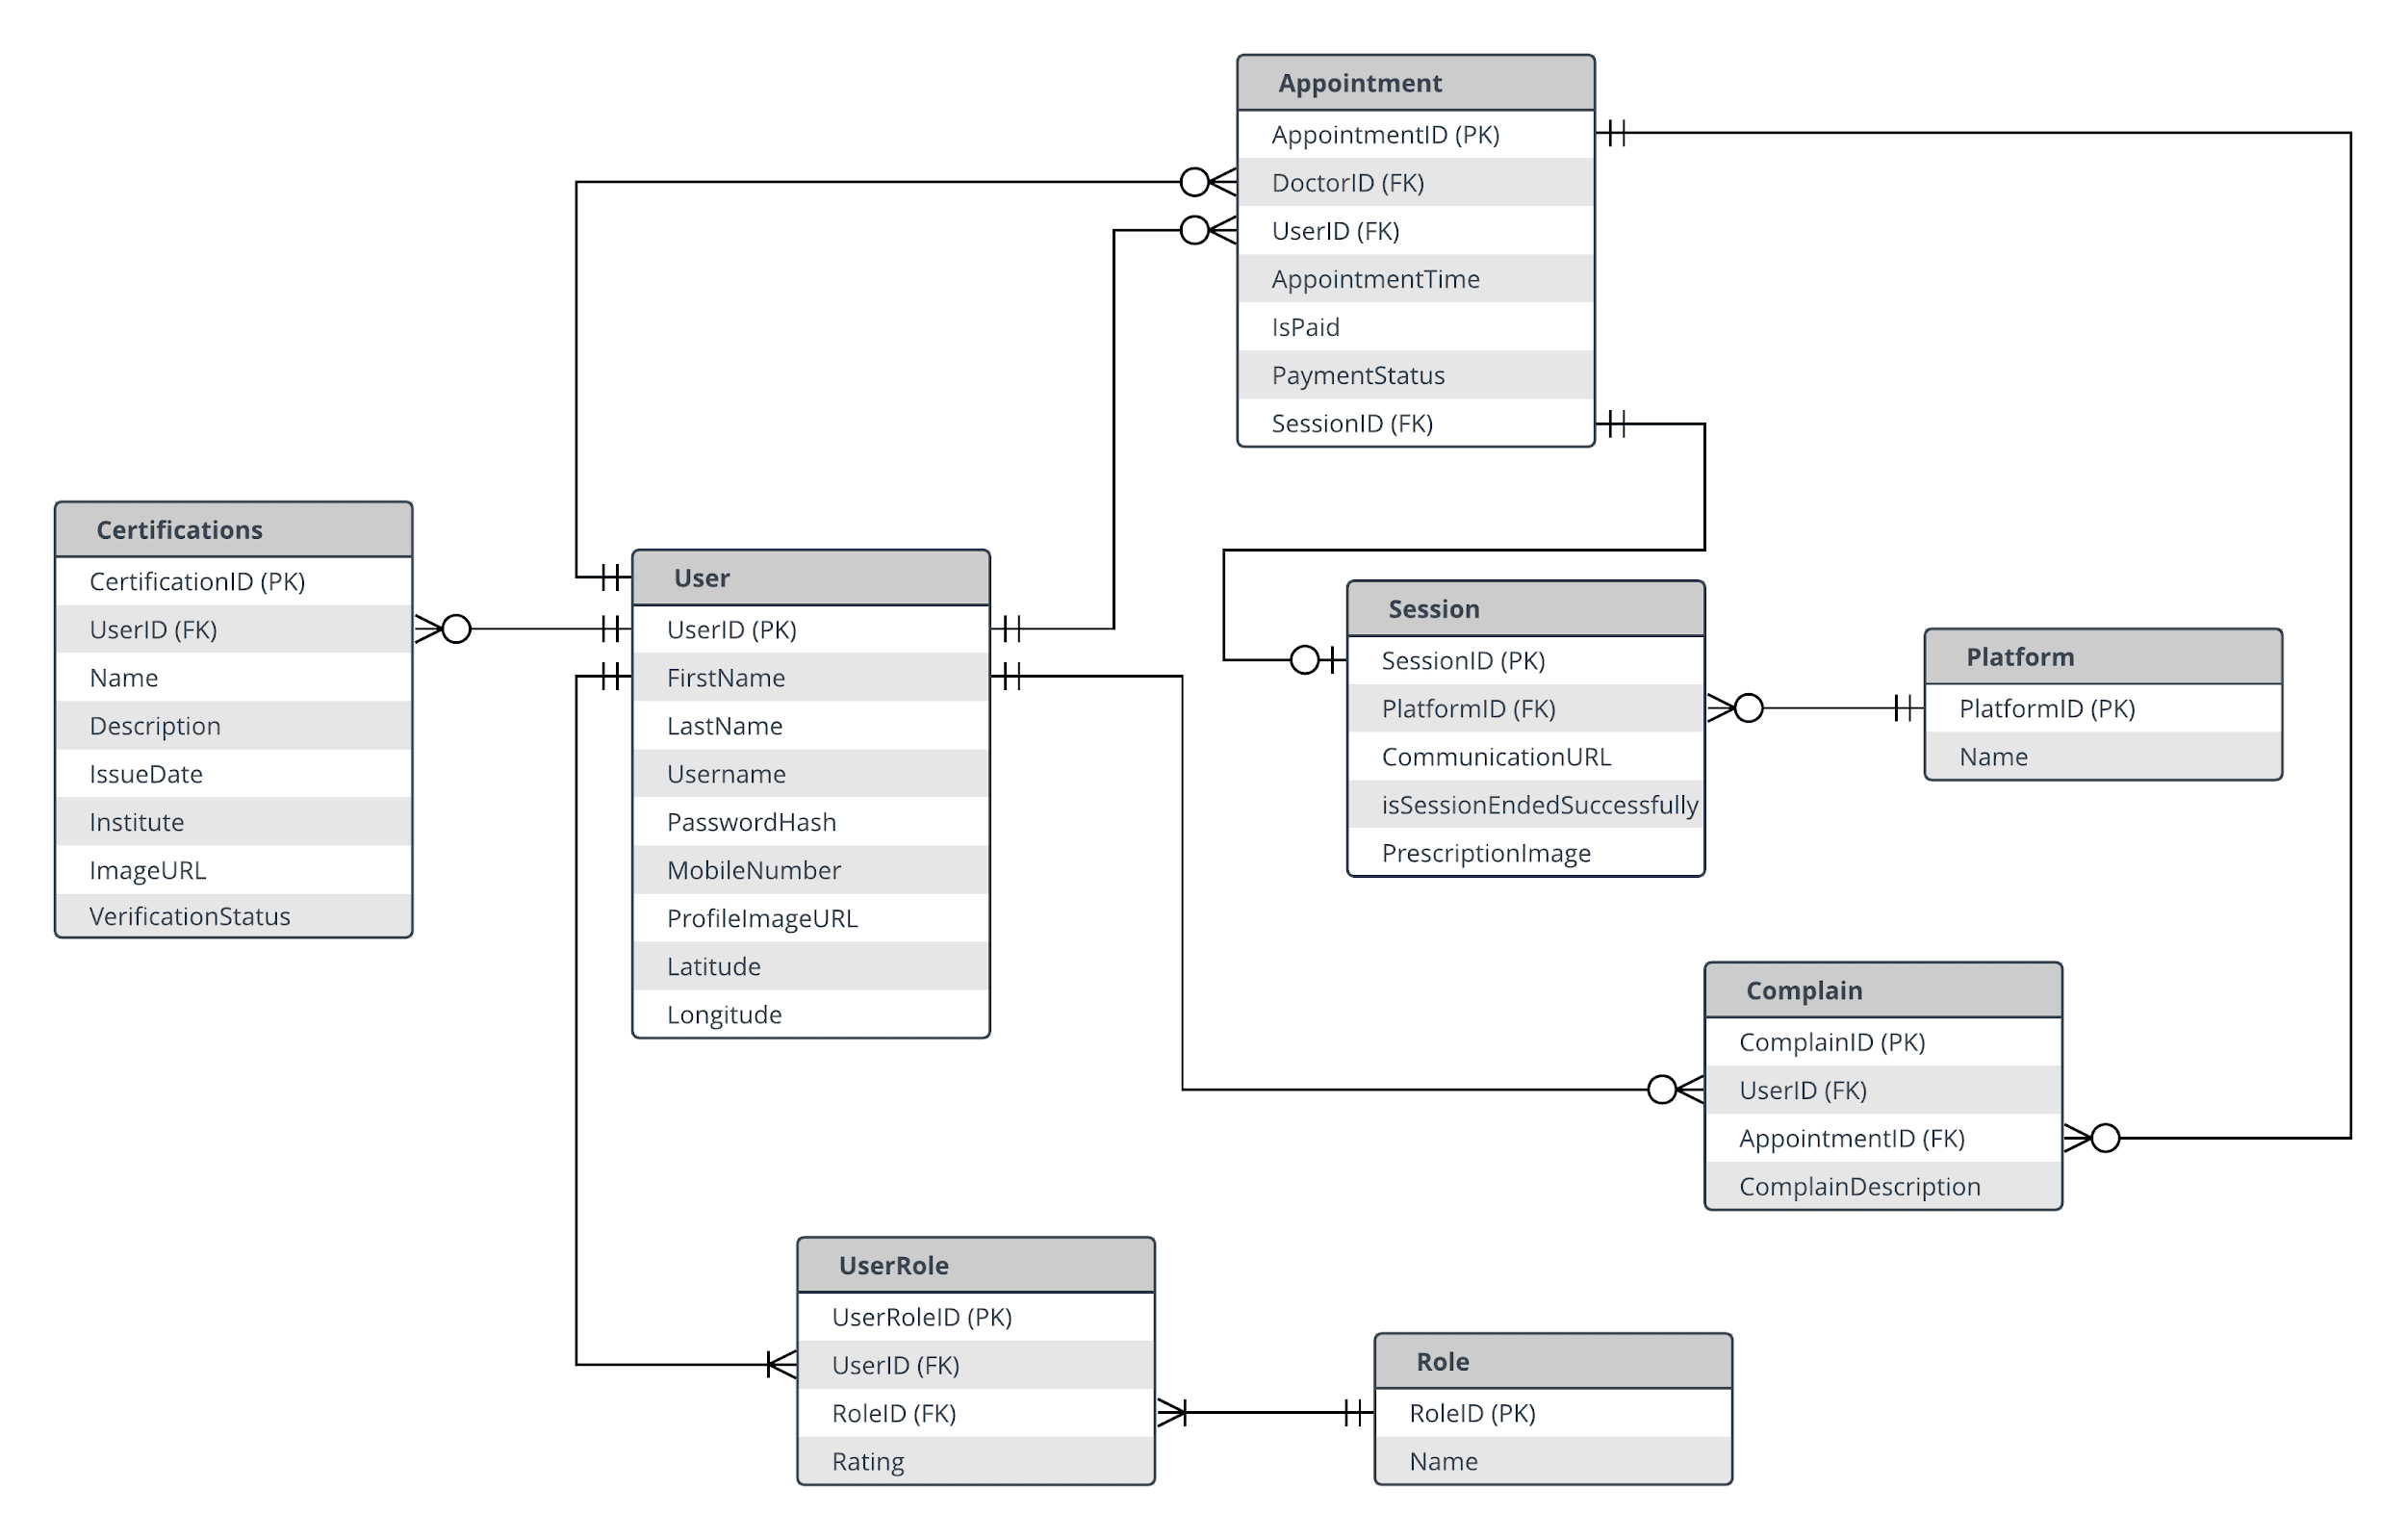

Slide 12
PROJECT DEPENDENCIES

Slide 13
Collaboration with Professionals:
- Health Professionals
- Server administrator/ server security specialists
- Full stack developers
- Business analysts
- Sales and Marketing Experts
- Data analysts

Slide 14
PROJECT REQUIREMENTS

Slide 15
- High configuration PCs for big data analysis

Slide 16
Advanced Features

Slide 17
Premium membership plan
Digital Currency
Appointment for offline session
Sample collection and Imaging
Referral system
Apprenticeship program
Notes:
Premium membership eg. some discounts on certain items/appointments.
Digital currency for if someone can’t afford instant payments, or refund policy etc.
Offline session kind of like offline appointment type
Referral for investigations and tests (one kind of revenue source for us)
Apprenticeship eg. Intern wants to go in the session and find how doctors deal … (maybe a revenue src)

Slide 18
IMPACT

Slide 19
Remote treatment that ensures proper social distancing between the doctor and the patient.
Ensuring distant health care for those who are unable to physically meet the physicians for some reason.
Employment opportunity for the doctors that don’t have any
chamber of their own.
Additional source of revenue for health-care professionals.
Countrywide utilization of Internet service & Technology.

Slide 20



THANK YOU FOR LISTENING. FEEL FREE TO ASK ANY QUESTIONS.

