Slide 1
DATA ANALYTICS / DATA VISUALISATION INTERNSHIP
Space Debris
Names : Mahima M , Niharika BA
AFID: AF05117635 , AF05117567
Institute: Sai Vidya Institute Of Technology
Guide / Mentor: Shruti Sengupta
Organization: Anudip Foundation
Academic Year: 2024-26

Slide 2
INTRODUCTION
Project Overview
The problem addressed is the increasing accumulation of debris, which poses threats to satellites, space missions, and overall space sustainability.
focusing on analyzing the distribution and characteristics of space debris to understand congestion risk in Earth’s orbital regions.
Rising satellite launches are increasing space debris and collision risks.
Covers:
Analysis of space debris data (altitude, orbital band, risk, inclination)
Identification of patterns in orbital congestion and risk levels
Visualization and statistical analysis (correlation, regression, hypothesis testing)

Slide 3
PROBLEM STATEMENT
With the increasing number of satellites and defunct objects in orbit, space debris has become a major challenge, causing higher collision risks and orbital congestion. This impacts satellite communication, navigation systems, and future space missions.
Existing systems mainly monitor debris positions but do not provide detailed analysis of congestion patterns, risk levels, and orbital region behavior, creating a gap in effective decision-making.

Slide 4
OBJECTIVES
Collect and preprocess real-world space debris data
Perform exploratory analysis to identify patterns and trends
Create meaningful visualizations for clear insights
Apply statistical methods to validate findings
Present results through an interactive dashboard/report

Slide 5
BUSINESS CONTEXT
Real-World Impact: Helps in understanding orbital congestion and supports decisions to reduce collision risks and improve satellite safety
Industry Domain: Space Technology / Aerospace / Environment
Stakeholders: Space agencies (NASA, ISRO), satellite operators, private space companies
Scale: Large-scale dataset of thousands of space objects across multiple orbital regions
Business Question: “Which orbital bands are most crowded, and how can this impact future satellite deployments?”
Potential Outcome / ROI: Improved mission planning, reduced risk of satellite damage, and better long-term sustainability of space operations

Slide 6
METHODOLOGY
Data Collection Gathered space debris data from multiple sources
Data Preprocessing Cleaned data by handling missing values, duplicates, and formatting
Data Integration Merged datasets using a common key (object_id)
Exploratory Data Analysis (EDA) Analyzed patterns in altitude, orbital bands, and congestion risk
Visualization Used charts (pie, dot plot, etc.) to represent insights clearly
Statistical Analysis Applied correlation, regression, and hypothesis testing
Result Interpretation Derived meaningful insights for congestion and risk patterns

Slide 7
TOOLS & TECHNOLOGIES USED
Programming Language : Python in (Jupyter Notebook)
Libraries Used :
Pandas → Data manipulation and preprocessing
NumPy → Numerical computations
Matplotlib → Data visualization
Data Handling : CSV datasets
Dashboards : Power BI
Queries for Analysis : MySql workbench

Slide 8
DATA SOURCES
1. Satellite Orbital Data
Source: CelesTrak / Space-Track Dataset: Satellite TLE (Two-Line Element) Data Granularity: Object-level, real-time / periodic updates Key Features : Mean Motion , Eccentricity , Inclination , Epoch , Object ID
2. Satellite Characteristics Data
Source: Union of Concerned Scientists / Kaggle Dataset: Satellite Database Granularity: Satellite-level Key Features : Country ,Purpose ,Orbital , Launch details
3. Space Environment & Orbit Data
Source: NASA Open Data Portal Dataset: Orbital Debris / Space Object Data Granularity: Object-level Key Features : Altitude ,Orbital Band , Congestion Indicators

Slide 9
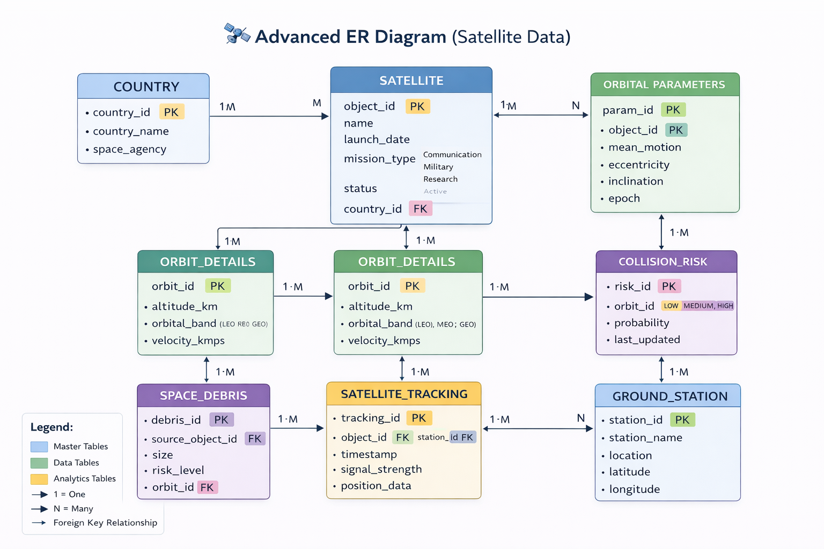
ER DIAGRAM

Slide 10
Data cleaning Steps
Handling Missing Values
Identified incomplete records, removed critical missing values, and filled minor gaps using default estimates.
2. Removing Duplicates
Checked for repeated debris entries using object ID and eliminated duplicate records
3. Standardizing Units
Converted all measurements into consistent units: Distance → kilometers (km) ,Velocity → km/s
3. Data Formatting & Consistency
Standardized date formats (YYYY-MM-DD).
Cleaned inconsistent naming (object types, country codes).
Ensured proper column data types (numeric, categorical).
4. Outlier Detection
Identified unrealistic values (extremely high velocity and altitude).

Slide 11
KEY ANALYTICAL QUESTIONS
How are space objects distributed across different orbital regions?
Which orbital band has the highest congestion risk?
How does altitude relate to congestion risk?
What is the distribution of objects across different risk categories?
Which orbital regions show higher inclination values?
Are there statistically significant relationships between key variables (altitude, risk, inclination)?

Slide 12
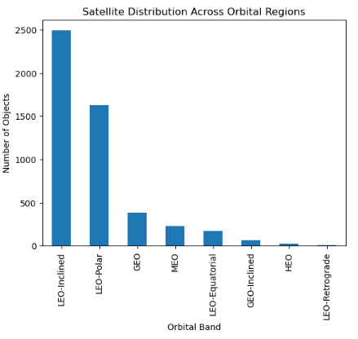
EDA - VISUALISATION 1:
How are satellites distributed across different orbital regions?
Most satellites are in LEO(Low Earth Orbit ), making it the most crowded region; other orbits have far fewer satellites.

Slide 13
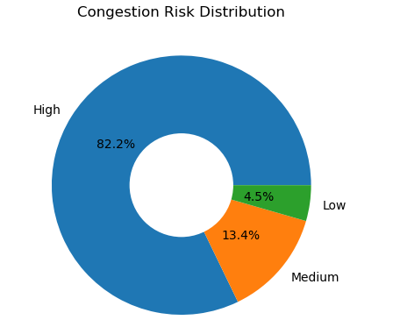
EDA - VISUALISATION 2:
2. How many objects fall under each congestion risk category?
Most objects fall under high congestion risk (~82%), while medium (~13%) and low risk (~5%) categories have significantly fewer objects, indicating a highly crowded space environment.

Slide 14
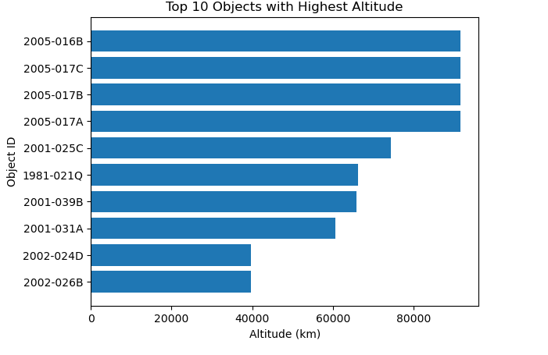
EDA - VISUALISATION 3:
3. Top 10 objects with highest altitude?
First four objects orbit extremely far (near 90,000 km), while the rest cluster much lower around 40,000–60,000 km,

Slide 15
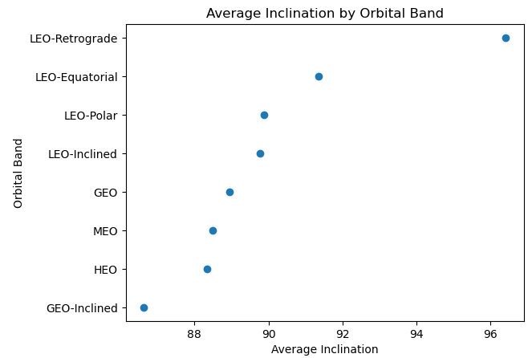
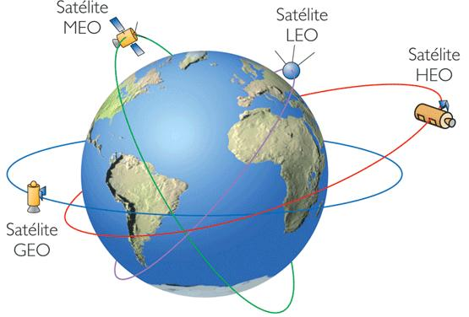
4. Orbital band with highest average inclination?
Among all orbital bands, LEO-Polar orbits have the greatest average inclination, near 97°,
Geostationary Earth Orbit
Highly Elliptical Orbit
Medium Earth Orbit
Low Earth Orbit

Slide 16
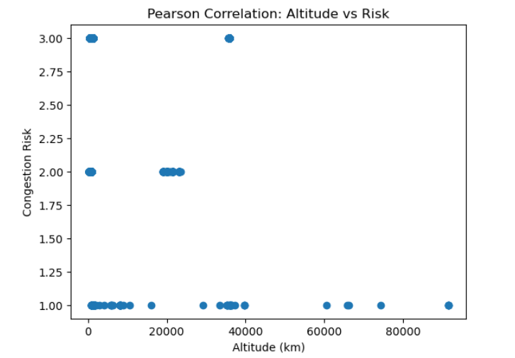
STATISTICAL ANALYSIS
Correlation Hypothesis Test (Pearson Test)
H₀ : No correlation between altitude and risk
H₁ : There is a correlation
Correlation (r)
r = -0.041 → Very weak negative relationship
Significance (p-value)
p = 0.0036 < 0.05 -> Statistically significant
Reject Null Hypothesis (H₀)
There is a statistically significant relationship between altitude and congestion risk (p < 0.05). However, the correlation is extremely weak (r ≈ -0.04), indicating negligible practical impact.

Slide 17
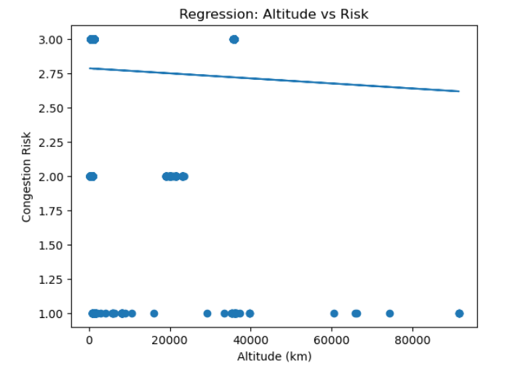
2. Regression Hypothesis Test (OLS)
H₀ : Altitude has no effect on risk (coefficient = 0)
H₁ : Altitude affects risk
R²
0.002 = 0.2%
0.2% of variation in risk
Independent Variable: Velocity (km/s)
Dependent Variable: Collision Risk
2. p-value
0.00358 < 0.05 Statistically significant
3. Coefficient
Negative value As altitude increases → risk slightly decreases BUT effect is extremely tiny
Altitude has a statistically significant effect on risk
Reject H₀, but altitude is not a strong predictor.

Slide 18
INSIGHTS SUMMARY
Most space objects are concentrated in specific orbital regions, indicating uneven distribution
Congestion risk is higher in densely populated orbits, especially in lower orbital regions
Altitude shows a statistically significant but very weak relationship with congestion risk
Orbital band provides better insight into risk compared to raw altitude values
Inclination varies across orbital regions, indicating different orbital behaviors

Slide 19
CONCLUSION
This project analyzed space debris data to understand congestion patterns and risk distribution across orbital regions.
While statistical tests show significance, altitude alone is not a strong predictor of risk. Instead, orbital classification provides more meaningful insights for managing space traffic.
Lower orbital regions show greater congestion due to active satellites and debris accumulation.
Altitude has a statistically significant but negligible practical impact on congestion risk
Orbital band is a more effective factor for analyzing and predicting debris risk
Identifying high-risk zones can support better satellite placement and mission planning

Slide 20
LIMITATIONS
Dataset is limited to available records and may not represent all space objects
Some variables (e.g., object size, velocity) are missing, limiting deeper analysis
External factors like space weather and orbital dynamics are not considered
No time-series analysis → cannot capture changes in debris

Slide 21
FUTURE SCOPE
Incorporate real-time space debris data for dynamic analysis.
Include additional features like velocity, size, and mass for better accuracy.
Develop predictive models (ML/AI) to forecast collision risks.
Perform time-series analysis to study debris trends over time.
Build an interactive dashboard for real-time monitoring and decision-making.
Apply advanced techniques like deep learning for anomaly detection.

Slide 22
REFERENCES
Dataset 1: Orbital Parameters Data -> https://svs.gsfc.nasa.gov/5258/ (USA Gov and NASA)
Dataset 2: Object Information Data ->https://svs.gsfc.nasa.gov/5258/#media_group_373927
Paper References
National Aeronautics and Space Administration. Space Sustainability Strategy, Volume 1: Earth Orbit; NASA Headquarters: Washington, DC, USA, 2024. Available online: https://www.nasa.gov/wp-content/uploads/2024/04/nasa-space-sustainability-strategy-march-20-2024-tagged3.pdf (accessed on 20 December 2025).
Boley, A.C.; Byers, M. Satellite mega-constellations create risks in Low Earth Orbit, the atmosphere and on Earth. Sci. Rep. 2021, 11, 10642.

Slide 23
THANK YOU

