Slide 1
Hadoop
Great Ideas….Simple Solutions

Slide 2
Hadoop
Hadoop was created by computer scientists Doug Cutting and Mike Cafarella in 2006.
Open source framework.
Handle thousands of terabytes of data.
Evolved in Yahoo.
Java-based programming framework.
It was inspired by Google's MapReduce.
It handles any type of data (structured, semi-structured or unstructured data).

Slide 3
Types of data
Structured Relational data
Unstructured Word, PDF, Text, Media
Semi- Structured XML data

Slide 4
What is BIG DATA
Collection of large amount of structured and unstructured datasets.
Huge in 100s of TB.
Data stores from multiple sources.
Required fast processing.
Providing more accurate analysis.
Amazon, IBM, Microsoft etc., to handle big data.
Big data challenges- capturing data, storage, searching, transfer, analysis, sharing.

Slide 5
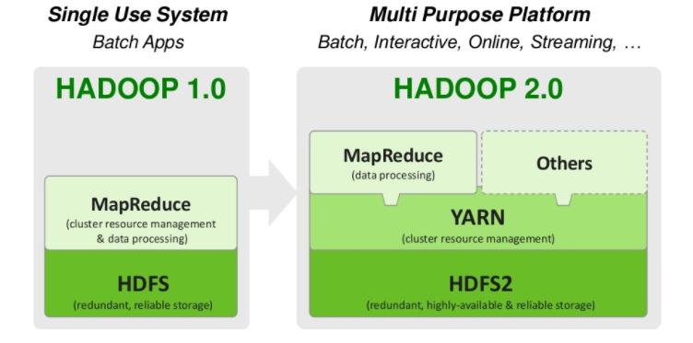
Hadoop1.0 vs Hadoop2.0

Slide 6
Hadoop Cluster
Designed for storing and analyzing huge amounts of unstructured data in a distributed computing environment.
Boost speed of data analysis
Highly scalable.
Facebook, Google, Yahoo, IBM have largest hadoop cluster.

Slide 7
Hadoop Ecosystem
Hadoop common- contains library and other modules which provides file systems
Hadoop YARN- framework for job scheduling and cluster resource management.
Map reduce- YARN-based system for parallel processing of large data sets
HDFS-Hadoop distributed file system

Slide 8
Advantages of Hadoop
Allows the user to quickly write and test distributed systems
Efficient and automatic distributes the data
Hadoop does not rely on hardware to provide fault-tolerance and high availability
Hadoop library itself has been designed to detect and handle failures at the application layer.
Servers can be added or removed from the cluster dynamically and hadoop continues to operate without interruption.
Open source.
Compatible on all the platforms since it is java based.

Slide 9
YARN
Yet another resource negotiator(YARN)
It’s a resource management in hadoop
Architectural centre of hadoop
Cluster management technology
Allocates all cluster resources in efficiently and dynamically.
High level of security
Help organisation to achieve better resource management
Allows real-time streaming
Process data into multiple engine
Batch processing to handle data stored in a single platform.
YARN is the foundation of the new generation of hadoop

Slide 10
Hadoop Distributed File System
Based on the Google file system (GFS)
Provides a distributed file system
Responsible for storing data on the cluster
Provides redundant storage for massive amounts of data
Files in HDFS are write once
HDFS uses a master/slave architecture

Slide 11
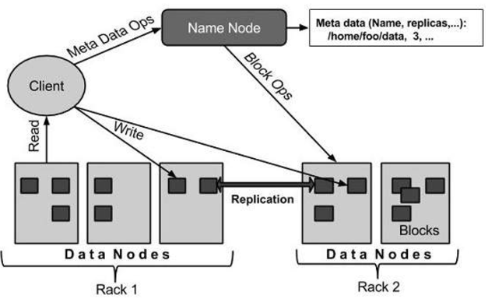
HDFS Architecture
Namenode -Contains metadata of files and directories
Large cluster with many files and Store in local disk.
Datanodes -Stores the actual data.

Slide 12
Map reduce
A software framework for easily writing applications
Store large amounts of structured and unstructured data in the Hadoop Distributed File System (HDFS)
Consists of two main functions
Map
Reduce

Slide 13
Map Reduce advantages
Simplicity- Easily run in any language.
Scalability- Run petabytes of data, stored in HDFS on one cluster
Speed - high speed to solve large problems
Recovery- takes care of failures. If a machine with one copy of the data is unavailable, another machine has a copy of the same key/value pair, which can be used to solve the same sub-task. The JobTracker keeps track of it all.

Slide 14
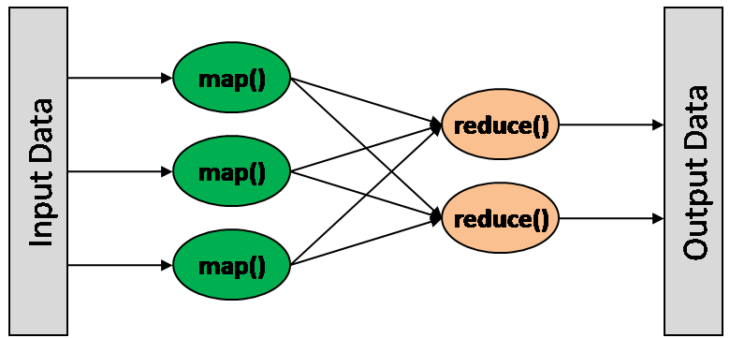
HOW MAP REDUCE WORKS?
Map: Map takes input data and converts it into a set of data, where individual elements are broken down into key/value pairs.
Reduce: It takes output from a map as input and collect the data and combine them to solve the problem.

Slide 15
H-Base
It’s used where we have millions and trillions of rows and columns in table
Data access in random manner
Column- oriented database.
Create automatic failure report
Horizontal scalability
Good for semi structured and structured data

Slide 16
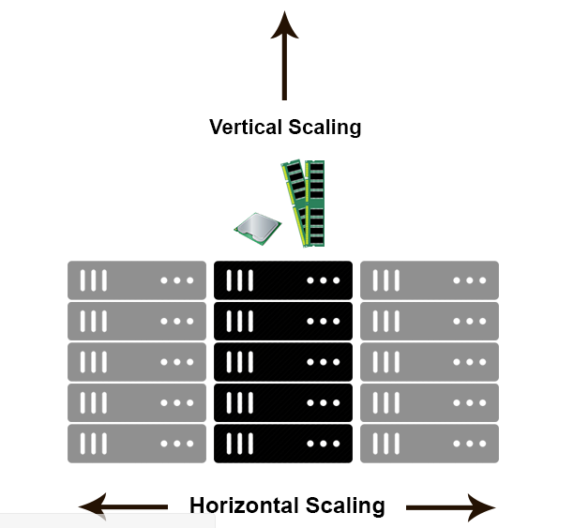
Scalability
Horizontal scaling means that you scale by adding more machines into your pool of resources.
Ex-MongoDB
Vertical scaling means that you scale by adding more power (CPU, RAM) to an existing machine.
Ex-My SQL

Slide 17
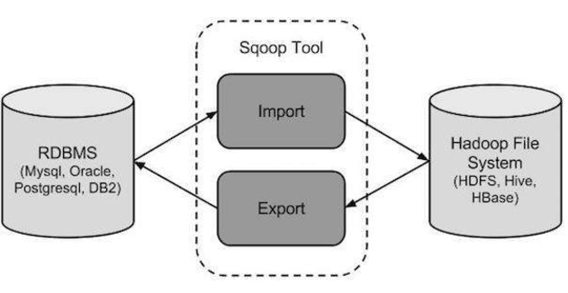
Sqoop
Transfer bulk of data between hadoop and RDBMS
Fast data copy
Fast performance

Slide 18
Hive
Hive is a data warehouse infrastructure tool to process structured data in Hadoop
developed by Facebook
It provides SQL type query language for querying called HiveQL or HQL.
It is familiar, fast, scalable, and extensible.

Slide 19
Thank you

