Slide 1
End-to-End Mutual Fund Analytics & Risk Engine
Capstone Project Portfolio Milestone
Presenter: Mahima Subhash Bhoite
Date: June 2026

Slide 2
Problem Statement & Project Objectives
The Problem:
• Financial analysts face data fragmentation when looking at historical NAV alongside investor behavior.
Project Objectives:
• Establish an automated, multi-source Python ETL pipeline. • Quantify tail risk using Historical VaR and CVaR (95%). • Deliver an interactive Power BI dashboard tracking asset metrics.

Slide 3
Data Architecture & Pipeline Flow
Data Lifecycle Phases:
1. Ingestion: Automated extraction of messy historical NAV logs and multi-variant transactions.
2. Processing: Data cleaning, anomaly handling, and relational constraint enforcement via Pandas.
3. Storage: Structured output exported to processed CSV databases.
4. Presentation: Visual consumption via interactive business intelligence tools.

Slide 4
Data Cleaning & ETL Operational Highlights
Core Engineering Wins:
• Rogue Data Containment: Mitigated structural file anomalies using selective string parsing and robust row-skipping tools (on_bad_lines='skip').
• Relational Integrity: Synced isolated transaction datasets directly to core master sheets using relational AMFI codes.
• Feature Engineering: Transformed static NAV records into daily percentage return metrics for downstream risk processing.

Slide 5
EDA Highlight 1: Fund Performance Overview
Key Structural Insights:
• Cleansed datasets confirm significant tracking variance across 40 mutual fund schemes.
• Flagship equity assets exhibit high market concentration parameters.
• [Placeholder: Insert Performance Chart from Notebook]

Slide 6
EDA Highlight 2: Investor Behavioral Cohorts
Behavioral Trends:
• Onboarding Segments: Grouped users by initial transaction year to track capital retention rates.
• Volume Drivers: Legacy cohorts contribute a substantial share of recurring SIP capital.
• Structural Shifts: Asset preference matrices show sharp divergence between newer and long-term investors.

Slide 7
Advanced Analytics: Downside Risk Quantification
Risk Metric Formulations:
• Historical VaR (95%): Establishes the 5th percentile of daily market returns, indicating the baseline boundary for expected losses.
• Conditional VaR (95% CVaR): Computes the true expected shortfall by taking the average of all returns breaching the VaR threshold.
• Operational Storage: Calculations run seamlessly across all active models and auto-export to reports/var_cvar_report.csv.

Slide 8
Advanced Analytics: 90-Day Rolling Sharpe Analysis
Volatility Mapping:
• Risk-Adjusted Tracking: Evaluated rolling consistency over time using (Rolling Mean / Rolling Std) x sqrt(252).
• Core Findings: Flagship trackers show durable stability, while speculative sectors reveal sharp performance decay during market corrections.

Slide 9
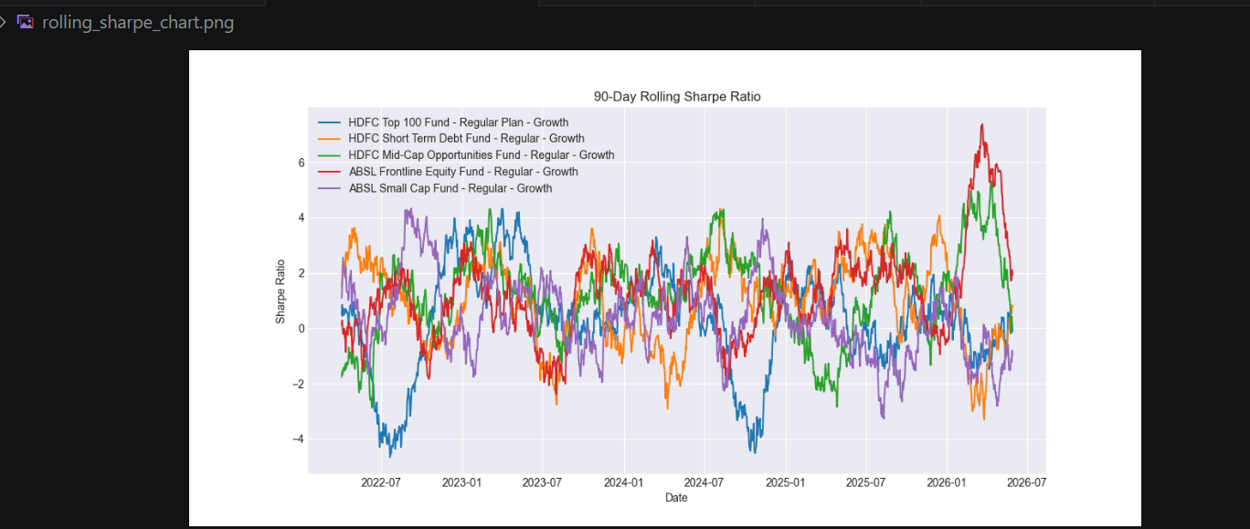
Rolling_shape_chart.png

Slide 10
Power BI Dashboard Showcase: Executive View
System Overview Monitoring:
• High-level macro views mapping total Assets Under Management (AUM) and total user footprint changes.
• Scalable layout optimized with clean, action-oriented KPI cards for rapid executive oversight.

Slide 11
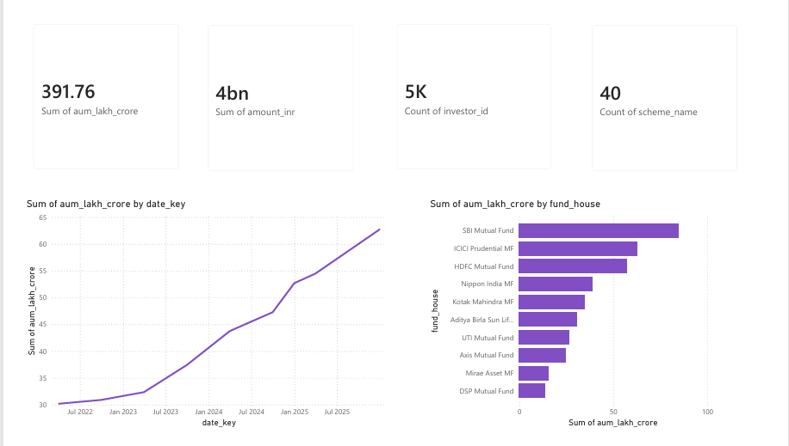
Main dashboard page

Slide 12
Power BI Dashboard Showcase: Granular Deep Dive
Interactivity Highlights:
• Integrated slicer panels allowing zero-latency filtering across date brackets, asset class, and risk categories.
• Embedded churn detection monitors for immediate account risk evaluation.

Slide 13
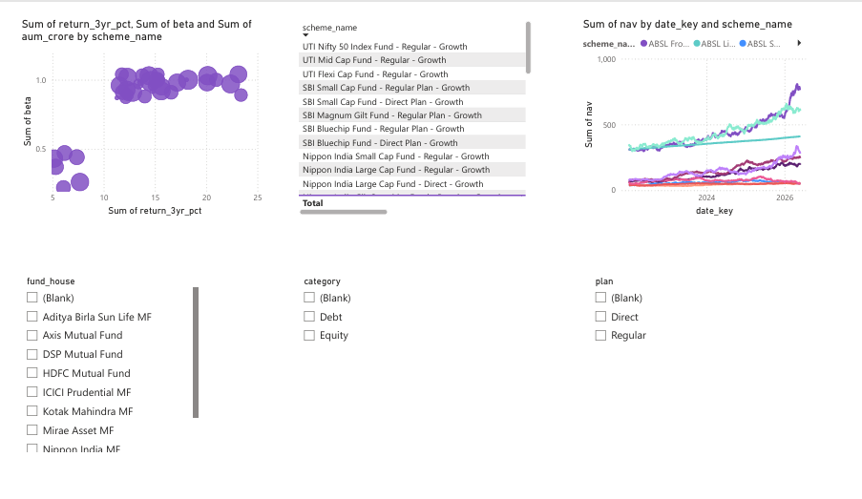
Filtered dashboard deep dive

Slide 14
Strategic Conclusions & Action Plan
Operational Strategies:
• Risk Mitigation: Enforce strict sector caps on highly concentrated (high HHI) profiles to mitigate volatility.
• Retentive Engagement: Flag at-risk SIP accounts with payment gaps over 35 days for automated customer service outreach.
• Product Engineering: Implement recommender.py's sorting logic directly into retail interfaces to drive personalized discovery.

Slide 15
Architecture Status & Closing (Q&A)
Deployment Summary:
• Production Status: Release Build v1.0 Live.
• Version Control: Fully committed, clean, tagged environment successfully deployed on GitHub.
• Thank you! Open for technical, architectural, or analytics questions.

