Slide 1
Assignment1_tableau
File created on: 10/28/2023 9:30:38 PM

Slide 2
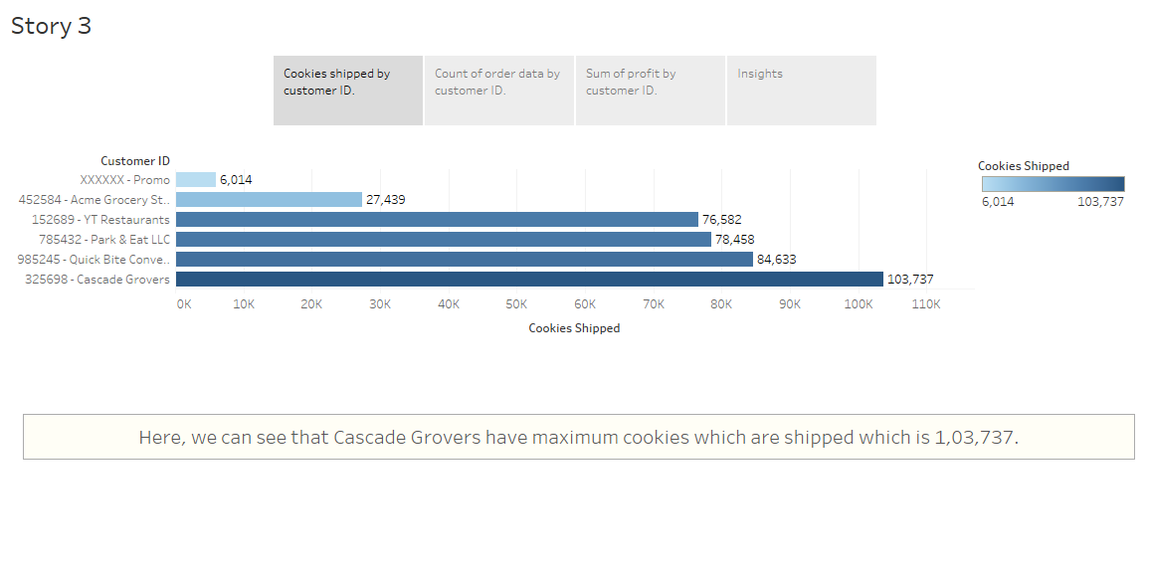

Slide 3
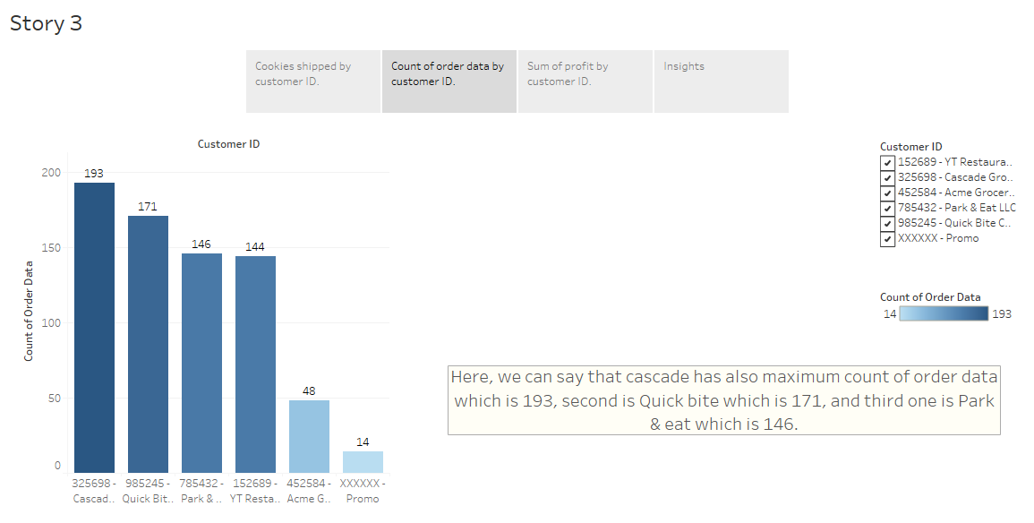

Slide 4
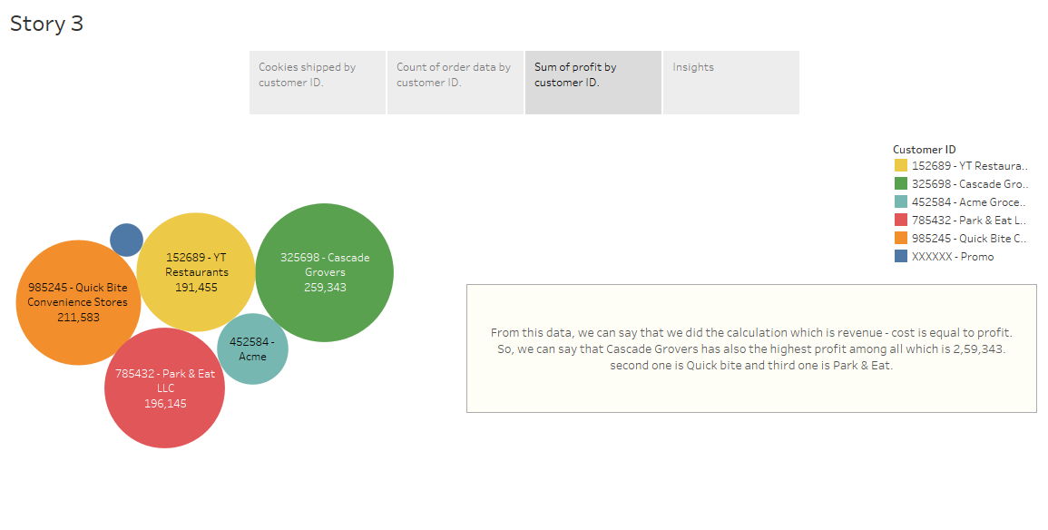

Slide 5
