Slide 1
Stress Level Detection

Slide 2
Introduction
Stress is a growing concern that affects emotional and physical well-being.
Our project aims to detect stress levels by analyzing user responses to carefully designed questions using Natural Language Processing (NLP) techniques.

Slide 3
Problem Statement
- Many people experience stress but find it hard to identify or express.
- Traditional mental health check-ups are time-consuming and often require in-person consultation.
- There's a need for an automated system that can detect stress by analyzing user responses to relevant questions.
Our solution: A question-based system that classifies user stress levels using their answers.

Slide 4
Objectives
- Collect responses from users through stress-related questions.
- Analyze the textual answers using NLP.
- Classify responses into:
1. Not Stressed
2. Moderate Stress
3. Highly Stressed
- Provide quick, automated feedback to users.

Slide 5
Technology Stack
- Frontend: React.js (for displaying questions and collecting answers)
- Backend: Node.js with Express.js (to handle API and routing)
- Machine Learning: Python (for training NLP models)
- Database: MySQL / MongoDB (to store responses and results)
- Libraries: NLTK, Scikit-learn, Pandas, NumPy
- Authentication: JWT / Firebase

Slide 6
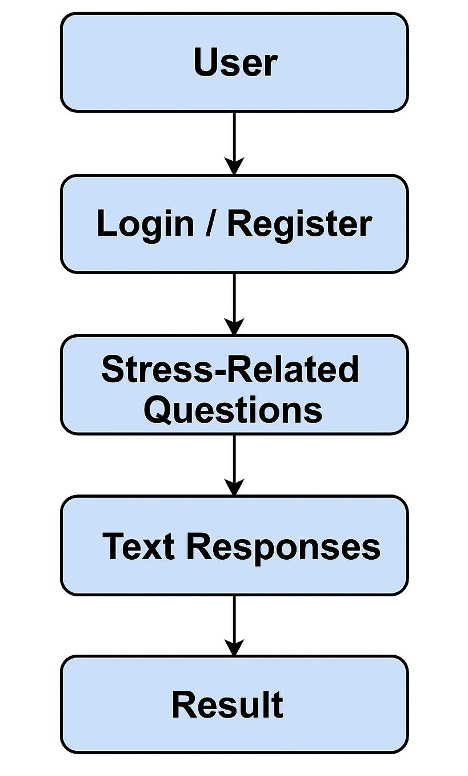
Flow Chart

Slide 7

Home Page

Slide 8
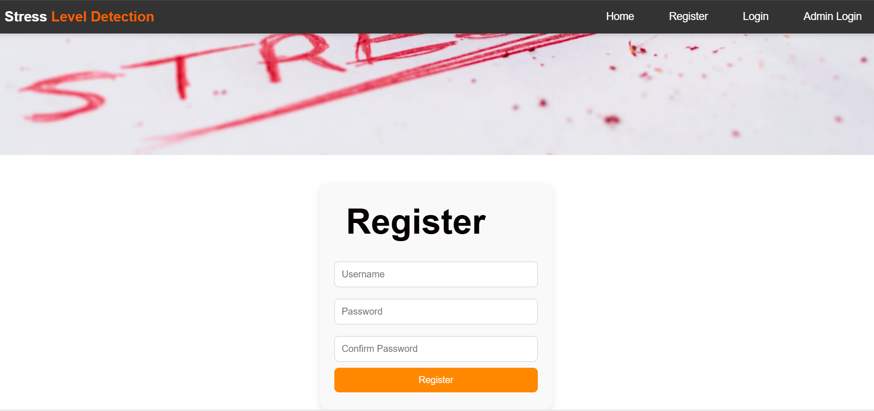
Register Page

Slide 9
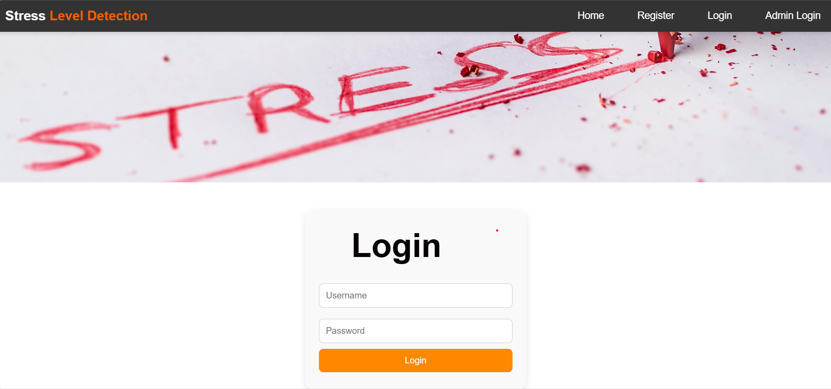
Login Page

Slide 10
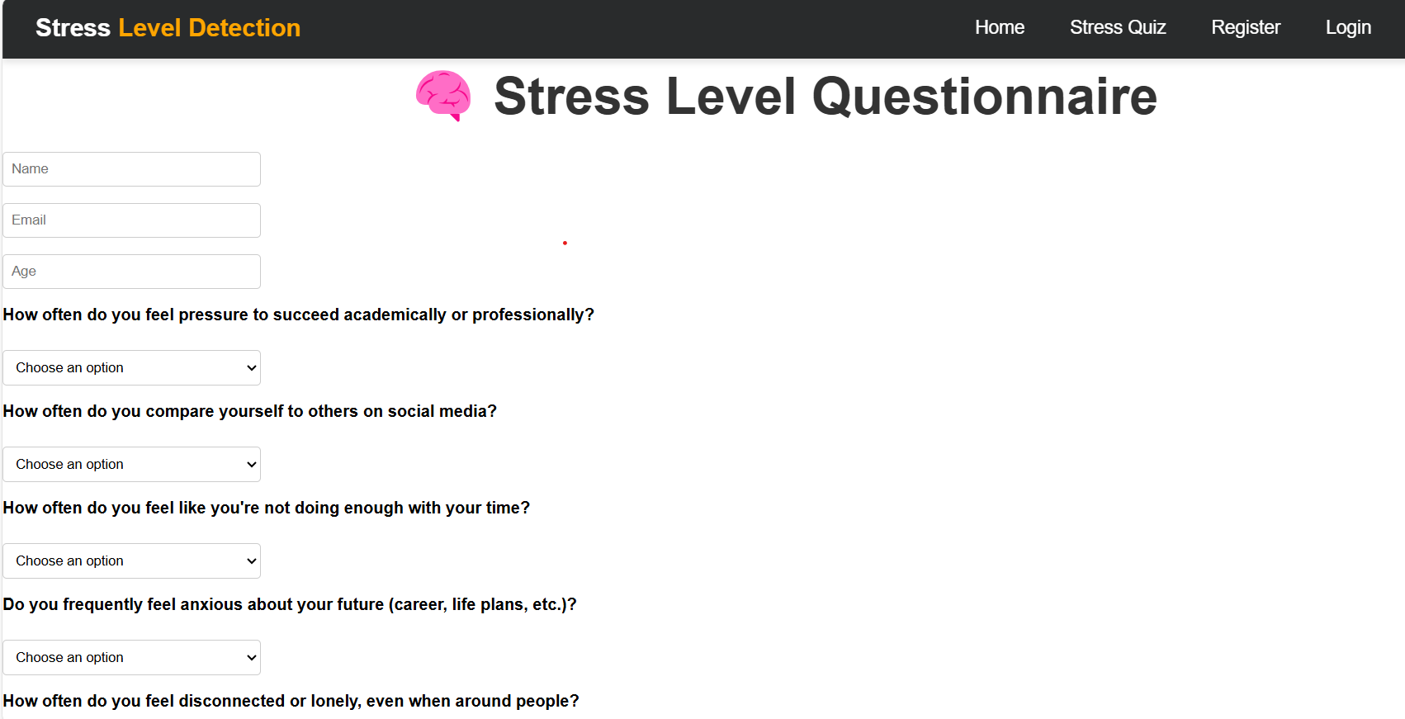
Text_Detection Question

Slide 11
Result Page

Slide 12
Conclusion
We created a text-based question system to detect stress levels using NLP.
It is simple, efficient, and accessible to users without medical intervention.
With further improvements, it can serve as a supportive tool for early mental health awareness.

