Slide 1

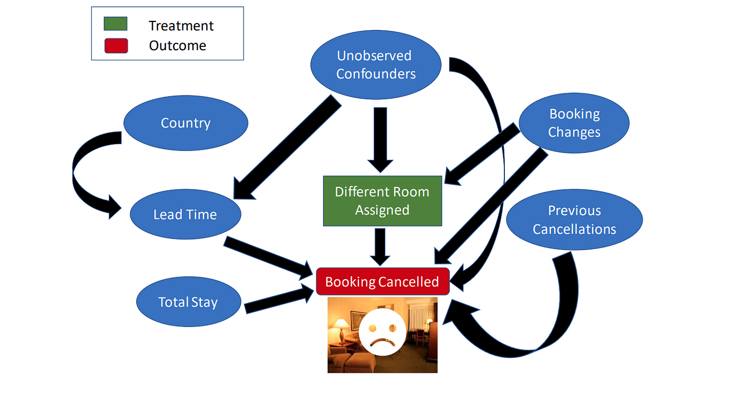
By- Mahima Lakra
Capstone project - I
Hotel Booking Analysis Exploratory Data Analysis(EDA)

Slide 2
Project Summary
This dataset contains booking information on City Hotels and Resort Hotels, and includes information such as when the booking was made, length of stay, number of adults, children, and/or Babies, and the number of available parking spaces, among other things. All personally identifiable information have been removed from the data.
The dataset is provided to find out links between different aspects of booking process to help a customer to make a well informed decision for booking at a right time or getting right value. The analysis could also help hotels in improving their services and therefore gaining more user base and even could retain customers in a long run.

Slide 3
Data analysis roadmap
Collecting data
Understanding Data
Preparing data
Data Analysis
Sharing Insights

Slide 4
Exploring data
Our dataset contains119390 rows and following fields: -
Hotel :- Type of hotel Booking, i.e. H1 = Resort Hotel, H2 = City Hotel.
is_cancelled :- explains if the booking was cancelled(1) or not cancelled(0).
lead_time :- Number of days that elapsed between entering date of the booking into the Hotel’s management system and the arrival date.
arrival_date_year :- year of arrival date.
arrival_date_month :- Month of arrival date.
arrival_date_week_number :- Week number of year for arrival date.
arrival_date_day_of_month :- Day of arrival date.
stays_in_weekend_nights :- Number of weekend nights (Saturday or Sunday) the guest stayed or booked to stay at the hotel.
stays_in_week_nights :- Number of week nights (Monday to Friday) the guest stayed or booked to stay at the hotel.
adults :- Number of adults.
children :- Number of children.
babies :- Number of babies.
Meal :- Type of meal booked. Categories are presented in standard hospitality meal packages.

Slide 5
country :- Country of origin.
market_segment :- Market segment belongs to. In categories, the term “TA” means “Travel Agents” and “TO” means “Tour Operators”.
distribution_channel :- Booking distribution channel. The term “TA” means “Travel Agents” and “TO” means “Tour Operators”.
is_repeated_guest :- Value '0' for customers coming for first time and Value '1' for customers who have visited previously.
previous_cancellations :- Number of previous bookings that were cancelled by the customer prior to the current booking.
previous_bookings_not_canceled :- Number of previous bookings not cancelled by the customer prior to the current booking.
reserved_room_type :- Type of room reserved, presented in the form of codes.
assigned_room_type :- Type of room assigned, presented in the form of codes.
booking_changes :- count of changes/amendments made from the time of booking till check-in or cancellation.
deposit_type :- Suggesting if deposit is made/not made or refunded.
agent :- ID of the travel agency that made the booking.
company :- ID of the company responsible for booking.
days_in_waiting_list :- Number of days the booking was in the waiting list before it was confirmed to the customer.
customer_type :- Type of customer.

Slide 6
Adr :- Average Daily Rate as defined by dividing the sum of all lodging transactions by the total number of staying nights.
required_car_parking_spaces :- Number of car parking spaces required by the customer.
total_of_special_requests :- Number of special requests made by the customer(e.g. - type of room or view from the room).
reservation_status :- Reservation status, if the booking was cancelled, customer has checked out or customer did not show.
reservation_status_date : - Date at which the last status was set.
EDA will include following type of analysis: -
Univariate analysis - This type of analysis includes one variable parameter. They are descriptive in nature. E.g. – Analysis of heights of a group of class 5 students.
Bivariate analysis – This type of analysis includes two value parameter. This is useful to find relation between two variable. E.g. - Analysis to find right range of Body Mass Index using height and weight.
Multivariate analysis – This type of analysis include more than two variable parameters and are used to deal with complexity and are best understood through charts such as heatmaps.

Slide 7
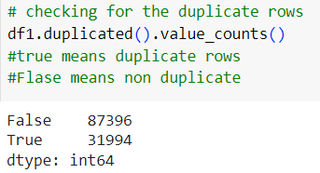
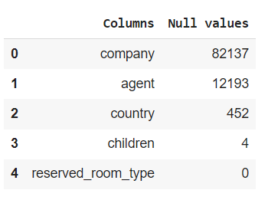
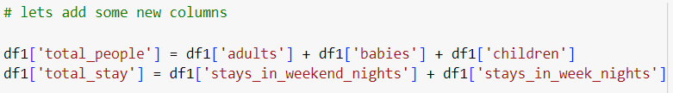
Data cleaning and manipulation
Checking duplicated rows and dropping.
New changes: -
New row shape – 87396, 32
Company and agents replace with 0.
Country is replaced with ‘Other’.
Children also replace with 0.
New columns added total people and total stay
Null values in descending order.
New shape – 87230, 34

Slide 8
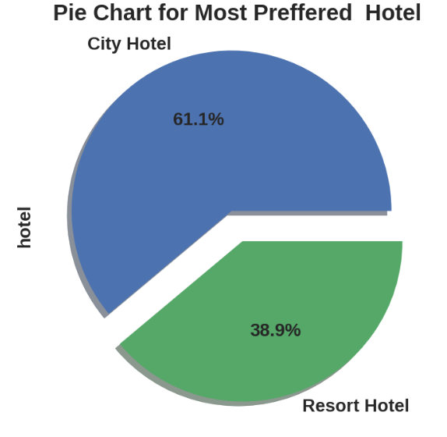
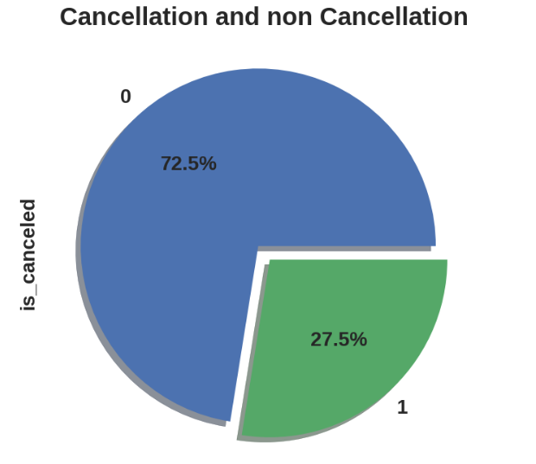
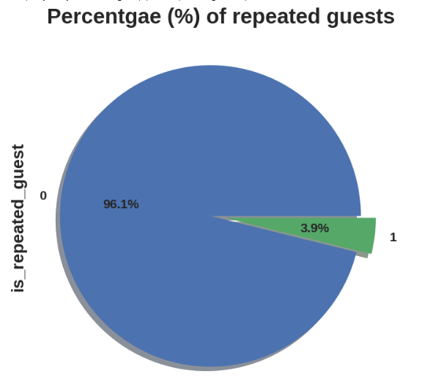
Exploratory Data analysis
Starting with Univariate analysis
Judging from the ratio of nearly 6:4 it might be possible that the number of City hotels are more compared to Resort hotel.
Hotels are not able to make a remark in the minds of guests, in order to retained the guests management should take feedbacks from guests and try to improve the services.
27.5% of cancellations can be from various reasons like, last moment change of plans or finding a better or different Hotels, or any technical or any such issue.

Slide 9
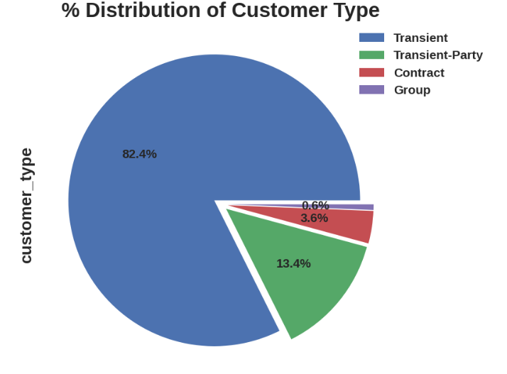
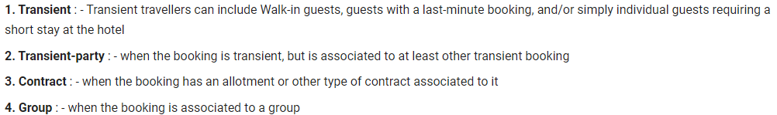
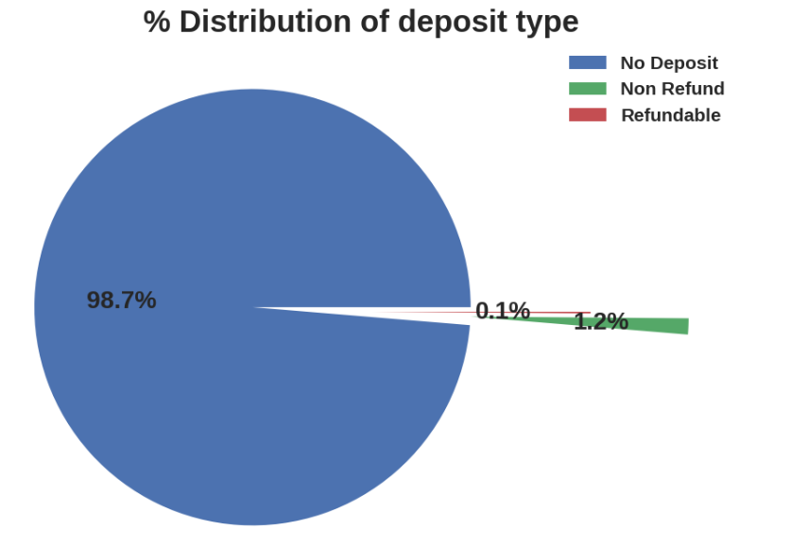
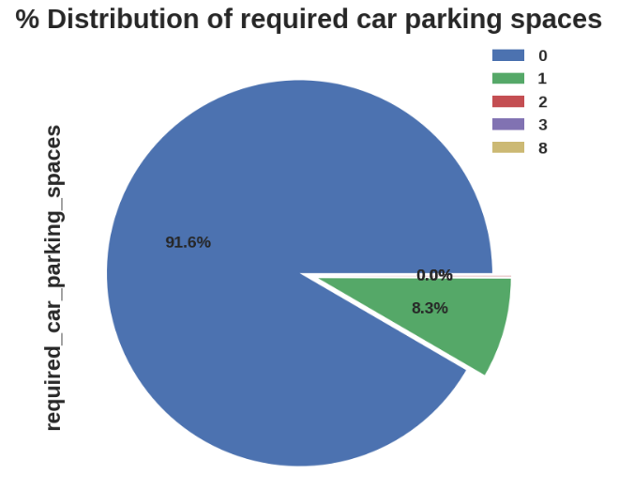
Guest in the location expect less crowd in the area and more Hotels which could explain a high percentage of Transient customers.
Most preferred deposit type is ‘no deposit’ which could be a better option since a deposit could involve risk of no refund on bad quality of service or other such things.
Most guests don’t need parking space and only a few need parking space for one.

Slide 10
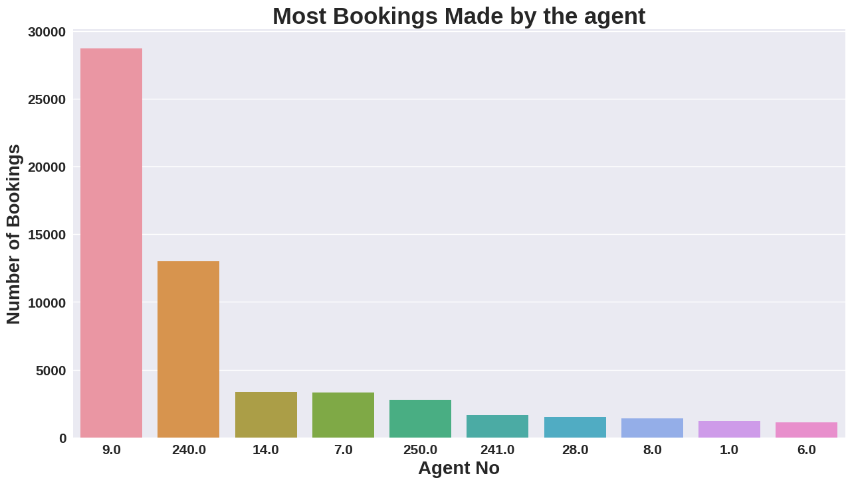
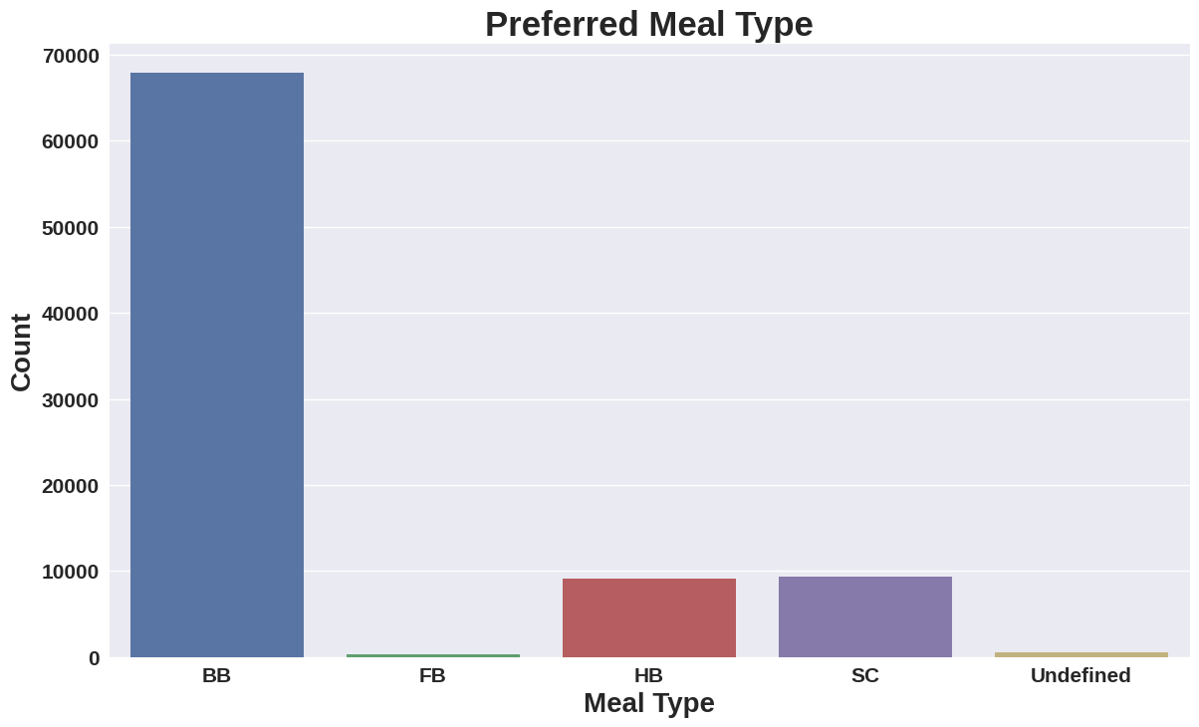
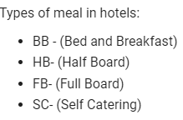
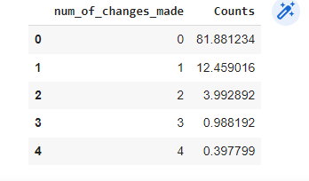
Agent ID-9 seems very popular for booking hotels since it made the most number of the bookings.
Most guests might be satisfied or don't want to make changes considering few number of days they are on.
Guest might want to try local cuisines or food from other places which could be the reason full meal is not preferred by most guests. Hotels should ask the opinion of guests in the process of making the food menu and make suitable arrangements as necessary.

Slide 11
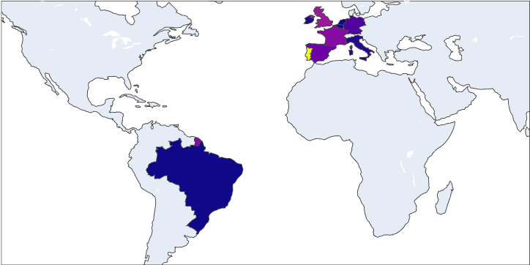
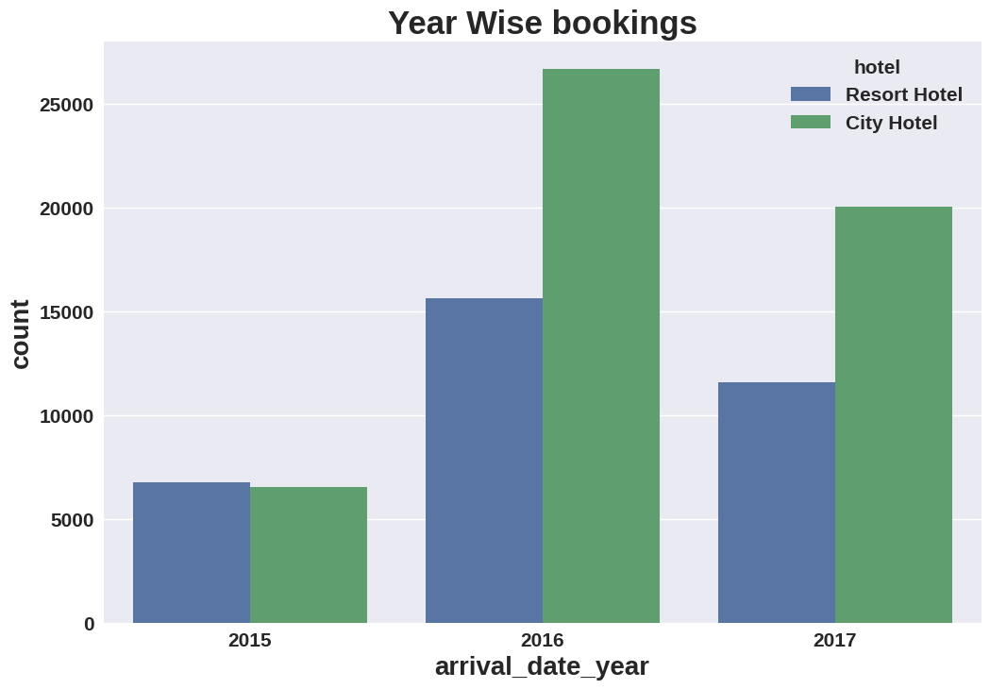
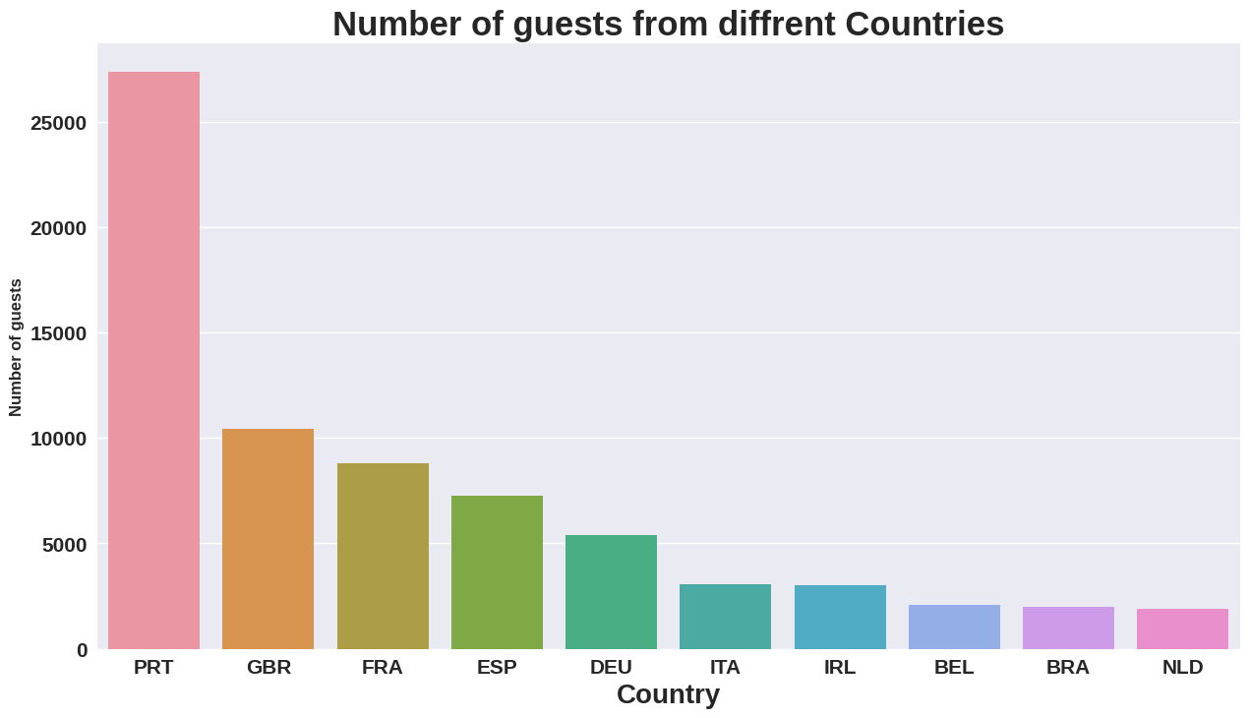
Map shows the distribution of customers of bookings from different countries with change in colour depicting different amount of bookings.
2016 had highest Bookings and 2015 bookings were more even. Overall consistency of bookings are low, it should be increasing which would be good or stable.
Over 27000 guests were from Portugal(PRT) followed by Great Britain(GBR) and France in second and third place respectively.

Slide 12
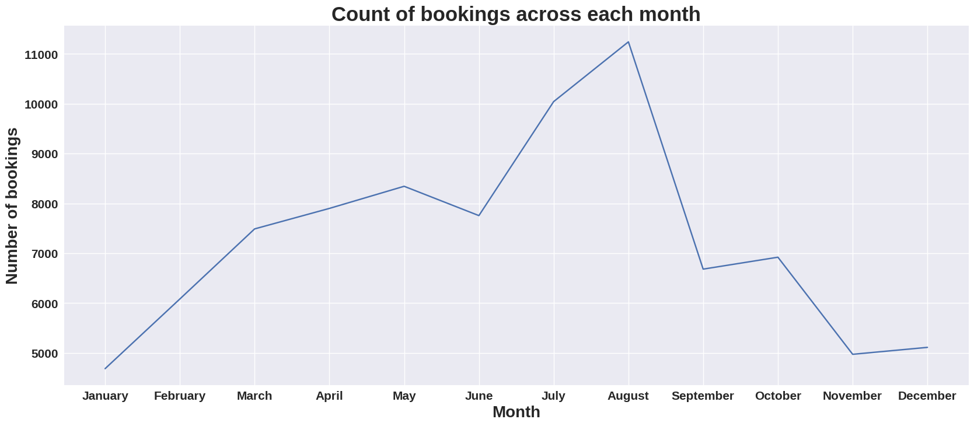
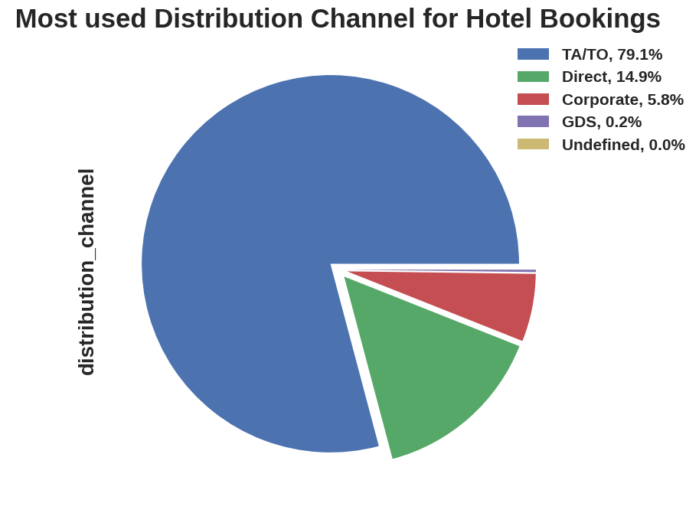
July and August saw a rise in number of bookings. This could be because of summer months in those the countries being more pleasant compared to winter months.
Travel agent(TA)/ Travel Operator(TO) contributed were a major contributors in terms of Hotel bookings and possibly could be a popular choice by guests.

Slide 13
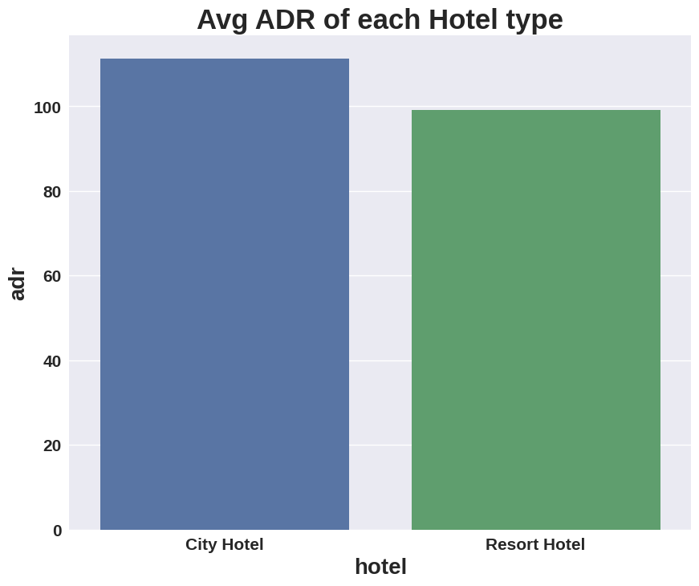
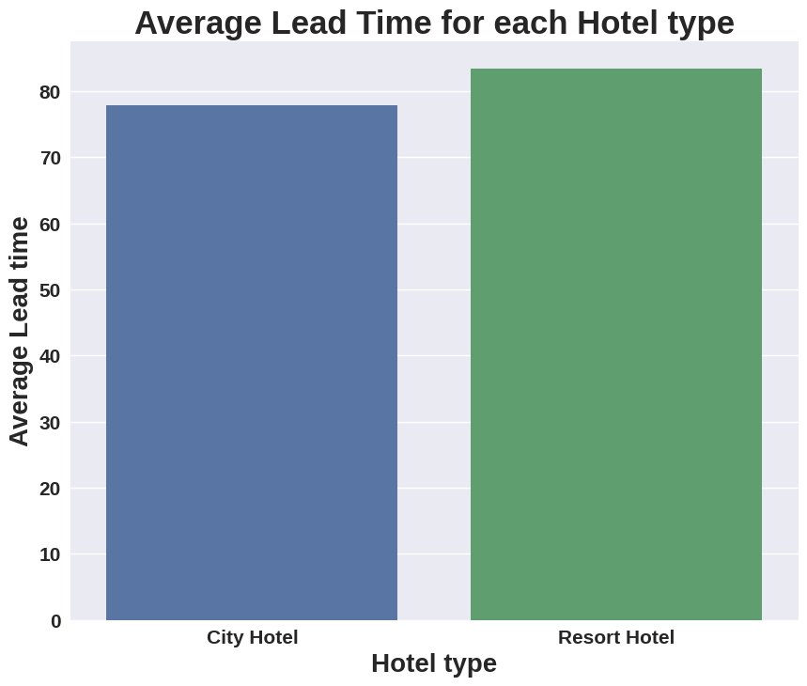
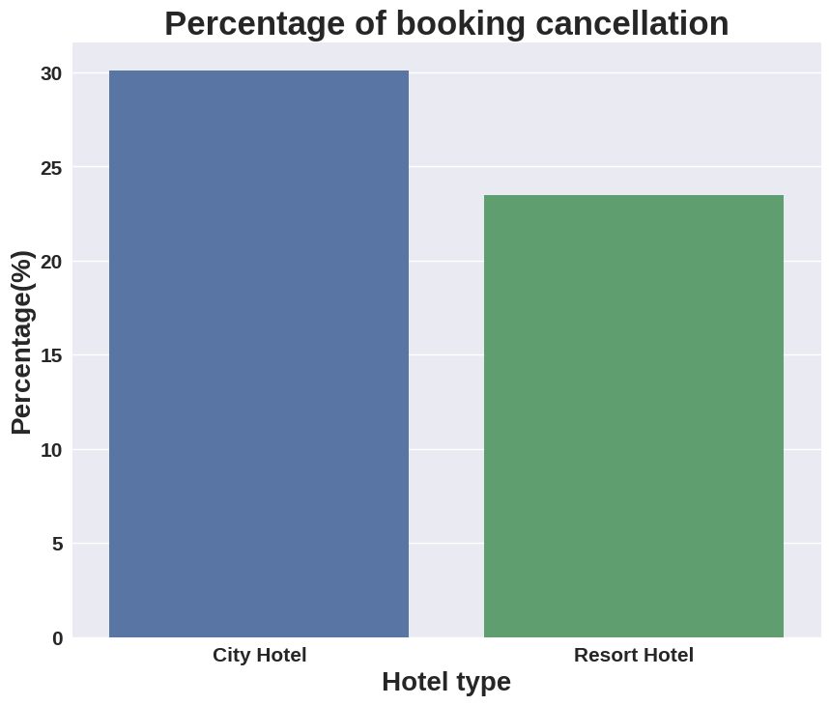
Bivariate and multivariate analysis
City Hotel having Higher ADR can mean that they are more efficient in generating revenue as compared to Resort hotels. One of the possible reason can be because of more number and percentage of bookings. Other could be the cost of service incurred and other such possible reasons.
Guests booking in resort hotel might be planning in advance compared to city hotel guests, which could explain a longer lead time.
Since guests in resort hotel plan in advance so it is possible that the guests have a clear understanding of the hotels they book and hence have a lesser percentage of cancellations.

Slide 14
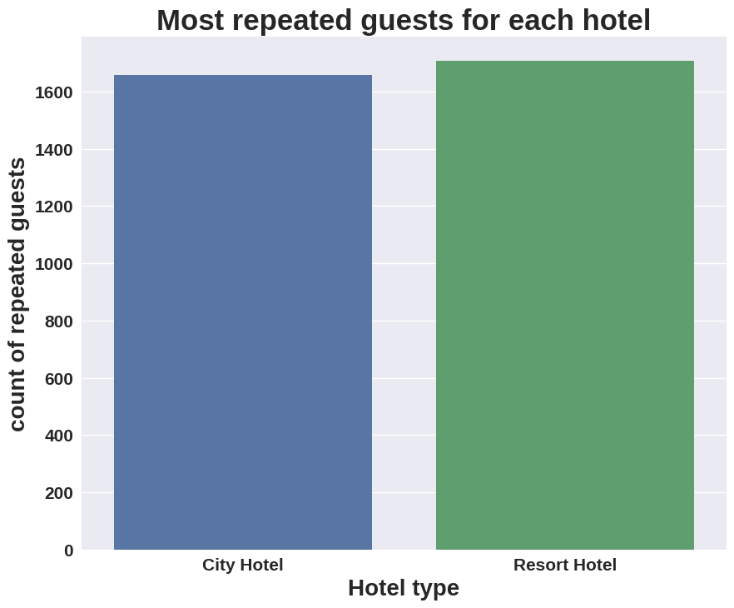
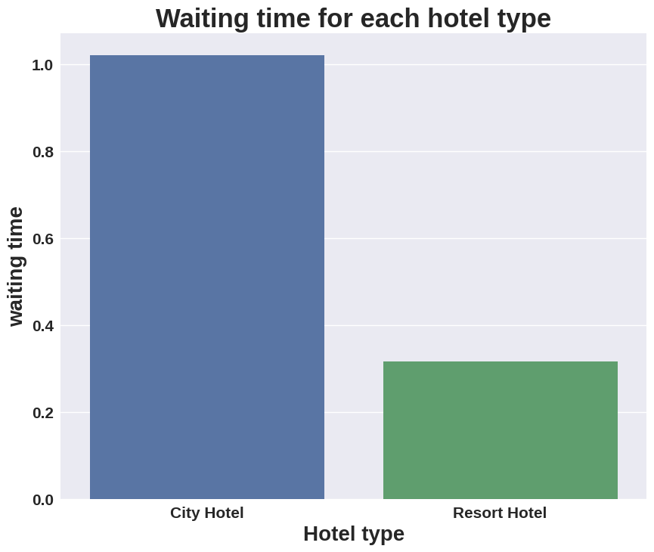
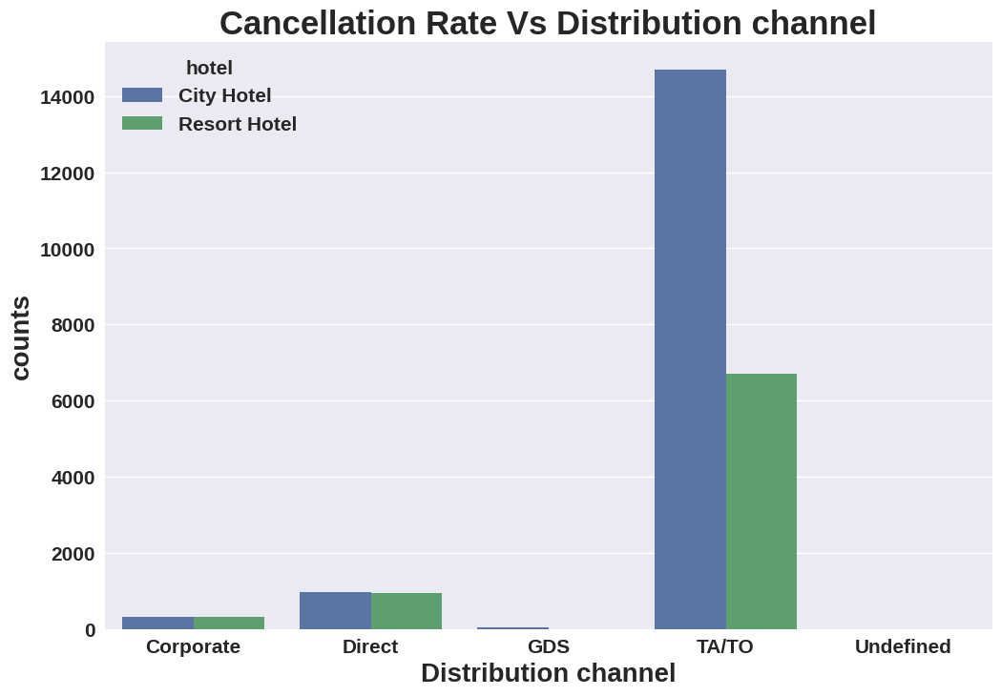
Since number of repeated guests who book are same but upon comparing previous data of number of city hotel bookings to resort hotel bookings, it can be seen that percentage of repeated guests who book resort is more. This could be because people tend to go to resort hotels for their quality of service and the experience they can have. Hence City hotel needs to improve its services and experience they provide.
City hotel might have a longer waiting time because of the quantity of bookings they have and are hence much busier. Since resort hotels have a longer average lead time it can also be said that city hotels are booked in a moments notice(in an immediate time frame) and since resort hotels might be booked in advance will have a shorter waiting time.
Cancellation rates are higher in TA/TO this could mean a lot of things like dissatisfaction with the type of hotel or the guests not getting proper information during booking, or a variety of reasons, which is why they need to improve their service and reduce the rate of cancellations.

Slide 15
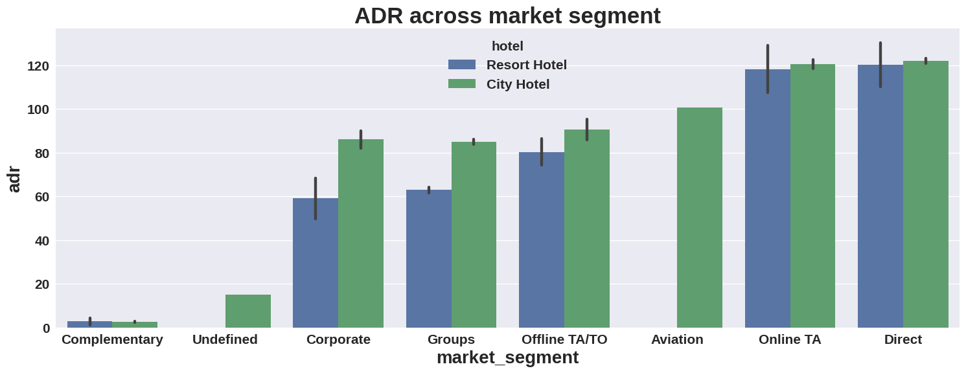
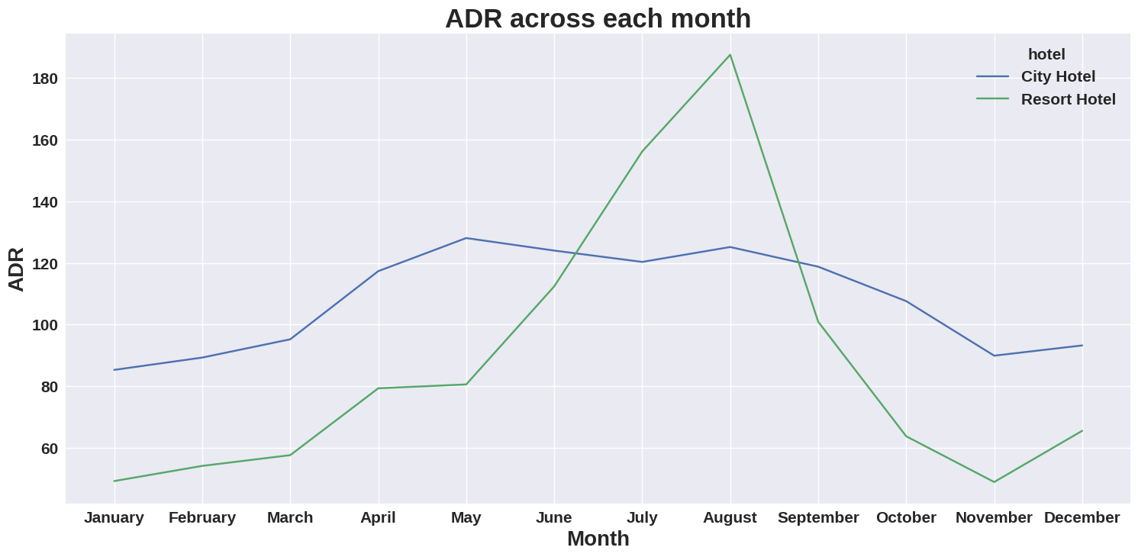
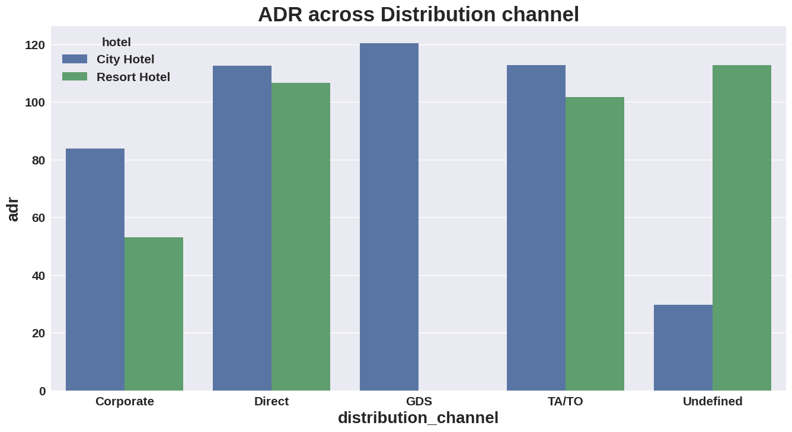
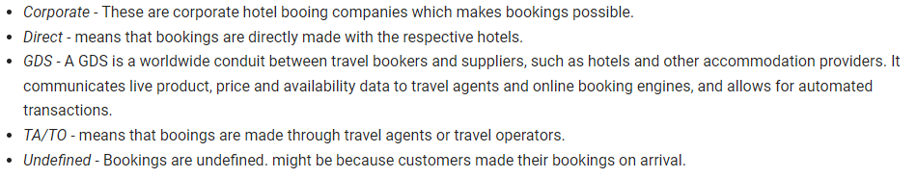
GDS and Aviation seems to have not explored much in resort hotel category in terms of booking or in generating ADR which needs to be improved.
'Direct' and 'TA/TO' have almost equally contributed to ADR in both hotels
City hotel on average have a higher ADR.
Higher ADR (means more bookings) in non winter months indicated that the data collected from regions tend to have more pleasant summers or this could be because of summer vacations during this time. Therefore, if bookings are to be made during this time interval then advance bookings are suggested and if the guests want to go during the time when there is lesser number of tourists in the region they should consider going during the months of November to March.

Slide 16
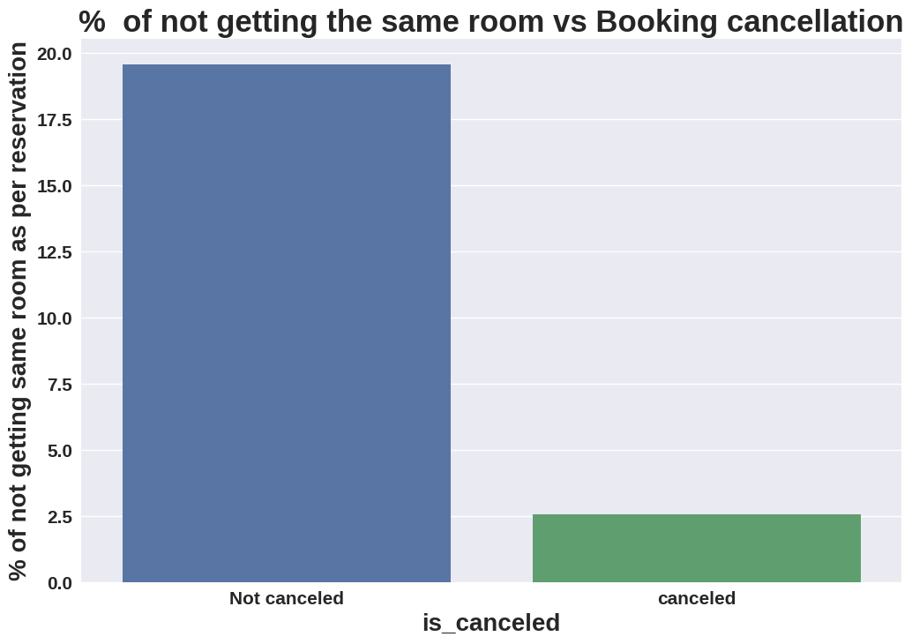
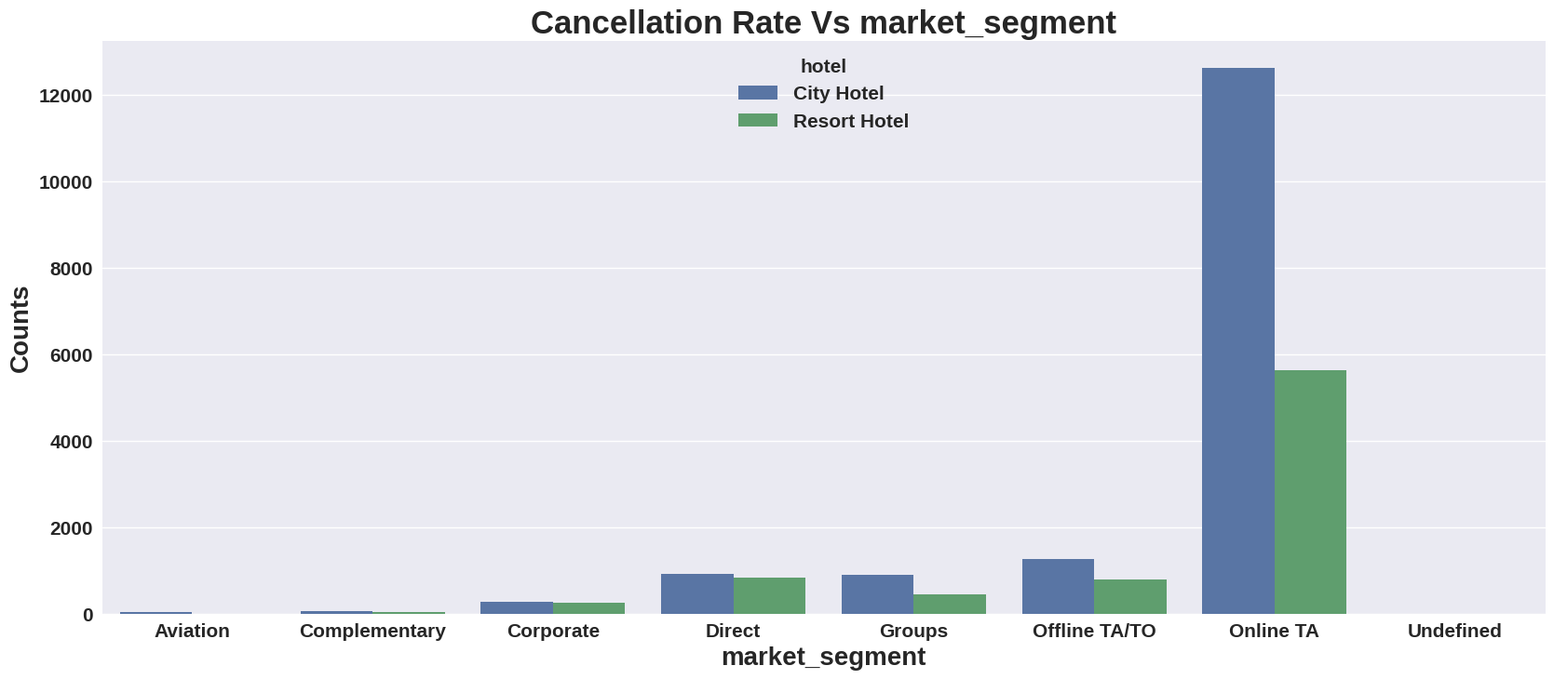
It seems that cancellations do not have much effect relative to getting a different room they are allocated to, since booking canceled in this case is as low as 2.5%. Most guest stick to the room they are allotted to and don’t change.
TA/TO has an overall higher cancellations where 'Online T/A' has the highest cancellation in both type of hotels.
In order to reduce the booking cancellations hotels need to improve their quality of service along with user experience and change their policies.

Slide 17
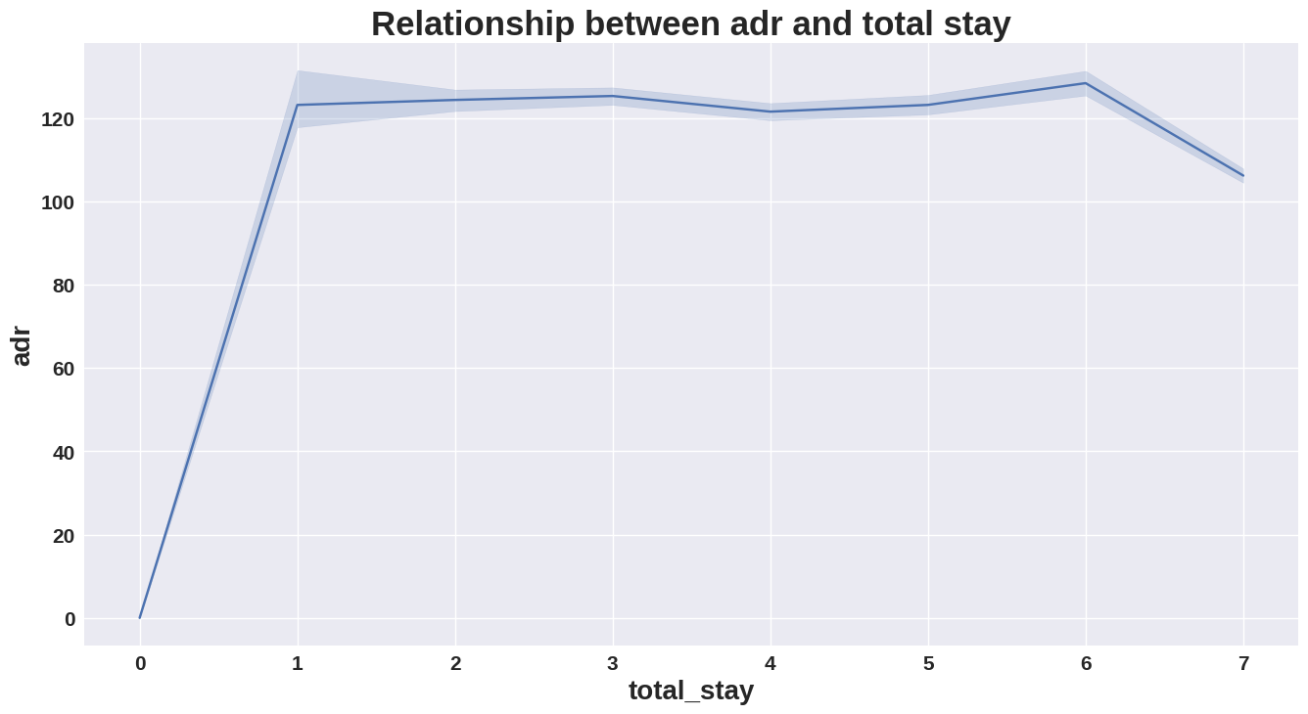
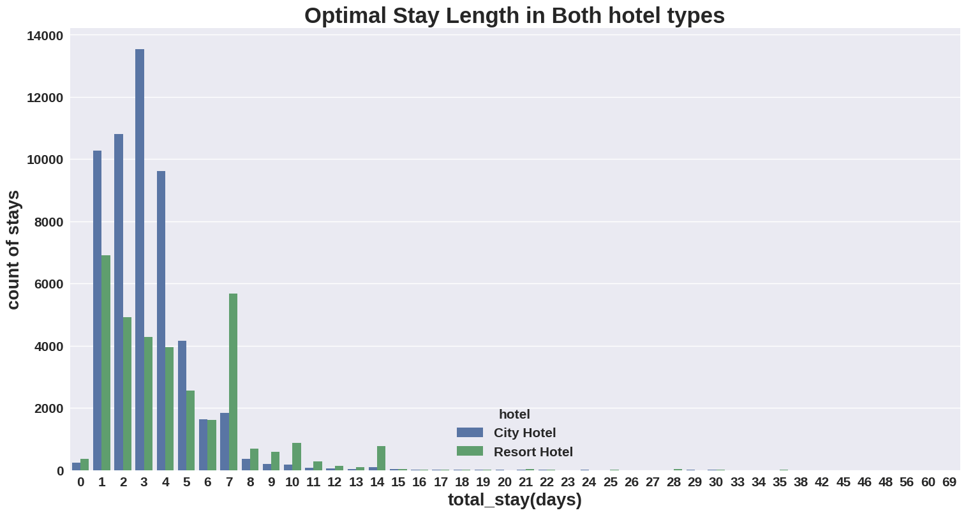
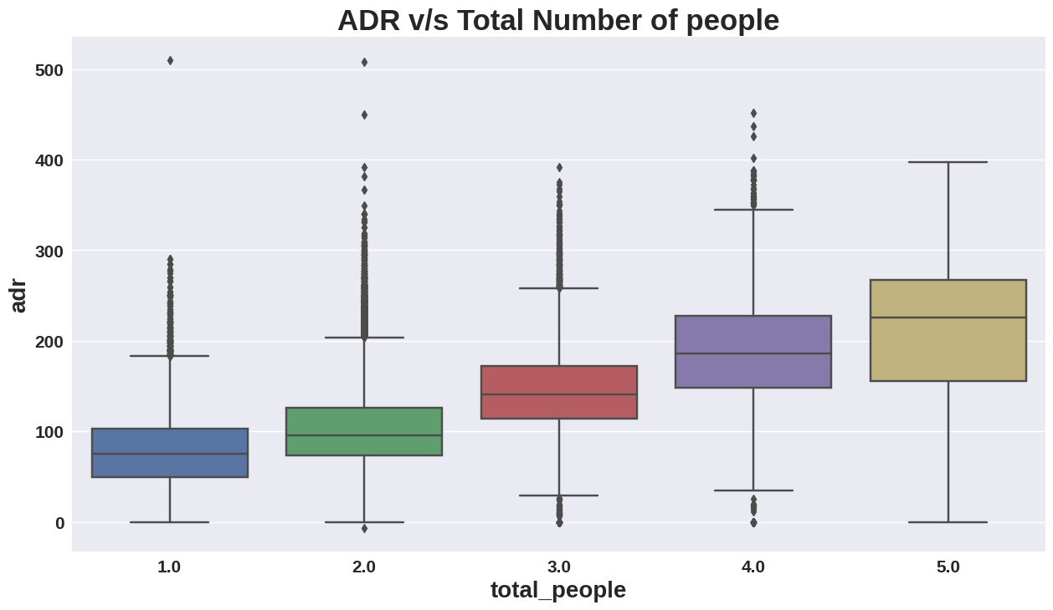
With increase in Total days of stay and total number of people ADR tends to increase.
More people means more beds which in turn needs more space which increases cost and hence the price of rooms , making it more profitable.
Optimal stay is about 6 to 7 days, since most people prefer it.
For city hotel optimal stay is 3 to 4 days and guests seem to stay longer in resort hotels which is evidential to the point that guests in resort hotel come for a nice and long relaxing trip.
ADR starts to decrease after a certain total stay i.e. greater than 7 days.

Slide 18
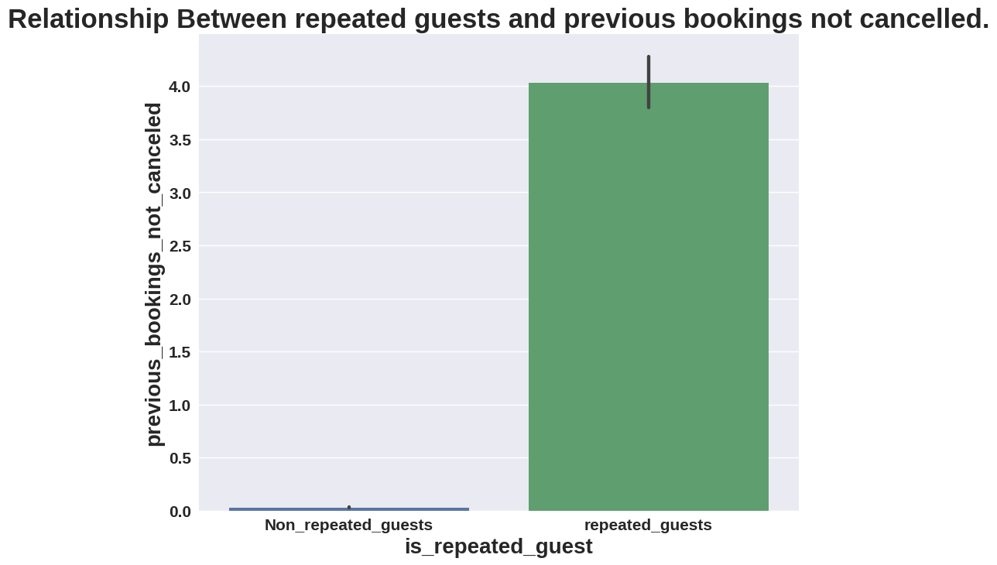
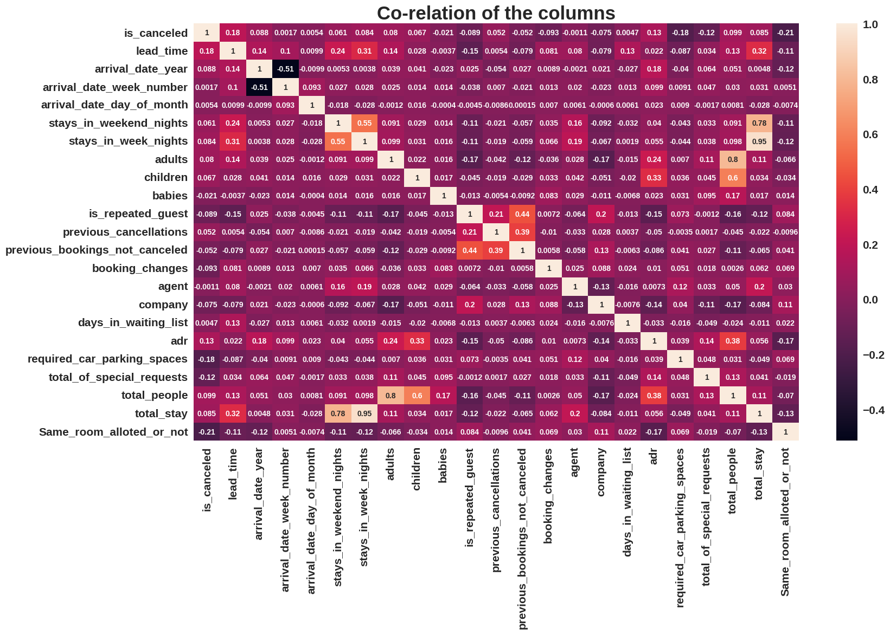
Repeated guests have canceled less bookings previously which means that guests who are satisfied with the services offered at the hotels are more likely to visit again. This point can be proved from correlation map.
A correlation map here is a summary of all the points and observations made so far.

Slide 19
CONCLUSION
An optimal say of 3 to 4 days in City hotels is an optimal stay for most guest and can extend up to 7 days.
More number of guests are better for both Hotels and guests in group, as it will bring down individual price for the room for guests and will generate more ADR for Hotels.
Waiting time is more in City Hotel is more and lead time is less so guests can book on spot during less crowded seasons and resort hotel guests have a longer lead time hence they are advised to book in advance.
Non-winter seasons (April till October) have a higher traffic of guests in the region hence guests are advised to book in advance during these seasons or prefer winter seasons for less traffic in the region.
Hotel’s staff are also advised to learn some international languages since it will be easier to communicate as many of the guests are from different countries. Languages like Portuguese, English, French and Español will be good since guests from these countries are higher in number.
City hotel are more popular among guests and Resort hotels are preferred for longer stays.

