Slide 1

“EMPLOYEE ATTRITION PREDICTION”
The University of Texas at Dallas
Academic Term: Fall 2025
Presented
By
Mahima Bhushan
Net ID: mxb240023

Slide 2

Introduction
What is Employee Attrition?
Employee attrition refers to employees leaving an organization over time.
It includes resignations, retirements, and voluntary exits.
High attrition affects business continuity and increases hiring costs.
Why This Matters Today
Modern companies experience rising attrition due to:
  Better opportunities
  Salary dissatisfaction
  Work-life balance issues
  Job dissatisfaction

Slide 3
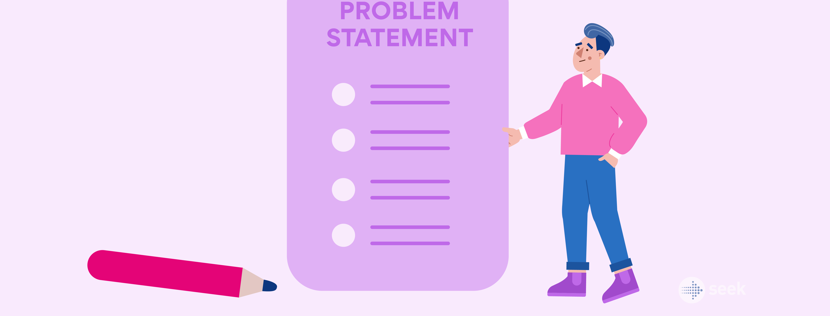
Problem statement
Why Predict Employee Attrition?
Companies face significant financial loss when trained employees leave.
Replacing employees is time-consuming and expensive.
Attrition impacts productivity, team stability, and long-term growth.
Predicting attrition early helps HR take preventive action.

Slide 4
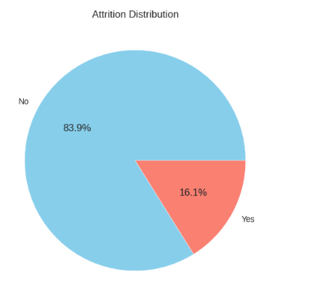
Dataset Description
IBM HR Analytics Attrition Dataset
1470 employee records
35 features
Mix of numerical & categorical attributes
Contains salary, job role, satisfaction,
manager ratings, behavior data
Target Variable
Attrition
  Yes = Employee left
  No = Employee stayed
Key Challenge
Highly imbalanced dataset
  84% No
  16% Yes

Slide 5







System Architecture Diagram
IMPORT DATASET
DATA
PREPROCESSING
EXPLORATORY
DATA ANALYSIS
COMPARING
MODEL
PERFORMANCE
ML ALGORITHMS
TRAINING
AND
TESTING
FEATURE ENGINEERING
/ENCODING/
SCALING

Slide 6
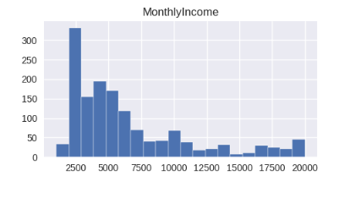
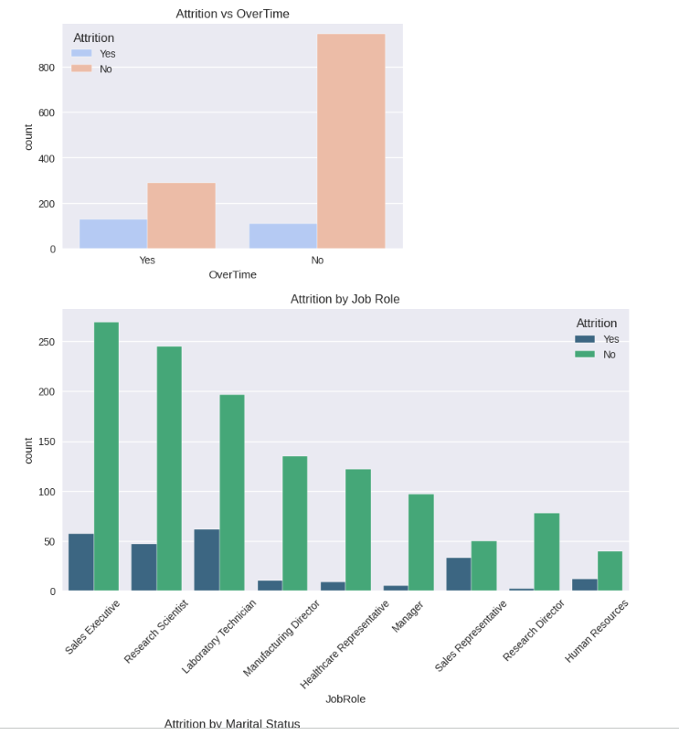
Exploratory Data Analysis (EDA)
Observations from EDA
Younger employees show higher attrition
Lower salary ranges show more attrition
Overtime workers show significantly higher attrition
Single employees show higher attrition than married ones
Highest attrition roles:
  Sales Representative
  Laboratory Technician
  Research Scientist

Slide 7
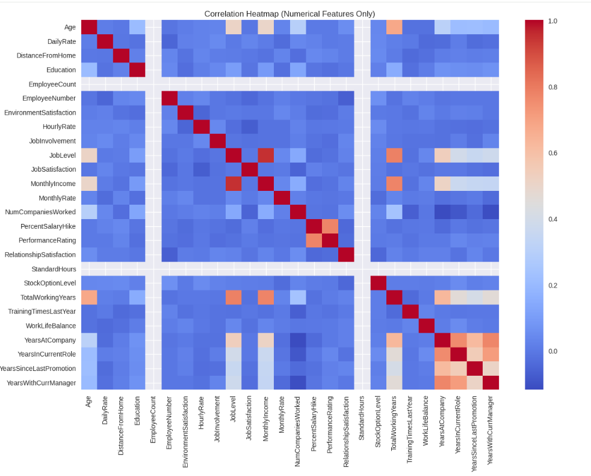
Correlation Insights (Numerical Features)
Correlation Heatmap Findings
Strong correlations:
  JobLevel and MonthlyIncome
  TotalWorkingYears and YearsAtCompany
  YearsInCurrentRole and YearsWithCurrManager
Weak correlation between attrition and individual numeric features
Attrition is driven by nonlinear multi-factor interactions

Slide 8

Data Preprocessing Pipeline
Steps Performed
Removed non-informative columns:
EmployeeCount, StandardHours, Over18, EmployeeNumber
One-Hot Encoding for categorical features
StandardScaler for numerical features
Train-Test split (80% / 20%)
Handled imbalance using SMOTE
Why SMOTE?
Prevents model from ignoring minority class
Creates synthetic “Yes” samples
Improves recall & F1-score

Slide 9
Models Implemented
Logistic Regression
Linear, interpretable
Best recall
Decision Tree
Nonlinear, interpretable
Prone to overfitting
Random Forest
Ensemble of trees
Best ROC-AUC
XGBoost
Gradient boosting
Best accuracy & precision
Why these models?
Covers both linear & nonlinear behaviors
Allows performance comparison
Tree models handle HR complexity well

Slide 10
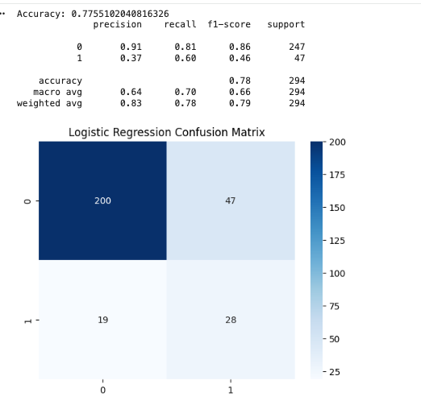
Logistic Regression
Best recall among all models (60%)
Good at detecting employees who leave
Lower precision → more false positives

Slide 11
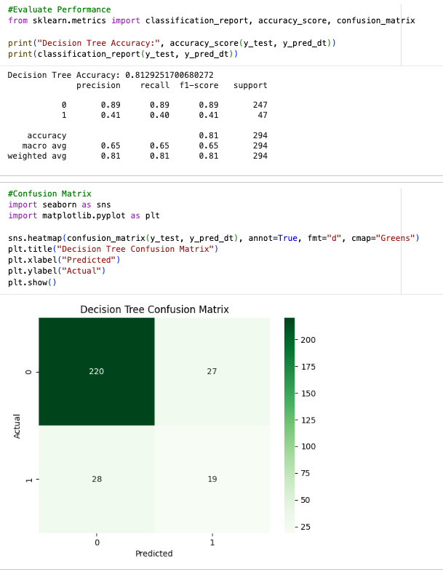
Decision Tree
Higher accuracy than Logistic Regression
Overfits [weaker recall (40%)]
Less reliable for imbalanced data

Slide 12
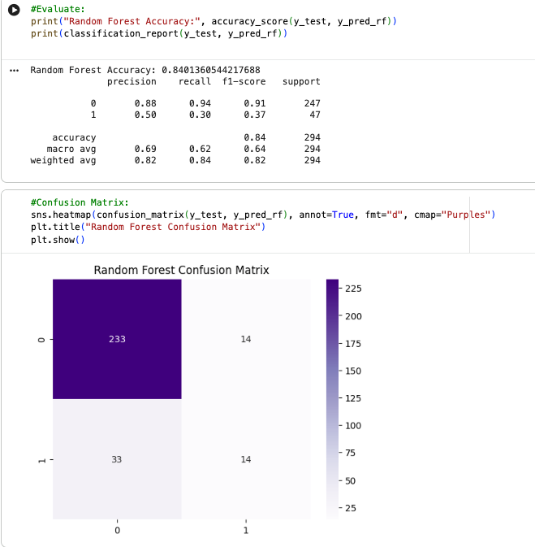
Random Forest
Strong overall accuracy (84%)
Precision improved (50%)
Low recall [misses many attrition cases]

Slide 13
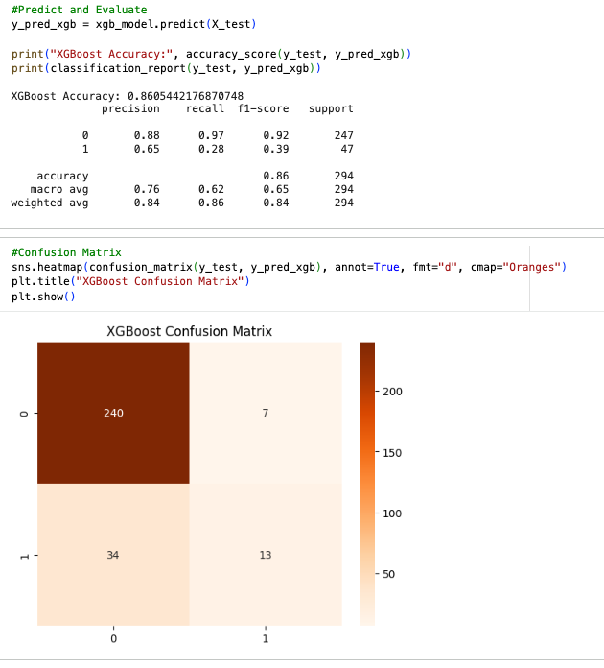
XGBoost
Best accuracy (86%)
Highest precision (65%)
Most reliable predictions overall

Slide 14
Model Performance Comparison
Summary of Metrics (Attrition = Yes)
Model | Accuracy | Precision | Recall | F1
Logistic Regression | 0.77 | 0.37 | 0.60 | 0.46
Decision Tree | 0.81 | 0.41 | 0.40 | 0.40
Random Forest | 0.84 | 0.50 | 0.30 | 0.37
XGBoost | 0.86 | 0.65 | 0.28 | 0.39

Slide 15
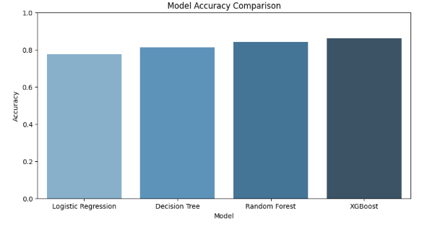
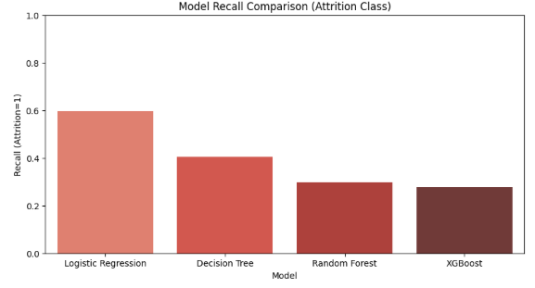
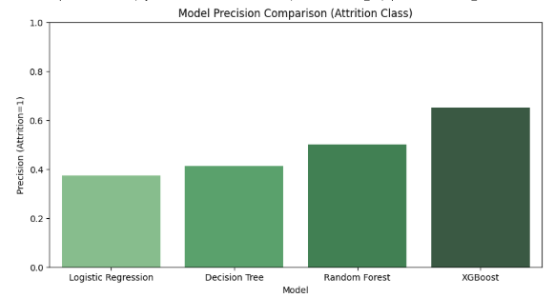
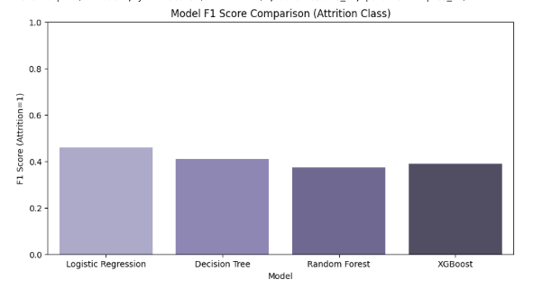
Visual Model Performance Comparison

Slide 16
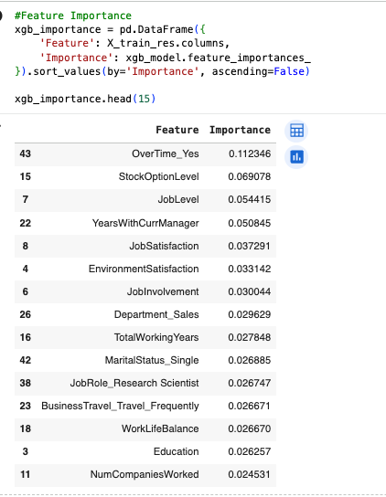
Best Model & Feature Importance
Best Performing Model: XGBoost
Highest accuracy (86%)
Best precision (65%)
Strong generalization on test data
Most Important Features
OverTime
YearsWithCurrManager
JobLevel
StockOptionLevel
JobSatisfaction

Slide 17
Conclusion
• Conducted full analysis of IBM HR Attrition dataset
• Applied preprocessing, encoding, scaling & SMOTE
• Trained and compared 4 ML models
• Identified XGBoost as the best-performing model
• Insights help HR understand & reduce employee attrition
• Shows how ML can solve real business problems

Slide 18

Thank You

