Slide 1
CS 5513 Computer Architecture
Lecture 6 – Instruction Level Parallelism continued

Slide 2
Review from Last Time #1
Leverage Implicit Parallelism for Performance: Instruction Level Parallelism
Loop unrolling by compiler to increase ILP
Branch prediction to increase ILP
Dynamic HW exploiting ILP
  Works when can’t know dependence at compile time
  Can hide L1 cache misses
  Code for one machine runs well on another

Slide 3
Review from Last Time #2
Reservations stations: renaming to larger set of registers + buffering source operands
  Prevents registers as bottleneck
  Avoids WAR, WAW hazards
  Allows loop unrolling in HW
Not limited to basic blocks
(integer units gets ahead, beyond branches)
Helps cache misses as well
Lasting Contributions
  Dynamic scheduling
  Register renaming
  Load/store disambiguation
360/91 descendants are Pentium 4, Power 5, AMD Athlon/Opteron, …

Slide 4
Outline
ILP
Speculation
Speculative Tomasulo Example
Memory Aliases
Exceptions
VLIW
Increasing instruction bandwidth
Register Renaming vs. Reorder Buffer
Value Prediction

Slide 5
Speculation to greater ILP
Greater ILP: Overcome control dependence by hardware speculating on outcome of branches and executing program as if guesses were correct
  Speculation ⇒ fetch, issue, and execute instructions as if branch predictions were always correct
  Dynamic scheduling ⇒ only fetches and issues instructions
Essentially a data flow execution model: Operations execute as soon as their operands are available

Slide 6
Speculation to greater ILP
3 components of HW-based speculation:
Dynamic branch prediction to choose which instructions to execute
Speculation to allow execution of instructions before control dependences are resolved
  + ability to undo effects of incorrectly speculated sequence
Dynamic scheduling to deal with scheduling of different combinations of basic blocks

Slide 7
Adding Speculation to Tomasulo
Must separate execution from allowing instruction to finish or “commit”
This additional step called instruction commit
When an instruction is no longer speculative, allow it to update the register file or memory
Requires additional set of buffers to hold results of instructions that have finished execution but have not committed
This reorder buffer (ROB) is also used to pass results among instructions that may be speculated

Slide 8
Reorder Buffer (ROB)
In Tomasulo’s algorithm, once an instruction writes its result, any subsequently issued instructions will find result in the register file
With speculation, the register file is not updated until the instruction commits
  (we know definitively that the instruction should execute)
Thus, the ROB supplies operands in interval between completion of instruction execution and instruction commit
  ROB is a source of operands for instructions, just as reservation stations (RS) provide operands in Tomasulo’s algorithm
  ROB extends number of registers like RS

Slide 9
Reorder Buffer Entry
Each entry in the ROB contains four fields:
Instruction type
  a branch (has no destination result), a store (has a memory address destination), or a register operation (ALU operation or load, which has register destinations)
Destination
  Register number (for loads and ALU operations) or
  memory address (for stores)
  where the instruction result should be written
Value
  Value of instruction result until the instruction commits
Ready
  Indicates that instruction has completed execution, and the value is ready

Slide 10
Reorder Buffer operation
Holds instructions in FIFO order, exactly as issued
When instructions complete, results placed into ROB
  Supplies operands to other instruction between execution
  complete & commit ⇒ more registers like RS
  Tag results with ROB buffer number instead of reservation station
Instructions commit ⇒values at head of ROB placed in registers
As a result, easy to undo
speculated instructions
on mispredicted branches
or on exceptions
Reorder
Buffer
FP
Op
Queue
FP Regs
Commit path
Res Stations
Res Stations
FP Adder
FP Adder

Slide 11
Recall: 4 Steps of Speculative Tomasulo Algorithm
1. Issue—get instruction from FP Op Queue
  If reservation station and reorder buffer slot free, issue instr & send operands & reorder buffer no. for destination (this stage sometimes called “dispatch”)
2. Execution—operate on operands (EX)
  When both operands ready then execute; if not ready, watch CDB for result; when both in reservation station, execute; checks RAW (sometimes called “issue”)
3. Write result—finish execution (WB)
  Write on Common Data Bus to all awaiting FUs
  & reorder buffer; mark reservation station available.
4. Commit—update register with reorder result
  When instr. at head of reorder buffer & result present, update register with result (or store to memory) and remove instr from reorder buffer. Mispredicted branch flushes reorder buffer (sometimes called “graduation”)

Slide 12
Tomasulo With Reorder buffer:
Done?
FP Op
Queue
ROB7
ROB6
ROB5
ROB4
ROB3
ROB2
ROB1
Newest
Reorder Buffer
Oldest
F0
LD F0,10(R2)
N
Registers
To
Memory
Dest
Dest
from
Memory
Dest
Reservation
Stations
1 10+R2
FP adders
FP multipliers
Notes:
Resolve RAW memory conflict? (address in memory buffers)
Integer unit executes in parallel

Slide 13
Tomasulo With Reorder buffer:
Done?
FP Op
Queue
ROB7
ROB6
ROB5
ROB4
ROB3
ROB2
ROB1
Newest
Reorder Buffer
F10
ADDD F10,F4,F0
N
Oldest
F0
LD F0,10(R2)
N
Registers
To
Memory
Dest
Dest
from
Memory
2 ADDD R(F4),ROB1
Dest
Reservation
Stations
1 10+R2
FP adders
FP multipliers
Notes:
Resolve RAW memory conflict? (address in memory buffers)
Integer unit executes in parallel

Slide 14
Tomasulo With Reorder buffer:
Done?
FP Op
Queue
ROB7
ROB6
ROB5
ROB4
ROB3
ROB2
ROB1
Newest
Reorder Buffer
F2
DIVD F2,F10,F6
N
F10
ADDD F10,F4,F0
N
Oldest
F0
LD F0,10(R2)
N
Registers
To
Memory
Dest
Dest
from
Memory
2 ADDD R(F4),ROB1
3 DIVD ROB2,R(F6)
Dest
Reservation
Stations
1 10+R2
FP adders
FP multipliers
Notes:
Resolve RAW memory conflict? (address in memory buffers)
Integer unit executes in parallel

Slide 15
Tomasulo With Reorder buffer:
Done?
FP Op
Queue
ROB7
ROB6
ROB5
ROB4
ROB3
ROB2
ROB1
Newest
F0
ADDD F0,F4,F6
N
F4
LD F4,0(R3)
N
Reorder Buffer
--
BNE F2,<…>
N
F2
DIVD F2,F10,F6
N
F10
ADDD F10,F4,F0
N
Oldest
F0
LD F0,10(R2)
N
Registers
To
Memory
Dest
Dest
from
Memory
2 ADDD R(F4),ROB1
6 ADDD ROB5, R(F6)
3 DIVD ROB2,R(F6)
Dest
Reservation
Stations
1 10+R2
5 0+R3
FP adders
FP multipliers
Notes:
Resolve RAW memory conflict? (address in memory buffers)
Integer unit executes in parallel

Slide 16
Tomasulo With Reorder buffer:
Done?
FP Op
Queue
--
ROB5
ST 0(R3),F4
N
ROB7
ROB6
ROB5
ROB4
ROB3
ROB2
ROB1
Newest
F0
ADDD F0,F4,F6
N
F4
LD F4,0(R3)
N
Reorder Buffer
--
BNE F2,<…>
N
F2
DIVD F2,F10,F6
N
F10
ADDD F10,F4,F0
N
Oldest
F0
LD F0,10(R2)
N
Registers
To
Memory
Dest
Dest
from
Memory
2 ADDD R(F4),ROB1
6 ADDD ROB5, R(F6)
3 DIVD ROB2,R(F6)
Dest
Reservation
Stations
1 10+R2
5 0+R3
FP adders
FP multipliers
Notes:
Resolve RAW memory conflict? (address in memory buffers)
Integer unit executes in parallel

Slide 17
Tomasulo With Reorder buffer:
Done?
FP Op
Queue
--
M[10]
ST 0(R3),F4
Y
ROB7
ROB6
ROB5
ROB4
ROB3
ROB2
ROB1
Newest
F0
ADDD F0,F4,F6
N
F4
M[10]
LD F4,0(R3)
Y
Reorder Buffer
--
BNE F2,<…>
N
F2
DIVD F2,F10,F6
N
F10
ADDD F10,F4,F0
N
Oldest
F0
LD F0,10(R2)
N
Registers
To
Memory
Dest
Dest
from
Memory
2 ADDD R(F4),ROB1
6 ADDD M[10],R(F6)
3 DIVD ROB2,R(F6)
Dest
Reservation
Stations
1 10+R2
FP adders
FP multipliers
Notes:
Resolve RAW memory conflict? (address in memory buffers)
Integer unit executes in parallel

Slide 18
Tomasulo With Reorder buffer:
Done?
FP Op
Queue
--
M[10]
ST 0(R3),F4
Y
ROB7
ROB6
ROB5
ROB4
ROB3
ROB2
ROB1
Newest
F0
<val2>
ADDD F0,F4,F6
Ex
F4
M[10]
LD F4,0(R3)
Y
Reorder Buffer
--
BNE F2,<…>
N
F2
DIVD F2,F10,F6
N
F10
ADDD F10,F4,F0
N
Oldest
F0
LD F0,10(R2)
N
Registers
To
Memory
Dest
Dest
from
Memory
2 ADDD R(F4),ROB1
3 DIVD ROB2,R(F6)
Dest
Reservation
Stations
1 10+R2
FP adders
FP multipliers
Notes:
Resolve RAW memory conflict? (address in memory buffers)
Integer unit executes in parallel

Slide 19
Tomasulo With Reorder buffer:
Done?
FP Op
Queue
--
M[10]
ST 0(R3),F4
Y
ROB7
ROB6
ROB5
ROB4
ROB3
ROB2
ROB1
Newest
F0
<val2>
ADDD F0,F4,F6
Ex
F4
M[10]
LD F4,0(R3)
Y
Reorder Buffer
--
BNE F2,<…>
N
F2
DIVD F2,F10,F6
N
F10
ADDD F10,F4,F0
N
Oldest
What about memory
hazards???
F0
LD F0,10(R2)
N
Registers
To
Memory
Dest
Dest
from
Memory
2 ADDD R(F4),ROB1
3 DIVD ROB2,R(F6)
Dest
Reservation
Stations
1 10+R2
FP adders
FP multipliers
Notes:
Resolve RAW memory conflict? (address in memory buffers)
Integer unit executes in parallel

Slide 20
Avoiding Memory Hazards
WAW and WAR hazards through memory are eliminated with speculation because actual updating of memory occurs in order, when a store is at head of the ROB, and hence, no earlier loads or stores can still be pending
RAW hazards through memory are maintained by two restrictions:
  not allowing a load to initiate the second step of its execution if any active ROB entry occupied by a store has a Destination field that matches the value of the A field of the load, and
  maintaining the program order for the computation of an effective address of a load with respect to all earlier stores.
these restrictions ensure that any load that accesses a memory location written to by an earlier store cannot perform the memory access until the store has written the data

Slide 21
Exceptions and Interrupts
IBM 360/91 invented “imprecise interrupts”
  Computer stopped at this PC; its likely close to this address
  Not so popular with programmers
  Also, what about Virtual Memory? (Not in IBM 360)
Technique for both precise interrupts/exceptions and speculation: in-order completion and in-order commit
  If we speculate and are wrong, need to back up and restart execution to point at which we predicted incorrectly
  This is exactly same as need to do with precise exceptions
Exceptions are handled by not recognizing the exception until instruction that caused it is ready to commit in ROB
  If a speculated instruction raises an exception, the exception is recorded in the ROB
  This is why reorder buffers in all new processors

Slide 22
Getting CPI below 1
CPI ≥ 1 if issue only 1 instruction every clock cycle
Multiple-issue processors come in 3 flavors:
  statically-scheduled superscalar processors,
  dynamically-scheduled superscalar processors, and
  VLIW (very long instruction word) processors
2 types of superscalar processors issue varying numbers of instructions per clock
  use in-order execution if they are statically scheduled, or
  out-of-order execution if they are dynamically scheduled
VLIW processors, in contrast, issue a fixed number of instructions formatted either as one large instruction or as a fixed instruction packet with the parallelism among instructions explicitly indicated by the instruction (Intel/HP Itanium)

Slide 23
VLIW: Very Large Instruction Word
Each “instruction” has explicit coding for multiple operations
  In IA-64, grouping called a “packet”
  In Transmeta, grouping called a “molecule” (with “atoms” as ops)
Tradeoff instruction space for simple decoding
  The long instruction word has room for many operations
  By definition, all the operations the compiler puts in the long instruction word are independent => execute in parallel
  E.g., 2 integer operations, 2 FP ops, 2 Memory refs, 1 branch
    16 to 24 bits per field => 7*16 or 112 bits to 7*24 or 168 bits wide
  Need compiling technique that schedules across several branches

Slide 24
Recall: Unrolled Loop that Minimizes Stalls for Scalar
1 Loop: L.D F0,0(R1)
2 L.D F6,-8(R1)
3 L.D F10,-16(R1)
4 L.D F14,-24(R1)
5 ADD.D F4,F0,F2
6 ADD.D F8,F6,F2
7 ADD.D F12,F10,F2
8 ADD.D F16,F14,F2
9 S.D 0(R1),F4
10 S.D -8(R1),F8
11 S.D -16(R1),F12
12 DSUBUI R1,R1,#32
13 BNEZ R1,LOOP
14 S.D 8(R1),F16 ; 8-32 = -24
14 clock cycles, or 3.5 per iteration
L.D to ADD.D: 1 Cycle
ADD.D to S.D: 2 Cycles

Slide 25
Loop Unrolling in VLIW
Memory Memory FP FP Int. op/ Clock
reference 1 reference 2 operation 1 op. 2 branch
L.D F0,0(R1) L.D F6,-8(R1) 1
L.D F10,-16(R1) L.D F14,-24(R1) 2
L.D F18,-32(R1) L.D F22,-40(R1) ADD.D F4,F0,F2 ADD.D F8,F6,F2 3
L.D F26,-48(R1) ADD.D F12,F10,F2 ADD.D F16,F14,F2 4
ADD.D F20,F18,F2 ADD.D F24,F22,F2 5
S.D 0(R1),F4 S.D -8(R1),F8 ADD.D F28,F26,F2 6
S.D -16(R1),F12 S.D -24(R1),F16 7
S.D -32(R1),F20 S.D -40(R1),F24 DSUBUI R1,R1,#48 8
S.D -0(R1),F28 BNEZ R1,LOOP 9
Unrolled 7 times to avoid delays
7 results in 9 clocks, or 1.3 clocks per iteration (1.8X)
Average: 2.5 ops per clock, 50% efficiency
Note: Need more registers in VLIW (15 vs. 6 in SS)

Slide 26
Problems with 1st Generation VLIW
Increase in code size
  generating enough operations in a straight-line code fragment requires ambitiously unrolling loops
  whenever VLIW instructions are not full, unused functional units translate to wasted bits in instruction encoding
Operated in lock-step; no hazard detection HW
  a stall in any functional unit pipeline causes entire processor to stall, since all functional units must be kept synchronized
  Compiler might prediction function units, but caches hard to predict
Binary code compatibility
  Pure VLIW => different numbers of functional units and unit latencies require different versions of the code

Slide 27
Intel/HP IA-64 “Explicitly Parallel Instruction Computer (EPIC)”
IA-64: instruction set architecture
128 64-bit integer regs + 128 82-bit floating point regs
  Not separate register files per functional unit as in old VLIW
Hardware checks dependencies
(interlocks => binary compatibility over time)
Predicated execution (select 1 out of 64 1-bit flags)
=> 40% fewer mispredictions?
Itanium™ was first implementation (2001)
  Highly parallel and deeply pipelined hardware at 800Mhz
  6-wide, 10-stage pipeline at 800Mhz on 0.18 µ process
Itanium 2™ is name of 2nd implementation (2005)
  6-wide, 8-stage pipeline at 1666Mhz on 0.13 µ process
  Caches: 32 KB I, 32 KB D, 128 KB L2I, 128 KB L2D, 9216 KB L3

Slide 28
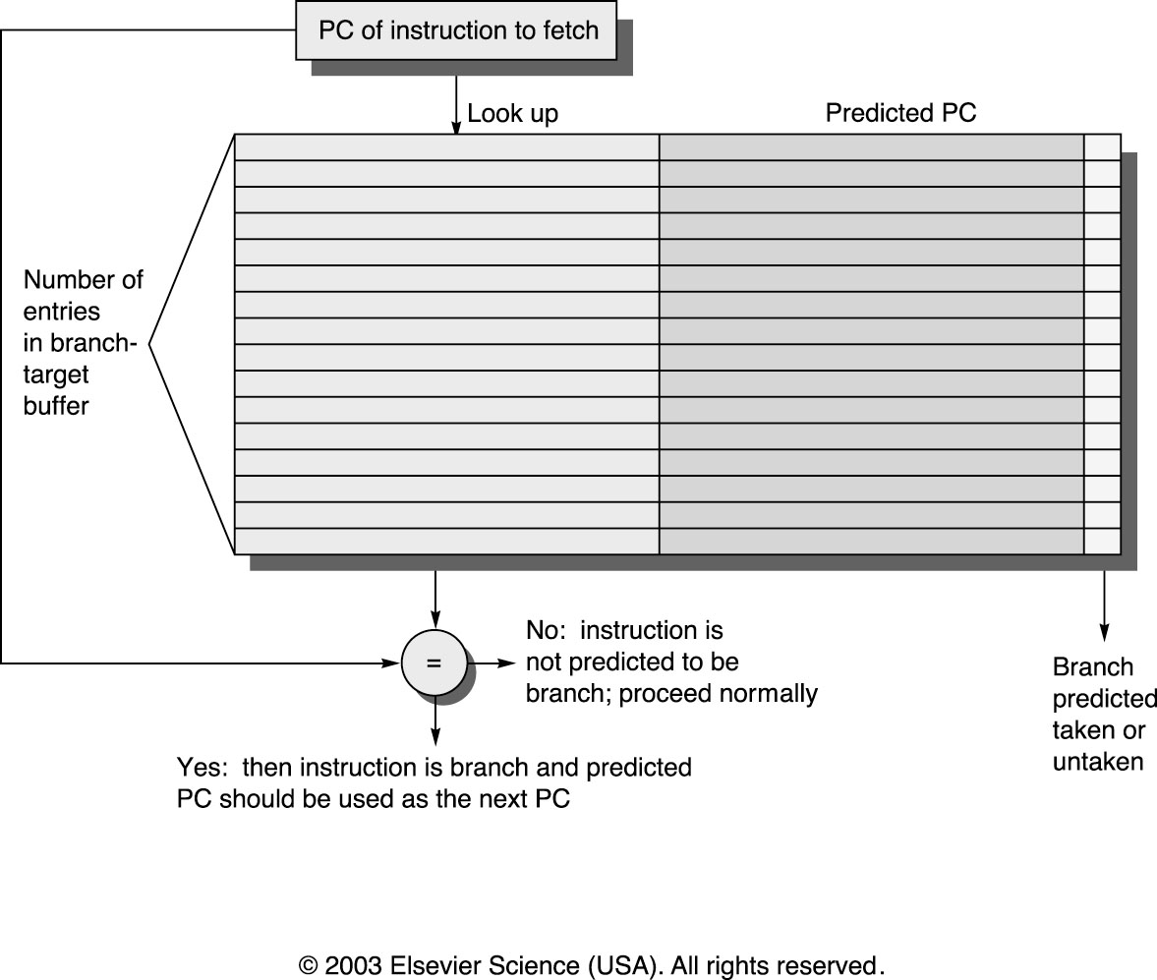
Increasing Instruction Fetch Bandwidth
Predicts next instruct address, sends it out before decoding instructuction
PC of branch sent to BTB
When match is found, Predicted PC is returned
If branch predicted taken, instruction fetch continues at Predicted PC
Branch Target Buffer (BTB)

Slide 29
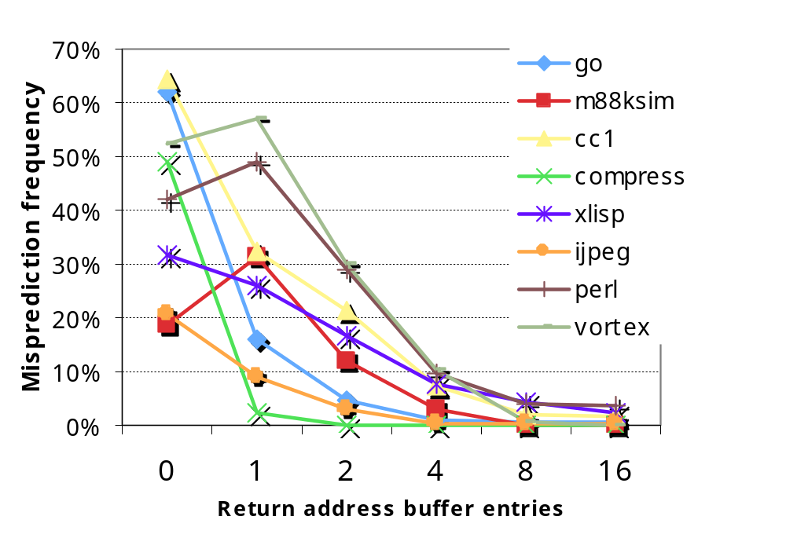
IF BW: Return Address Predictor
Small buffer of return addresses acts as a stack
Caches most recent return addresses
Call ⇒ Push a return address
on stack
Return ⇒ Pop an address off stack & predict as new PC

Slide 30
More Instruction Fetch Bandwidth
Integrated branch prediction branch predictor is part of instruction fetch unit and is constantly predicting branches
Instruction prefetch Instruction fetch units prefetch to deliver multiple instruct. per clock, integrating it with branch prediction
Instruction memory access and buffering Fetching multiple instructions per cycle:
  May require accessing multiple cache blocks (prefetch to hide cost of crossing cache blocks)
  Provides buffering, acting as on-demand unit to provide instructions to issue stage as needed and in quantity needed

Slide 31
Speculation: Register Renaming vs. ROB
Alternative to ROB is a larger physical set of registers combined with register renaming
  Extended registers replace function of both ROB and reservation stations
Instruction issue maps names of architectural registers to physical register numbers in extended register set
  On issue, allocates a new unused register for the destination
  (which avoids WAW and WAR hazards)
  Speculation recovery easy because a physical register holding an instruction destination does not become the architectural register until the instruction commits
Most Out-of-Order processors today use extended registers with renaming

Slide 32
Value Prediction
Attempts to predict value produced by instruction
  E.g., Loads a value that changes infrequently
Value prediction is useful only if it significantly increases ILP
  Focus of research has been on loads; so-so results, no processor uses value prediction
Related topic is address aliasing prediction
  RAW for load and store or WAW for 2 stores
Address alias prediction is both more stable and simpler since need not actually predict the address values, only whether such values conflict
  Has been used by a few processors

Slide 33
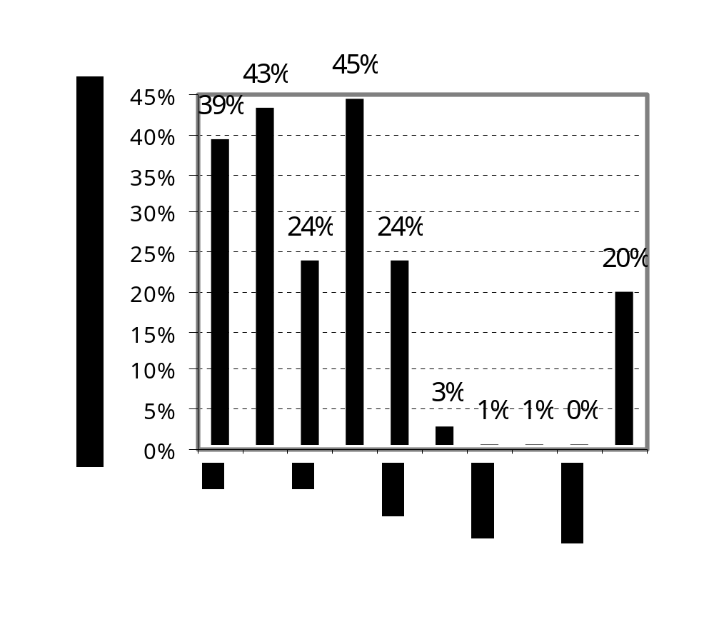
(Mis) Speculation on Pentium 4
% of micro-ops not used
Integer
Floating Point

Slide 34
Perspective
Interest in multiple-issue because wanted to improve performance without affecting uniprocessor programming model
Taking advantage of ILP is conceptually simple, but design problems are amazingly complex in practice
Conservative in ideas, just faster clock and bigger
Processors of last 10 years (Intel Core, Pentium 4, IBM Power 5, AMD Opteron) have the same basic structure and similar sustained issue rates (3 to 4 instructions per clock) as the 1st dynamically scheduled, multiple-issue processors announced in 1995
  Clocks 10 to 20X faster, caches 4 to 8X bigger, 2 to 4X as many renaming registers, and 2X as many load-store units
  ⇒ performance 8 to 16X
Peak v. delivered performance gap increasing

Slide 35
In Conclusion …
Interrupts and Exceptions either interrupt the current instruction or happen between instructions
  Possibly large quantities of state must be saved before interrupting
Machines with precise exceptions provide one single point in the program to restart execution
  All instructions before that point have completed
  No instructions after or including that point have completed
Hardware techniques exist for precise exceptions even in the face of out-of-order execution!
  Important enabling factor for out-of-order execution

