Slide 1
CS 5513 Computer Architecture
Pipelining Examples

Slide 2
Data Hazard with Stalls (1/2)
Consider the following code:
DADD R1,R3,R3
DSUB R4,R1,R5
AND R6,R1,R7
OR R8,R1,R9
XOR R10,R1,R11
Let’s diagram the execution of this code

Slide 3
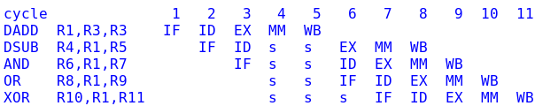
Data Hazards with Stalls (2/2)
The ID stage in cycle 3 stalls up to cycle 5 so it can read R1
The IF stage in cycle 3 stalls until cycle 5 because ID can’t start for the DSUB until it is finished for the DADD
By this time, R1 is available for subsequent instructions in their ID stages.
11 cycles total

Slide 4
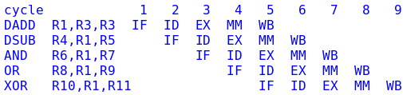
Data Hazards with Forwarding
The EX stage in cycle 3 forwards to the EX stage in cycle 4
The MM stage in cycle 4 forwards to the EX stage in cycle 5
The WB stage in cycle 5 “forwards” to the EX stage in cycle 6
9 cycles total

Slide 5
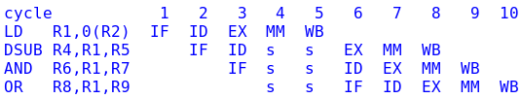
Another Example (1/2)
Without forwarding
DSUB stalls ID in cycles 4 and 5 waiting for R1 to be written back
AND and OR must stall as well
10 cycles total

Slide 6
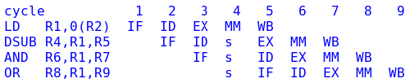
Another Example (2/2)
With forwarding
A stall is still needed because the EX stage for DSUB will need the result of the MEM stage for LD
9 cycles total

Slide 7
Multi-cycle latency
Until now, all instructions have 1 cycle latency
In the presence of floating point or slow memory, some instructions will take longer than others
Multi-cycle instructions have:
  An Initiation Interval: how long we must wait before starting another instruction with the same functional unit.
  A latency: how many extra cycles this instruction takes
For the MIPS FP pipeline:
  Multiplication has an initiation interval of 1 and a latency of 6.
  FP addition has an initiation interval of 1 and a latency of 3.

Slide 8
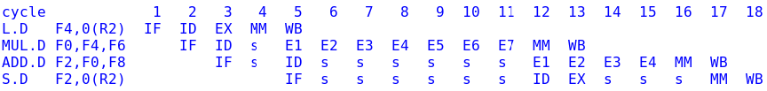
Example: Multi-cycle latency
MUL.D stalls in ID waiting for the forwarded result from the L.D
MUL.D starts executing in cycle 5 and takes 6 extra cycles
ADD.D stalls waiting for the forwarded result from MUL.D
ADD.D computes its result in 1+3=4 cycles
S.D stalls waiting for the result from ADD.D
18 cycles total

Slide 9
Strategies for Handling Branches
Execute branches in decode
  A good idea regardless of other ways of handling branches
Stall until branch is resolved
  Simple and slow
Predict branch taken
  Most backward branches are taken
Predict branch not taken
  Most forward branches are not taken

Slide 10
Example: Branch with Stall (1/2)
Consider the following code:
Loop: LD R6,0(R2)
DADDI R2,R2,#4
SD R6,8(R2)
DSUB R4,R2,R3
BNZ R4,Loop
Assume R3 = R2 + 100, so the loop iterates 25 times

Slide 11
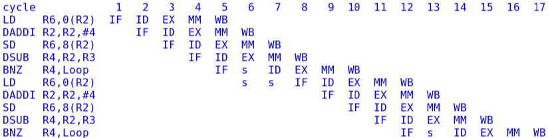
Example: Branch with Stall (2/2)
Execute branch in decode stage
From one branch fetch to the next, there are 7 cycles.
So loop takes 7(25)=175 cycles.
Add another 5 cycles after the last fetch = 180 cycles

