Slide 1
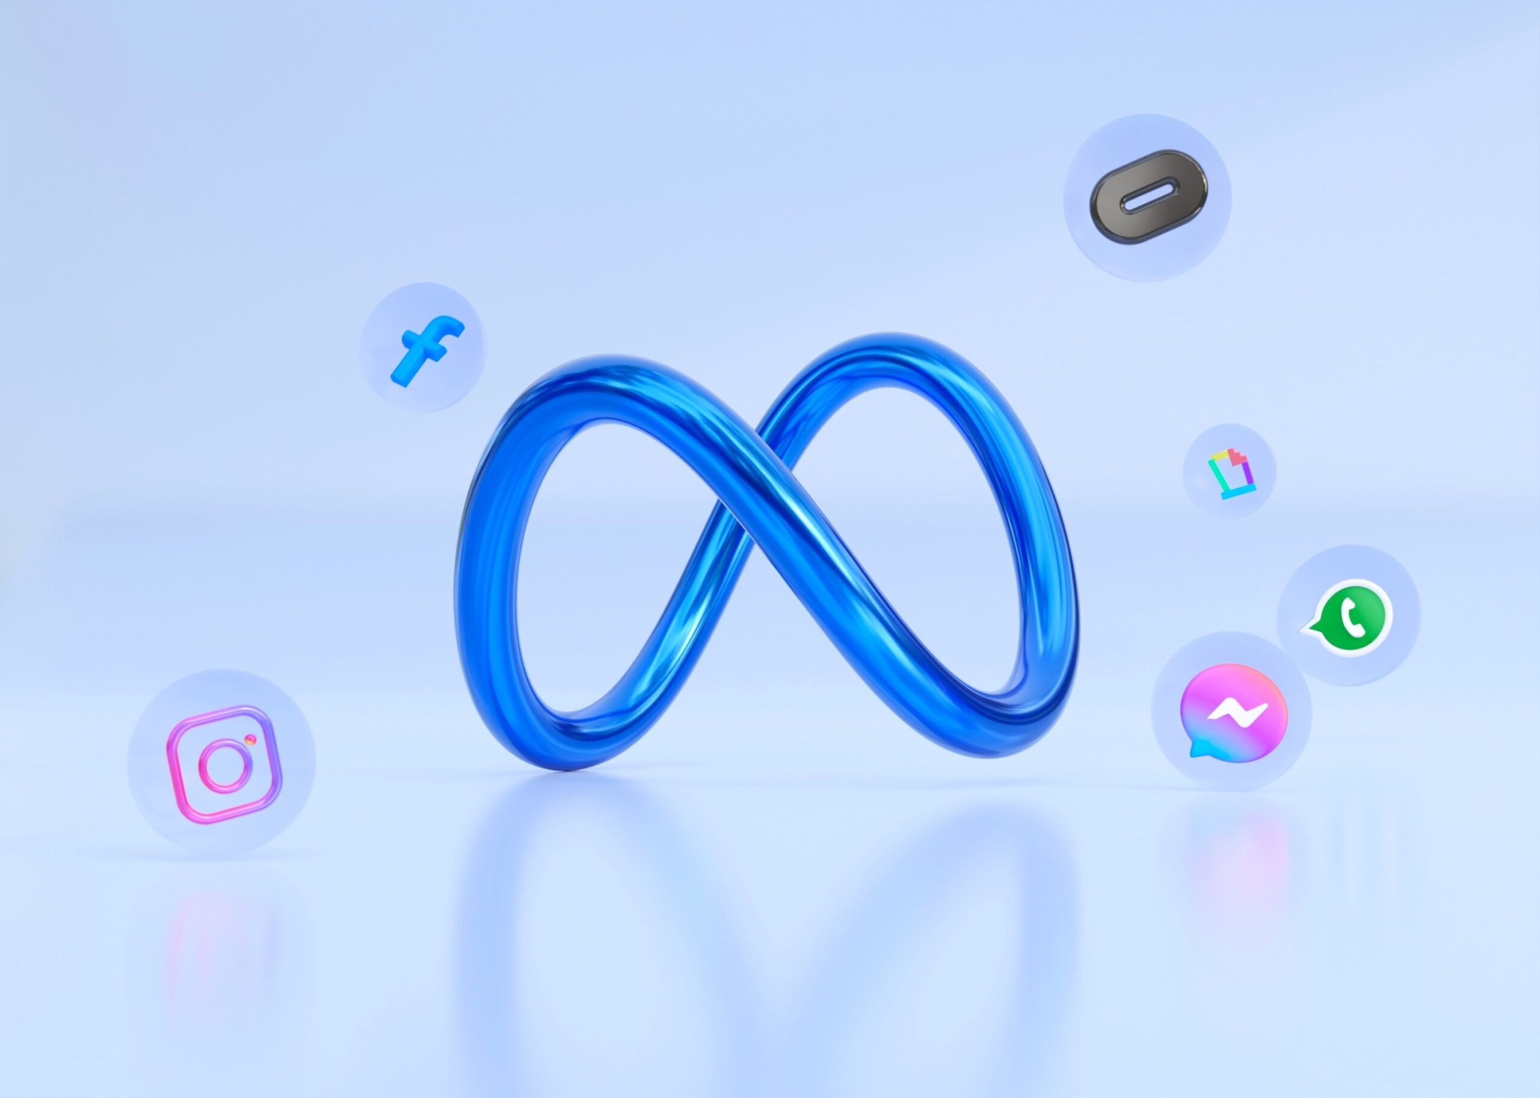
META
Shaping the Future of Social Connectivity
P. MAHIMA
22071A67A7

Slide 2
INTRODUCTION
Meta, formerly known as Facebook, is a global technology company founded by Mark Zuckerberg in 2004.
Originally a social media platform, Facebook rebranded to Meta in 2021 to reflect its new focus on the "metaverse," a virtual world where people can interact in 3D environments.
Meta aims to build this future digital space by combining social networking with immersive experiences through virtual reality (VR) and augmented reality (AR).
In addition to its work on the metaverse, Meta owns popular platforms like Facebook, Instagram, WhatsApp, and Messenger, connecting billions of people worldwide.

Slide 3
METAVERSE
The Metaverse is:
Definition: A virtual environment where people interact through digital avatars, allowing them to communicate, explore, and engage in a shared digital space.
AR and VR: It combines augmented reality (AR), which overlays digital elements in the real world, and virtual reality (VR), which immerses users in fully digital environments.
Multifaceted Experience: The metaverse integrates various aspects of life, such as social interactions, gaming, workspaces, shopping, and entertainment, creating a seamless digital world where people can socialize, play, and collaborate remotely.

Slide 4




META’S CORE PLATFORMS
The world’s largest social networking platform, allowing users to connect with friends, share content, join communities, and discover news and events.
A leading photo and video-sharing platform known for features like Stories, Reels, and IGTV, enabling users to express themselves creatively and connect with others.
A global messaging service offering secure, end-to-end encrypted text, voice, and video communications, used by billions worldwide.
Meta’s messaging platform, integrated with Facebook, enabling users to send texts, make voice and video calls, and share media across devices.

Slide 5
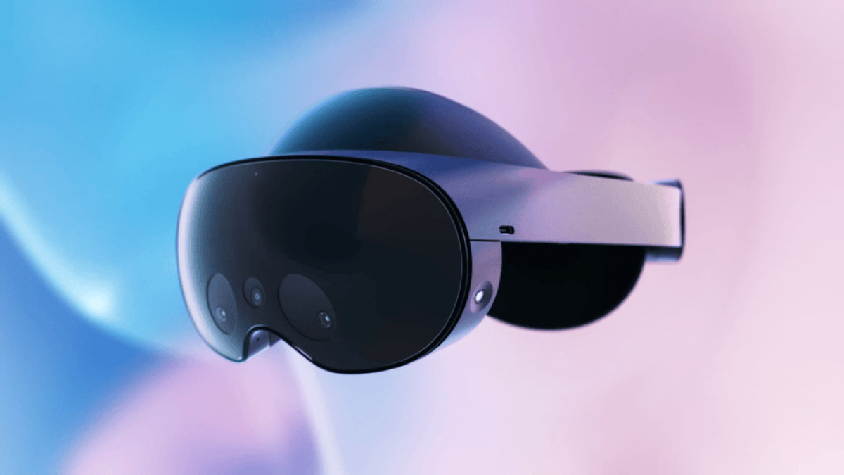

Focus on Immersive Experiences (VR/AR): Meta is investing heavily in virtual reality (VR) and augmented reality (AR) to create deeply immersive digital experiences where people can interact in more lifelike ways. Enhancing Digital Spaces: Meta aims to improve virtual environments that support collaboration, creativity, and entertainment, allowing users to work together, socialize, and create in new and interactive ways. Expansion into the Gaming Industry: Meta is growing its presence in gaming, particularly through VR platforms like Horizon Worlds, where users can explore, build, and play in virtual worlds, as part of its broader metaverse strategy.
VISION FOR FUTURE

Slide 6
SECURITY
Data Privacy Issues: Meta has faced concerns over how it collects and uses personal data, including tracking user activities across its platforms and other websites.
Meta’s Privacy Efforts: Meta has tried to improve by adding features like secure, encrypted messaging (especially in WhatsApp), clearer information about how they use data, and tools to help users control their privacy settings.
Criticisms: Even with these changes, Meta still faces criticism from governments and privacy experts, who believe the company needs to do more to protect user privacy.

Slide 7
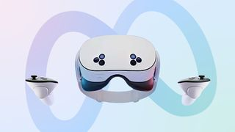
INVESTMENTS IN AR/VR
Oculus (now Meta Quest): Meta makes VR headsets called Meta Quest that let people explore and interact in virtual worlds, games, and experiences.
Reality Labs: This is Meta’s team focused on creating new technologies for AR (adding digital things to the real world), VR (fully virtual worlds), and AI to make these experiences better.
Smart Glasses and Other Devices: Meta is working on smart glasses and other gadgets that help people see digital information or images overlaid in the real world, making everyday life more connected to technology.

Slide 8
ECONOMIC ECOSYSTEM
Generating Revenue Through Advertising: Meta makes most of its money by showing targeted ads to users across its platforms like Facebook, Instagram, and Messenger, using data to deliver personalized advertising.
Meta Marketplace: This feature allows users to buy and sell products directly on Facebook, supporting social commerce and online transactions within Meta’s platforms.
Empowering Creators: Meta helps content creators (like influencers and artists) by offering tools to create, share, and monetize their work, allowing them to earn money through ads, fan subscriptions, and other forms of digital income.

Slide 9





CHALLENGES
Handling Misinformation
Regulatory Issues
Antitrust Concerns
Ethics of the Metaverse
User Safety and Privacy

Slide 10
CONCLUSION
Meta is at the forefront of shaping how we connect and interact online, influencing the future of social media and digital communication.
The metaverse has the long-term potential to change the way people interact, work, and play, creating new experiences and opportunities for connection.
Meta is committed to continuous innovation in augmented reality (AR), virtual reality (VR), and artificial intelligence (AI), driving advancements that enhance user experiences.
“The future is what we build,” emphasizing that our collective actions today will shape the digital landscape of tomorrow.

Slide 11
THANK YOU

