Slide 1



Hackers
Mahima Rao
Neha G Reddy
Sumedha Agarwal
MockingJay
#Wintathon
#WomenCoders
#LinkedInIndia
#LinkedInLife

Slide 2


MOCK INTERVIEWER
MOCKINGJAY

Slide 3

HACKATHON
THEME
COMPANY
Linkedin is a platform,to explore new opportunities pitch business ideas,network and expand his/her horizon.
The 2nd all women hackathon hosted by LinkedIn
Machine Learning is an inherent part of several components in LinkedIn.
Using ML to create an extension to LinkedIn.
The 2nd all women hackathon hosted by LinkedIn

Slide 4
Job interviews can be a nerve-wrecking experience for the applicant and a time-consuming exercise for the hiring company.
So automating this process is can be beneficial for both the company as well as its applicants.
THE PROBLEM
STATEMENT

Slide 5

INTRODUCING OUR MOCK INTERVIEWER
HI I AM JAY!

Slide 6

To ensure the applicant makes most of his/her opportunity we have created a mock interviewer
to boost the interviewee’s confidence level
Highlight the various aspects that he has to work on
Prepare him for the d-day
SOLUTION

Slide 7
SOLUTION
It can also be implemented as a method of screening in the recruitment process
In the recruiter’s perspective, depending on the user’s

Slide 8

IMPLEMENTATION
We have implemented a basic web app that uses API calls to DialogFlow,Webkit speech recognition.
It is a verbot that mimics the interview process.

Slide 9
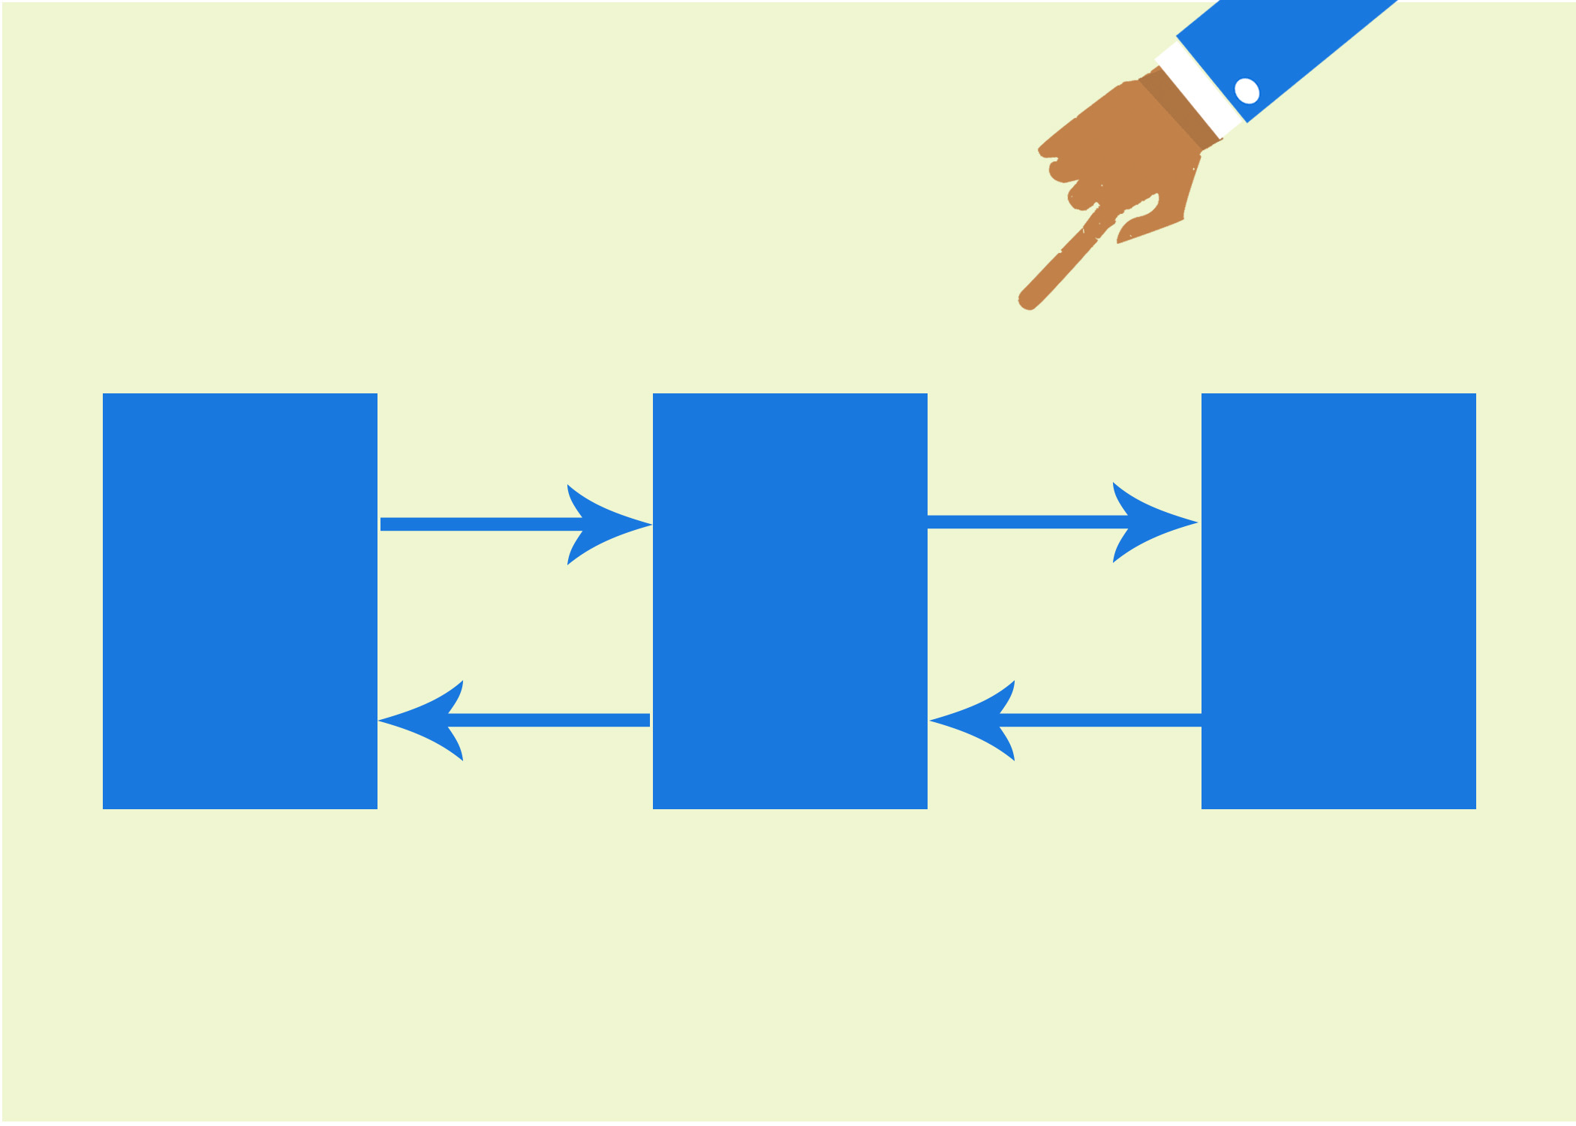
Speech
Input
WEBAPP
User’s answer
USER
API.ai
Evaluation
Speech
output
JSON
response

Slide 10
Uses machine learning algorithms to match user requests to specific intents and uses entities to extract relevant data from them.
“learns” both from the examples you provide in the User Says section and the language models developed by Dialogflow
DIALOGFLOW

Slide 11
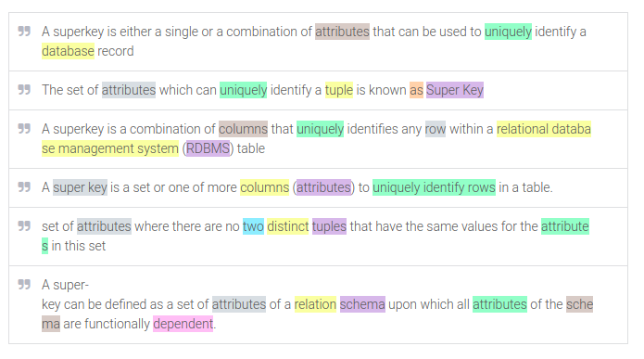

Slide 12
WHY WE CHOSE api.ai?
Other possible options-
NLTK
Word2vec
Google NLP
IBM watson
Microsoft Azure
Dialogflow combines different sets of algorithms to obtain the output
It is not Open Source
DIALOGFLOW

Slide 13
The interviewee interacts with “Jay” ,out verbot through speech inputs which can be even extended to text inputs
The response is also obtained from the bot as a speech output
The HTML5 Speech Recognition API ,which allows JavaScript to have access to a browser's audio stream and convert it to text.
USER INTERACTION

Slide 14
Our web application introduces Jay, the mock interviewer, which interacts with the candidate. The candidate is directed to choose one of the domains. Jay asks questions based on the dataset, and the user gives an answer, which is mapped to one of the sentences using api.ai, by doing the intent analysis. If the answer is mapped to the desired response of the question asked, the answer is evaluated to true otherwise false. Hence, calculating the score of the candidate.
WEB APP

Slide 15
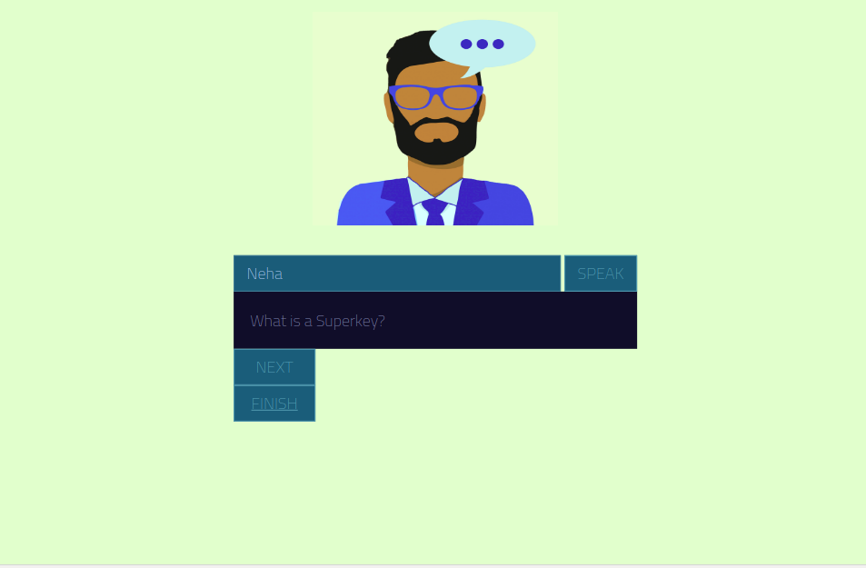

Slide 16
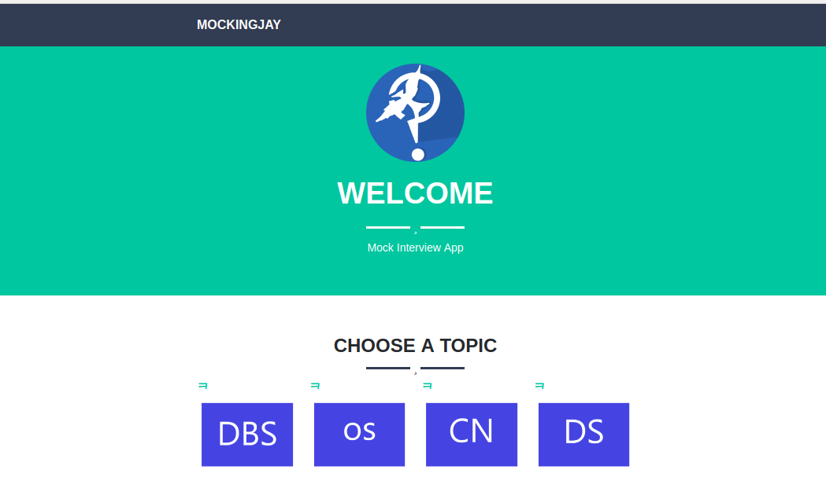

Slide 17
ACCURACY
Dialogflow allows the user to tune the machine learning classification threshold.
If the returned "score" value in the JSON response to a query is less than the threshold value, then a fallback intent will be triggered or, if there are no fallback intents defined, no intent will be triggered.

Slide 18
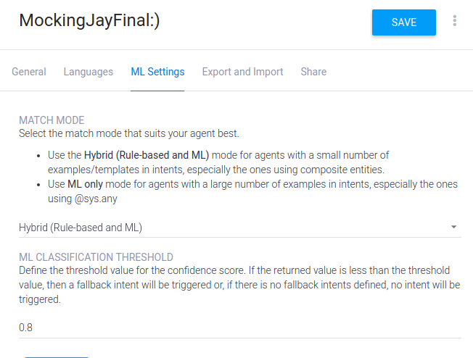

Slide 19
SCOPE
We have created a basic implementation of the app which allows the user to interact with the bot by choosing a certain topic.
The bot learns,understands and evaluates the answer by entity matching and tells the user whether the answer is correct or no.

Slide 20
EXTENSIONS
1.The data collection process can be automated by scraping the web using custom search engine API this will further automate the training process

Slide 21
EXTENSIONS
2.Connection with a database for feeding intents and entities to the ML training model

Slide 22
EXTENSIONS
3.Incorporating vast subjects and topics including overlapping fields according to the requirements of the job profile

Slide 23
EXTENSIONS
4.Confidence Analysis of the interviewee and suggestion of relevant tutorials

Slide 24
EXTENSIONS
5.Fine-tuning and analysis of the responses from dialogflow

