Slide 1
HUMAN PERSONALITY PREDICTION
HEMASRI R 312321202020
MAHIMAA B 312321202041
1

Slide 2
OBJECTIVE
The main objective is to analyse and cluster individuals based on their personality traits extracted from the database
This performs K-means clustering on the personality test data, identifying optimal clusters then applying PCA for dimensionality reduction.
It performs Hierarchical clustering on test data, visualizes the clusters in 2D space in PCA.
To explore the clustering of individuals based on their responses.
2
2

Slide 3
ABSTRACT
This project explores the application of machine learning algorithms for personality prediction
Three clustering algorithms namely K-means ,Gaussian Mixture models(GMM) and hierarchical clustering are employed to cluster individuals.
Principal component Analysis (PCA) is used for dimensionality reduction.
Scatter plots are generated to visualize the clustering results, providing insights to the distribution personality traits among individuals .
3

Slide 4
LITERATURE SURVEY
SNO | AUTHOR,TITLE & YEAR | METHODOLOGY | ADVANTAGES | DISADVANTAGES
1 | Carlyn, M. (1977). An assessment of the Myers-Briggs type indicator. Journal of Personality Assessment, 41, 461–473. | systematically reviewing existing research to evaluate the test's validity, reliability, and applications. | The MBTI offers a framework for understanding personality differences and preferences, facilitating self-awareness and interpersonal understanding. | It has been criticized for lacking scientific validity and reliability, oversimplifying personality, and potentially reinforcing stereotypes.
2 | Furnham AJP, Differences I (1996) The big five versus the big four: the relationship between the Myers–Briggs type indicator (MBTI) and NEOPI five factor model of personality. Pers Individ Differ 21:303–307 | examine the relationship between the MBTI types and the Big Five personality traits. | provides insights into the relationship between the MBTI and the Big Five personality traits, potentially enhancing understanding of personality assessment. | limitations such as sample biases, reliance on self-report measures.
3 | Tadesse MM, Lin H, Xu B, Yang L (2018) Personality predictions based on user behavior on the Facebook social media platform. IEEE Access 6:61959–61969 | employed data-driven methods to predict personality from user behavior on Facebook | providing insights into online personality assessment. | facing challenges of data privacy and platform-specific biases.
4 | Xue D, Wu L, Hong Z et al (2018) Deep learning-based personality recognition from text posts of online social networks. Appl Intell 48:4232– 4246 | to develop a model for personality recognition using text posts from online social networks. 4 | providing more accurate and nuanced insights compared to traditional methods. | over-reliance on specific social media platforms or challenges in generalizing findings to broader populations.

Slide 5
LITERATURE SURVEY CONTD.
SNO | AUTHOR,TITLE & YEAR | METHODOLOGY | ADVANTAGES | DISADVANTAGES
5 | . Golbeck JA (2016) Predicting personality from social media text. AIS Trans Replic Res 2:1–10. | natural language processing techniques to predict personality from social media text | scalable approach for personality assessment | encountering challenges in accurately capturing nuances of individual traits.
6 | ​Majumder N, Poria S, Gelbukh A, Cambria E (2017) Deep learning based document modeling for personality detection from text. IEEE Intell Syst 32:74–79. | deep learning for document modeling to detect personality from text, | offering potential for nuanced understanding | data representativeness and model interpretability.
7 | Ren Z, Shen Q, Diao X, Xu H (2021) A sentiment-aware deep learning approach for personality detection from text. Inf Process Manag 58:102532. | sentiment-aware deep learning to detect personality from text | offering potential for nuanced understanding | model generalization and sentiment annotation.
8 | Howlader P, Pal KK, Cuzzocrea A, Kumar SDM (2018) Predicting facebook-users’ personality based on status and linguistic features via fexible regression analysis techniques. Proc ACM Sympos Appl Comput. | flexible regression analysis techniques to predict Facebook users' personality from status and linguistic features | Potentialfor personalized insights | feature selection and model interpretation.

Slide 6
LITERATURE SURVEY CONTD.
SNO | AUTHOR,TITLE & YEAR | METHODOLOGY | ADVANTAGES | DISADVANTAGES
9 | Elmitwally N (2022) Personality detection using context based emotions in cognitive agents. CMC Comput Mater Continua 70(3):4947–4964. | context-based emotions in cognitive agents for personality detection | nuanced understanding | emotion representation and integration into cognitive systems.
10 | El-Demerdash K, El-Khoribi RA, Shoman MAI, Abdou S (2022) Deep learning based fusion strategies for personality prediction. Egypt Inform J 23(1):47–53. | deep learning-based fusion strategies for personality prediction 6 | improved predictive performance | model complexity and interpretability.

Slide 7
EXISTING SYSTEM
the Myers-Briggs Type Indicator (MBTI) or the Big Five Personality Traits model. These tests involve self-report questionnaires designed to assess various aspects of personality, providing a structured framework for understanding individual differences..
machine learning and NLP techniques to predict personality traits based on textual data, such as social media posts, emails, or other written communications.
More advanced systems incorporate contextual information, such as behavioral data from online interactions, biometric data, or environmental factors, to enhance the accuracy and richness of personality predictions.
7
7

Slide 8
DRAWBACKS OF EXISTING SYSTEM
limiting their ability to capture the complexity and variability of human personality across diverse populations and contexts.
Machine learning and NLP-based systems may suffer from bias inherent in the training data.
raise privacy concerns regarding the collection, storage, and usage of sensitive information.
Existing systems may struggle to incorporate contextual understanding.
8
8
8

Slide 9
PROPOSED WORK
Integrate diverse sources of data, including textual, visual, and behavioral data, to capture a more holistic view of an individual's personality.
Utilize Machine learning techniques such as clustering, gaussian mixture.
We'll create a simple way for people to use our method in their everyday work or research.
Instead of relying on just one way to understand personalities, we'll combine different methods to get a better overall picture.
9

Slide 10
ADVANTAGES OF PROPOSED WORK
These algorithms help us make better guesses about people's personalities.
more accurate and reliable personality predictions compared to conventional approaches.
They can be used in many different fields, from psychology to marketing.
These methods can be adjusted to work with different kinds of data or situation
10

Slide 11
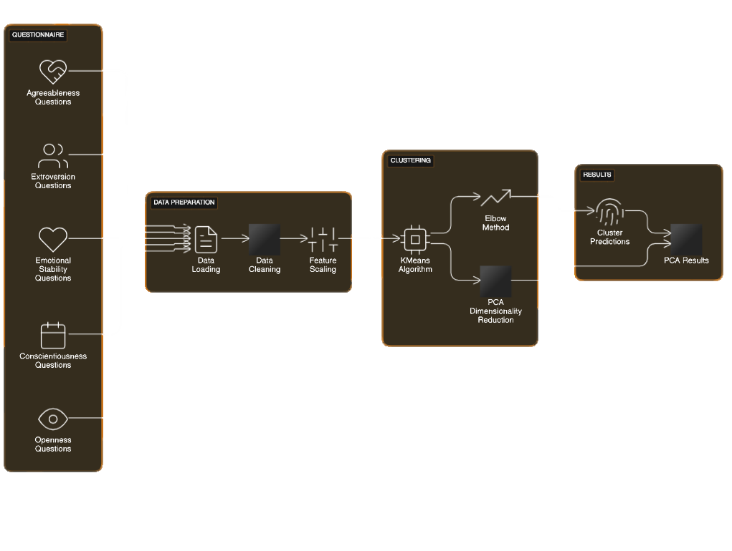
ARCHITECTURE DIAGRAM
11

Slide 12
LIST OF MODULES
The modules are
K-means clustering
Hierarchical clustering
Guassian Mixture model
12
12

Slide 13
DATASET ACQUISITION
Data Source Selection: Choosing the right data sources is crucial. This could include surveys, psychological assessments, social media profiles, biometric data, and more. Each source has its strengths and limitations.
Data Quality Assurance: Ensuring the quality of the acquired data is essential for building reliable predictive models.
Ethical Considerations: Respecting ethical guidelines is paramount throughout the dataset acquisition process.
13
13

Slide 14
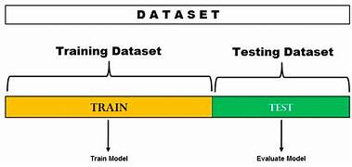
DATASET ACQUISITION :
14

Slide 15
DATASET SEGMENTATION
Partitioning the dataset based on demographic factors such as age, gender, education level, or cultural background.
Dividing the dataset into temporal segments to capture changes in personality over time.
Segmenting the dataset based on behavioral patterns or interaction styles exhibited by individuals.
Dividing the dataset into segments based on psychological profiles derived from psychometric tests or personality assessments.
15
15

Slide 16
DATASET SEGMENTATION CONTD.
This processing has three steps. They are
Data Preprocessing
Feature Extraction
Model Integration
16

Slide 17
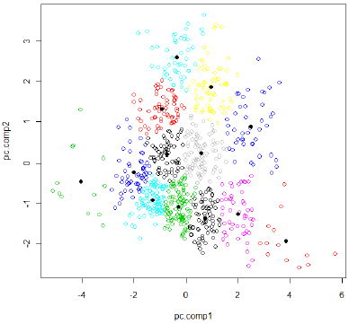
DATASET SEGMENTATION CONTD.
K –means clustering
Choosing the right features to represent personality traits is crucial for effective k-means clustering.
Interpreting the clusters generated by k-means in the context of human personality requires expertise in psychology and data analysis.
17

Slide 18
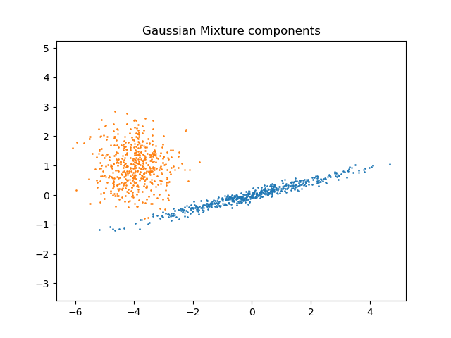
Guassian Mixture :
DATASET SEGMENTATION CONTD.
By fitting a Gaussian mixture model to personality data, it's possible to identify clusters or subgroups of individuals with similar personality profiles, allowing for more nuanced and fine-grained analysis of personality variation.
18

Slide 19
HIERARCHIAL CLUSTERING:
DATASET SEGMENTATION CONTD.
hierarchical clustering in human personality prediction is its utility in identifying hierarchical structures and relationships among individuals based on their personality traits.
19

Slide 20
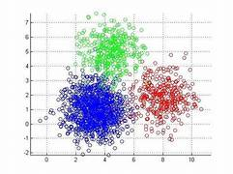
20

Slide 21
DATASET CLASSIFICATION
Employing supervised learning techniques such as classification algorithms to train models that can predict an individual's personality type or traits based on labeled data
Extracting relevant features from the dataset that are indicative of personality traits, such as linguistic patterns in text data.
Training classification models
21

Slide 22
CONCLUSION
Personality prediction models offer personalized insights into individual traits and preferences, enabling tailored recommendations in fields such as marketing, education, healthcare, and human resources.
Understanding personality traits can improve human-computer interaction by enabling systems to adapt their behavior or content to better match users' preferences and communication styles.
Personality prediction models can provide insights into mental health conditions, such as depression, anxiety, or personality disorders.
22

Slide 23
FUTURE ENHANCEMENT
Integration of Multimodal Data: Future research could focus on integrating diverse sources of data, including textual, visual, auditory, and physiological signals, to create more comprehensive models of personality..
Dynamic and Contextual Modeling: There is potential for future enhancements to incorporate dynamic and contextual modeling techniques to account for changes in personality expression across different situations and over time.
23
23

Slide 24
REFERENCES
Carlyn, M. (1977). An assessment of the Myers-Briggs type indicator. Journal of Personality Assessment, 41, 461–473.
Furnham AJP, Differences I (1996) The big five versus the big four: the relationship between the Myers–Briggs type indicator (MBTI) and NEOPI five factor model of personality. Pers Individ Differ 21:303–307
. Xue D, Wu L, Hong Z et al (2018) Deep learning-based personality recognition from text posts of online social networks. Appl Intell 48:4232–4246
Golbeck JA (2016) Predicting personality from social media text. AIS Trans Replic Res 2:1–10.
24

Slide 25
REFERENCES CONTD.
Majumder N, Poria S, Gelbukh A, Cambria E (2017) Deep learning based document modeling for personality detection from text. IEEE Intell Syst 32:74–79
Golbeck JA (2016) Predicting personality from social media text. AIS Trans Replic Res 2:1–10.
. Ren Z, Shen Q, Diao X, Xu H (2021) A sentiment-aware deep learning approach for personality detection from text. Inf Process Manag 58:102532.
Howlader P, Pal KK, Cuzzocrea A, Kumar SDM (2018) Predicting facebook-users’ personality based on status and linguistic features via fexible regression analysis techniques. Proc ACM Sympos Appl Comput.
25

Slide 26
REFERENCES CONTD.
Elmitwally N (2022) Personality detection using context based emotions in cognitive agents. CMC Comput Mater Continua 70(3):4947–4964
El-Demerdash K, El-Khoribi RA, Shoman MAI, Abdou S (2022) Deep learning based fusion strategies for personality prediction. Egypt Inform J 23(1):47–53.
26

Slide 27
THANK YOU
27

