Slide 1




ELITE HACK CHALLENGE
ELITE HACK CHALLENGE- In collaboration with CSI Hyderabad Chapter
24th February to 25th February,2023.
HACK- Health, Agriculture, Culture, Know your security
Team No:# 25 Team Name:#TRAGIC BYTES
IDEA NAME:Crop Recommendation using Machine Learning

Slide 2


OUTLINE
Problem Statement
Proposed Methodology
Test Results
Innovation Elements
Value and Impact

Slide 3
PROBLEM STATEMENT(S)
The common problem existing among the Indian farmers are they don't choose the right crop based on their soil requirements and surrounding environmental conditions.
Due to this they face a serious setback in productivity.

Slide 4
PROPOSED METHODOLOGY
Smart farming is an approach that utilizes modern technologies and data analysis to increase the efficiency and productivity of agricultural practices.
One of the techniques of smart farming is CROP RECOMMENDATION using machine learning.
To impelement crop recommendation,several steps are to be performed such as: collecting data,analyzing the data,develop a model, vaidate it and deploy the model.

Slide 5
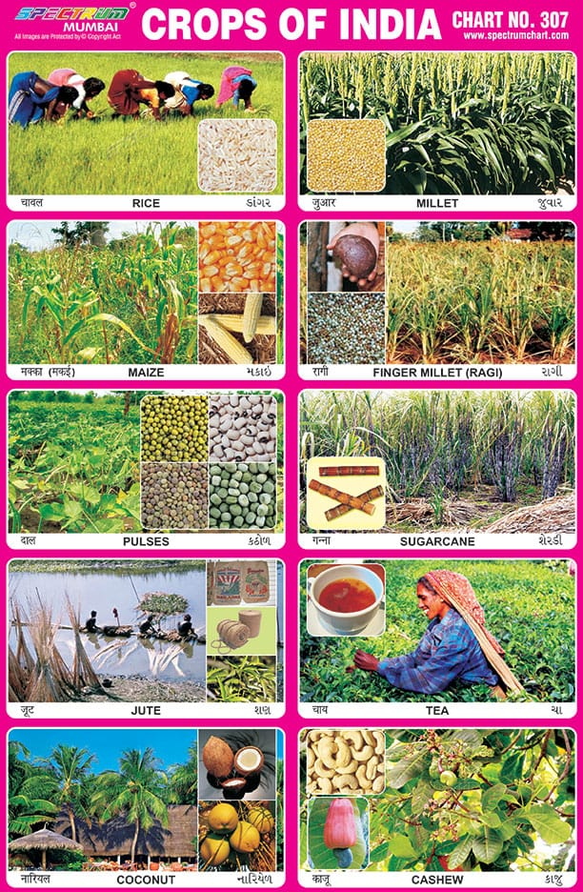
TEST RESULTS
DATA COLLECTED
SOIL PH
SOIL NUTRIENTS
HUMIDITY
RAINFALL
TEMPARATURE
DECISION TREE
NAIVE BAYES
LOGISTIC REGRESSION
RANDOM FOREST
SVM

Slide 6

INNOVATION ELEMENTS
The Three Key Elements are:
Big Data Analytics
Precision Farming
Machine Learning

Slide 7

VALUE AND IMPACT
Crop recommendation prototype helps to:
Increase crop yields
Optimise resource utilization
Reduce risk
Improve sustainability
The accuracy of the model depends on the quality of the data used to train the model.

Slide 8
TEAM MEMBERS
Shaik Mahin Emroz-7995102455-mahinemroz@gmail.com
linkedin :https://www.linkedin.com/in/mahin-emroz-b0b68a267
Kota Thanvi-8688973148-kotathanvi3@gmail.com
linkedin:https://www.linkedin.com/in/kota-thanvi-286819233
Paderu Pranitha-8143187941-paderupranitha066@gmail.com
likedin:https://www.linkedin.com/in/paderu-pranitha-2a98b7267
Chamarthi Sharvani-9985111654-sharvaniram.chamarthi@gmail.com
linkedin:https://www.linkedin.com/in/sharvani-chamarthi-874392267

